Slide 1

2021-2022 STOP (Services, Training, Officers, and Prosecutors) Violence Against Women Formula Grant RFP Webinar
March 30th, 2021

Slide 2
Thanks for joining us today: Please keep your lines muted during the presentation. Webinar is being recorded. It will be posted on the ICJI website. Questions and Answers at the end. Feel Free to utilize the chat box during the webinar.

Slide 3
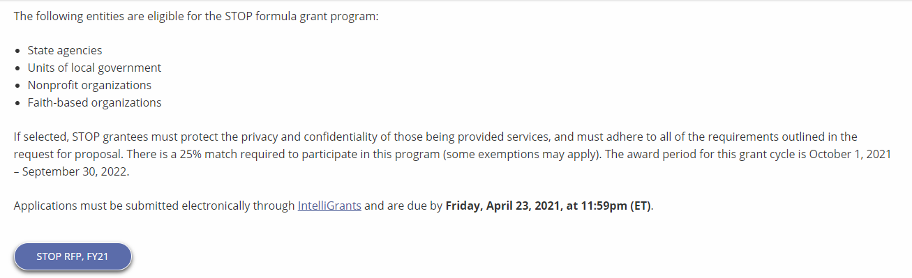
Accessing the RFP
Located on ICJI Website
In.gov/cji → Victim Services → STOP Grant “Learn More” → STOP RFP, FY21
https://www.in.gov/cji/victim-services/vawa-stop/

Slide 4
2021-2022 STOP (Services, Training, Officers, and Prosecutors) Violence Against Women Formula Grant Application
Application opened: Tuesday, March 23rd at 9 AM
Application closes: Friday, April 23rd at 11:59 PM
Applicants are strongly encouraged to submit applications 48 hours prior to the deadline.
Award Period for STOP: October 1, 2021 to September 30, 2022 (12-month award period)
Projects should begin on October 1, 2021 and must be in operation no later than 60 days after this date. Failure to have the funded project operational within 60 days from October 1, 2021 will result in the cancellation of the grant and the de-obligation of all awarded funds.

Slide 5
Overview:
The Services, Training, Officers, Prosecutors (STOP) Violence Against Women Formula Grant Program (STOP Formula Grant Program) supports communities, including American Indian Tribes and Alaska Native villages, in their efforts to develop and strengthen effective responses to sexual assault, domestic violence, dating violence, and stalking

Slide 6

STOP Funding Eligibility:
Eligible entity types include:
State Agencies
Units of local government
Nonprofit organizations
Faith-based organizations
Other Requirements include:
Registered DUNS number
Active and current registration with SAM.gov
Good standing with the Department of Revenue (DOR), Department of Workforce Development (DWD), and Secretary of State (SOS)

Slide 7
Funding Allocation **Of the 30% Victim Services Allocation, 10% goes to culturally specific community-based organizations

Slide 8
Purpose Areas- Funds under this program must be used for one or more of the following purposes:
Training Law Enforcement Officers, Judges, other court personnel, and prosecutors to more effectively identify and respond to violent crimes against women
Developing, training, or expanding units of law enforcement officers, judges, other court personnel, and prosecutors specifically targeting violent crimes against women
Developing and implementing more effective police, court, and prosecution policies, protocols, orders, and services specifically devoted to preventing, identifying, and responding to violent crimes against women
Developing, installing, or expanding data collection and communication systems, including computerized systems, linking police, prosecutors, and courts for the purpose of identifying, classifying, and tracking arrests, protection orders, violations of protection orders, prosecutions, and convictions
Developing, enlarging, or strengthening victim services and legal assistance programs
Developing, enlarging, or strengthening programs addressing the needs and circumstances of Indian tribes in dealing with violent crimes against women
Supporting formal and informal statewide multidisciplinary efforts to the extent not supported by state funds to coordinate response

Slide 9
Continued Purpose Areas
Training of sexual assault forensic medical personnel examiners in the collection and preservation of evidence, analysis, prevention, and providing expert testimony and treatment of trauma related to sexual assault
Developing, enlarging, or strengthening programs to assist law enforcement, prosecutors, courts, and others to address the needs and circumstances of older and disabled women who are victims of sexual assault, domestic violence, or stalking
Providing assistance to victims of domestic violence and sexual assault in immigration matters
Maintaining core victim services and criminal justice initiatives while supporting complementary new initiatives and emergency services for victims and their families
Supporting the placement of special victim assistants in local law enforcement agencies to serve as liaisons
Developing and promoting state/local/tribal legislation and policies that enhance best practices for responding to sexual assault, domestic violence, dating violence, and stalking
Developing, implementing or enhancing Sexual Assault Response Teams (SARTs)
Developing and strengthening policies, protocols, best practices, and training for law enforcement agencies and prosecutors
Developing, enlarging, or strengthening programs addressing sexual assault against men, women, and youth in correctional and detention settings
Identifying and conducting inventories of backlogs of sexual assault evidence collection kits and developing protocols and policies for responding to and addressing such backlogs

Slide 10
Out of Scope Activities
Research projects
Services provided to youth under the age of 11 or services to those above the age of 10 who are seeking servies for victimization that occurred when they were under the age of 11
Activities that jeopardize victim safety, deter or prevent physical or emotional healing for victims, or allow offenders to escape responsibility for their actions

Slide 11
Other Requirements / Trainings
Determination of suitability to interact with participating minors
Every 5 years additional background checks (fingerprinting, etc.) must be run on any grant/match funded employees (including volunteers) that interact with anyone under the age of 18
This is a required condition of any DOJ grant- for more details about the required checks please visit https://www.ojp.gov/funding/explore/interact-minors
Civil Rights Training
The DOJ requires all recipients and subrecipients of federal funds to comply with a variety of Federal civil rights laws. ICJI has a checklist that each subgrantee needs to complete on an annual basis to remain in compliance
CJI Grantee Training and Resources Link-
https://www.in.gov/cji/grantee-training-and-resources/
These requirements along with other trainings can be found at:

Slide 12
Initiating an application in IntelliGrants
https://intelligrants.in.gov

Slide 13
Steps to initiating an application in IntelliGrants (ICJI’s Grant Management system):
Log into your IntelliGrants account
If you do not have an account, then you can obtain one on the home screen of intelligrants (New User?)
On the “MY HOME” page access the “VIEW AVAILABLE PROPOSALS” section
Click on VIEW OPPORTUNITIES
Intelligrants will take you to the My Opportunities page
Access the 2021 STOP Grant Application
Select “Apply Now”

Slide 14
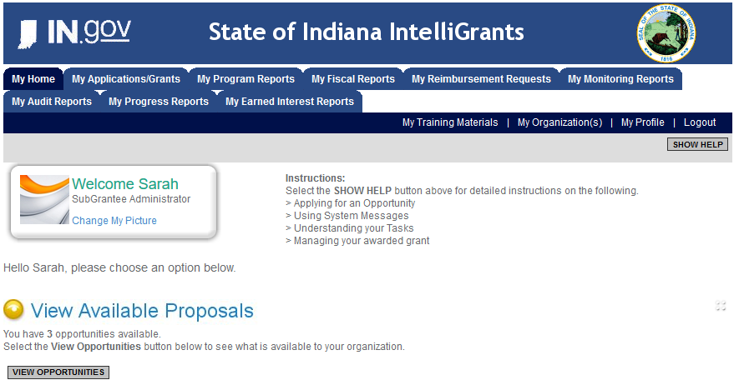

Slide 15
STOP Application

Slide 16
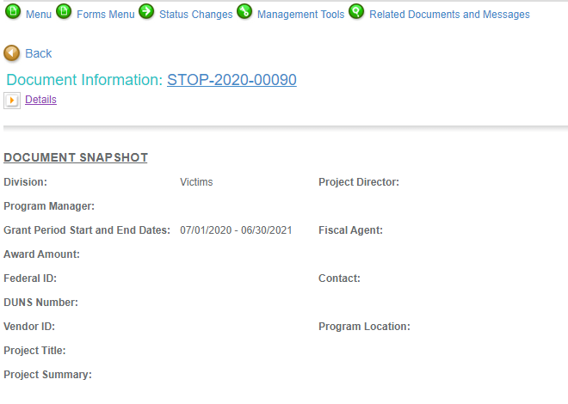
Notes:
To access the different components of the application you will need to navigate to the forms menu.

Slide 17
Forms that need to be completed:
Contact
Project Information
Programmatic Information
Problem Statement & Analysis
Goals, Objectives, & Outcomes
Program Descriptions
Evidence Based/Best Practices
Use of Volunteers
Budget
Budget Narrative
Attachments

Slide 18
Contact
Points of Contact for the grant (CJI will notify these individuals of your award notice)
Project Information
SAMs Registration must be up-to-date
Audit
If you receive more than $750,000 in federal grant funds, you are required to have an audit. This will be requested if CJI is aware that you receive more than $750,000.
Programmatic Information
Information about your proposed STOP grant
Problem Statement & Analysis
All government agency’s audits are included in the County audit and should all have one attached
Forms to be Completed (continued)

Slide 19
Goal, Objective, and Outcomes
The goal should directly address the problem identified in the Problem Statement.
Objectives are the steps needed to achieve goals. Objectives should be concrete, action-oriented, measurable and Specific, Measurable, Achievable, Realistic, Timely (SMART).
Example of Objective: By September 2022, a minimum of 50 culturally and linguistically appropriate support groups for survivors of domestic violence will be provided.
Outcomes measure objectives and are criteria for how the program is deemed to be effective.
Example of Outcome: 85% of participants will indicate that they have learned ways to act in their own best interest.
Program Description
What? Who? Where? Why? When? How?
Evidence Based/Best Practice
Use of Volunteers
Forms to be Completed (continued)

Slide 20
All grants from ICJI Victim Services are reimbursement grants, which means that agency must first incur the expense prior to CJI reimbursing for the expense. Verification of expenses along with verification of payment of expenses must be provided to ICJI on a monthly or quarterly basis prior to reimbursement of expenses by ICJI.
Match Requirement for STOP is 25% for only governmental agencies
Important Notes

Slide 21
Ineligible Budget Items
Administrative costs over 10% of the total grant budget
(2) Direct financial assistance to a client such as cash, gift cards, or checks
(3) Food and beverages
(4) Lobbying and/or fundraising
(5) Immigration fees
(6) Purchase of real estate,
(7) Construction,
(8) Physical modification to buildings, including minor renovations (such as painting or carpeting),
(9) Vehicles,
(10) Fuel
(11) Overtime is allowed but to claim the increased rate, there must be a separate line item in the budget that includes the overtime rate of pay.

Slide 22

Budget Narrative
Be sure all items in the Budget are included in the Budget Narrative.
Ex: Office Supplies (copy paper, pencils, pens)
Grant reviewers are not required to contact you for clarification.
Any missing information in this section may disqualify that budget item for funding.

Slide 23

Attachments Required:
Total Agency Budget
Found on ICJI’s website (https://www.in.gov/cji/victim-services/resources/) – Nonprofit Applicant Budget Form
Sustainability Plan
Your plan to maintain the program once the grant funds expire
Timeline
Outlining the completion of the project/ or expenditures of the grant funds
Letters of Endorsement
For this program specifically
Miscellaneous
Job Descriptions for any position listed in personnel
If applicable any contracts
Consultation Form – example on the last page of the RFP
EEOP Certification
Legal Services Certification Form – example also included in the RFP

Slide 24
For technical assistance contact the ICJI Helpdesk at CJIHelpDesk@cji.in.gov. Help Desk hours are Monday – Friday, 8:00 am to 4:30 pm ET, except state holidays.
ICJI is not responsible for technical issues with grant submission within 48 hours of grant deadline.
For assistance with any other requirements of this solicitation, please contact The Victim Services Division at ICJI.

Slide 25

Questions?

Slide 26
Thanks for attending!
Presenter:
Max Brown, Victim Services Program Specialist
maxbrown@cji.in.gov
317-232-2927

