Slide 1

2022-2023 STOP (Services, Training, Officers, and Prosecutors) Violence Against Women Formula Grant RFP Webinar
June 30, 2022

Slide 2
Thanks for joining us today:
Please keep your lines muted during the presentation.
Webinar is being recorded. It will be posted on the ICJI website.
Questions and Answers at the end.
Feel Free to utilize the chat box during the webinar.

Slide 3
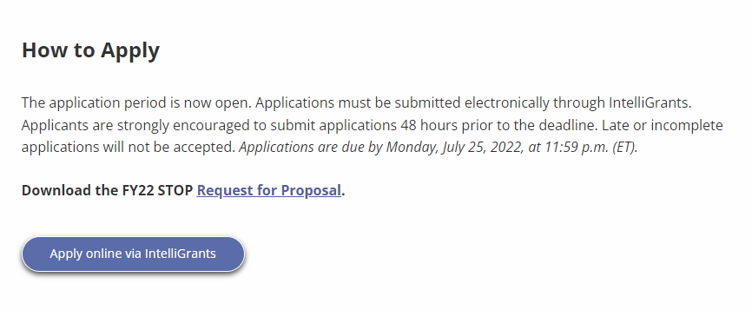
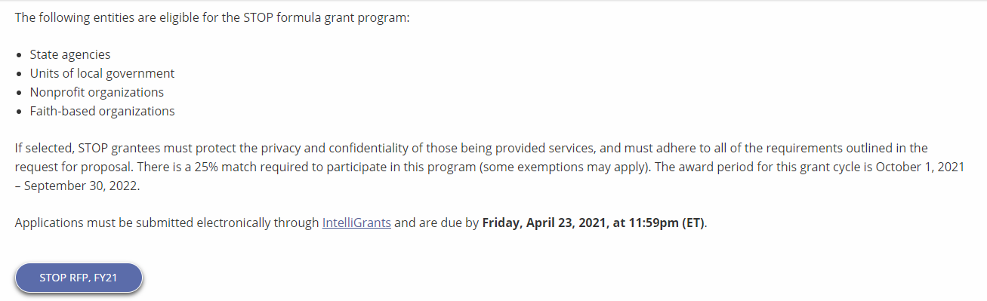
Accessing the RFP
Located on ICJI Website
In.gov/cji → Victim Services → STOP Grant “Learn More” → STOP RFP, FY22
https://www.in.gov/cji/victim-services/vawa-stop/

Slide 4
2022-2023 STOP (Services, Training, Officers, and Prosecutors) Violence Against Women Formula Grant Application
Application opened: Monday, June 27th at 9 AM
Application closes: Monday, July 25th at 11:59 PM
Applicants are strongly encouraged to submit applications 48 hours prior to the deadline.
Award Period for STOP: October 1, 2022 to September 30, 2023 (12-month award period)
Projects should begin on October 1, 2022 and must be in operation no later than 60 days after this date. Failure to have the funded project operational within 60 days from October 1, 2022 will result in the cancellation of the grant and the de-obligation of all awarded funds.

Slide 5
Overview:
The Services, Training, Officers, Prosecutors (STOP) Violence Against Women Formula Grant Program (STOP Formula Grant Program) supports communities, including American Indian Tribes and Alaska Native villages, in their efforts to develop and strengthen effective responses to sexual assault (including sex trafficking), domestic violence, dating violence, and stalking

Slide 6

STOP Funding Eligibility:
Eligible entity types include:
  State Agencies
  Units of local government
  Nonprofit organizations
  Faith-based organizations
Other Requirements include:
  Registered UEI number
  Active and current registration with SAM.gov
  Determination of Suitability to Interact with Participating Minors Certificate
  Good standing with the Department of Revenue (DOR), Department of Workforce Development (DWD), and Secretary of State (SOS)

Slide 7
Funding Allocation
**Of the 30% Victim Services Allocation, 10% goes to culturally specific community-based organizations
.
20% amongst 2 categories above must be allocated for programs or projects that meaningfully address sexual assault, including stranger rape, acquaintance rape, alcohol or drug-facilitated rape, and rape within the context of intimate partner relationship

Slide 8
Purpose Areas-
Funds under this program must be used for one or more of the following purposes:
Training Law Enforcement Officers, Judges, other court personnel, and prosecutors to more effectively identify and respond to violent crimes against women
Developing, training, or expanding units of law enforcement officers, judges, other court personnel, and prosecutors specifically targeting violent crimes against women
Developing and implementing more effective police, court, and prosecution policies, protocols, orders, and services specifically devoted to preventing, identifying, and responding to violent crimes against women
Developing, installing, or expanding data collection and communication systems, including computerized systems, linking police, prosecutors, and courts for the purpose of identifying, classifying, and tracking arrests, protection orders, violations of protection orders, prosecutions, and convictions
Developing, enlarging, or strengthening victim services and legal assistance programs
Developing, enlarging, or strengthening programs addressing the needs and circumstances of Indian tribes in dealing with violent crimes against women
Supporting formal and informal statewide multidisciplinary efforts to the extent not supported by state funds to coordinate response

Slide 9
Continued Purpose Areas
Training of sexual assault forensic medical personnel examiners in the collection and preservation of evidence, analysis, prevention, and providing expert testimony and treatment of trauma related to sexual assault
Developing, enlarging, or strengthening programs to assist law enforcement, prosecutors, courts, and others to address the needs and circumstances of individuals 50 years of age or over, individuals with disabilities and Deaf individuals who are victims of sexual assault, domestic violence, or stalking
Providing assistance to victims of domestic violence and sexual assault in immigration matters
Maintaining core victim services and criminal justice initiatives while supporting complementary new initiatives and emergency services for victims and their families
Supporting the placement of special victim assistants in local law enforcement agencies to serve as liaisons
Developing and promoting state/local/tribal legislation and policies that enhance best practices for responding to sexual assault, domestic violence, dating violence, and stalking
Developing, implementing or enhancing Sexual Assault Response Teams (SARTs)
Developing and strengthening policies, protocols, best practices, and training for law enforcement agencies and prosecutors
Developing, enlarging, or strengthening programs addressing sexual assault against men, women, and youth in correctional and detention settings
Identifying and conducting inventories of backlogs of sexual assault evidence collection kits and developing protocols and policies for responding to and addressing such backlogs

Slide 10
Continued Purpose Areas
Developing, enhancing, or strengthening programs and projects to improve evidence collection methods for victims of domestic violence, dating violence, sexual assault, or stalking, including through funding for technology that better detects bruising and injuries across skin tones and related training
Developing, enhancing, or strengthening culturally specific victim services programs to provide culturally specific victim services and responses to female genital mutilation or cutting
Providing victim advocates in State or local law enforcement agencies, prosecutors’ offices, and courts and providing supportive services and advocacy to Indian victims of domestic violence, dating violence, sexual assault, and stalking
Paying any fees charged by any governmental authority for furnishing a victim or the child of a victim with any of the following documents:
  A birth certificate or passport of the individual, as required by law
  An identification card issued to the person by a State or Tribe, that shows that the person is a resident of the State or member of the Tribe.

Slide 11
Out of Scope Activities
Research projects
Services provided to youth under the age of 11 or services to those above the age of 10 who are seeking services for victimization that occurred when they were under the age of 11
Activities that jeopardize victim safety, deter or prevent physical or emotional healing for victims, or allow offenders to escape responsibility for their actions

Slide 12
Other Requirements / Trainings
Determination of suitability to interact with participating minors
Every 5 years additional background checks (fingerprinting, etc.) must be run on any grant/match funded employees (including volunteers) that interact with anyone under the age of 18
This is a required condition of any DOJ grant- for more details about the required checks please visit https://www.ojp.gov/funding/explore/interact-minors
Civil Rights Training
The DOJ requires all recipients and subrecipients of federal funds to comply with a variety of Federal civil rights laws. ICJI has a checklist that each subgrantee needs to complete on an annual basis to remain in compliance
CJI Grantee Training and Resources Link-
https://www.in.gov/cji/grantee-training-and-resources/
These requirements along with other trainings can be found at:

Slide 13
Initiating an application in IntelliGrants
https://intelligrants.in.gov

Slide 14
Steps to initiating an application in IntelliGrants (ICJI’s Grant Management system):
Log into your IntelliGrants account
  If you do not have an account, then you can obtain one on the home screen of intelligrants (New User?)
On the “MY HOME” page access the “VIEW AVAILABLE PROPOSALS” section
Click on VIEW OPPORTUNITIES
Intelligrants will take you to the My Opportunities page
Access the 2022 STOP Grant Application
Select “Apply Now”

Slide 15
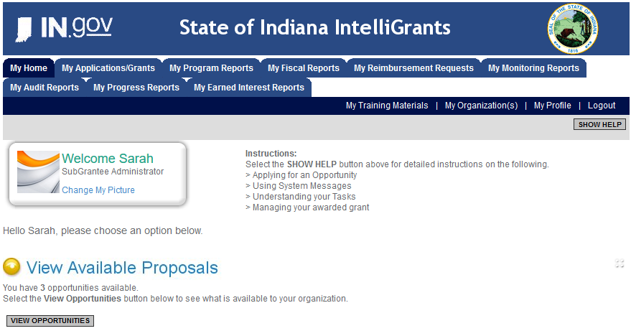

Slide 16
STOP Application

Slide 17
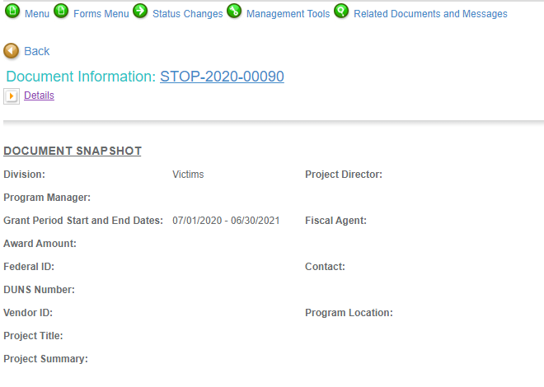

Slide 18
Forms that need to be completed:
Contact
Project Information
Programmatic Information
Problem Statement & Analysis
Goals, Objectives, & Outcomes
Program Descriptions
Evidence Based/Best Practices
Use of Volunteers
Budget
Budget Narrative
Attachments

Slide 19
Contact
Points of Contact for the grant (CJI will notify these individuals of your award notice)
Project Information
SAMs Registration must be up-to-date
Audit
If you receive more than $750,000 in federal grant funds, you are required to have an audit. This will be requested if CJI is aware that you receive more than $750,000.
Programmatic Information
Information about your proposed STOP grant
Problem Statement & Analysis
All government agency’s audits are included in the County audit and should all have one attached
Forms to be Completed (continued)

Slide 20
Goal, Objective, and Outcomes
The goal should directly address the problem identified in the Problem Statement.
Objectives are the steps needed to achieve goals. Objectives should be concrete, action-oriented, and Specific, Measurable, Achievable, Realistic, Timely (SMART).
Example of Objective: By September 2022, a minimum of 50 culturally and linguistically appropriate support groups for survivors of domestic violence will be provided.
Outcomes measure objectives and are criteria for how the program is deemed to be effective.
Example of Outcome: 85% of participants will indicate that they have learned ways to act in their own best interest.
Program Description
What? Who? Where? Why? When? How?
Evidence Based/Best Practice
Use of Volunteers
Forms to be Completed (continued)

Slide 21
Grants cannot be processed until ICJI receives its Federal Award Letter, which more than likely will be delayed pending the passage of the federal budget. Please be aware of this as you are writing your proposal.
All grants from ICJI Victim Services are reimbursement grants, which means that agency must first incur the expense prior to CJI reimbursing for the expense. Verification of expenses along with verification of payment of expenses must be provided to ICJI on a monthly or quarterly basis prior to reimbursement of expenses by ICJI.
Match Requirement for STOP is 25% for only governmental agencies
Important Notes

Slide 22
MATCH REQUIREMENT
There is a 25% match requirement imposed on grant funds under this program for governmental entities.
Matching funds must:
  Be verifiable from the subgrantee’s records
  Not be included as contributions for any other federal award
  Be necessary and reasonable for the accomplishment of the project or program objectives
  Be allowable under 2 C.F.R. 200.400
  Not be paid by the federal government under another federal award, except where authorized by federal statue
  Be included in the subgrantee’s approved budget
  Conform to all other provisions of 2 C.F.R Part 200

Slide 23
MATCH EXAMPLE
STEP 1: Award amount / % of Federal Share = Total Project Cost
STEP 2: Total Project Cost – Award Amount = Required Match
EXAMPLE: A grant recipient is awarded $150,000 in federal funding and there is a 25% match requirement.
STEP 1: $150,000 / .75 = $200,000 Total Project Cost
STEP 2: $200,000 – 150,000 = $50,000 Required Match
Notes:
Example

Slide 24
Ineligible Budget Items
(1) Administrative costs over 10% of the total grant budget
(2) Direct financial assistance to a client such as cash, gift cards, or checks
(3) Food and beverages
(4) Lobbying and/or fundraising
(5) Immigration fees
(6) Purchase of real estate,
(7) Construction,
(8) Physical modification to buildings, including minor renovations (such as painting or carpeting),
(9) Vehicles
(10) Overtime is allowed but to claim the increased rate, there must be a separate line item in the budget that includes the overtime rate of pay. There must also be a separate line in benefits for the OT if you wish to claim FICA.
(11) Costs may not be included or used to meet match requirements of any other federal grant

Slide 25

Budget Narrative
Be sure all items in the Budget are included in the Budget Narrative.
  Ex: Office Supplies (copy paper, pencils, pens)
Grant reviewers are not required to contact you for clarification.
Any missing information in this section may disqualify that budget item for funding.

Slide 26

Attachments Required:
Total Agency Budget
  Found on ICJI’s website (https://www.in.gov/cji/victim-services/resources/) – Subgrantee Basic Budget (Nonprofit Applicant Budget Form)
Sustainability Plan
  Your plan to maintain the program once the grant funds expire
Timeline
  Outlining the completion of the project/ or expenditures of the grant funds
Letters of Endorsement
  For this program specifically
Miscellaneous
  Job Descriptions for any position listed in personnel
  If applicable any contracts
  Consultation Form – example on the last page of the RFP
  EEOP Certification
  Legal Services Certification Form – example also included in the RFP
  Signed Determination of Suitability form

Slide 27
SUPPLANTING
Federal Funds must be used to supplement existing funds for program activities and cannot replace or supplant non-federal funds that have been appropriated for the same purpose.
Supplanting occurs when a state, local, or tribal government reduces state, local or tribal funds for an activity specifically because federal funds are available (or expected to be available) to fund the same activity.

Slide 28
For technical assistance contact the ICJI Helpdesk at CJIHelpDesk@cji.in.gov. Help Desk hours are Monday – Friday, 8:00 am to 4:30 pm ET, except state holidays.
ICJI is not responsible for technical issues with grant submission within 48 hours of grant deadline.
For assistance with any other requirements of this solicitation, please contact The Victim Services Division at ICJI.

Slide 29

Questions?

Slide 30
Thanks for attending!
Presenter:
Dalayna Anderson, Victim Services Program Specialist
DaAnderson1@cji.in.gov
317-232-3482

