Slide 1

This webinar is being recorded and will be posted on the ICJI website along with all Questions and Answers.
2024 STOP Violence Against Women For Law Enforcement Formula Grant
RFP Webinar
July 19, 2024

Slide 2
Thanks for joining us today:
Please keep your lines muted during the presentation.
This webinar is being recorded and will be posted on the ICJI website along with all Questions and Answers.
Questions and Answers at the end.
Feel Free to utilize the chat box during the webinar.

Slide 3

2024 STOP LEA Grant Application
Application opened: Monday, June 17th at 9 AM
Application closes: Wednesday, July 31st at 11:59 PM
Applicants are strongly encouraged to submit applications 48 hours prior to the deadline.
Award Period for STOP: October 1, 2024 – September 30, 2025 (12-month award period)
Projects should begin on October 1, 2024, and must be in operation no later than 60 days after this date. Failure to have the funded project operational within 60 days from October 1, 2024, will result in the cancellation of the grant and the de-obligation of all awarded funds.

Slide 4
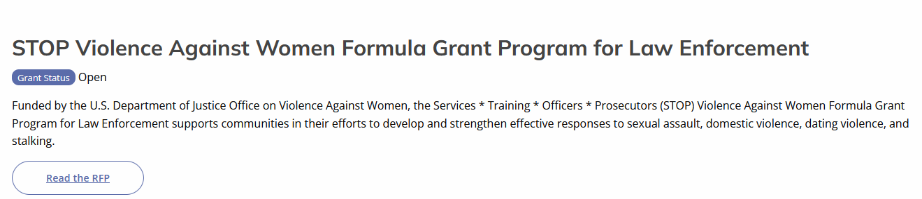
Accessing the RFP
Located on ICJI Website:
CJI.IN.gov → Victim Services → S.T.O.P for Law Enforcement → STOP RFP 2024
https://www.in.gov/cji/victim-services/vawa-stop/stop-for-law-enforcement/

Slide 5

STOP Violence Against Women Formula Grant Program for Law Enforcement
The Services * Training * Officers * Prosecutors (STOP) Violence Against Women Formula Grant Program (STOP Formula Grant Program) supports communities, including American Indian Tribes and Alaska Native villages, in their efforts to develop and strengthen effective responses to sexual assault, domestic violence, dating violence, and stalking.
Funding for this grant opportunity is limited to Law Enforcement activities only.
Law enforcement activities include, but are not limited to the following:
  Investigation of a crime
  Training law enforcement to more effectively identify, investigate, and respond to crimes against women
  Developing more effective protocols
  Training forensic examiners in the collection of evidence

Slide 6

2024 STOP-LEA
PURPOSE AREAS

Slide 7
Training law enforcement officers to more effectively identify and respond to violent crimes against women, including the crimes of sexual assault, domestic violence, dating violence, and stalking, including the appropriate use of nonimmigrant status under subparagraphs (T) and (U) of section 101(a)(15) of the Immigration and Nationality Act (8 U.S.C. § 1101(a)).
Developing, training, or expanding units of law enforcement officers, specifically targeting violent crimes against women, including the crimes of sexual assault, domestic violence, dating violence, and stalking.
Developing and implementing more effective police protocols, orders, and services specifically devoted to preventing, identifying, and responding to violent crimes against women, including the crimes of sexual assault, domestic violence, dating violence, and stalking, as well as the appropriate treatment of victims.
Training of sexual assault forensic medical personnel examiners in the collection and preservation of evidence, analysis, prevention, and providing expert testimony and treatment of trauma related to sexual assault.
Developing, enlarging, or strengthening programs to assist law to address the needs and circumstances of older and disabled women who are victims of sexual assault, domestic violence, dating violence, or stalking, including recognizing, investigating, and prosecuting instances of such violence or assault and targeting outreach and support, counseling, and other victim services to such older and disabled individuals.
Developing and strengthening policies, protocols, best practices, and training for law enforcement agencies relating to the investigation and prosecution of sexual assault cases and the appropriate treatment of victims.
Developing, enlarging, or strengthening programs addressing sexual assault against men, women, and youth in correctional and detention settings.

Slide 8
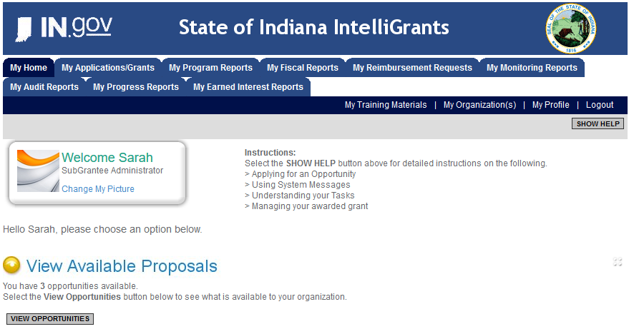
Initiating an Application
Log into IntelliGrants
  If you do not have an account, register by clicking “NEW USER”
On the “MY HOME” page, access “VIEW AVAILABLE PROPOSALS”
Click on “VIEW OPPORTUNITIES”
IntelliGrants will take you to “MY OPPORTUNITIES”
Access the “2024 STOP LEA GRANT” Application
Select “APPLY NOW”
https://intelligrants.in.gov

Slide 9
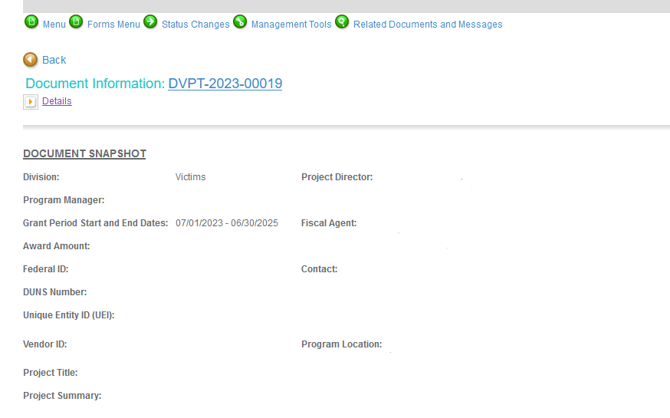




Navigating Forms Menu

Slide 10

Application Forms That Must Be Completed
Contact Information
Project Information
Programmatic Information
Goals, Objectives, and Outcomes
Problem Statement & Analysis
Program Description
Evidence Based/Best Practices
Use of Volunteers

Slide 11
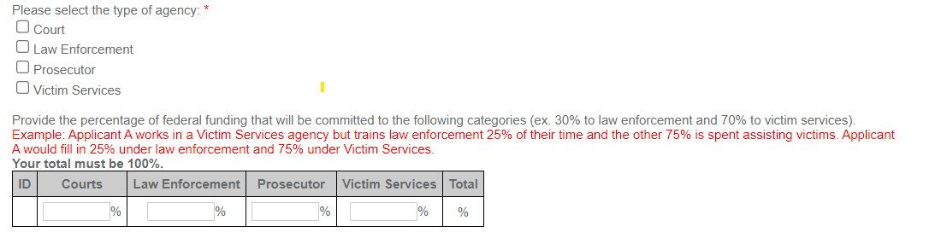
Programmatic Information Form
Example: A Prosecutor’s office is requesting funds for a Prosecutor who will spend 50% of their time prosecuting domestic violence and sexual assault cases. They are also requesting 100% for a Victim Assistant position who will provide victim services.
Prosecutor Salary: $100,000 @ 50% = $50,000 Funding Requested
Victim Assistant Salary: $50,000 @ 100% = $50,000 Funding Requested
Prosecutor = $50,000/$100,000 = 50%
Victim Services = $50,000/$100,000 = 50%

Slide 12

Important Notes
All grants from ICJI Victim Services are reimbursement grants, which means that agencies must first incur the expense prior to ICJI reimbursing for the expense.
Verification of expenses along with verification of payment of expenses must be provided to ICJI on a monthly or quarterly basis prior to reimbursement of expenses by ICJI.

Slide 13
25% Match Requirement for Gov’t Entities
Be verifiable from the subgrantee’s records
Not be included as contributions for any other federal award
Be necessary and reasonable for the accomplishment of the project or program objectives
Be allowable under 2 C.F.R. 200.400
Not be paid by federal government under another federal award, except where authorized by federal statue
Be included in the subgrantee’s approved budget
Conform to all other provisions of 2 C.F.R Part 200

Slide 14
MATCH EXAMPLE
Determining Match:
STEP 1: Award amount / % of Federal Share = Total Project Cost
STEP 2: Total Project Cost – Award Amount = Required Match
Example Match Requirement:
A grant recipient is awarded $150,000 in federal funding and there is a 25% match requirement.
STEP 1: $150,000 / .75 = $200,000 Total Project Cost
STEP 2: $200,000 - $150,000 = $50,000 Required Match

Slide 15

Budget Narrative
Be sure all items in the Budget are included in the Budget Narrative.
  Ex: Office Supplies (copy paper, pencils, pens)
Grant reviewers are not required to contact you for clarification.
Any missing information in this section may disqualify that budget item for funding.

Slide 16
REQUIRED ATTACHMENTS
Total Agency Budget for non-profits
Indirect Cost Rate –
if applicable
Sustainability Plan
Timeline
Letter(s) of Endorsement
Determination of Suitability to Interact with Participating Minors Certification Form (all applicants)
STOP Requirements Form `all applicants)
Consultation Form
(all governmental agencies)
Confidentiality Notice
(all applicants)
Completed and signed EEOP certification
(all applicants)
Job Descriptions for grant and/or match funded personnel
Any other requested information
Please visit ICJI’s Forms, Resources, and Guidance page for links and additional information for the required attachments.
Notes:
In the webinar, tell them to be sure to use the one found at this link/our website and not one they might have used before. We updated the format so want to ensure you use the new one.

Slide 17
Assistance
For technical assistance, contact the ICJI Helpdesk at CJIHelpDesk@cji.in.gov.
  Help Desk hours are Monday – Friday, 8:00 am to 4:30 pm ET, except state holidays.
ICJI is not responsible for technical issues with grant submission within 48 hours of grant deadline.
  We strongly encourage you to submit your application before the 48-hour window prior to the deadline.
For assistance with any other requirements of this solicitation, please contact the Victim Services Division at victimservices@cji.in.gov

Slide 18
QUESTIONS?

Slide 19
Thanks for attending!
Presented by
Dalayna Anderson, Victim Services, Program Specialist
DaAnderson1@cji.in.gov
317-232-3482
Becky Venus, Victim Services, Senior Grant Manager
Rvenus@cji.in.gov
317-233-5681

