Slide 1

2023-2024 STOP (Services, Training, Officers, and Prosecutor’s) Violence Against Women Formula Grant RFP Webinar
June 29, 2023

Slide 2
Thanks for joining us today:
Please keep your lines muted during the presentation.
This webinar is being recorded and will be posted on the ICJI website.
Questions and Answers at the end.
Feel Free to utilize the chat box during the webinar.

Slide 3
2023-2024 STOP Grant Application
Application opened: Tuesday, June 20th at 8 AM
Application closes: Tuesday, July 25th at 11:59 PM
Applicants are strongly encouraged to submit applications 48 hours prior to the deadline.
Award Period for STOP: October 1, 2023 – September 30, 2024 (12-month award period)
Projects should begin on October 1, 2023 and must be in operation no later than 60 days after this date. Failure to have the funded project operational within 60 days from October 1, 2023 will result in the cancellation of the grant and the de-obligation of all awarded funds.

Slide 4
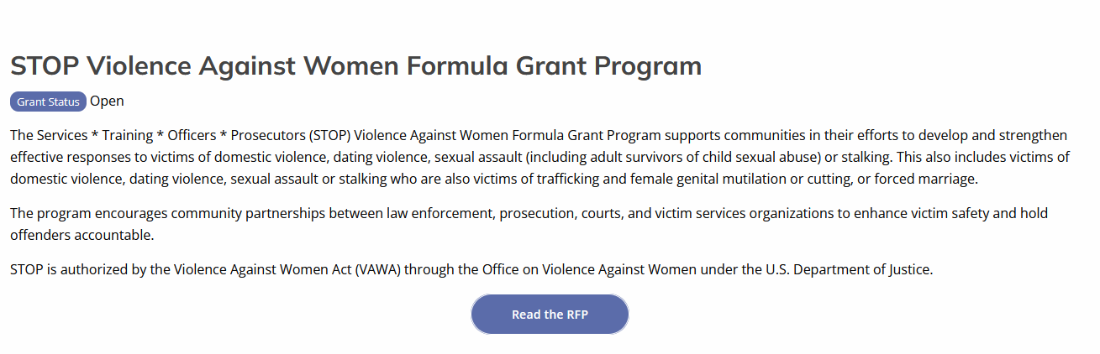
Accessing the RFP
Located on ICJI Website
CJI.IN.gov → Victim Services → S.T.O.P Violence Against Women grant → STOP RFP 2023
https://www.in.gov/cji/victim-services/vawa-stop/

Slide 5
Overview
The Services * Training * Officers * Prosecutors (STOP) Violence Against Women Formula Grant Program (STOP Formula Grant Program) supports communities, including American Indian Tribes and Alaska Native villages, in their efforts to develop and strengthen effective responses to victims of domestic violence, dating violence, sexual assault (including adult survivors of child sexual abuse) or stalking. This also includes victims of domestic violence, dating violence, sexual assault or stalking who are also victims of trafficking and female genital mutilation or cutting, or forced marriage.

Slide 6
STOP Funding Eligibility
Eligible entity types include
  State Agencies
  Units of local government
  Nonprofit organizations
  Faith-based organizations
Other Requirements include
  Registered UEI number
  Active and current registration with SAM.gov
  Good standing with the Department of Revenue (DOR), Department of Workforce Development (DWD), and Secretary of State (SOS)

Slide 7
Funding Allocation
There must be 20% allocated between two categories for programs or projects that meaningfully address sexual assault, including stranger rape, acquaintance rape, alcohol or drug-facilitated rape, and rape within the context of an intimate partner relationship
**10% of the 30% allocation for Victim Services must go to culturally specific community-based organizations.

Slide 8
Culturally Specific Definition
Culturally specific services are services directed toward a racial or ethnic minority group. An organization will qualify for funding for the culturally specific allocation if:
Its primary mission is to address the needs of racial or ethnic minority groups or
If the organization has developed a special expertise regarding a particular racial or minority group.

Slide 9
Modified/New Purpose Areas
3) Developing and implementing more effective police, court, and prosecution policies, protocols, orders, and services specifically devoted to preventing, identifying, and responding to violent crimes against women, including the crimes of sexual assault, domestic violence, dating violence, and stalking, as well as the appropriate treatment of victims, including implementation of the grant conditions in section 40002(b) of the Violence Against Women Act of 1994 (34 U.S.C. 12291(b)).
5) Developing, enlarging, or strengthening victim services and legal assistance programs, including sexual assault, domestic violence, dating violence, and stalking programs, developing or improving delivery of victim services and legal services to underserved populations, providing specialized domestic violence court advocates in courts where a significant number of protection orders are granted, and increasing
9) Developing, enlarging, or strengthening programs to assist law enforcement, prosecutors, courts, and others to address the needs and circumstances of individuals 50 years of age or over, individuals with disabilities, and Deaf individuals who are victims of sexual assault, domestic violence, dating violence, or stalking, including recognizing, investigating, and prosecuting instances of such violence or assault and targeting outreach and support, counseling, legal assistance, and other victim services to such individuals.
*Full list of purpose areas are listed in the RFP starting on page 7.

Slide 10
Modified/New Purpose Areas, Continued
11) Maintaining core victim services and criminal justice initiatives, while supporting complementary new initiatives and emergency services for victims and their families including rehabilitative work with offenders.
20) Developing, enhancing, or strengthening prevention and educational programming to address sexual assault, domestic violence, dating violence, stalking, or female genital mutilation or cutting; with not more than 5 percent of the amount allocated to a state to be used for this purpose.
21) Developing, enhancing, or strengthening programs and projects to improve evidence collection methods for victims of domestic violence, dating violence, sexual assault, or stalking, including through funding for technology that better detects bruising and injuries across skin tones and related training.
22) Developing, enlarging, or strengthening culturally specific victim services programs to provide culturally specific victim services and responses to female genital mutilation or cutting.
*Full list of purpose areas are listed in the RFP starting on page 7.

Slide 11
Modified/New Purpose Areas, Continued
23) Providing victim advocates in State or local law enforcement agencies, prosecutors’ offices, and courts and providing supportive services and advocacy to Indian victims of domestic violence, dating violence, sexual assault, and stalking.
24) Paying any fees charged by any governmental authority for furnishing a victim or the child of a victim with any of the following documents:
  a. A birth certificate or passport of the individual, as required by law.
  b. An identification card issued to the person by a State or Tribe, that shows that the person is a resident of the State or member of the Tribe.
*Full list of purpose areas are listed in the RFP starting on page 7.

Slide 12
New Program Requirements

Slide 13
Grant Eligibility Regarding Compelling Victim Testimony
For a Prosecutor’s Office to be eligible to receive grant funds under this subchapter, the head of the office shall certify, to the State, that the office will, during the 3-year period beginning on the date on which the grant is awarded, engage in planning, developing, and implementing the following:
Training developed by experts in the field regarding victim-centered approaches in domestic violence, sexual assault, dating violence, and stalking cases;
Policies that support a victim-centered approach, informed by such training; and
A protocol outlining alternative practices and procedures for material witness petitions and bench warrants, consistent with best practices, that shall be exhausted before employing material witness petitions and bench warrants to obtain victim-witness testimony in the investigation, prosecution, and trial of a crime related to domestic violence, sexual assault, dating violence, and stalking of the victim in order to prevent further victimization and trauma to the victim.
A completed certification form must be attached to your application in IntelliGrants under the miscellaneous section of attachments. The certification form can be found here: CJI: Victim Services: Resources (in.gov)

Slide 14
STOP Requirements
All grantees and subgrantees of STOP funding must state how they will meet the requirements of the applicable provisions of 34 U.S.C. 122912(b) as listed below.
Nondisclosure of confidential or private information - grantees and subgrantees shall protect the confidentiality and privacy of persons receiving services. For more information see 28 CFR 90.4(b) and FAQs on the OVW web page (FAQ on the VAWA Confidentiality Provision (justice.gov)).
Approved activities - If grantees and subgrantees collaborate with or provide information to public officials and agencies to develop and implement policies and develop and promote legislation or model codes to reduce or eliminate domestic violence, dating violence, sexual assault, and stalking, then they must maintain confidentiality of victims (as required above) and ensure that personally identifying information about victims is not included.
Non-supplantation - Federal funds shall be used to supplement, not supplant, non-Federal funds that would otherwise be available for STOP funded activities.
Reports - An entity receiving a grant shall submit to the disbursing agency a report on activities undertaken with the grant funds.
A completed certification form must be attached to your application in IntelliGrants under miscellaneous section in the attachments. The certification form can be found here: CJI: Victim Services: Resources (in.gov)

Slide 15
STOP Requirements, Continued
Nonexclusivity - nothing in the VAWA shall be construed to prohibit male victims of domestic violence, dating violence, sexual assault and stalking from receiving STOP Program funded services.
Prohibition on tort litigation - Funds under the STOP Program may not be used to fund civil representation in a lawsuit based on a tort claim.
Prohibition on lobbying - Funds under the STOP Program are subject to the prohibition in 18 U.S.C. 1913 (a provision that broadly prohibits the use of appropriated funds for lobbying).
Delivery of legal assistance - Grantees and subgrantees providing legal assistance with STOP funds shall comply with the requirements of 34 U.S.C. 20121(d) (see Resources for Applicants (justice.gov) for a sample letter provided by OVW).
Civil rights – grantees and subgrantees are prohibited from discriminating on the basis of actual or perceived race, color, religion, national origin, sex, gender identity, sexual orientation, or disability. For more information, see Frequently Asked Questions - Nondiscrimination Grant Condition in the Violence Against Women Reauthorization Act of 2013 (justice.gov).

Slide 16
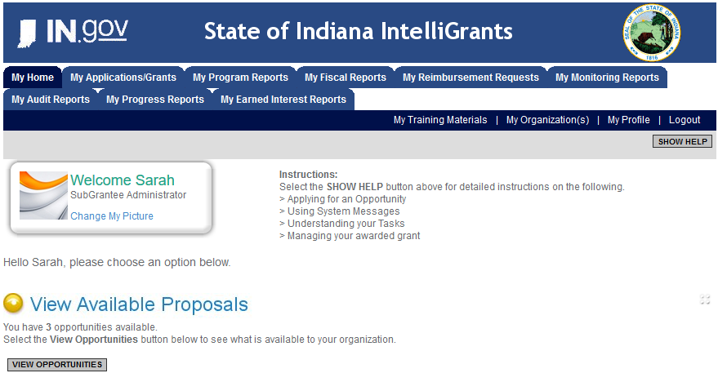
Initiating an Application
Log into IntelliGrants
  If you do not have an account, register by clicking “NEW USER”
On the “MY HOME” page, access “VIEW AVAILABLE PROPOSALS”
Click on “VIEW OPPORTUNITIES”
IntelliGrants will take you to “MY OPPORTUNITIES”
Access the “2023 STOP GRANT” Application
Select “APPLY NOW”
https://intelligrants.in.gov

Slide 17
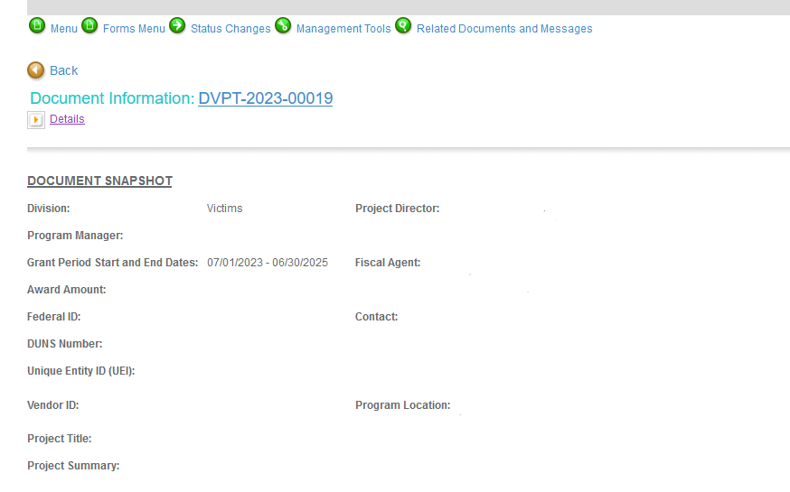


Navigating Forms Menu

Slide 18
Contact
Project Information
Programmatic Information
Problem Statement & Analysis
Goals, Objectives, and Outcomes
Program Description
Evidence Based/Best Practices
Use of Volunteers
Budget
Budget Narrative
Attachments
Forms that MUST BE Completed

Slide 19
Contact
Points of Contact for the grant (CJI will notify these individuals of your award notice)
Project Information
SAMs Registration must be up-to-date
Audit
If you receive more than $750,000 in federal grant funds, you are required to have an audit. This will be requested if CJI is aware that you receive more than $750,000.
Programmatic Information
Information about your proposed STOP grant
Problem Statement & Analysis
All government agency’s audits are included in the County audit and should all have one attached
Forms that MUST BE Completed, continued

Slide 20
Goal, Objective, and Outcomes
The goal should directly address the problem identified in the Problem Statement.
Objectives are the steps needed to achieve goals. Objectives should be concrete, action-oriented, measurable and Specific, Measurable, Achievable, Realistic, Timely (SMART).
Example of Objective: By September 2022, a minimum of 50 culturally and linguistically appropriate support groups for survivors of domestic violence will be provided.
Outcomes measure objectives and are criteria for how the program is deemed to be effective.
Example of Outcome: 85% of participants will indicate that they have learned ways to act in their own best interest.
Program Description
What? Who? Where? Why? When? How?
Evidence Based/Best Practice
Use of Volunteers
Forms that MUST BE Completed, continued

Slide 21
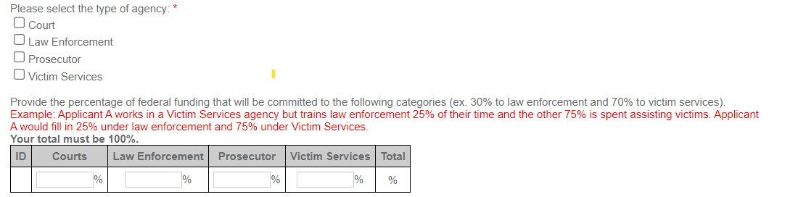
Programmatic Information Form
Example: A Prosecutor’s office is requesting funds for a Prosecutor who will spend 50% of their time prosecuting domestic violence and sexual assault cases. They are also requesting 100% for a Victim Assistant position who will provide victim services.
Prosecutor Salary: $100,000 @ 50% = $50,000 Funding Requested
Victim Assistant Salary: $50,000 @ 100% = $50,000 Funding Requested
Prosecutor = $50,000/$100,000 = 50%
Victim Assistant = $50,000/$100,000 = 50%

Slide 22
Important Notes
Grants cannot be processed until ICJI receives its Federal Award Letter, which more than likely will be delayed pending the passage of the federal budget. Please be aware of this as you are writing your proposal.
All grants from ICJI Victim Services are reimbursement grants, which means that agency must first incur the expense prior to CJI reimbursing for the expense. Verification of expenses along with verification of payment of expenses must be provided to ICJI on a monthly or quarterly basis prior to reimbursement of expenses by ICJI.

Slide 23
MATCH REQUIREMENT
There is a 25% match requirement imposed on grant funds under this program*.
Matching funds must
  Be verifiable from the subgrantee’s records
  Not be included as contributions for any other federal award
  Be necessary and reasonable for the accomplishment of the project or program objectives
  Be allowable under 2 C.F.R. 200.400
  Not be paid by the federal government under another federal award, except where authorized by federal statue
  Be included in the subgrantee’s approved budget
  Conform to all other provisions of 2 C.F.R Part 200
Match is restricted to the same use of funds as allowed for federal funds.
If an expenditure is not allowable with federal funds, it is not allowable with match funds.
Applicants must identify all sources of the non-federal portion of the total project costs (i.e., match funds), and applicants must explain how the match funds will be used in the budget narrative section of the application within IntelliGrants.
*Match is only required of government agencies.

Slide 24
MATCH EXAMPLE
To determine your match requirement:
STEP 1: Award amount / % of Federal Share = Total Project Cost
STEP 2: Total Project Cost – Award Amount = Required Match
An example of match requirement:
A grant recipient is awarded $150,000 in federal funding and there is a 25% match requirement.
  STEP 1: $150,000 / .75 = $200,000 Total Project Cost
  STEP 2: $200,000 - $150,000 = $50,000 Required Match

Slide 25

Budget Narrative
Be sure all items in the Budget are included in the Budget Narrative.
  Ex: Office Supplies (copy paper, pencils, pens)
Grant reviewers are not required to contact you for clarification.
Any missing information in this section may disqualify that budget item for funding.

Slide 26
REQUIRED ATTACHMENTS
Total Agency Budget
  Subgrantee Basic Budget (Nonprofit Applicant Budget Form)
  Found on ICJI’s website (https://www.in.gov/cji/victim-services/resources/)
Indirect Cost Rate
  If applicable
Sustainability Plan
  Your plan to maintain the program once grant funds expire
Timeline
  Outlining the completion of the project/spending expenditures for reimbursement of grant funds
Letter(s) of Endorsement
  Must mention the letter is for your specific program

Slide 27
REQUIRED ATTACHMENTS,
CONTINUED
Miscellaneous
  Determination of Suitability to Interact with Participating Minors Certification Form (all applicants)
  STOP Requirements Form (all applicants)
  Consultation Form (all governmental agencies)
  Prosecutor Office Certification Form (all Prosecutor Offices)
  Legal Assistance Certification Letter (if applicable)
  Completed and signed EEOP certification (all applicants)
  Job Descriptions, if applying for personnel costs
  Any other requested information

Slide 28
Technical Assistance
For technical assistance, contact the ICJI Helpdesk at CJIHelpDesk@cji.in.gov.
  Help Desk hours are Monday – Friday, 8:00 am to 4:30 pm ET, except state holidays.
ICJI is not responsible for technical issues with grant submission within 48 hours of grant deadline.
  We strongly encourage you to submit your application before the 48-hour window prior to the deadline.
For assistance with any other requirements of this solicitation, please contact the Victim Services Division at ICJI.

Slide 29
QUESTIONS?

Slide 30
Thanks for attending!
Presented by
Dalayna Anderson, Victim Services, Program Specialist
DaAnderson1@cji.in.gov
317-232-3482

