Slide 1

2022 SASP and SAVAF RFP Webinar
September 22nd, 2021

Slide 2
Thanks for joining us today:
Please keep your lines muted during the presentation.
Webinar is being recorded. It will be posted on the ICJI website.
Questions and Answers at the end.
Feel Free to utilize the chat box during the webinar.

Slide 3
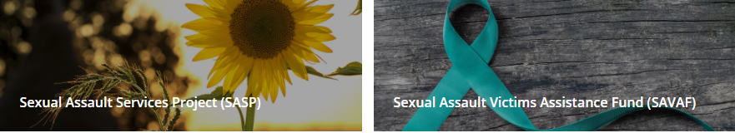
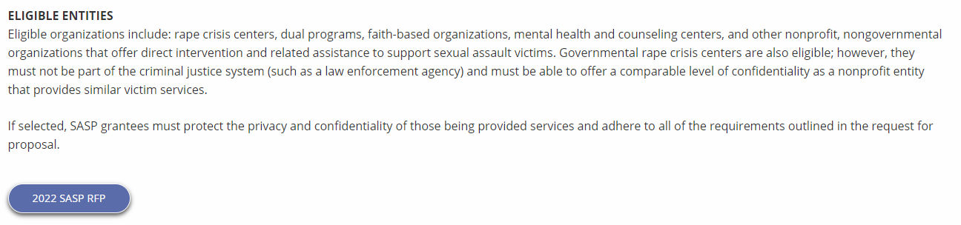
Accessing the RFP
Located on ICJI Website
In.gov/cji → Victim Services → Sexual Assault Services Project (SASP) → 2022 SASP RFP
In.gov/cji → Victim Services → Sexual Assault Victims Assistance Fund (SAVAF)→ 2022 SAVAF RFP
https://www.in.gov/cji/victim-services/sasp/
https://www.in.gov/cji/victim-services/sexual-assault-victim-assistance-fund/

Slide 4
2022 SASP (Sexual Assault Services Program) Violence Against Women Formula Grant Application
Application opened: Tuesday, September 14th at 9 AM
Application closes: Monday, October 18th at 11:59 PM
Applicants are strongly encouraged to submit applications 48 hours prior to the deadline.
Award Period for SASP: January 1, 2022 to December 31, 2022 (12-month award period)
Projects should begin on January 1, 2022 and must be in operation no later than 60 days after this date. Failure to have the funded project operational within 60 days from January 1, 2022 will result in the cancellation of the grant and the de-obligation of all awarded funds.

Slide 5
2022 SAVAF (Sexual Assault Victims Assistance Fund) Grant Application
Application opened: Monday, September 20th at 9 AM
Application closes: Monday, October 25th at 11:59 PM
Applicants are strongly encouraged to submit applications 48 hours prior to the deadline.
Award Period for SAVAF: January 1, 2022 to December 31, 2022 (12-month award period)
Projects should begin on January 1, 2022 and must be in operation no later than 60 days after this date. Failure to have the funded project operational within 60 days from January 1, 2022 will result in the cancellation of the grant and the de-obligation of all awarded funds.

Slide 6
SASP Overview:
The Sexual Assault Services Program (SASP) was created by the Violence Against Women and Department of Justice Reauthorization Act of 2005, 34 U.S.C. § 12511. The program directs grant dollars to states to assist them in supporting rape crisis centers and nonprofit, nongovernmental organizations that provide core services, direct intervention, and related assistance to victims of sexual assault.

Slide 7
SAVAF Overview:
The Sexual Assault Victim Assistance Fund (SAVAF) was created to (1) establish and maintain rape crisis centers (RCC), (2) enhance services provided by existing rape crisis centers, and (3) develop, implement, and expand trauma informed sexual assault services. SAVAF was established pursuant to Indiana Code § 5-2-6-23 and is funded by the collection fees assessed under Indiana Code § 33-37-5-23.

Slide 8

Funding Eligibility:
Eligible entity types include:
  Nonprofit, nongovernmental rape crisis centers
  Nonprofit, nongovernmental dual programs that provide sexual assault and domestic violence services
  Governmental entity rape crisis (or dual) centers.
    The entity may not be part of the criminal justice system (such as a law enforcement agency) and must be able to offer a comparable level of confidentiality
  Faith-based organizations
  Other state, local public, and nonprofit agencies such as mental health or counseling centers or other programs that have staff specifically trained to serve victims of Sexual Assault
Other Requirements include:
  Registered DUNS number
  Active and current registration with SAM.gov
  Good standing with the Department of Revenue (DOR), Department of Workforce Development (DWD), and Secretary of State (SOS)

Slide 9
Funding Availability
SASP- ICJI has approximately $550,000 available in funding for this solicitation and estimates awarding 10-14 grants ranging from $10,000 - $60,000
SAVAF- ICJI has approximately $1,700,000 available in funding for this solicitation and estimates awarding 15-18 grants ranging from $50,000 to $250,000
**This is not a cap for the minimum/maximum able to be requested with your applications. This is just an average of what we are expecting.**

Slide 10
SASP Purpose Areas-
Funds under this program must be used for one or more of the following purposes:
  Funds under this program must be used to provide intervention and related assistance to:
    Adult, youth, and child victims of sexual assault;
    Family and household members of such victims; and
    Those collaterally affected by the victimization, except for the perpetrator of such victimization
  Funds under this program must be used to support the establishment, maintenance, and expansion of rape crisis centers and other nongovernmental or tribal programs and activities that provide direct intervention and related assistance to individuals who have been victimized by sexual assault, without regard to the age of individual
  Intervention and related assistance may include:
    24-hour hotline services providing crisis intervention services and referral
    Accompaniment and advocacy through medical, criminal justice, and social support systems, including medical facilities, police, and court proceedings
    Crisis intervention, short-term individual and group support services, and comprehensive service coordination and supervision to assist sexual assault victims and family or household members
    Information and referral to assist sexual assault victims and family or household members
    Community Based, culturally specific services and support mechanisms, including outreach activities for underserved communities; and
    Development and distribution of materials on issues related to the services described above

Slide 11
Priority Areas
SASP:
Priority will be given to programs that can and will promote civil rights (including by meeting the needs of underserved and marginalized survivors), improve access to justice for survivors, and enhance survivor safety.
SAVAF:
The priority area of funding is to establish and maintain rape crisis centers that are providing trauma informed sexual assault services and are meeting the components of a rape crisis center.

Slide 12
SAVAF Allowable Activities and Costs
24-hour crisis line and 24-hour on-call advocate to respond onsite to hospitals and other locations where a victim presents
Direct services to victims including informational and referral services, advocacy, legal advocacy, and case management
Counseling or therapy services for victims including support groups
Emergency flexible funding for victims including emergency transportation, shelter, clothing, and food
Expenses associated with providing services to victims including travel, phones, interpretation, equipment, printing of materials, and training costs
Overtime for grant funded staff is an allowable cost, but to claim the increased rate, there must be a separate line item in the budget that includes the overtime rate of pay

Slide 13
Out of Scope Activities - SASP
Research Projects
Activities focused on prevention efforts and public education
Criminal Justice related projects, including Law Enforcement, prosecution, courts, and forensic interviews
Sexual Assault Forensic Medical Examiner programs
Sexual Assault Response Team Coordination
Providing training to allied professionals and the community
Domestic Violence services unrelated to sexual violence

Slide 14
Unallowable Activities - SASP
This grant program does not fund activities that jeopardize victim safety, deter or prevent physical or emotional healing for victims, or allow offenders to escape responsibilities for their actions. The following activities have been found to jeopardize victim safety, deter, or prevent physical or emotional healing for victims, or allow offenders to escape responsibility for their actions. Ensure that these activities are not included
Procedures or Polices that:
  Exclude victims from receiving safe shelter, advocacy services, counseling and other assistance based on their actual or perceived sex, age, immigration status, race, religion, sexual orientation, gender identity, mental health condition, physical health condition, criminal record, work in the sex industry, income, or lack of income, or the age and/or sex of their children
  Compromise the confidentiality of information and/or privacy of persons receiving services
  Require victims to take certain actions in order to receive services
  Fail to include conducting a safety plan with victims
  Fail to account for the unique needs of individuals with disabilities
  Using technology without addressing implications for victim confidentiality, safety planning, and the need for informed consent
  Support/promote practices that compromise victim safety and recovery or undermine offender accountability

Slide 15
Other Requirements / Trainings
Determination of suitability to interact with participating minors
Every 5 years additional background checks (fingerprinting, etc.) must be run on any grant/match funded employees (including volunteers) that interact with anyone under the age of 18
This is a required condition of any DOJ grant- for more details about the required checks please visit https://www.ojp.gov/funding/explore/interact-minors
Civil Rights Training
The DOJ requires all recipients and subrecipients of federal funds to comply with a variety of Federal civil rights laws. ICJI has a checklist that each subgrantee needs to complete on an annual basis to remain in compliance
CJI Grantee Training and Resources Link-
https://www.in.gov/cji/grantee-training-and-resources/
These requirements along with other trainings can be found at:

Slide 16
Initiating an application in IntelliGrants
https://intelligrants.in.gov

Slide 17
Steps to initiating an application in IntelliGrants (ICJI’s Grant Management system):
Log into your IntelliGrants account
  If you do not have an account, then you can obtain one on the home screen of intelligrants (New User?)
On the “MY HOME” page access the “VIEW AVAILABLE PROPOSALS” section
Click on VIEW OPPORTUNITIES
Intelligrants will take you to the My Opportunities page
Access the 2022 SASP Grant and/or 2022 SAVAF Grant Application
Select “Apply Now”

Slide 18
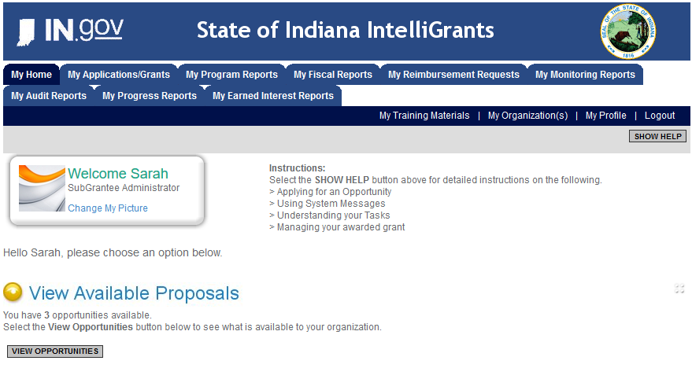

Slide 19
Intelligrants Application

Slide 20
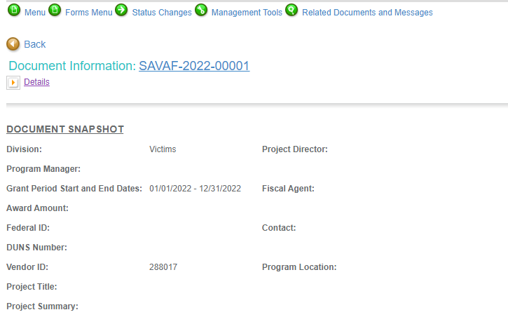
Notes:
To access the different components of the application you will need to navigate to the forms menu.

Slide 21
Forms that need to be completed:
Contact
Project Information
Programmatic Information
Problem Statement & Analysis
Goals, Objectives, & Outcomes
Program Descriptions
Evidence Based/Best Practices
Use of Volunteers
Budget
Budget Narrative
Attachments

Slide 22
Contact
Points of Contact for the grant (CJI will notify these individuals of your award notice)
Project Information
SAMs Registration must be up-to-date
Audit
If you receive more than $750,000 in federal grant funds, you are required to have an audit. This will be requested if CJI is aware that you receive more than $750,000.
Programmatic Information
Information about your proposed program
Problem Statement & Analysis
All government agency’s audits are included in the County audit and should all have one attached
Forms to be Completed (continued)

Slide 23
Goal, Objective, and Outcomes
The goal should directly address the problem identified in the Problem Statement.
Objectives are the steps needed to achieve goals. Objectives should be concrete, action-oriented, measurable and Specific, Measurable, Achievable, Realistic, Timely (SMART).
Example of Objective: By September 2022, a minimum of 50 culturally and linguistically appropriate support groups for survivors of sexual assault will be provided.
Outcomes measure objectives and are criteria for how the program is deemed to be effective.
Example of Outcome: 85% of participants will indicate that they have learned ways to act in their own best interest.
Program Description
What? Who? Where? Why? When? How?
Evidence Based/Best Practice
Use of Volunteers
Forms to be Completed (continued)

Slide 24
All grants from ICJI Victim Services are reimbursement grants, which means that agency must first incur the expense prior to CJI reimbursing for the expense. Verification of expenses along with verification of payment of expenses must be provided to ICJI on a monthly or quarterly basis prior to reimbursement of expenses by ICJI.
No match required for SASP or SAVAF
Important Notes

Slide 25
Ineligible Budget Items
Administrative costs over 10% of the total grant budget
(2) Direct financial assistance to a client such as cash, gift cards, or checks
(3) Food and beverages
(4) Lobbying and/or fundraising
(5) Immigration fees
(6) Purchase of real estate,
(7) Construction,
(8) Physical modification to buildings, including minor renovations (such as painting or carpeting),
(9) Vehicles,
(10) Fuel

Slide 26

Budget Narrative
Be sure all items in the Budget are included in the Budget Narrative.
  Ex: Office Supplies (copy paper, pencils, pens)
Grant reviewers are not required to contact you for clarification.
Any missing information in this section may disqualify that budget item for funding.

Slide 27

Attachments Required:
Total Agency Budget
  Found on ICJI’s website (https://www.in.gov/cji/victim-services/resources/) – Nonprofit Applicant Budget Form
Sustainability Plan
  Your plan to maintain the program once the grant funds expire
Timeline
  Outlining the completion of the project/ or expenditures of the grant funds
Letters of Endorsement
  For this program specifically
Miscellaneous
  Job Descriptions for any position listed in personnel
  If applicable any contracts
  EEOP Certification

Slide 28
For technical assistance contact the ICJI Helpdesk at CJIHelpDesk@cji.in.gov. Help Desk hours are Monday – Friday, 8:00 am to 4:30 pm ET, except state holidays.
ICJI is not responsible for technical issues with grant submission within 48 hours of grant deadline.
For assistance with any other requirements of this solicitation, please contact The Victim Services Division at ICJI.

Slide 29

Questions?

Slide 30
Thanks for attending!
Presenter:
Max Brown, Victim Services Program Specialist
maxbrown@cji.in.gov
317-232-2927

