Slide 1
2024 SASP & SAVAF RFP Webinar
September 25, 2023

Slide 2
Thanks for joining us today: Please keep your lines muted during the presentation. Webinar is being recorded and will be posted on the ICJI website. Questions and Answers at the end. Feel Free to utilize the chat box during the webinar.

Slide 3
Accessing the RFP’s
In.gov/cji → Victim Services → Sexual Assault Services Project (SASP) → 2024 SASP RFP
In.gov/cji → Victim Services → Sexual Assault Victims Assistance Fund (SAVAF)→ 2024 SAVAF RFP
https://www.in.gov/cji/victim-services/sasp/
https://www.in.gov/cji/victim-services/sexual-assault-victim-assistance-fund/

Slide 4
2024 SASP (Sexual Assault Services Program) Violence Against Women Formula Grant Application
Application opened: September 20th, 2023
Application closes: October 30th, 2023
Applicants are strongly encouraged to submit applications 48 hours prior to the deadline.
Award period for SASP: January 1, 2024, to December 31, 2024 (12-month award period)
Projects should begin on January 1, 2024, and must be in operation no later than 60 days after this date. Failure to have the funded project operational within 60 days from January 1, 2024, will result in the cancellation of the grant and the de-obligation of all awarded funds.

Slide 5
SASP Overview:
The Sexual Assault Services Program (SASP) was created by the Violence Against Women and Department of Justice Reauthorization Act of 2005, 34 U.S.C. § 12511. The program directs grant dollars to states to assist them in supporting rape crisis centers and nonprofit, nongovernmental organizations that provide core services, direct intervention, and related assistance to victims of sexual assault.

Slide 6
SASP Funding Eligibility
Eligible applicants include:
Nonprofit, nongovernmental rape crisis centers
Nonprofit, nongovernmental dual programs that provide sexual assault and domestic violence services
Governmental entity rape crisis (or dual) centers.
The entity may not be part of the criminal justice system (such as a law enforcement agency) and must be able to offer a comparable level of confidentiality
Faith-based organizations
Other state, local public, and nonprofit agencies such as mental health or counseling centers or other programs that have staff specifically trained to serve victims of Sexual Assault
Other Requirements include:
Registered UEI
Active and current registration with SAM.gov
Good standing with the Department of Revenue (DOR), Department of Workforce Development (DWD), and Secretary of State (SOS)

Slide 7
SASP Purpose Areas
Funds under this program must be used to provide intervention and related assistance to:
Adult, youth, and child victims of sexual assault;
Family and household members of such victims; and
Those collaterally affected by the victimization, except for the perpetrator of such victimization
Funds under this program must be used to support the establishment, maintenance, and expansion of rape crisis centers and other nongovernmental or tribal programs and activities that provide direct intervention and related assistance to individuals who have been victimized by sexual assault, without regard to the age of individual.
Intervention and related assistance may include:
24-hour hotline services providing crisis intervention services and referral
Accompaniment and advocacy through medical, criminal justice, and social support systems, including medical facilities, police, and court proceedings
Crisis intervention, short-term individual and group support services, and comprehensive service coordination and supervision to assist sexual assault victims and family or household members
Information and referral to assist sexual assault victims and family or household members
Community Based, culturally specific services and support mechanisms, including outreach activities for underserved communities; and
Development and distribution of materials on issues related to the services described above

Slide 8
SASP Allowable Activities and Costs The activities and associated costs for the activities below are allowable
24-hour hotline services providing crisis intervention services and referral;
Accompaniment and advocacy through medical, criminal justice, and social support systems, including medical facilities, police, and court proceedings;
Crisis intervention, short-term individual and group support services, direct payments, and comprehensive service coordination and supervision to assist sexual assault victims and family or household members;
Information and referral to assist sexual assault victims and family or household members;
Community-based, culturally specific services and support mechanisms, including outreach activities for underserved communities; and
Development and distribution of materials on issues related to the services described above.
Equipment or supplies, applicant shall reveal in application and budget narrative whether they are purchasing, renting, or leasing all listed and proposed equipment or supplies. The applicant shall comply with 2 C.F.R. § 200.216 and 2 C.F.R. § 200.217 when renting, purchasing, or leasing any telecommunications, video surveillance systems and service, or equipment. The applicant shall comply with 2 C.F.R. § 200.465 regarding the lease and or rental of real property and equipment

Slide 9
SASP Allowable Activities and Costs Cont.
Direct payments to victims and their family or household members must be for costs related to the sexual assault. OVW encourages payments are paid to vendors directly. Examples of costs that direct payments may cover include, but are not limited to:
Replacement bedding, clothing, or other household items;
Securing new or temporary housing, including paying a security deposit, first month’s rent, or moving expenses;
Travel expenses;
Childcare expenses;
Food, including culturally appropriate food;
Utility assistance (other than utilities in arrears): and
Security measures such as re-keying locks, replacing a cell phone, or purchasing a motion detector

Slide 10
2024 SAVAF (Sexual Assault Victims Assistance Fund) State Grant Application
Application opened: September 19th, 2023
Application closes: October 25th, 2023
Applicants are strongly encouraged to submit applications 48 hours prior to the deadline.
Award period for SAVAF: January 1, 2024, to December 31, 2025 (24-month award period)
Projects should begin on January 1, 2024, and must be in operation no later than 60 days after this date. Failure to have the funded project operational within 60 days from January 1, 2024, will result in the cancellation of the grant and the de-obligation of all awarded funds.
Notes:
NEW 2 year award period

Slide 11
The Sexual Assault Victim Assistance Fund (SAVAF) was created to:
Establish and maintain rape crisis centers (RCC),
Enhance services provided by existing rape crisis centers, and
Develop, implement, and expand trauma informed sexual assault services. SAVAF was established pursuant to Indiana Code § 5-2-6-23 and is funded by the collection fees assessed under Indiana Code § 33-37-5-23.
SAVAF OVERVIEW

Slide 12
SAVAF Funding Eligibility
Eligible applicants include the following that provide services to victims of sexual assault:
Public social service entities
Nonprofit organizations
Nongovernmental organizations who provide services to victims of sexual
Other Requirements include:
Registered UEI
Active and current registration with SAM.gov
Good standing with the Department of Revenue (DOR), Department of Workforce Development (DWD), and Secretary of State (SOS)

Slide 13
SAVAF Allowable Activities and Costs
Allowable activities and costs are those that support the operations and services delivered to victims of sexual assault statewide. These activities include:
24-hour crisis line and 24-hour on-call advocate to respond onsite to hospitals and other locations where a victim presents.
Direct services to victims including informational and referral services, advocacy, legal advocacy, and case management.
Counseling or therapy services for victims including support groups.
Emergency flexible funding for victims including, but not limited to, emergency transportation, shelter, clothing, and food. Note: Funds may not be used as a direct payment to any victim, thus the sexual assault program would have to pay the cost directly to a third-party vendor. Subrecipients should have an established policy in place to make these funds available to all program participants; to ensure these funds meet a reasonable, basic need.
Expenses associated with providing services to victims including travel, phones, interpretation, equipment, printing of materials, and training costs.
Overtime for grant funded staff is an allowable cost, but to claim the increased rate, there must be a separate line item in the budget that includes the overtime rate of pay.

Slide 14
Priority Areas
SASP
SAVAF
Priority will be given to programs that can and will promote civil rights (including by meeting the needs of underserved and marginalized survivors), improve access to justice for survivors, and enhance survivor safety.
The priority area of funding will be given to establish and maintain rape crisis centers that are providing trauma informed sexual assault services and are meeting the components of a rape crisis center.

Slide 15
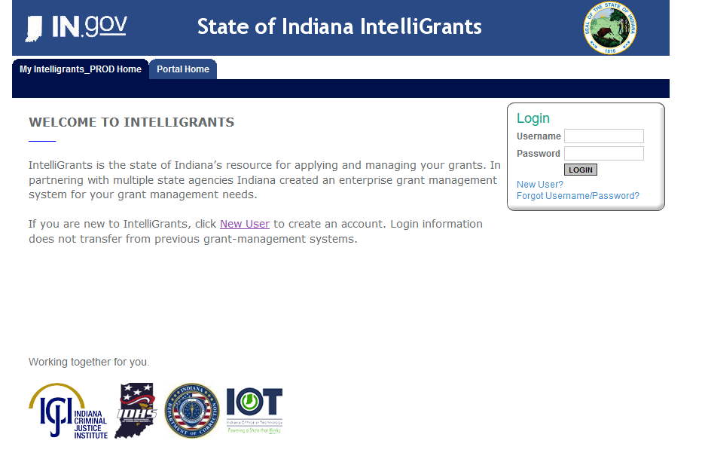
Initiating an application in IntelliGrants
https://intelligrants.in.gov

Slide 16
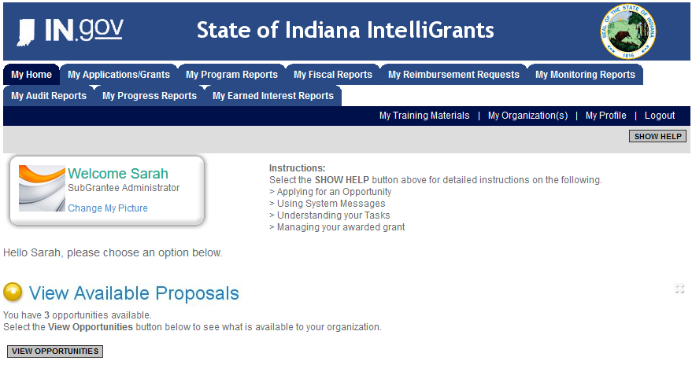
Steps to initiating an application
Log into your IntelliGrants account
If you do not have an account, then you can obtain one on the home screen of IntelliGrants (New User?)
On the “MY HOME” page access the “VIEW AVAILABLE PROPOSALS” section
Click on VIEW OPPORTUNITIES
IntelliGrants will take you to the My Opportunities page
Access the 2024 SASP Grant and/or 2024 SAVAF
Select “Apply Now”

Slide 17
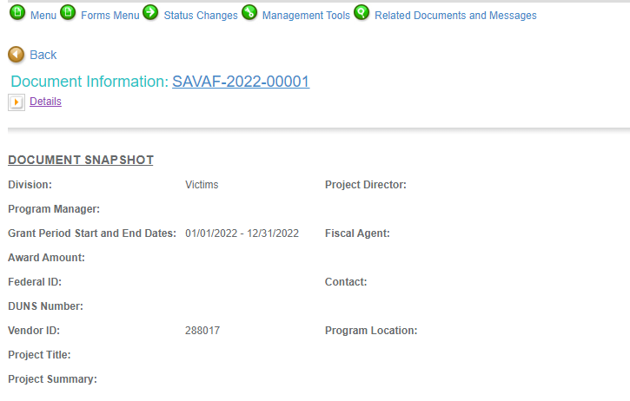
Forms that need to be completed
Contact
Project Information
Programmatic Information
Problem Statement & Analysis
Goals, Objectives, & Outcomes
Program description
Evidence Based/Best Practices
Use of Volunteers
Budget
Budget Narrative
Attachments

Slide 18
Contact
Points of Contact for the grant (CJI will notify these individuals of your award notice)
Project Information
SAMs Registration must be up-to-date
Audit
If you receive more than $750,000 in federal grant funds, you are required to have an audit. This will be requested if CJI is aware that you receive more than $750,000.
Programmatic Information
Information about your proposed program
Problem Statement & Analysis
All government agency’s audits are included in the County audit and should all have one attached

Slide 19
Goal, Objective, and Outcomes
The goal should directly address the problem identified in the Problem Statement.
Objectives are the steps needed to achieve goals.
Example of Objective: By September 2022, a minimum of 50 culturally and linguistically appropriate support groups for survivors of sexual assault will be provided.
Outcomes measure objectives and are criteria for how the program is deemed to be effective.
Example of Outcome: 85% of participants will indicate that they have learned ways to act in their own best interest.
Program Description
What? Who? Where? Why? When? How?
Evidence Based/Best Practice
Use of Volunteers
Objectives should be concrete, action-oriented, measurable and Specific, Measurable, Achievable, Realistic, Timely (SMART).

Slide 20
Budget Narrative
Be sure all items in the budget narrative are included in the Budget Narrative.
Ex: Office Supplies (copy paper, pencils, pens)
Grant reviewers are not required to contact you for clarification
Any missing information in this section may disqualify that budget item for funding.
Attachments Required
Total Agency Budget (TAB)
Complete TAB (NON PROFIT/NON GOVERNMENTAL) Located: (https://www.in.gov/cji/victim-services/resources/)
Sustainability Plan
Plan to maintain program once the grant funds expire
Timeline
Outlines completion of project/or expenditures of grant funds
Letters of Endorsement
Letters endorsing this program specifically
Miscellaneous
Job descriptions for any position listed in personnel
EEOP Certification
Determination of Suitability (SASP Applicants)
If applicable, attach other requested information

Slide 21
New In IntelliGrants

Slide 22
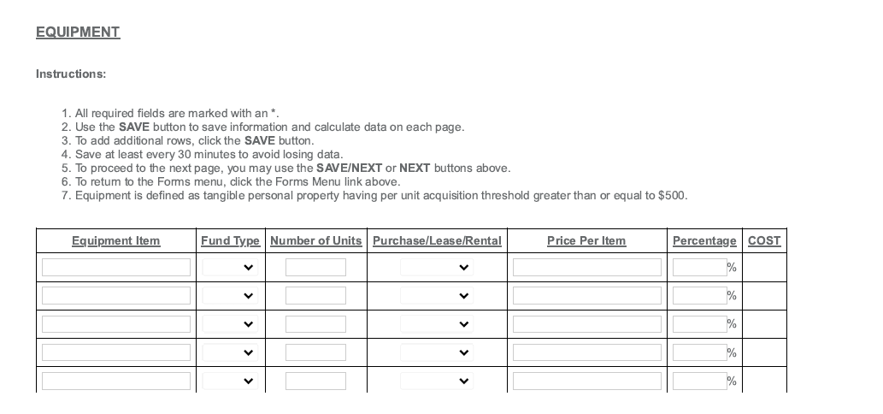
New in IntelliGrants: Equipment
In the Equipment form, there is a new question that has a drop-down box – options include purchase, lease, rental.
Notes:
In the Equipment form, there is a new question that has a drop-down box – options include purchase, lease, rental.

Slide 23
New in IntelliGrants: Budget Narrative

Slide 24
IMPORTANT NOTES
All grants from ICJI Victim Services are reimbursement grants, which means that the agency must first incur the expense prior to CJI reimbursing for the expense. Verification of expenses along with verification of payment of expenses must be provided to ICJI on a monthly or quarterly basis prior to reimbursement of expenses by ICJI.
No match required for SASP or SAVAF
SAVAF is a 2-year grant cycle, therefore the budget must include Year 1 and Year 2 after every expense.

Slide 25
For technical assistance contact the ICJI Helpdesk at CJIHelpDesk@cji.in.gov. Help Desk hours are Monday – Friday, 8:00 am to 4:30 pm ET, except state holidays.
ICJI is not responsible for technical issues with grant submission within 48 hours of grant deadline.
For assistance with any other requirements of this solicitation, please contact The Victim Services Division at ICJI.

Slide 26
Contact Info:
Dalayna Anderson, Victim Services Program Specialist
DaAnderson1@cji.in.gov

