Slide 1

New Administrators Training Session 5
Personnel Name Changes and Project Modifications (PMR’s)

Slide 2
A few things to keep in mind for this Webinar:
Please keep your lines muted during the presentation.
The Webinar is being recorded. It will be posted on the CJI Website.
Question and Answers at the end.
Feel free to utilize the chat box during this webinar, we are monitoring the questions.

Slide 3
Grant Management Directive 3
Grant Management Directive 3 which was revised on December 27, 2021 discusses both Personnel Name Changes and Project Modifications. The Grant Management Directives can be found by going to the CJI website and into the Grantee Training, Resources and Policies link midway down the Home Page.
You can click on the Grant Management Directives at the top of the page or scroll down a little way on the Grantee Training, Resources and Policies page. There are 7 Grant Management Directives which are important to review and understand, however the one we are discussing for the purposes of the PMR’s and Personnel Name Changes is Directive 3.

Slide 4
Personnel Name Changes
As is described in the Grant Management Directive 3, an agency must notify their grant manager in writing, within 10 days of the new grant related staff person start date. Then the agency must create a Personnel Name Change as soon as the feature is available.
The new employee must have the same job title and duties as the grant related employee who left the position. If the new employee is making the same or lower salary or hourly rate as the former grant related person, then a Personnel Name Change can be created. If the new employee’s salary or hourly rate is higher than the former grant related person, a PMR must be completed by the subgrantee to capture not only the change in employee but also the new rate of pay.
The Notification of CJI AND the Name Change or PMR MUST be completed prior to the submission of the first fiscal report where the subgrantee is seeking reimbursement for the new employee.

Slide 5
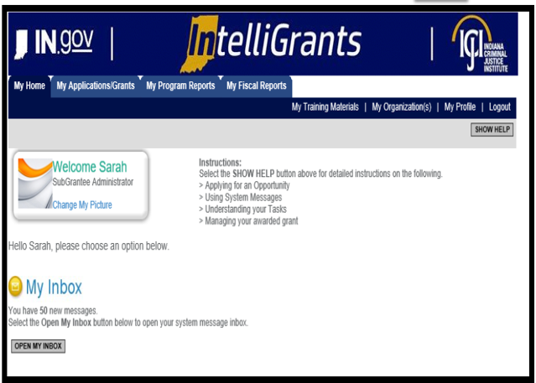
How to Initiate a Personnel Name Change
As a refresher we will go over how to access your grant in IntelliGrants.
Once logged in, you should see the following screen:

Slide 6
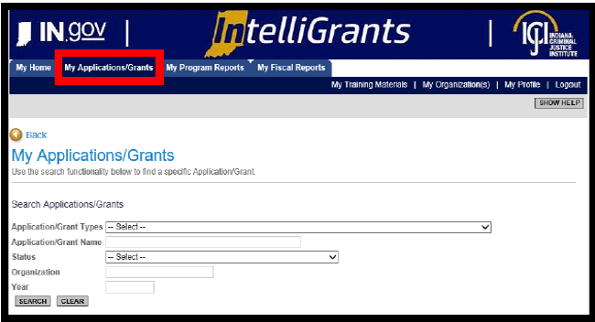
Accessing your Grant
There are two ways to access your grant:
#1 – Navigating to “My Applications/Grants” (tab at the top of the screen)

Slide 7
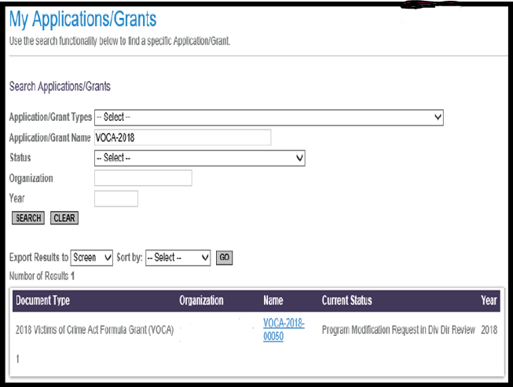
Accessing your Grant
Once you have clicked on “My Applications/Grants” then utilize the search fields to find a particular grant. SUGGESTION: Clear out fields first (Click on CLEAR button) as IntelliGrants keeps results of your last search in the fields.
Example: clear out the search fields (clicked CLEAR button) then type in the grant number you are wanting to review, VOCA-2018. After you have either utilized the Application/Grant Type or Application/Grant Name then click SEARCH.

Slide 8
Accessing your grant
To review the grant, you will want to click on the Grant Name. For this example, it would be, VOCA – 2018 – 00050. This should take you to the Document Snapshot Page.

Slide 9
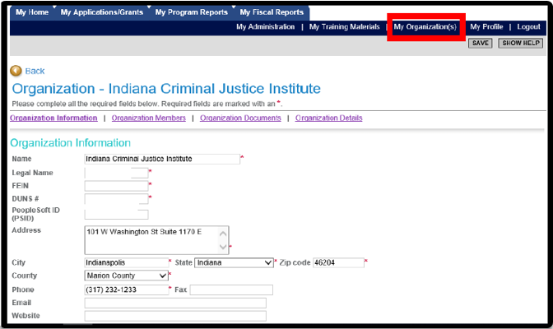
Accessing your Grant
#2 – Utilizing the “My Organization” feature (right side of screen)

Slide 10
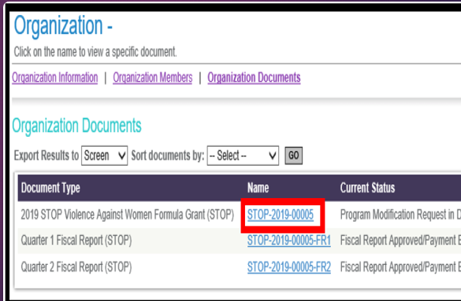
Accessing your Grant
Once you have selected “My Organization” then you should see your agency’s information prepopulate. To navigate to a grant select “Organization Documents”.
“Organization Documents” should pull up all the documents that your organization has initiated. You will want to select the grant you wish to initiate a Personnel Name change to.
Example: Make sure you select the Grant Name. Once you click on the Grant name it will take you to that Grant’s “Document Snapshot” page.

Slide 11
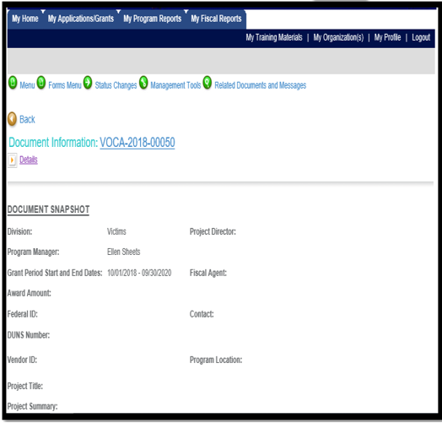
Requesting a Personnel Name Change
Once you have reached the Document Snapshot page of your grant, please follow the instructions below to request a Personnel Name Change:

Slide 12
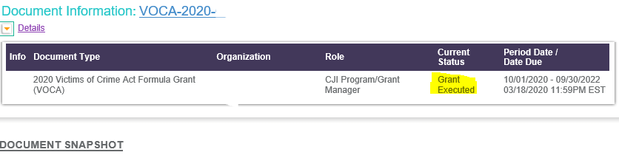
Requesting a Personnel Name Change
Step 1: Check to make sure your Grant is in “Grant Executed” Status. This status allows you to request a personnel name change. If it is in any other status this option will not be available to you. To check your status click on the “details” button at the top of the document snapshot screen. You can locate which status your grant is in under the “status” column.

Slide 13
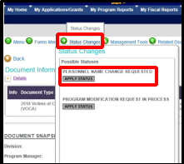
Requesting a Personnel Name Change
Step 2: Once you have confirmed your grant is in “Grant Executed” status then you can navigate to the Status Changes button (green button at the top of document snapshot). You can hover over this button and you will see two options, Personnel Name Change Requested and Program Modification Request in Process. Select “Apply Status” under Personnel Name Change Requested.

Slide 14
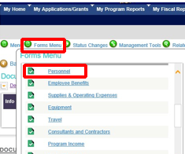
Requesting a Personnel Name Change
Step 3: After changing the status of the document, the name fields on the personnel form can be edited. This form is located under the Forms Menu.

Slide 15
Requesting a Personnel Name Change
Step 4: Modify the lines that need to be edited.
  NOTE: You must include end date for the employee that is leaving and start date for the employee taking over that position. Also, please follow the personnel name change 10 day rule!
  Example of Name Change:
  Bobby Bee (left 3/25/2020); John Smith (start 4/21/2020)
  or
  Suzy Que (left 9/20/2019); John Smith (10/1/2019-4/1/2020); Jane Smith (start 4/21/2020)

Slide 16
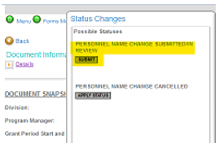
Requesting a Personnel Name Change
Step 5: After updating the Personnel form, click the SAVE button at the top of the screen and save all your changes.
Step 6: Go to the Employee Benefits Page, click the SAVE button at the top of the screen (no changes will be made to this page, however IntelliGrants pulls information from the Personnel Page and must ensure this page is also updated).
Step 7: Hover over the Status Changes button and select SUBMIT under “Personnel Name Change Submitted/In Review”.

Slide 17
Requesting a Personnel Name Change
After you submit, your request will be sent to your assigned Grant Manager. If you encounter any issues while completing a personnel name change, please reach out to your Grant Manager or the CJI HelpDesk.
NOTE: If you created a name change by mistake you can cancel the Personnel Name Change Request by accessing the Status Changes button and select APPLY STATUS under Personnel Name Change Cancelled.

Slide 18
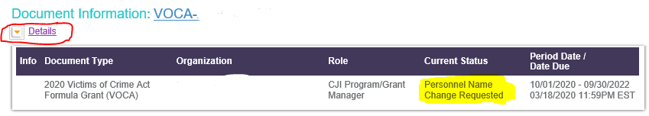
How to verify the Personnel Name Change was submitted
To check the status of your Personnel Name Change you can click on the purple Details hyperlink and it will show you the status of the grant.
In the Current Status box you will see in this example it says Personnel Name Change Requested. This means it has not yet been submitted. Even if you clicked the submit button there are times that it will not submit due to some sort of error. This error could be not saving the benefits page or a different error. Check the orange octagon at the top of the page with the hand in the center to see the error.

Slide 19
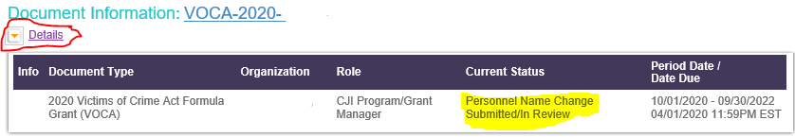
How to verify the Personnel Name Change was submitted
When the Personnel Name Change is submitted the Current Status is Personnel Name Change Submitted/In Review.
If you have difficulty submitting your Personnel Name Change, please contact your Grant Manager.

Slide 20
Personnel Name Changes
A few things to know:
  If you create a Personnel Name Change AFTER a Fiscal Report has been created then the changes made on the Personnel Name Change will not show on the already created fiscal report, they will show and the next fiscal report.
  The Only column you will be able to change on the Personnel Name Change is the name column. It will not allow you to make changes in job title or salary/hourly rates.
  You can only seek reimbursement for a new person AFTER their name is showing on the fiscal report.

Slide 21
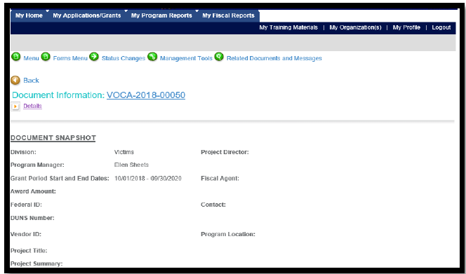
How to Create a Project Modification or PMR
You will search for the grant you want by using the steps on the first few slides of this PowerPoint.
Once you are on the Document Snapshot page, Please follow these instructions to request a Program Modification.

Slide 22
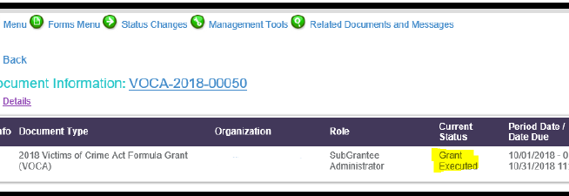
How to Create a Project Modification or PMR
Only the Subgrantee Administrator and Subgrantee Project Director are able to initiate a Program Modification Request. The Grant must be in Grant Executed status to start the Program Modification Request process. (Use previous instructions to determine what status the grant is in)

Slide 23
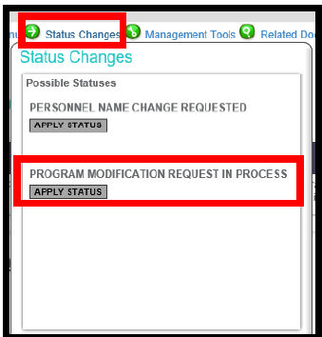
How to Create a Project Modification or PMR
Step 1: Navigate to the Status Changes link (green button at top of screen) – hover over the link and you will see the following two options. Select APPLY STATUS under Program Modification Request in Process.

Slide 24
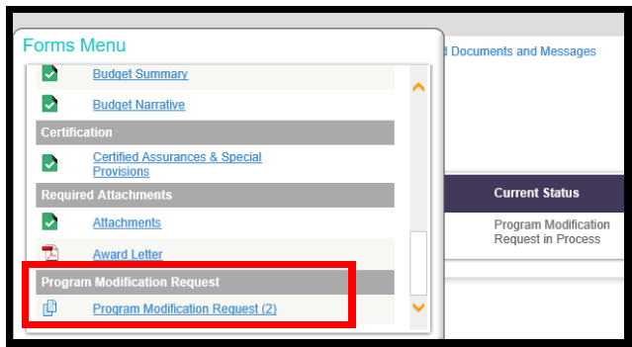
How to Create a Project Modification or PMR
Step 2: Once you have applied the status your grant will be moved to Program Modification Request in Process. You will need to find your way to the Program Modification Request form – which can be found under the Forms Menu.
NOTE: If this is not your first PMR, there will be a number (2, 3, 4, etc) you will need to click on the most recent number to edit the form.

Slide 25
How to Create a Project Modification or PMR
Step 3: Fill out the Program Modification Request Form for the modifications you wish to complete. You will need to select the Budget Revision or Change of Scope checkbox and any other checkbox that corresponds to what you are wanting to do, or you will not have access to edit those pages. A Justification text box will then appear above the attachments where you will explain with as much detail as possible what you are wanting to modify. You may also attach anything that will help explain your justification; i.e. job description, budget changes, lease, etc.

Slide 26
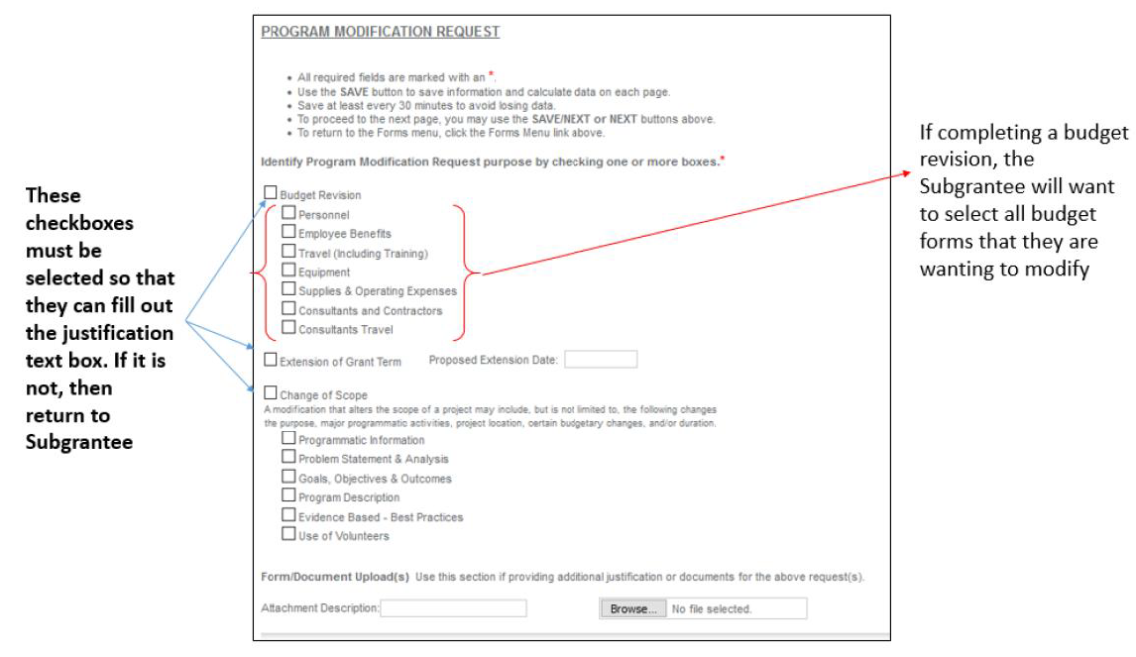

Slide 27
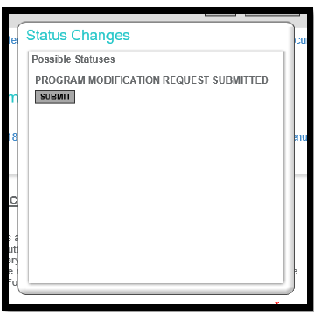
How to Create a Project Modification or PMR
NOTE: At this point in the PMR, you will not be able to edit your budget forms or any other form. You must submit your justification to CJI for approval before you can complete this step.
Step 4: After you have filled out the program modification request form, click the SAVE button at the top of the page. Once you have saved your changes, navigate to the STATUS CHANGES button and click SUBMIT under Program Modification Request Submitted.

Slide 28
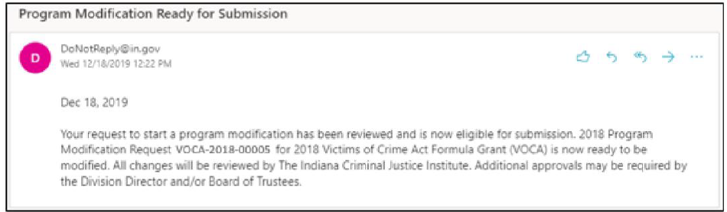
How to Create a Project Modification or PMR
Step 5: Once submitted your Modification Request will be sent to your assigned Grant Manager, they will review your request. Your grant manager will either approve it, return the justification for additional explanation or deny the request.
  NOTE: You will receive notifications from IntelliGrants if it is approved, denied, or sent back for modifications.
Step 6: If the justification is approved, then you will receive an email stating you may now modify the forms that you selected on your Program Modification Request Form.

Slide 29
How to Create a Project Modification or PMR
Step 7: At this stage, the appropriate budget and/or programmatic pages can be modified to reflect the modification. After completing the modifications, click the Apply Status button under the Status Changes link.
Helpful Tips:
  Your award amount and match amount must match the amount on your Signed Grant Agreement. This can be found on the budget summary form.
  You can only move up to 10% of grant funds per PMR.
  Do not move items that you did not mention in your justification.

Slide 30
How to Create a Project Modification or PMR
Helpful Tips continued:
  Do not move more than what you have expended on a certain line item. If you do this it will cause that line to go into the negative on your next fiscal report and you will have to complete another PMR. You can view the amount expended by looking at your latest submitted fiscal report.
  Once you are finished making changes, IntelliGrants will make you re-save the Budget Summary form and Budget Narrative. If you do not save these after you have made all your changes then you will receive a global error.

Slide 31
How to Create a Project Modification or PMR
Step 8: Once you have submitted your modifications, your assigned grant manager will review all the changes made and take the changes to the Victim Services Division Director. The Victim Services Division Director will either send it back for modifications, approve the modifications, or deny your request.
Step 9: After your Modification has been approved your grant status will be “Grant Executed.” At this time, you will be able to initiate and submit a program/fiscal report or personnel name change.

Slide 32

QUESTIONS?

