Slide 1
New Administrators Training
Session 4
Program Reporting

Slide 2
A few things to keep in mind for this Webinar:
Please keep your lines muted during the presentation.
The Webinar is being recorded. It will be posted on the CJI Website.
Question and Answers at the end.
Feel free to utilize the chat box during this webinar, we are monitoring the questions.

Slide 3
Frequency of Reporting
The frequency of fiscal and program reporting is determined by the subgrantee agency during the grant approval process.
Options for reporting frequency are monthly or quarterly
Once you have selected the reporting frequency option it cannot be changed during the grant period.
Reporting dates for a subgrantee with monthly reports are the 20th of the month following the reporting period.
Reporting dates for a subgrantee with quarterly reports is the 20th of the month following the quarter.

Slide 4
Reporting Frequency Quarterly Reports with due dates
Quarterly Reports with a grant that starts 10/1
PR1 due 1/20 Period 10/1 – 12/31
PR2 due 4/20 Period 1/1 – 3/31
PR3 due 7/20 Period 4/1 – 6/30
PR4 due 10/20 Period 7/1 – 9/31
One-year grants will have 4 Quarterly reports and Two-year grants will have 8 Quarterly reports.
Monthly and Quarterly reports are based off the months/quarters in the Grant period not based on a calendar year or fiscal year.

Slide 5
Reporting Frequency – Monthly reports with due dates
PR1 due 11/20 Period 10/1 – 10/31
PR2 due 12/20 Period 11/1 – 11/30
PR3 due 1/20 Period 12/1 – 12/31
PR4 due 2/20 Period 1/1 – 1/31
PR5 due 3/20 Period 2/1 – 2/28
PR6 due 4/20 Period 3/1 – 3/31
PR7 due 5/20 Period 4/1 – 4/30
PR8 due 6/20 Period 5/1 – 5/31
PR9 due 7/20 Period 6/1 – 6/30
PR10 due 8/20 Period 7/1 – 7/31
PR11 due 9/20 Period 8/1 – 8/31
PR12 due 10/30 Period 9/1 – 9/31
For 1-year grants there will be 12 fiscal reports and for 2-year grants there will be 24 fiscal reports.

Slide 6
How To initiate a Program report Once logged in, you should see the following screen. This would be your home screen for Intellirants.

Slide 7
There are two ways to access your Grant
The first way is to go to My Applications/Grants

Slide 8
Accessing your Grant
Once you have clicked on My Applications/Grants then utilize the search fields to find a specific grant. Suggestion: clear out fields first (click on Clear button) as IntelliGrants keeps results of your last search in the fields.
Example on next page. All search fields were cleared and then we selected a grant to open, VOCA-2018. After utilizing either the line Application/Grant Type or Application/Grant Name and then Search.

Slide 9
Accessing your Grant To review the grant, you will want to click on the grant name. For example it would be VOCA-2018-00050. This will take you to the document snapshot page.

Slide 10
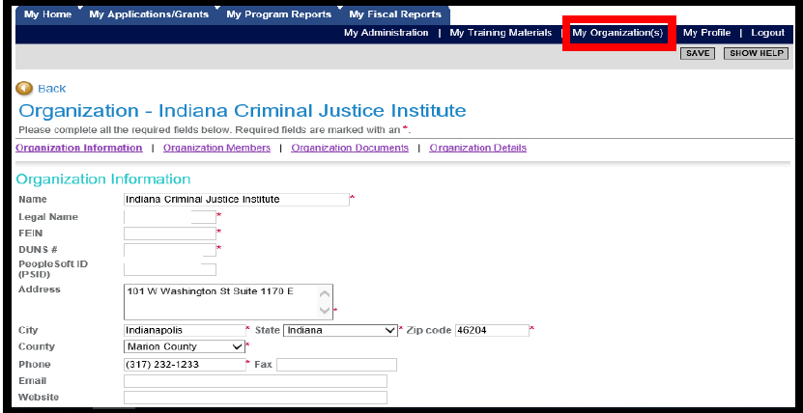
Accessing your grant
The second way you can access your grant is by using the My Organization page on the upper right side of the screen.

Slide 11
Accessing your Grant
Once you have selected My Organization then you should see your agency’s information prepopulate. To navigate to a particular grant select Organization Documents.
Organization Documents will pull up all the documents that your agency has initiated. You will want to select the specific grant for which you wish to initiate a report.

Slide 12
Accessing your Grant
Make sure you select the Grant Name. Once you click on the Grant name it will take you to that Grant’s Document Snapshot page.

Slide 13
Initiating a Program Report
Once you have reached the Document snapshot page, follow the next set of instructions to initiate the Program report.

Slide 14
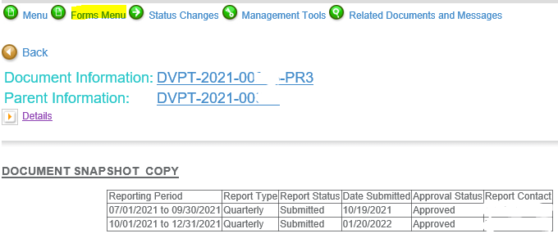
Program Reports
To access the Program Report forms from the document snapshot page, you go up to forms menu which is the second green button at the top of the page. Hover over or click this and the two program report forms will show.

Slide 15
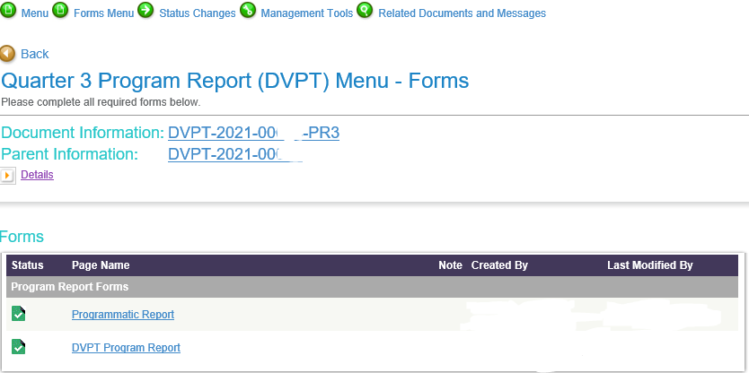
Program Reports
The two Program Report forms are the Programmatic Report and the Program Report.

Slide 16
Program Reports
Program Reports are much shorter than Fiscal Reports and depending on the funding source there can be several questions or very few questions on the second page of the report.
The first page of the Program Report is the Programmatic Report and the top part of this report is like the Financial Accounting and Claim form for the Fiscal Reports. It has the Project start and end dates, the dates for the reporting period and the date the program report was submitted and the date it was due.

Slide 17
Programmatic Report Form

Slide 18
Programmatic Report Form
The middle section of the Programmatic Report form asks for updates on the GOALS, OBJECTIVES AND OUTCOMES for the grant that were written when the application was submitted.
This information should be detailed enough for us to be able to tell exactly how far along the agency is in meeting the Goal, Objective or Outcome. Objectives are required to be measurable therefore we should see information that provides the current measure of each objective. Many times, Outcomes are measurable as well so we should be able to tell the current measure of the outcome as well, if it was measurable.
Be sure to only report information based on the goals, objectives and outcomes listed in the application. If you have new projects you want to share then please email your grant manager with this information.

Slide 19
Programmatic Report
The last section of the Programmatic Report form asks if there were any barriers/issues encountered in the reporting period. If there were then a narrative box will open so you can describe the barriers/issues and then you are asked if there is anything that CJI can do to assist.
There is another question that asks if this is your Final program Report. If it is the final report then another page will populate which will ask you to provide additional information regarding the entire grant period. You will only mark Yes when it is the last program report for the grant.
There is an option to attach documents to the bottom of the Programmatic Report form. This is not required but if you have anything that you would like us to see about your program then feel free to attach the document.

Slide 20
Program Report
One question that is asked in each of the program reports is: How many victims did your program serve this quarter/month?
Please note that this question is talking about how many victims did the FUNDED program serve during the time frame and not how many victims did the Agency serve.
Additionally, please ensure that the number of victims throughout the Program Report is consistent. If there is an objective/outcome related to the number of victims your agency served, then ensure that number is consistent with the number of victims listed on the second page. Same with demographic information, that should be consistent as well.

Slide 21
Program Report
It is recommended that if your agency has had grants with CJI before to either print a previous Program Report for the funding source so that you can see what questions are asked or just read one of the previous reports. You may need to reach out to your CJI Grant Manager for help with this as there may be an issue or two that will need to resolved for you to access those reports.
Program Reports ask different questions depending on the funding source so a FVPSA ARP program Report will not be the same as a VOCA program Report. The Programmatic Report page will be the same, all discuss the Goals, Objectives and Outcomes. However, the Program Report page will be different for most grant fund sources.

Slide 22
Additional tips for Program Reports
Only include activities that are funded by the grant source in the narrative sections. For example, do not include fund raising events, team building retreats or social events. If you would like to share this information with CJI then please email the information to your Grant Manager or put it in the attachment section of the Program Report.
If including any stories about victims, please do not put any personal information that could identify them.
Unlike the Fiscal Reports, you do not have to wait for the previous Program Report to be approved before submitting the next one.

Slide 23
Questions?
If you have questions as you are completing your program reports, please feel free to reach out to your grant manager. We are all willing to assist in any way we can, and we understand that learning grant management is very difficult and confusing. Do not be concerned about bothering your grant manager, this is what we are here for, to help.

