Slide 1
New Administrator Training Session 1
Indiana Criminal Justice Institute
Who we are and what we do

Slide 2

What is the indiana criminal justice institute?
The Indiana Criminal Justice Institute (ICJI) is the State planning agency for criminal justice, juvenile justice, traffic safety and victim services. The institute develops long-range strategies for the effective administration of Indiana’s criminal and juvenile justice systems and administers state and federal funds to carry out these strategies.

Slide 3

What does ICJI do?
Through the use of evidence-based decision making, ICJI works to improve the efficiency of the criminal justice system, from call for service through post-conviction. The agency accomplishes this by bringing together key leaders from the criminal justice system at the state, local and national levels to identify critical issues facing Indiana. The agency evaluates policies, programs and legislation designed to address these issues.
ICJI is designated as the State Administering Agency for distribution of federal funds, and as the State Statistical Analysis Center for research.

Slide 4
What does ICJI do? (con’t)
ICJI has several divisions, of which Victim Services, is one. Other divisions include Behavioral Health, Drug and Crime and Traffic Safety which all provide funding for programming within their respective areas of expertise.
Research and Planning is another division within ICJI. They serve as the research team for the State Administering Agency, utilizing strategic planning to analyze crime trends, evaluating the priorities of all segments of the criminal justice system, setting out a plan for reducing crime and victimization, and guiding the use of grant funds. The team also serves as the Indiana Statistical Analysis Center, conducting objective analyses informing policy and practice at the state and local levels.

Slide 5

What does ICJI Do? (Con’t)
The Indiana Criminal Justice Institute manages the Indiana Victim Compensation Program, which works to reduce the impact of crime on victims’ lives. The program was established to reimburse victims (or their dependents), who have suffered physical injury, for certain costs incurred as a result of a violent crime. Expenses include but are not limited to: medical bills, mental health counseling, lost wages, childcare services, attorney fees and funeral expenses, up to a certain amount. Additional information can be found on the ICJI website.

Slide 6
What does ICJI do? (con’t)
ICJI’s Regulatory Compliance Division is responsible for ensuring that ICJI’s partners comply with all relevant Federal, State and agency-specific laws, rules and regulations governing the grant funds that ICJI awards. ICJI does this through policy creation and distribution, training opportunities, and on- and off-site monitoring reviews.
When there is a misuse of grant funds or one of the entities that ICJI provides funding to is out of compliance with the pertinent requirements, the Regulatory Compliance Division is responsible for seeking repayment of the relevant amounts, and in certain circumstances, referring issues to the Department of Justice and/or the Indiana Office of Inspector General to conduct further investigations.

Slide 7
How does the Victim Service division get grant funds and where do the funds come from?
Victim Services receives grant funds from Federal and State sources. We have seven main funding sources, five which are Federal funds and two that are State funds. At various times there may be more than one grant effective at a time within these main funding sources. These grants have different grant periods, start/end dates, application periods and qualifications.
Federal Funding:
FVPSA- Family Violence Prevention Services Act
VOCA- Victims of Crime Act
STOP- Services, Training, Officers, Prosecutors Grant
SASP- Sexual Assault Services Program
SSBG- Social Services Block Grant

Slide 8
How does the Victim Service division get grant funds and where do the funds come from? (Con’t)
State Funding:
DVPT- Domestic Violence Prevention and Treatment Grant
SAVAF-Sexual Assault Victims Assistance Fund

Slide 9
Family Violence Prevention Services Act (FVPSA)
The FVPSA program is the primary federal funding stream dedicated to the support of emergency shelter and related assistance for victims of domestic violence and their children. The purpose of the program is to:
(1) assist states in efforts to increase public awareness about, and primary and secondary prevention of, family violence, domestic violence, and dating violence;
(2) assist states in efforts to provide immediate shelter and supportive services for victims of family violence, domestic violence, or dating violence, and their dependents.
FVPSA is a program under the U.S. Department of Health and Human Services Family and Youth Bureau, an office of the Administration for Children and Families.

Slide 10
Family Violence Prevention Services Act (FVPSA)
Through the American Rescue Plan (ARP), CJI has received supplemental FVPSA funding to help organizations prevent, prepare for and respond to the COVID-19 pandemic.
FVPSA ARP: Supplemental funding to prevent, prepare for and respond to COVID-19.
FVPSA ARP SA: Supplemental funding to support Sexual Assault survivors across Indiana. The purpose is to:
(1) to assist with the transition to virtual/remote services for rape crisis centers, sexual assault programs and culturally specific programs that provide crisis and support services and assistance to sexual assault survivors and
(2) to support the increased emergency needs of sexual assault survivors as a result of the COVID-19 public health emergency.

Slide 11
Victims of Crime Act (VOCA)
Funded by the U.S. Department of Justice Office for Victims of Crime (CFDA: 16.575), the purpose of the VOCA grant program is to provide high quality services that directly improve the health and well being of victims of crime across the state and nation. “Crime Victim” is defined as a person who has suffered physical, sexual, financial, and/or emotional hardship as the result of the commission of a crime.
For the purpose of these program’s guidelines, services are defined as those efforts that:
Respond to the emotional, psychological, and/or physical needs of crime victims:
Assist victims to stabilize their lives after victimization:
Assist victims to understand and participate in the criminal justice system; and
Restore a measure of safety and security for the victim.
Notes:
CFDA = Catalog of Federal Domestic Assistance

Slide 12
Services, Training, officers, Prosecutors (STOP)
Funded by the U.S. Department of Justice Office on Violence Against Women, the STOP Violence Against Women Formula Grant Program aims to develop and strengthen the criminal justice system’s response to violence against women and to support and enhance services for the victims. The program encourages community partnerships between law enforcement, prosecution, courts and victim services organizations to enhance victim safety and hold offenders accountable in cases of domestic violence, dating violence, sexual assault and stalking.
STOP Formula Grant Program for Law Enforcement- Limited to Law Enforcement activities only. This grant supports communities in their efforts to develop and strengthen effective responses to sexual assault, domestic violence, dating violence and stalking.

Slide 13
Sexual Assault Services Program (SASP)
Funded by the U.S. Department of Justice Office on Violence Against Women, SASP works to support rape crisis centers and nonprofit, nongovernmental organizations that provide core services, direct intervention and related assistance to victims of sexual assault in Indiana. Rape crisis centers and other nonprofit organizations, such as dual programs providing both domestic violence and sexual violence intervention services, play a vital role in assisting sexual assault victims through the healing process, as well as assisting victims through the medical, criminal justice, and other social support systems.

Slide 14
Social Services Block Grant (SSBG)
The SSBG program works to assist residential domestic violence programs in providing emergency shelter to survivors of domestic violence and their dependents.
Priority is given to non-profit private organizations that, as their primary purpose, operate shelters or provide counseling, advocacy and self-help services to victims of family violence, domestic violence, and dating violence and their dependents.

Slide 15
Domestic Violence Prevention and Treatment Grant Program (DVPT)
The DVPT Grant Program was created by the Indiana General Assembly in 1992 to support Indiana’s domestic violence centers, offer domestic violence training for service providers and expand services to treat and prevent domestic violence.

Slide 16
Sexual assault victim assistance fund (SAVAF)
The SAVAF program aims to provide a comprehensive statewide response for victims of sexual assault. Funding is awarded to
Establish and maintain rape crisis centers
Enhance services provided by existing rape crisis centers and,
Develop, implement, and expand trauma informed sexual assault services.

Slide 17
What is an RFP? Where is the RFP located?
For the purposes of an ICJI grant, an RFP is a Request for Proposal or a document that announces a grant, describes the requirements and provides critical information about the grant or application to those agencies who may be interested in applying.
RFPs are located on the ICJI website: www.in.gov/cji/
On the home page of the ICJI Website, scroll down toward the bottom of the page and you will see the open grants available, and you can also click into the open solicitations box just above the open grants section.
You can print or save these RFPs for your records. However, they will remain on the CJI website if you need to refer to it later.

Slide 18
What can you find on ICJI’s Website?
On the ICJI website you can find information about all the divisions within ICJI
Within the Victim Services section of the website, you can find information about the specific grants managed by the Victim Services Division as well as a section called Training Webinars. In this section there are general Training videos and RFP webinars. The first video on this page is Grant writing for Victim Service Grants. This New Administrator video series will be found in this same section of the CJI Website. With the training videos, there are also PowerPoint documents that can be printed and there are also Q&A documents for some of the videos.
Also, in the Victim Services section of the website down at the bottom of the page there are two sections one titled Online Services, and the other is Resources. In the Resources box, there is a link for forms. These are forms needed for the application as well as example of time sheets and instructions with forms.

Slide 19
What can you find on ICJI’s Website? (con’t)
ICJI’s Policies and Grant Management Directives as well as required training can be found on the home page of the ICJI website and toward the bottom of the page in Grantee Training, Resources & Policies.
Various reports that the Research Division completes as well as dashboards for various grants that reflects quarterly reports entered by subgrantees.
There is a link to IntelliGrants on the home page of the ICJI website at the bottom of the page along with a link to Register someone in IntellIGrants and the Subgrantee User Manual for IntelliGrants.

Slide 20
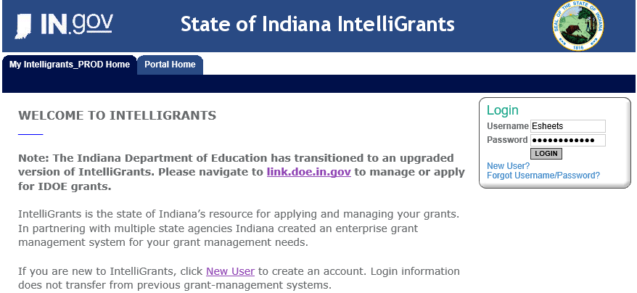
IntelliGrants
How to use and how to access your grant
Website for IntelliGrants: https://intelligrants.in.gov/login2.aspx

Slide 21
IntelliGrants- LogIN Problems
If you forget your password, you can reset it yourself by clicking Forgot Username/Password.
You will have to input the email that is associated with your account.
You will receive an email with a temporary password.
NOTE: YOU HAVE TO TYPE IN THE TEMPORARY PASSWORD –COPY AND PASTING IT WILL NOT WORK!
If this approach does not work than feel free to reach out to your Grant Manager or CJI’s Helpdesk (cjihelpdesk@cji.in.gov).

Slide 22
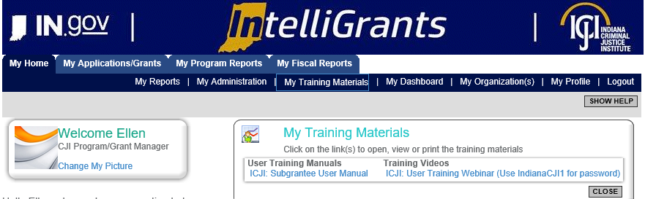
IntelliGrants Training Materials

Slide 23
Notes:
This is the home screen, it will have your name at the top, available proposals, my inbox and My tasks

Slide 24
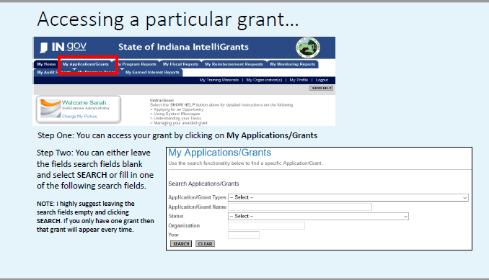

Slide 25
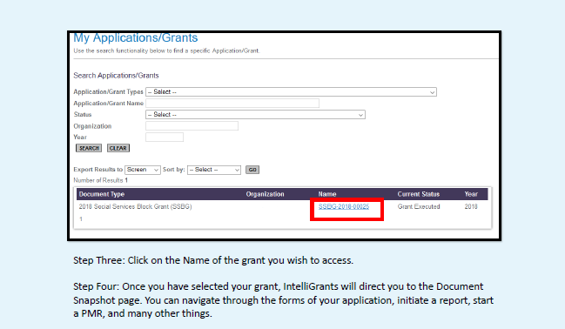

Slide 26
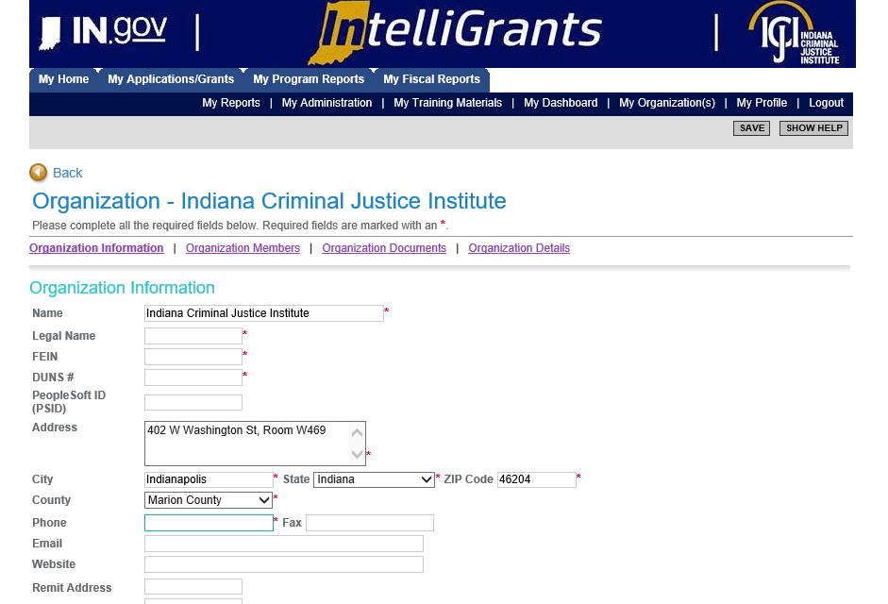
Another way to access Agency Grants and information
Once My Organization is opened there are additional links including Organization Members and Organization Documents.
Organization members is where staff who will be doing reporting and writing the applications will be added to have access to the grants.
Organization documents is where all the grants are listed and all fiscal and program reports that are approved are located.

Slide 27
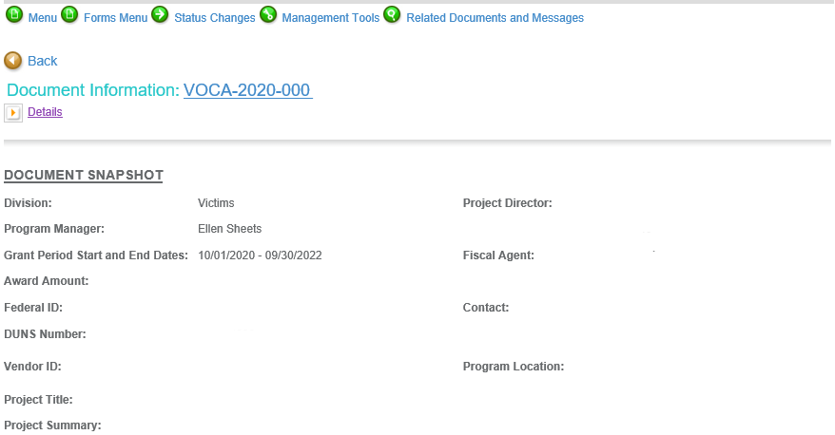
Accessing a Grant
Once the grant hyperlink is selected then the first page that will come up is the Document Snapshot form, which is a summary of the grant and your agency information.

Slide 28
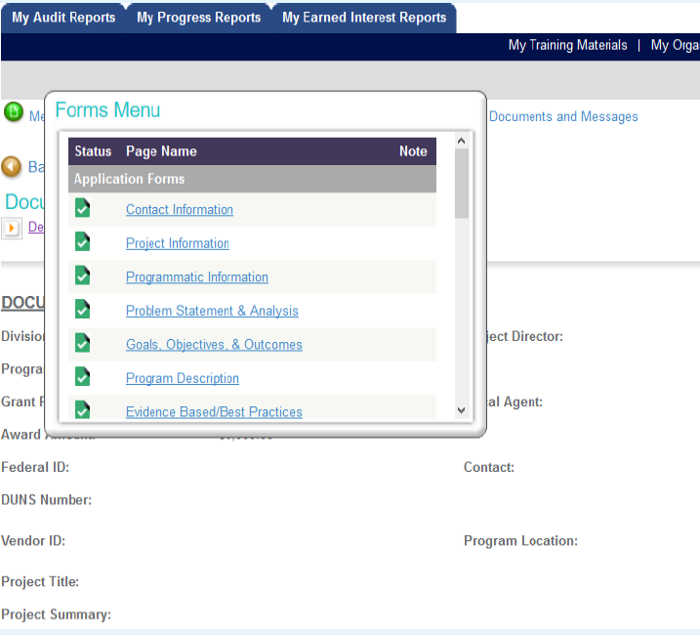
Navigating through IntelliGrants
Forms Menu: The forms menu is where most of the work is completed within IntelliGrants. This section contains the forms from your application.

Slide 29
Forms Menu options
Application Forms
Contact information
Project information
Programmatic Information
Problem Statement & Analysis
Goals, Objectives, & Outcomes
Program Description
Evidence Based Practices
Use of Volunteers

Slide 30
Forms Menu Options (Con’t)
Budget Forms
Personnel
Employee Benefits
Supplies & Operating Expenses
Equipment
Travel
Consultants and Contractors
Program Income
Budget Summary
Budget Narrative

Slide 31
Forms Menu options (con’t)
Certified Assurances & Special Provisions- is completed during application but no further work is required in this section other than the agency understanding the assurances signed and the special provisions required.
Required Attachments- If there are required attachments missing during the application process you will be asked to attach them during the Application Modification step before the grant can be processed through the approval process.
Program Modification Request- This will be discussed at length in Session 5, but this is the section that will be used once the grant is executed and any significant changes need to be made to the grant such as moving grant funds from one line item to another, adding of a line item in any section of the budget, etc.

Slide 32
Forms Menu options (con’t)
Contract- Not much will be needed in this section, however during the grant approval process there is one section that will need to be updated.
There is a hyperlink in the Forms menu at the bottom for Grant Agreement. During the grant approval process agencies will be asked to go into this section and select if they want to complete fiscal and program reports monthly or quarterly.
Contract Status- Once the grant is executed and a copy of the executed grant is put on the Indiana Transparency Portal, then you should be able to find a copy of the entire grant agreement in the Contract Status section of the Forms menu. If the executed copy is not there, please contact your ICJI Grant Manager for assistance.

Slide 33
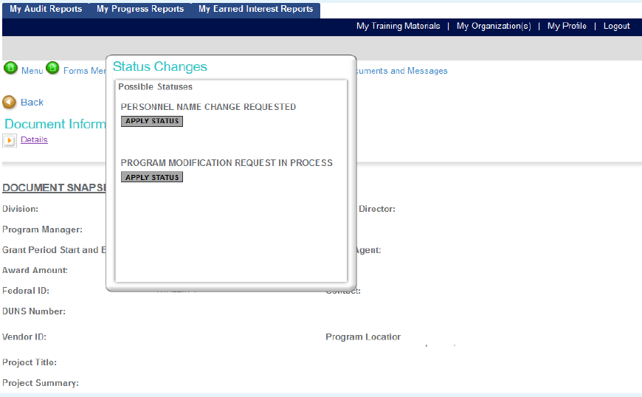
Navigating Through IntelliGrants
Status Changes: In the status change section there will be different options depending on what is being done in the grant at the time. We will discuss status changes when completing a fiscal or program report in a different session.
The Status Changes section allows a Subgrantee Administrator or Subgrantee Project Director to change the status at any given time.

Slide 34
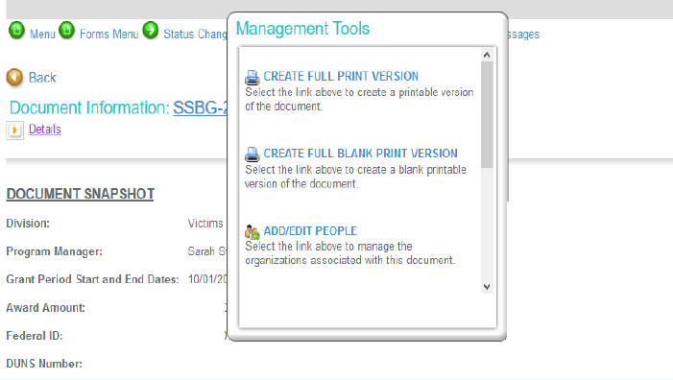
Navigating through IntelliGrants
Management tools: The Management Tools section allows a Subgrantee Administrator and/or Subgrantee Project Director certain administrative responsibilities.
Create full print version: create printable version of your application
Create full Blank Print Version: create a blank printable version of an application.
Add/Edit People: Manage the people who have access to your agency’s grant
Status History: View the status history of your application
Check for errors: Check the entire document for errors
Attachment Repository: View attachments in the application

Slide 35
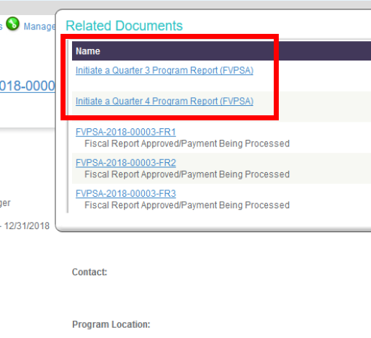
Navigating through Intelligrants
Related Documents and Messages:
The Related Documents and Messages section is where documents such as Program Reports, Fiscal Reports and related messages are found.
It is also used to initiate documents such as Fiscal and Program Reports.

Slide 36
What are the additional sessions going to be about?
Session 2: What happens after applications are submitted?
In this session we will discuss what happens after the grant application is submitted, what happens once an agency is awarded funds, what is expected after a grant is executed through the end of the grant.
Session 3: Fiscal Reporting
Session 4: Program Reporting
Session 5: Making changes to the grant

Slide 37

Presenter Contact information
Ellen Sheets Esheets1@cji.in.gov

Slide 38

Questions?

