Slide 1


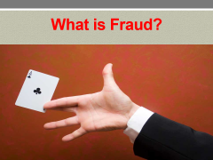
United States Department of Justice Office of the Inspector General
GRANT FRAUD
AWARENESS
Jason P. LeBeau
Special Agent
(773) 571-0633

Slide 2

What is Fraud?

Slide 3


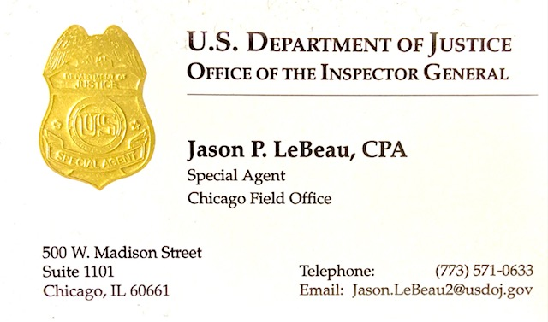


Special Agent Jason P. LeBeau
Special Agent, DOJ-OIG (2021-Present)
Special Agent, FDIC-OIG (2014-2021)
Special Agent, IRS-CI (2001-2014)
Tax Accountant, Arthur Andersen (2001)

Slide 4
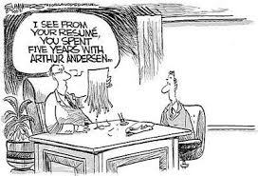
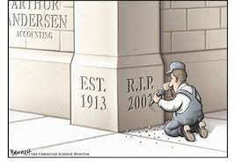
Did You Say Arthur Andersen?

Slide 5
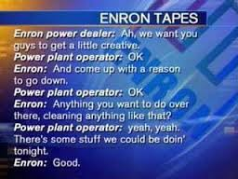
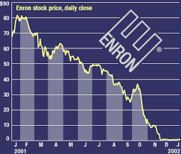
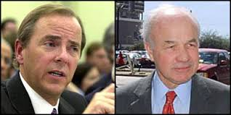
ENRON: What Exactly Happened?
“What is the difference between California and the Titanic? At least when the Titanic went down, the lights were on”
– Jeffrey Skilling during an Enron employee meeting

Slide 6
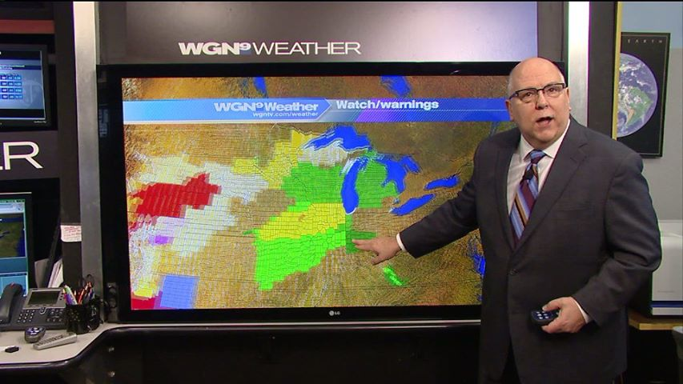

Slide 7
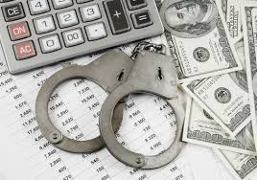
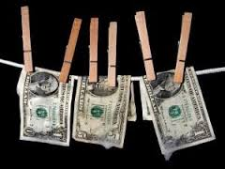

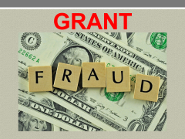
Investigations
Bank Fraud
Money Laundering
Tax Evasion
Financial Reporting Fraud
Terrorist Financing
Embezzlement
Wire/Mail Fraud
Drug Trafficking
Unlawful Money Structuring
Employee Misconduct

Slide 8
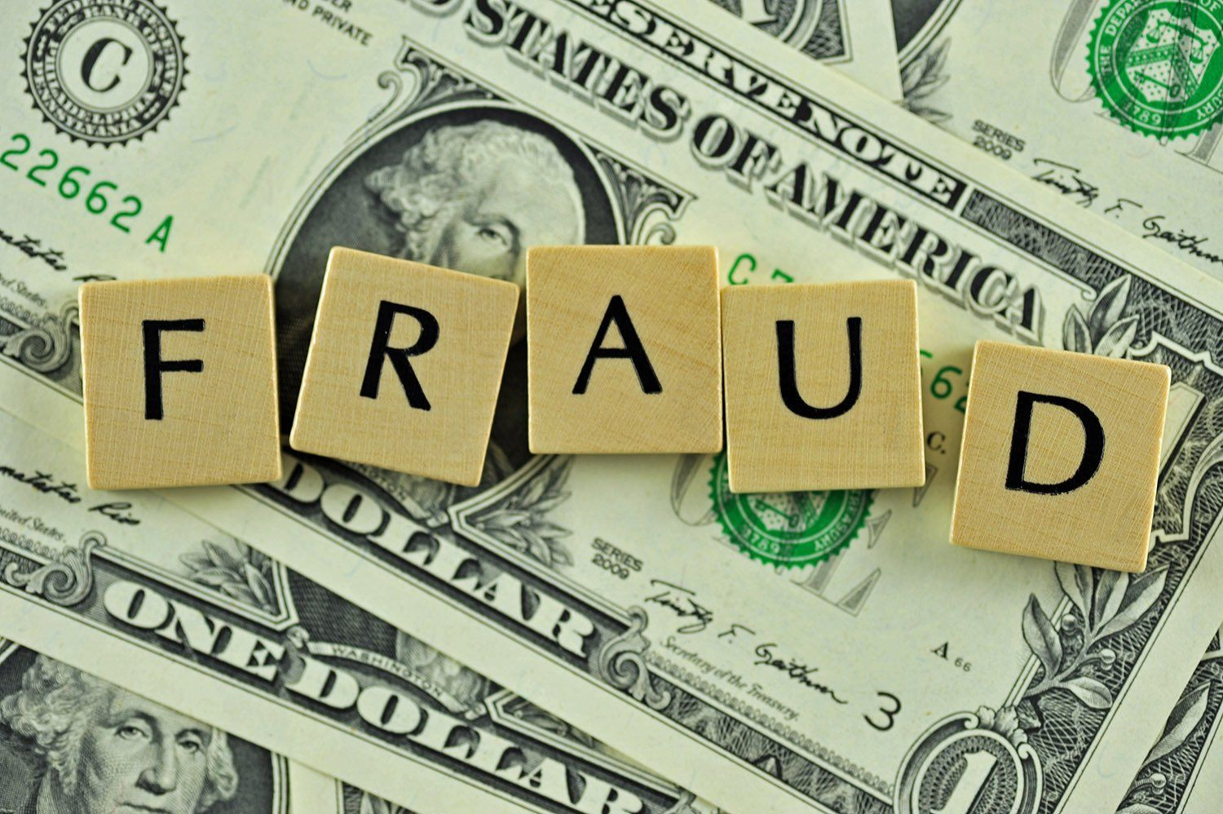
GRANT

Slide 9
What is DOJ-OIG?
The DOJ-OIG has the responsibility and authority to investigate fraud, waste, and abuse related to DOJ employees and programs.
The mission is to promote integrity, efficiency, and accountability within the Department of Justice.

Slide 10
How Does the U.S. DOJ Apply to Me?
The non-federal entity, or applicant, for a federal award must disclose, in a timely manner, and in writing, to the federal awarding agency all violations of federal criminal law involving fraud, bribery, or gratuity violations potentially affecting the federal award. Failure to make required disclosures can result in a variety of remedies including suspension or debarment.

Slide 11

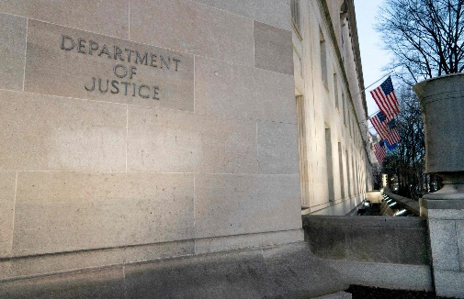



DOJ Grant Agencies

Slide 12
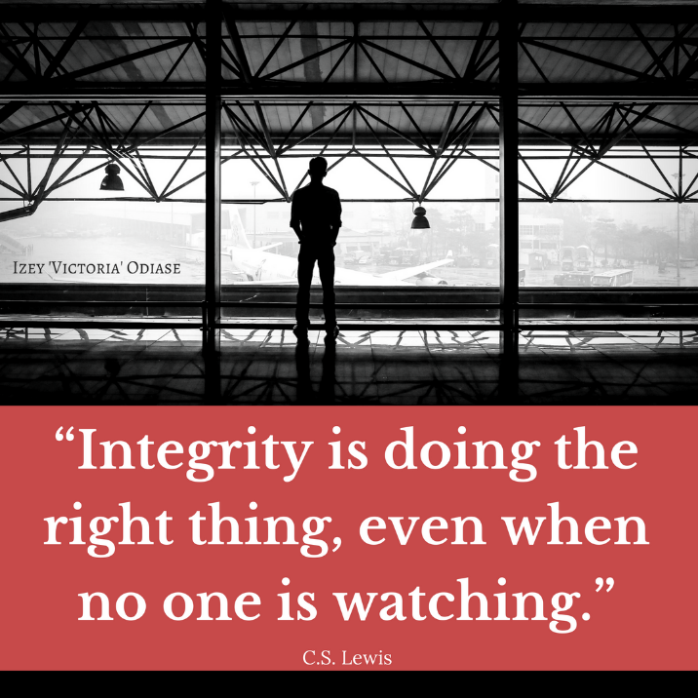

What is Grant Fraud?
Grant funds are awarded for specific purposes and grantees must use them accordingly & follow the rules.
Grant Fraud = Lying, Cheating, or Stealing anywhere in the process.

Slide 13
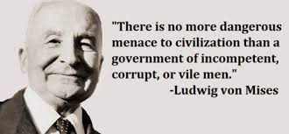
Incompetent or Corrupt?
Mistakes Negligence Fraud

Slide 14

Fraud Consequences
Mistakes Negligence Fraud

Slide 15
Red Flags
Large dollar grants awarded
Directors involved in multiple related organizations
Charging expenses that are for future grant project phases
Multiple grants having only one bank account
Grantees being awarded multiple similar grants from different entities
Heavy reliance on consultants
Grantees keeping two sets of books
Executive director serving for exceptionally long period
An uninvolved grantee board of directors
Grantee documents sent to locations different than the grantee location
Unexplainable expenditures or deposits
Vagueness in grant expense documentation
Lack of segregation of duties/responsibilities
Lack of financial controls
Lack of supervision by the agency issuing the grant
Employees with financial or other personal problems

Slide 16
Red Flags
Failure to produce a ledger or simple financial records
All the grant funds being used (zeroing the grant funds)
Avoiding/delaying audit or site visit
Failure to conduct the grant work
Signs of the grantee failing to pay bills or incurring a tax debt
Unusual performance results
Loss of personnel by the grantee (especially financial personnel)
Complaints of grant performance that contradict grantee’s reports
Sudden change of venue by the grantee
Unusual close friendships/family between grantees and consultants
Gifts being sent to your staff
Routine expenditures consistently varying in cost
Soliciting donations for same purpose as grant funds
Employees having a similar for-profit business as the grantee org Excessive trust in the organization’s management

Slide 17

Why People Obey the Law
In his book, Why People Obey the Law, Tom Tyler studies two types of law-abiding people:
Instrumental Perspective
Normative Perspective
Voluntary Compliance is the Goal!

Slide 18
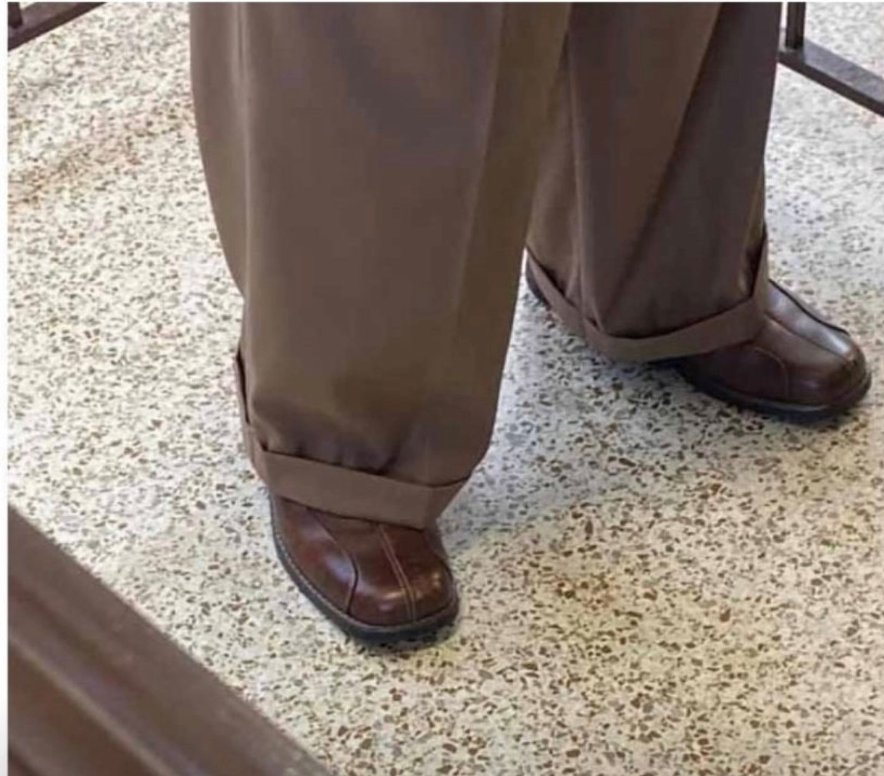
Fraud Prevention Policy

Slide 19
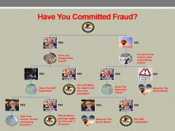
Fraud Prevention Policy
1) Increase the Perception of Detection
2) Have a Written Ethics Policy
3) Have a Written Disciplinary Policy
4) Identify Areas that are Most Vulnerable to Fraud
5) Conduct Surprise Audits
6) Have Zero Tolerance for Fraud
7) Educate Employees on Anti-Fraud Practices
8) Conduct Fraud Assessments with Employees
9) Ensure Anonymous Ways for People to Report Fraud
10) Use Analytical Review Procedures
11) Develop Plans to Mitigate Fraud Risks
12) Comply with Laws, Regulations, and Professional Standards
13) Think Like a Fraudster

Slide 20
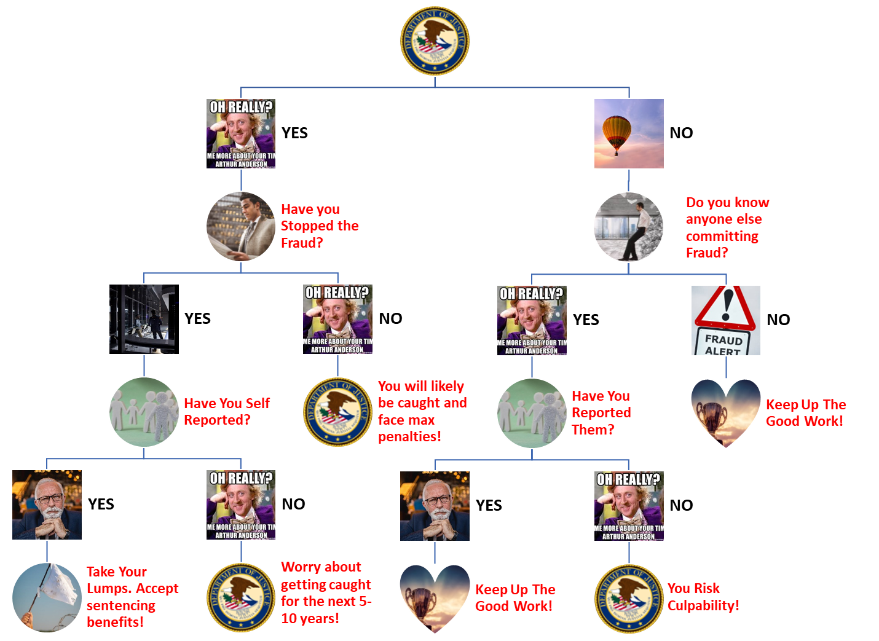
Have You Committed Fraud?

Slide 21
Federal Sentencing Guidelines
Loss Amount | Level | Sentence in Months | Zone | Zone Meaning
(A) $6,500 or less | 6 | 0-18 | A | Allows Probation
(B) More than $6,500 | 8 | 0-24 | A | Allows Probation
(C) More than $15,000 | 10 | 6-30 | B | Allows Home Confinement
(D) More than $40,000 | 12 | 10-37 | C | Allows Split Sentence
(E) More than $95,000 | 14 | 15-46 | D | Imprisonment
(F) More than $150,000 | 16 | 21-57 | D | Imprisonment
(G) More than $250,000 | 18 | 27-71 | D | Imprisonment
(H) More than $550,000 | 20 | 33-87 | D | Imprisonment
(I) More than $1,500,000 | 22 | 41-105 | D | Imprisonment
(J) More than $3,500,000 | 24 | 51-125 | D | Imprisonment
(K) More than $9,500,000 | 26 | 63-150 | D | Imprisonment
(L) More than $25,000,000 | 28 | 78-175 | D | Imprisonment
(M) More than $65,000,000 | 30 | 97-210 | D | Imprisonment
(N) More than $150,000,000 | 32 | 121-262 | D | Imprisonment
(O) More than $250,000,000 | 34 | 151-327 | D | Imprisonment
(P) More than $550,000,000 | 36 | 188-405 | D | Imprisonment

Slide 22
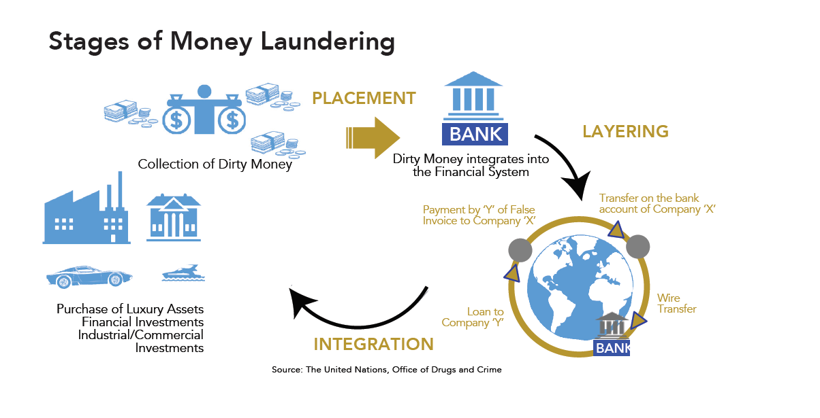
Money Laundering

Slide 23
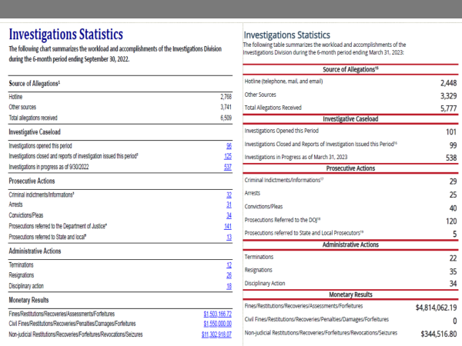

Slide 24
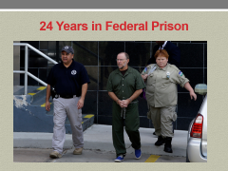
Hypothetical Future Value Video

Slide 25
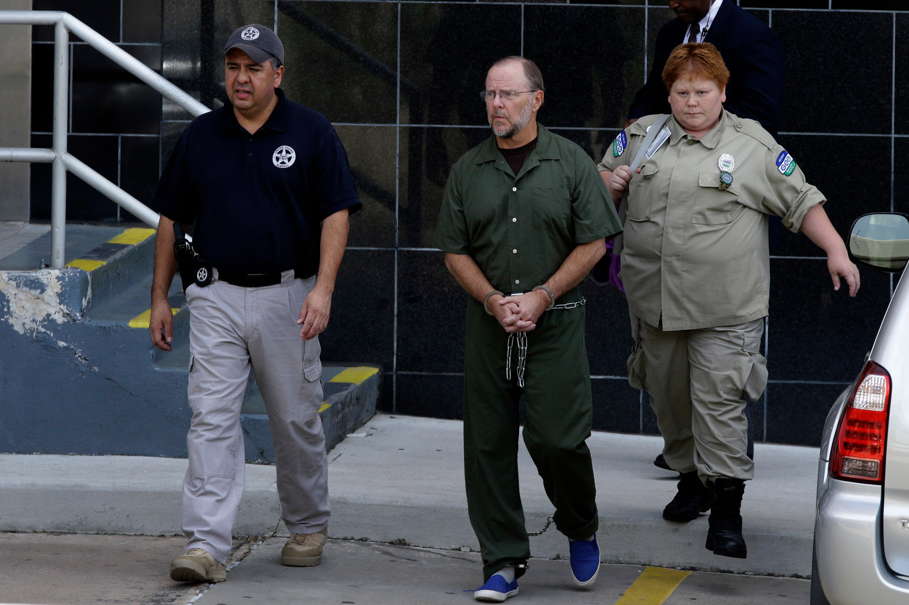
24 Years in Federal Prison

Slide 26

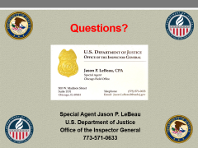
Communicate Your Concerns
Share your concerns related to fraud, waste, and abuse of Department of Justice funds with us. We will investigate!
Our goal is to ensure every program is successful, funds are used as effectively and efficiently as possible, and is free of fraud, waste, and abuse.

Slide 27


Questions?
Special Agent Jason P. LeBeau
U.S. Department of Justice
Office of the Inspector General
773-571-0633

