Slide 1
2022-2024 FVPSA ARP Testing RFP Webinar
July 14, 2022

Slide 2
Thanks for joining us today: Please keep your lines muted during the presentation. Webinar is being recorded. It will be posted on the ICJI website. Questions and Answers at the end. Feel Free to utilize the chat box during the webinar.

Slide 3
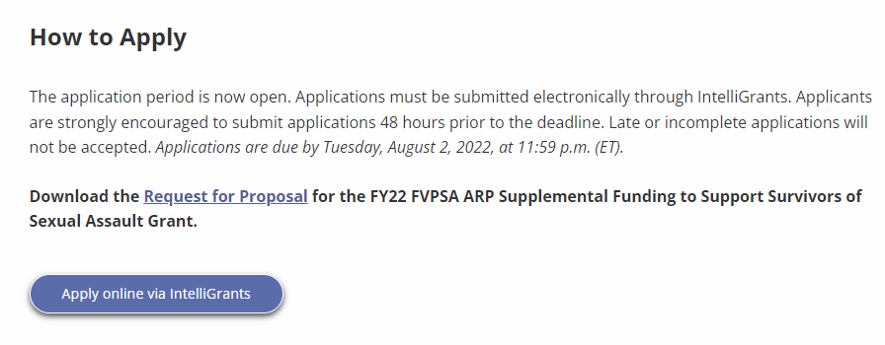
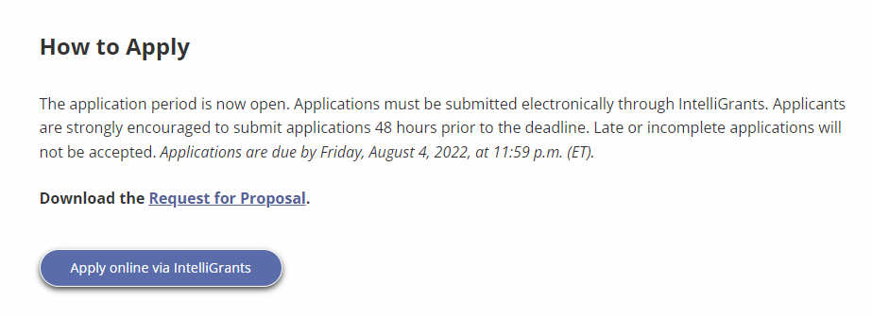
Accessing the RFP
Located on ICJI Website
CJI.in.gov → Victim Services → Family Violence Prevention Services Act (FVPSA) grant → FVPSA ARP (COVID-19 Testing) → Request for Proposal
https://www.in.gov/cji/victim-services/family-violence-prevention-and-services-act/american-rescue-plan-supplemental-grant-for-covid-19/

Slide 4
2022-2024 FVPSA ARP Testing Grant Application
Application opened: Friday, July 1st at 2:00 PM
Application closes: Tuesday, August 4th at 11:59 PM
Applicants are strongly encouraged to submit applications 48 hours prior to the deadline.
Award Period for FVPSA-Testing: October 1, 2022 to September 30, 2024 (24-month award period)
Projects should begin on October 1, 2022 and must be in operation no later than 60 days after this date. Failure to have the funded project operational within 60 days from October 1, 2022 will result in the cancellation of the grant and the de-obligation of all awarded funds.

Slide 5
Overview:
The Family Violence Prevention and Services Act (FVPSA) authorizes the FVPSA grant program, which is governed by the Department of Health and Human Services (HHS) Administration on Children, Youth and Families (ACYF)/Family and Youth Services Bureau (FYSB). The purpose of FVPSA funds is to provide shelter, temporary housing, supportive services, information, and assistance to adult and youth victims of family violence, domestic violence, or dating violence, as well as family and household members of such victims, and persons affected by the victimization. The FVPSA program has received supplemental funding through the American Rescue Plan (ARP). The purpose of these funds is to prevent, prepare for, and respond to COVID-19 by providing access to COVID-19 testing, vaccines, and mobile health units for domestic violence shelters, domestic violence programs, tribes, rural communities, culturally specific programs, and underserved communities.

Slide 6
Funding Eligibility:
Eligible applicants include local public agencies and nonprofit private organizations including faith-based and charitable organizations, community-based organizations, tribal organizations and voluntary associations that assist victims (and their dependents) and have a documented history of effective work involving family violence, domestic violence, or dating violence.
Other Requirements include:
Registered UEI number
Active and current registration with SAM.gov
Good standing with the Department of Revenue (DOR), Department of Workforce Development (DWD), and Secretary of State (SOS)

Slide 7
Purpose Areas: The purpose of these supplemental funds is to prevent, prepare for, and respond to COVID-19 with an intentional focus on increasing access to COVID-19 testing, vaccines, and mobile health units to mitigate the spread of this virus and increase supports for domestic violence survivors and their dependents.
COVID-19 Testing
The intent of the ARP COVID-19 testing, vaccines, and mobile health units supplemental funding is to assist with:
Eliminating barriers to COVID-19 testing and supplies for domestic violence shelters, domestic violence programs, culturally specific organizations, tribes and rural communities
Providing resources and access for onsite testing and access to rapid COVID-19 testing and supplies for domestic violence shelters, domestic violence programs, culturally specific organizations, tribes and rural communities
Maintaining and increasing COVID-19 testing efforts for domestic violence survivors and their dependents
Expanding range of COVID-19 mitigation activities as well as expanding access to testing for tribes, rural communities, racial and ethnic specific communities, limited English Proficient (LEP) individuals
The activities that will be supported by these funds within these purpose areas include:

Slide 8
Purpose Areas: The purpose of these supplemental funds is to prevent, prepare for, and respond to COVID-19 with an intentional focus on increasing access to COVID-19 testing, vaccines, and mobile health units to mitigate the spread of this virus and increase supports for domestic violence survivors and their dependents.
COVID-19 Vaccine Access
The supplemental testing funding for supplies and vaccine administration fees for administering the COVID-19 vaccine are outlined below but are not limited to:
Administration of a single-dose of COVID-19 vaccine, or the first and last dose of the COVID-19 vaccine when requiring a series of two or more doses.
Administration of recommended booster dose of COVID-19 vaccine
Other activities to support COVID-19 vaccine access or administration, including planning for implementation of COVID-19 vaccine program, providing interpreters and translated materials for LEP individuals, procuring supplies to provide vaccines, training providers and staff on COVID-19 vaccine procedures, and reporting data on vaccine activities
Mobile Health Units Access
The supplemental testing funds can be used to establish or maintain contracts with mobile health units for regularly scheduled visits or on-call visits to domestic violence programs, culturally specific organizations, tribes, or rural communities to mitigate the spread of COVID-19. Additional allowable uses of funds are outlined below but are not limited to:
COVID-19 testing and vaccine administration
Preventative health services to mitigate the spread of COVID-19 such as vaccines, primary health care, or behavioral health services
Operational costs or supply costs associated with the operation of mobile health units or partners with domestic violence shelters, programs, tribes, culturally specific organizations or rural communities
The activities that will be supported by these funds within these purpose areas include:

Slide 9
Purpose Areas: The purpose of these supplemental funds is to prevent, prepare for, and respond to COVID-19 with an intentional focus on increasing access to COVID-19 testing, vaccines, and mobile health units to mitigate the spread of this virus and increase supports for domestic violence survivors and their dependents.
Workforce Expansions, Capacity Building, and Supports
The supplemental testing funds can be used for COVID-19 workforce related expansions and supports, or to reimburse subrecipients for such costs and for costs that include but are not limited to:
Planning for implementation of a COVID-19 testing program, COVID-19 mitigation program, or mobile health unites access program
Training providers and staff on COVID-19 testing program, COVID-19 mitigation program, or mobile health coordination activities
Hiring culturally competent and linguistically-appropriate providers and staff to carry out COVID-19 testing procedures, COVID-19 mitigation activities, or mobile health unit coordination activities
Reporting data to HHS on COVID-19 testing activities, COVID-19 mitigation activities, or mobile health unit coordination activities
Expenses to secure and maintain adequate personnel to carry out COVID-19 testing, COVID-19 mitigation activities, or mobile health unit coordination activities; may be considered allowable costs under applicable HHS regulations if the activity generating the expense and/or the expenses are necessary to secure and maintain adequate personnel.
The purpose of these allowable workforce capacity building expenses is to ensure the continuity of domestic violence services in local communities by allowing supplement funding to be used to sustain an advocacy workforce to prevent, prepare for, and respond to the needs of domestic violence survivors impacted by the COVID-19 public health emergency. A sustainable workforce is needed to operate COVID-19 testing programs, COVID-19 mitigation programs, or mobile health units access programs; and to coordinate partnerships with health departments for each local program to keep families healthy and safe during the COVID-19 public health emergency.
If requesting personnel costs for workforce capacity building or to sustain an advocacy workforce, an attachment will need to be added to the application detailing how each position will participate in COVID-19 testing programs, perform mitigation activities or operate mobile health units as part of their job duties.
The activities that will be supported by these funds within these purpose areas include:

Slide 10
Priority Areas
ICJI will give special emphasis to the support of community-based projects of demonstrated effectiveness that are carried out by nonprofit private organizations whose primary purpose is the operation of shelters for victims of family violence, domestic violence, and dating violence, and their dependents, or those organizations who provide counseling, advocacy, and self-help services to victims of family violence, domestic violence, and dating violence, and their dependents.

Slide 11
Initiating an application in IntelliGrants
https://intelligrants.in.gov

Slide 12
Steps to initiating an application in IntelliGrants (ICJI’s Grant Management system):
Log into your IntelliGrants account
If you do not have an account, then you can obtain one on the home screen of intelligrants (New User?)
On the “MY HOME” page access the “VIEW AVAILABLE PROPOSALS” section
Click on VIEW OPPORTUNITIES
Intelligrants will take you to the My Opportunities page
Access the 2022 FVPSA ARP Testing Grant Application
Select “Apply Now”

Slide 13
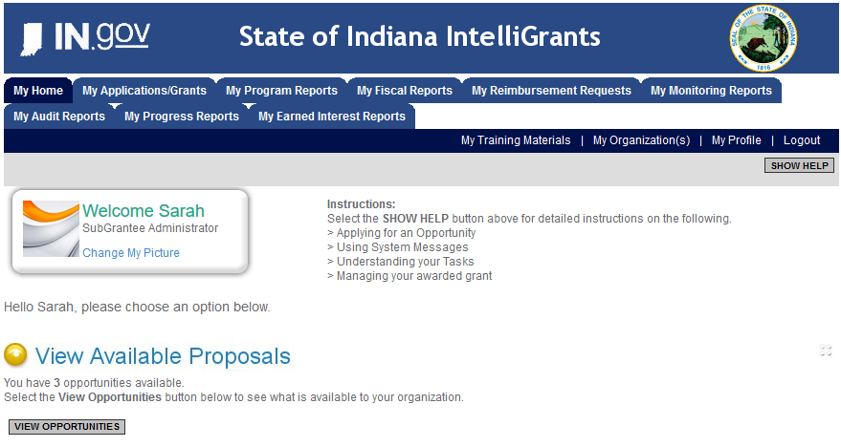

Slide 14
FVPSA ARP Testing Application

Slide 15
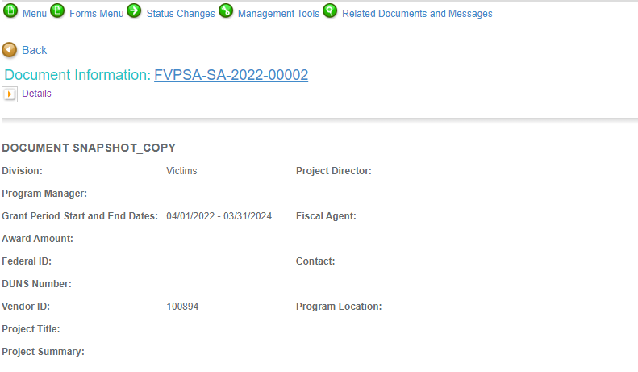

Slide 16
Forms that need to be completed:
Contact
Project Information
Programmatic Information
Problem Statement & Analysis
Goals, Objectives, & Outcomes
Program Descriptions
Evidence Based/Best Practices
Use of Volunteers
Budget
Budget Narrative
Attachments

Slide 17
Contact
Points of Contact for the grant (CJI will notify these individuals of your award notice)
Project Information
SAMs Registration must be up-to-date
Audit
If you receive more than $750,000 in federal grant funds, you are required to have an audit. This will be requested if CJI is aware that you receive more than $750,000.
Programmatic Information
Information about your proposed FVPSA grant
Problem Statement & Analysis
All government agency’s audits are included in the County audit and should all have one attached
Forms to be Completed (continued)

Slide 18
Goal, Objective, and Outcomes
The goal should directly address the problem identified in the Problem Statement.
Objectives are the steps needed to achieve goals. Objectives should be concrete, action-oriented, measurable and Specific, Measurable, Achievable, Realistic, Timely (SMART).
Example of Objective: By September 2022, a minimum of 50 culturally and linguistically appropriate support groups for survivors of domestic violence will be provided.
Outcomes measure objectives and are criteria for how the program is deemed to be effective.
Example of Outcome: 85% of participants will indicate that they have learned ways to act in their own best interest.
Program Description
What? Who? Where? Why? When? How?
Evidence Based/Best Practice
Use of Volunteers
Forms to be Completed (continued)

Slide 19
All grants from ICJI Victim Services are reimbursement grants, which means that agency must first incur the expense prior to CJI reimbursing for the expense. Verification of expenses along with verification of payment of expenses must be provided to ICJI on a monthly or quarterly basis prior to reimbursement of expenses by ICJI.
There is no Match Requirement for this FVPSA ARP Testing grant
Important Notes

Slide 20
Allowable Costs
Prevention services such as outreach, parenting, employment training, educational services, promotion of good nutrition, disease prevention, and substance abuse prevention
Counseling with respect to family violence, counseling or other supportive services provided by peers, either individually or in groups, and referral to community social services.
Safety plan development and supporting the efforts of victims to make decisions related to their ongoing safety and well-being.
Culturally and linguistically appropriate services such as interpreters and/or having documents translated into other languages.
Technical assistance with respect to obtaining financial assistance under Federal and State programs.
Housing advocacy to assist in locating and securing safe and affordable permanent housing and homeless prevention services.
Medical advocacy including referrals for healthcare services (including mental health and alcohol and drug abuse treatment) but shall not include reimbursement for any healthcare services.
Legal advocacy to provide victims with information and assistance through the civil and criminal courts, and legal assistance.
Children’s counseling and support services, and childcare services for children who are victims of family violence of the dependents of such victims, and children who witness domestic violence.

Slide 21
Unallowable Costs
Direct financial assistance to a client such as cash, gift cards, or checks.
Moving costs for victims.
Food and beverages except emergency food and beverages for victims.
Lobbying.
Fundraising (including financial campaigns, endowment drives, solicitation of gifts and bequests, and similar expenses incurred solely to raise capital or obtain contributions) and time spent procuring funding including completing federal and state funding applications.
Purchase of real estate.
Construction.
Physical modification to buildings including minor renovations (such as painting or carpeting).
Purchase of vehicles.

Slide 22
Budget Narrative
Be sure all items in the Budget are included in the Budget Narrative.
Ex: Office Supplies (copy paper, pencils, pens)
Grant reviewers are not required to contact you for clarification.
Any missing information in this section may disqualify that budget item for funding.

Slide 23
Attachments Required:
Total Agency Budget
Found on ICJI’s website (https://www.in.gov/cji/victim-services/resources/) – Subgrantee Basic Budget (Nonprofit Applicant Budget Form)
Sustainability Plan
Your plan to maintain the program once the grant funds expire
Timeline
Outlining the completion of the project/ or expenditures of the grant funds
Letters of Endorsement
For this program specifically
Miscellaneous
Job Descriptions for any position listed in personnel
EEOP Certification
If requesting funds for workforce capacity building or sustaining workforce, attach a summary of how each position will perform mitigation activities
If applicable, attach other requested information

Slide 24
For technical assistance contact the ICJI Helpdesk at CJIHelpDesk@cji.in.gov. Help Desk hours are Monday – Friday, 8:00 am to 4:30 pm ET, except state holidays.
ICJI is not responsible for technical issues with grant submission within 48 hours of grant deadline.
For assistance with any other requirements of this solicitation, please contact The Victim Services Division at ICJI.

Slide 25
Questions?

Slide 26
Thanks for attending!
Presenter:
Dalayna Anderson, Victim Services Program Specialist
DaAnderson1@cji.in.gov
317-232-3482

