Slide 1
2021-2023 FVPSA American Rescue Plan (ARP) RFP Webinar
July 22nd, 2021

Slide 2
Thanks for joining us today: Please keep your lines muted during the presentation. Webinar is being recorded. It will be posted on the ICJI website. Questions and Answers at the end. Feel Free to utilize the chat box during the webinar.

Slide 3
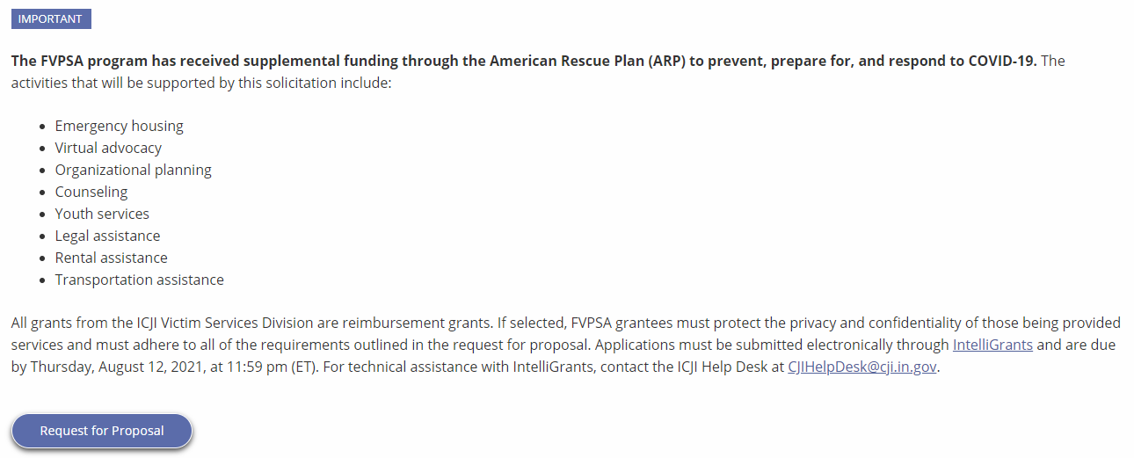
Accessing the RFP
Located on ICJI Website
CJI.in.gov → Victim Services → FVPSA “Learn More”→ Request for Proposal
https://www.in.gov/cji/victim-services/family-violence-prevention-and-services-act/

Slide 4
2021-2023 FVPSA ARP Grant Application
Application opened: Wednesday, July 15th at 9 AM
Application closes: Wednesday, August 12th at 11:59 PM
Applicants are strongly encouraged to submit applications 48 hours prior to the deadline.
Award Period for FVPSA ARP: October 1, 2021 to September 30, 2023 (24-month award period)
Projects should begin on October 1, 2021 and must be in operation no later than 60 days after this date. Failure to have the funded project operational within 60 days from October 1, 2021 will result in the cancellation of the grant and the de-obligation of all awarded funds.

Slide 5
Overview:
The Family Violence Prevention and Services Act (FVPSA) authorizes the FVPSA grant program, which is governed by the Department of Health and Human Services (HHS) Administration on Children, Youth and Families (ACYF)/Family and Youth Services Bureau (FYSB). The purpose of FVPSA funds is to provide shelter, temporary housing, supportive services, information, and assistance to adult and youth victims of family violence, domestic violence, or dating violence, as well as family and household members of such victims, and persons affected by the victimization. The FVPSA program has received supplemental funding through the American Rescue Plan (ARP). The purpose of these funds is to prevent, prepare for, and respond to COVID-19.

Slide 6
Funding Eligibility:
Eligible entity types include:
State Agencies
Units of local government
Nonprofit organizations
Faith-based organizations
Other Requirements include:
Registered DUNS number
Active and current registration with SAM.gov
Good standing with the Department of Revenue (DOR), Department of Workforce Development (DWD), and Secretary of State (SOS)

Slide 7
Required Allocations
In the Distribution of FVPSA funds, ICJI must ensure that:
No less than 70% of funds distributed are used for the primary purpose of providing immediate shelter and supportive services to adult and youth victims of family violence, domestic violence, or dating violence, and their dependents; and
No less than 25% of funds will be used for the purpose of providing supportive services and prevention services.

Slide 8
Funding Availability
The amount of funding available is $2,250,000 for this two-year grant award period. ICJI estimates providing approximately 35-40 awards in the amount of $10,000 to $60,000.

Slide 9
Purpose Areas: The purpose of these supplemental funds is to prevent, prepare for, and respond to COVID-19. The activities that will be supported by these funds within these purpose areas include
Prevent
Activities under this purpose area will focus on the continued effort to stop the spread of COVID-19.
Emergency Housing – Hotels, Motels, and Safe Houses
Mobile Advocacy – meeting platforms and virtual platforms to provide services to victims
Prepare
Activities under this purpose area will focus on preparing for any future surge or variant of COVID-19.
Organizational Planning
Respond
Activities under this purpose area will focus on victims and their children who have been affected by COVID-19 who could benefit from services and assistance to recover from this health crisis.
Counseling – Counseling to victims including continued telehealth options
Youth Services – Provide for the emotional well being of children
Legal Assistance – Civil legal assistance related to protective orders and evictions
Rental Assistance – Short Term Rental, Deposit, and Utility Assistance
Transportation – Costs associated with victims receiving treatment and gaining employment

Slide 10
Initiating an application in IntelliGrants
https://intelligrants.in.gov

Slide 11
Steps to initiating an application in IntelliGrants (ICJI’s Grant Management system):
Log into your IntelliGrants account
If you do not have an account, then you can obtain one on the home screen of intelligrants (New User?)
On the “MY HOME” page access the “VIEW AVAILABLE PROPOSALS” section
Click on VIEW OPPORTUNITIES
Intelligrants will take you to the My Opportunities page
Access the 2021 FVPSA ARP Grant Application
Select “Apply Now”

Slide 13
FVPSA American Rescue Plan (ARP) Application

Slide 14
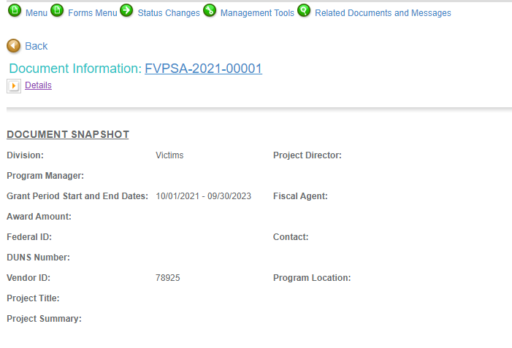
Notes:
To access the different components of the application you will need to navigate to the forms menu.

Slide 15
Forms that need to be completed:
Contact
Project Information
Programmatic Information
Problem Statement & Analysis
Goals, Objectives, & Outcomes
Program Descriptions
Evidence Based/Best Practices
Use of Volunteers
Budget
Budget Narrative
Attachments

Slide 16
Contact
Points of Contact for the grant (CJI will notify these individuals of your award notice)
Project Information
SAMs Registration must be up-to-date
Audit
If you receive more than $750,000 in federal grant funds, you are required to have an audit. This will be requested if CJI is aware that you receive more than $750,000.
Programmatic Information
Information about your proposed FVPSA ARP grant
Problem Statement & Analysis
All government agency’s audits are included in the County audit and should all have one attached
Forms to be Completed (continued)

Slide 17
Goal, Objective, and Outcomes
The goal should directly address the problem identified in the Problem Statement.
Objectives are the steps needed to achieve goals. Objectives should be concrete, action-oriented, measurable and Specific, Measurable, Achievable, Realistic, Timely (SMART).
Outcomes measure objectives and are criteria for how the program is deemed to be effective.
Program Description
What? Who? Where? Why? When? How?
Evidence Based/Best Practice
Use of Volunteers
Forms to be Completed (continued)

Slide 18
All grants from ICJI Victim Services are reimbursement grants, which means that agency must first incur the expense prior to CJI reimbursing for the expense. Verification of expenses along with verification of payment of expenses must be provided to ICJI on a monthly or quarterly basis prior to reimbursement of expenses by ICJI.
No Match Requirement for FVPSA ARP
Important Notes

Slide 19
Unallowable Costs
Administrative costs over 10% of the total grant budget
(2) Direct financial assistance to a client such as cash, gift cards, or checks
(3) Food and beverages
(4) Lobbying and/or fundraising
(5) Immigration fees
(6) Purchase of real estate,
(7) Construction,
(8) Physical modification to buildings, including minor renovations (such as painting or carpeting),
(9) Vehicles,
(10) Fuel
(11) Overtime is allowed but to claim the increased rate, there must be a separate line item in the budget that includes the overtime rate of pay.

Slide 20
Budget Narrative
Be sure all items in the Budget are included in the Budget Narrative.
Ex: Office Supplies (copy paper, pencils, pens)
Grant reviewers are not required to contact you for clarification.
Any missing information in this section may disqualify that budget item for funding.

Slide 21
Attachments Required:
Total Agency Budget
Found on ICJI’s website (https://www.in.gov/cji/victim-services/resources/) – Nonprofit Applicant Budget Form
Sustainability Plan
Your plan to maintain the program once the grant funds expire
Timeline
Outlining the completion of the project/ or expenditures of the grant funds
Letters of Endorsement
For this program specifically
Miscellaneous
Job Descriptions for any position listed in personnel
If applicable any contracts
Consultation Form – example on the last page of the RFP
EEOP Certification

Slide 22
For technical assistance contact the ICJI Helpdesk at CJIHelpDesk@cji.in.gov. Help Desk hours are Monday – Friday, 8:00 am to 4:30 pm ET, except state holidays.
ICJI is not responsible for technical issues with grant submission within 48 hours of grant deadline.
For assistance with any other requirements of this solicitation, please contact The Victim Services Division at ICJI.

Slide 23
Questions?

Slide 24
Thanks for attending!
Presenter:
Max Brown, Victim Services Program Specialist
maxbrown@cji.in.gov
317-232-2927

