Slide 1
2021-2023 Domestic Violence Prevention and Treatment RFP Webinar
December 18, 2020

Slide 2
Thanks for joining us today: Please keep your lines muted during the presentation. Webinar is being recorded. It will be on ICJI website by next Tuesday, December 22nd. Questions and Answers at the end. Feel Free to utilize the chat box during the webinar.

Slide 3
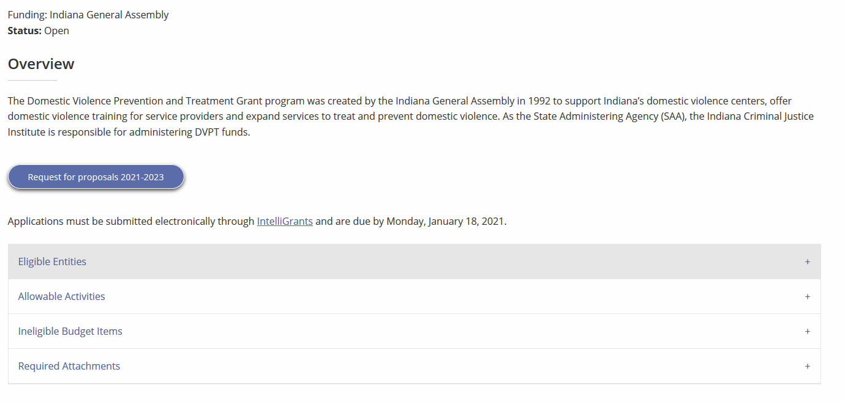
Accessing the RFP
Located on ICJI Website (www.in.gov/cji)
Open Solicitations
Domestic Violence Prevention and Treatment grants
Request for proposals 2021-2023

Slide 4
2021-2023 Domestic Violence Prevention and Treatment Grant Application
Application opened: Monday, December 14th at 9 AM
Application closes: Monday, January 18, 2021 at 11:59 PM
Applicants are strongly encouraged to submit applications 48 hours prior to the deadline.
Award Period for DVPT: July 1, 2021 to June 30, 2023 (24-month award period)
Projects should begin on July 1, 2021 and must be in operation no later than 60 days after this date. Failure to have the funded project operational within 60 days from July 1, 2021 will result in the cancellation of the grant and the de-obligation of all awarded funds.

Slide 5
Overview:
The Domestic Violence Prevention and Treatment (DVPT) grant fund is established in Indiana Code and may be used in the following ways: (1) to establish and maintain domestic violence prevention and treatment centers, (2) to develop and establish training programs for professional, paraprofessional or volunteer personnel who are engaged in areas related to the problems of domestic violence, and (3) to develop and implement the means for prevention and treatment of domestic violence.

Slide 6
Important Note in RFP:
The DVPT program is funded by the Indiana General Assembly through the state’s biennial budget. Since this grant cycle is governed by the 2021-2022 budget, which is up for consideration next year, all awards are subject to change and may be modified, reduced or discontinued depending on the funding allocated during the upcoming legislative session.

Slide 7
Entities Eligible for DVPT Funding: (An entity is eligible to receive funding if it furnishes, agrees to furnish, or arranges with a third party to furnish all the following services)
(1) Emergency shelter provided either at the center or by arrangement at temporary residential facilities available in the community, that are available to a person who fears domestic or family violence.
(2) A twenty-four (24) hour telephone system to provide crisis assistance to a person threatened by domestic or family violence.
(3) Emergency transportation services, if necessary, to aid victims of domestic or family violence.
(4) Information, referral, and victim advocacy services in the areas of health care assistance, social and mental health services, family counseling, job training and employment opportunities, legal assistance, and counseling for dependent children.

Slide 8
Allowable Activities with DVPT funds:
(1) Support the operations and service delivery of residential and nonresidential domestic violence programs statewide. These activities include:
• Providing emergency shelter. Shelter may be provided either at a residential facility or by arrangement at temporary residential facilities available in the community.
• Providing 24-hour crisis intervention, information and referral, support and advocacy.
• Providing emergency transportation services.
• Providing information, referral, and victim services in the areas of housing, health care advocacy, social and mental health services, family counseling, job training and employment opportunities, and legal assistance and counseling for dependents.
• Retaining and/or expanding agency staffing to support program activities.
• Providing organizational management and infrastructure support. Activities may include, but are not limited to: governance, internal controls and policies, compliance and monitoring, fiscal management, and human resources. No more than twenty percent (20%) of an applicant’s total requested grant funds may be allocated toward providing organizational management and infrastructure support.
(2) Expand basic domestic violence services to underserved and unserved communities. Basic services may be provided by shelters, satellite offices operated by an existing program, and/or non-residential service providers who provide advocacy services.
(3) Develop and establish a primary prevention initiative that addresses risk and protective factors related to domestic violence.
• Primary prevention initiatives are defined as a systematic process that promote safe and healthy environments and behaviors, primary prevention strategies seek to prevent first-time perpetration or victimization, (i.e., teen dating violence, healthy relationships). The CDC Technical Packages for Violence Prevention can be found at https://www.cdc.gov/violenceprevention/pub/technical-packages.html.

Slide 9
Continued Allowable Activities with DVPT funds….
(4) Develop and establish training programs for professionals, paraprofessionals, or volunteers who are engaged in the areas related to the prevention or intervention of domestic violence. Training includes training others in the community as well as staff and volunteer training.
(5) Develop a coordinated effort to address the system response to domestic violence. A system response can include:
• Collaboration with local or statewide agencies and organizations that interface with survivors.
• Providing technical assistance to agencies that work with survivors.
• Participating or collaborating with a local task force, commission or advisory council to address domestic violence.
(6) Increase organizational capacity through meeting data collection and technology needs.
(7) Provide emergency one-time flexible funding to support survivors’ immediate financial needs. Emergency financial assistance is defined as financial assistance not to exceed $500 per client that assists survivors with re/establishing their lives free of domestic violence. This may include but is not limited to rental assistance, utility deposits, car repairs, phone costs. A maximum of $10,000 per agency may be requested for emergency financial assistance and supporting documentation will be required for reimbursement.
(8) Provide or coordinate language access services for victims/survivors of domestic violence. Language access allows for people with limited English proficiency to use and benefit from a wide range of services. Any organization that receives funding is required to provide language access to its services. Types of language access services include in-person (face-to-face) interpreting, remote (telephone & video) interpreting, and document translation.

Slide 10
Ineligible Items
(1) Administrative costs over 10% of the total grant budget including time to complete DVPT required time and attendance sheets and programmatic documentation, reports, and required statistics; administrative time to collect and maintain satisfaction surveys and needs assessments used to improve services delivery within the DVPT funded project; and the prorated share of audit costs,
(2) Direct financial assistance to a client such as cash, gift cards, or checks
(3) Food and beverages except emergency food and beverage for victims
(4) Lobbying,
(5) Fundraising (including financial campaigns, endowment drives, solicitation of gifts and bequests, and similar expenses incurred solely to raise capital or obtain contributions) and time spent procuring funding including completing federal and state funding applications,
(6) Purchase of real estate,
(7) Construction,
(8) Physical modification to buildings, including minor renovations (such as painting or carpeting),
(9) Vehicles,
(10) Overtime is allowed but to claim the increased rate, there must be a separate line item in the budget that includes the overtime rate of pay.

Slide 11
Initiating an application in IntelliGrants
https://intelligrants.in.gov

Slide 12
Steps to initiating an application in IntelliGrants (ICJI’s Grant Management system):
Log into your IntelliGrants account
If you do not have an account, then you can obtain one on the home screen of intelligrants (New User?)
On the “MY HOME” page access the “VIEW AVAILABLE PROPOSALS” section
Click on VIEW OPPORTUNITIES
Intelligrants will take you to the My Opportunities page
Access the 2021 Domestic Violence Prevention & Treatment Grant (DVPT) Application
Select “Apply Now”

Slide 13
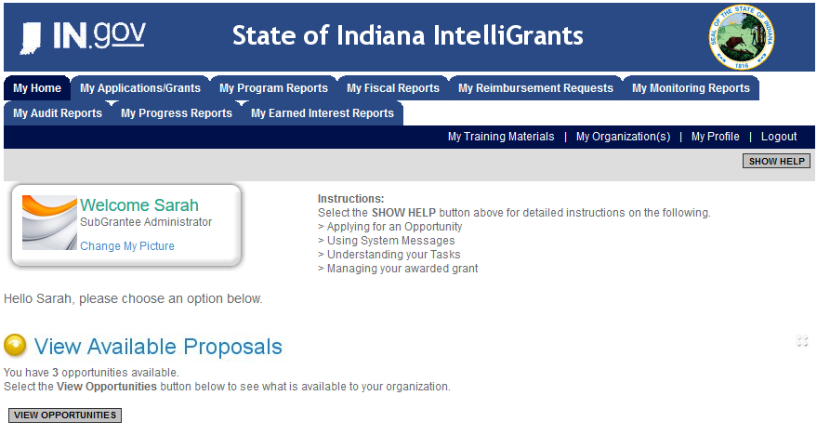

Slide 14
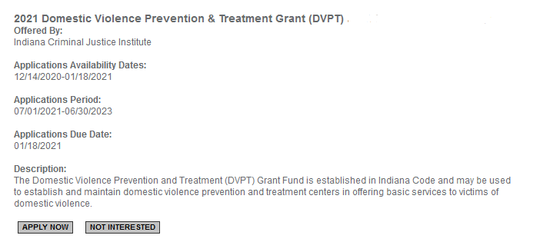

Slide 15
DVPT Application

Slide 16
Forms that need to be completed:
Contact
Project Information
Programmatic Information
Problem Statement & Analysis
Goals, Objectives, & Outcomes
Program Descriptions
Evidence Based/Best Practices
Use of Volunteers
Budget
Budget Narrative
Attachments

Slide 17
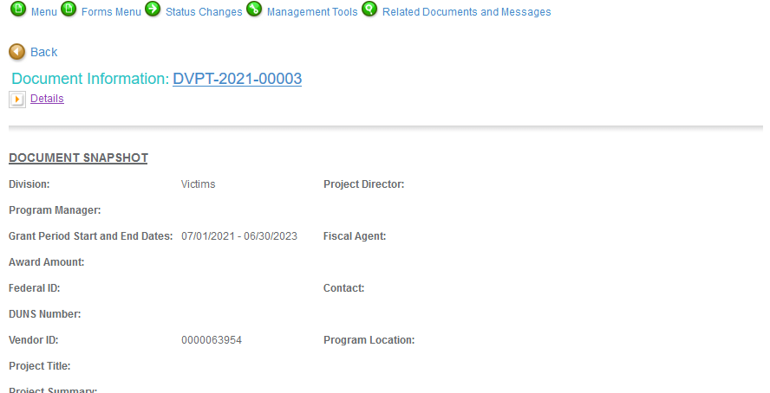
Notes:
To access the different components of the application you will need to navigate to the forms menu.

Slide 18
Contact
Points of Contact for the grant (CJI will notify these individuals of your award notice)
Project Information
SAMs Registration must be up-to-date
Audit
If you receive more than $750,000 in grant funds you are required to have an audit. This will be requested if CJI is aware that you receive more than $750,000.
Programmatic Information
Information about your proposed DVPT grant
Problem Statement & Analysis

Slide 19
Goal, Objective, and Outcomes
The goal should directly address the problem identified in the Problem Statement.
Objectives are the steps needed to achieve goals. Objectives should be concrete, action-oriented, measurable and Specific, Measurable, Achievable, Realistic, Timely (SMART).
Example of Objective: From July 1, 2021 to June 2023, a minimum of 300 survivors of domestic violence will be provided supportive service.
Outcomes measure objectives and are criteria for how the program is deemed to be effective.
Example of Outcome: A minimum of 85% of survivors will participate in case management with an advocate.
Program Description
What? Who? Where? Why? When? How?
Evidence Based/Best Practice
Use of Volunteers

Slide 20
Budget
The submitted budget will need to reflect Year 1 and Year 2 of funding on every expense. Funds designated under Year 1 must be spent in Year 1 and will not be available in Year 2. The same is true of Year 2. Funds designated under Year 2 will not be available in Year 1. During any Project Modification Request funds will not be able to be moved between years.

Slide 21
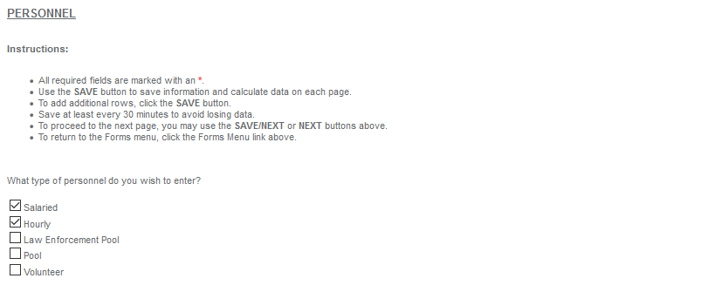
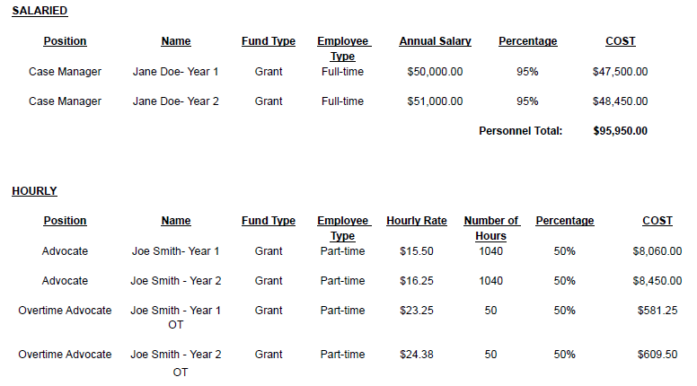
Personnel

Slide 22
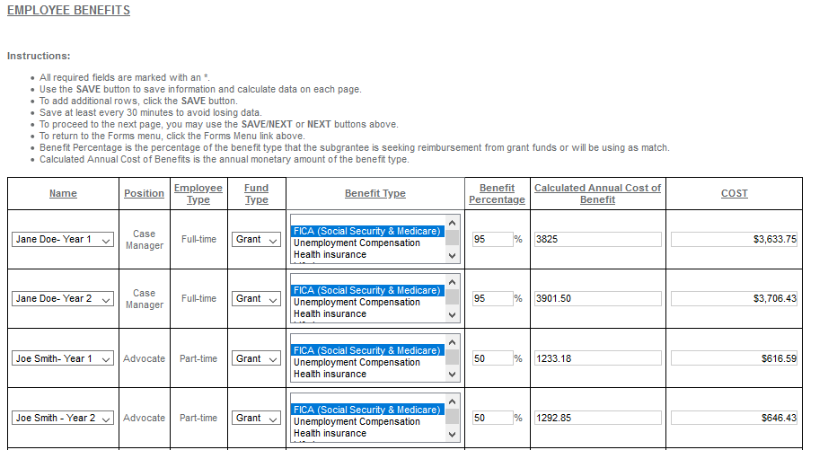
Employee Benefit

Slide 23
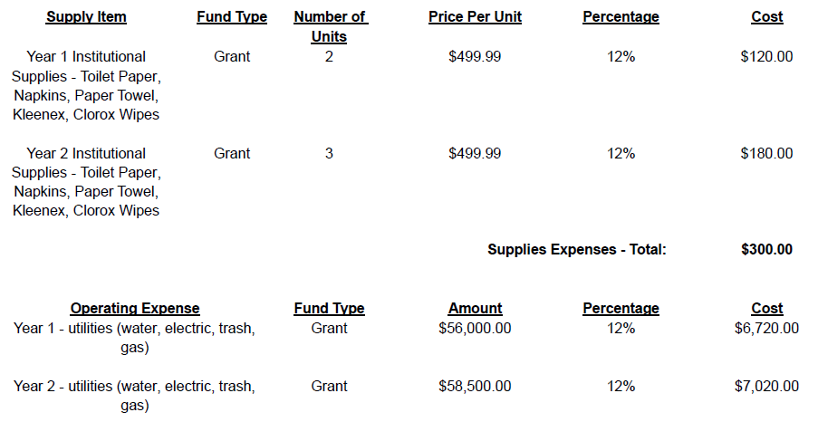
Supplies & Operating

Slide 24
Equipment

Slide 25
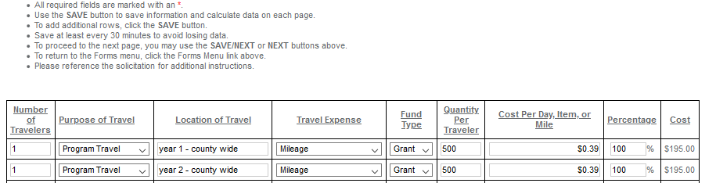
Travel

Slide 26
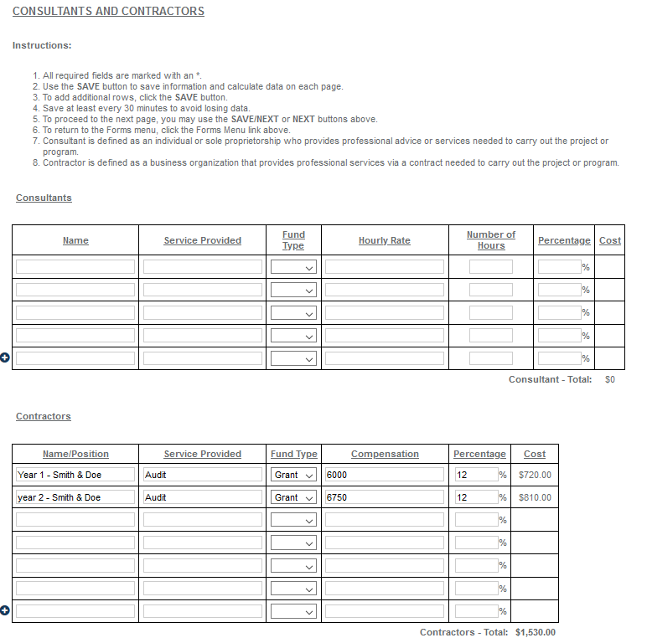
Consults and Contractors

Slide 27
All grants from ICJI Victim Services are reimbursement grants, which means that agency must first occur the expense prior to CJI reimbursing for the expense. Verification of expenses along with verification of payment of expenses must be provided to ICJI on a monthly or quarterly basis prior to reimbursement of expenses by ICJI.
Important Note:

Slide 28
Budget Narrative
Be sure all items in the Budget are included in the Budget Narrative.
Grant reviewers are not required to contact you for clarification.
Any missing information in this section may disqualify that budget item for funding.

Slide 29
Attachments:
Total Agency Budget
Found on ICJ’s website (https://www.in.gov/cji/victim-services/resources/) – Nonprofit Applicant Budget Form
Sustainability Plan
Your plan to maintain the program once the grant funds expire
Timeline
Outlining the completion of the project/ or expenditures of the grant funds
Letters of Endorsement
For this program specifically
Miscellaneous
Job Descriptions for any position listed in personnel
If applicable any contracts

Slide 30
For technical assistance contact the ICJI Helpdesk at CJIHelpDesk@cji.in.gov. Help Desk hours are Monday – Friday, 8:00 am to 4:30 pm ET, except state holidays.
ICJI is not responsible for technical issues with grant submission within 48 hours of grant deadline.
For assistance with any other requirements of this solicitation, please contact The Victim Services Division at ICJI.

Slide 31
Questions?

Slide 32
Thanks for attending!
Presenter:
Sarah Strevels, Victim Services Program Specialist
sstrevels@cji.in.gov
317-234-4387

