Slide 1



DVPT-2025 Program Report Updates
Presentation by Katherine Barnes and Becky Venus

Slide 2




Welcome and Thank You for Joining
DVPT-2025 Program Report Updates Webinar
Keep lines MUTED during presentation.
Webinar is being RECORDED and will be posted on ICJI website along with Q & A.
Utilize CHATBOX during webinar.
Time allowed at end for Q & A.

Slide 3
Presentation Agenda
Updates for FVPSA & DVPT Subgrantees
Total Individuals Served
FTE Calculations
Demographics Tables
  Age
  Race
  County
  Other
Services
Community Education
Flex Funding
Impacts and Challenges
Reporting Frequency
Q & A
End

Slide 4
Regarding FVPSA Data
Beginning with DVPT-2025, Agencies receiving both FVPSA and DVPT grants will no longer be required to include FVPSA data in your DVPT program reports.
Important Note

Slide 5

FTE of Grant Funded Staff
FTE should be based on your budget and only include GRANT funded staff.
ICJI Website Resource Page now includes FTE calculator (NEW!)

Slide 6
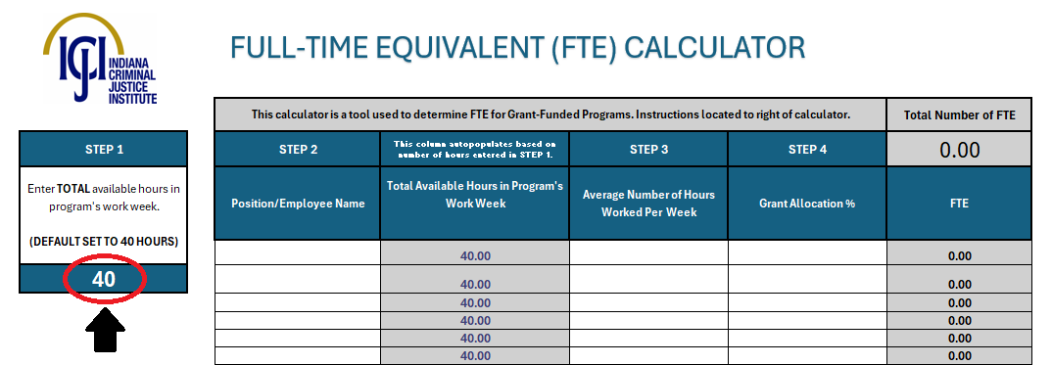
FTE Calculator (Step 1)
Step 1: Enter total available hours in your program's work week (default is set to 40 Hours) in the Dark Blue box under “Step 1”.
This number will autopopulate for all positions in Total Available Hours in Program's Week Column.
See resource page of website: https://www.in.gov/cji/victim-services/resources/ (first link under “Guidance”)

Slide 7
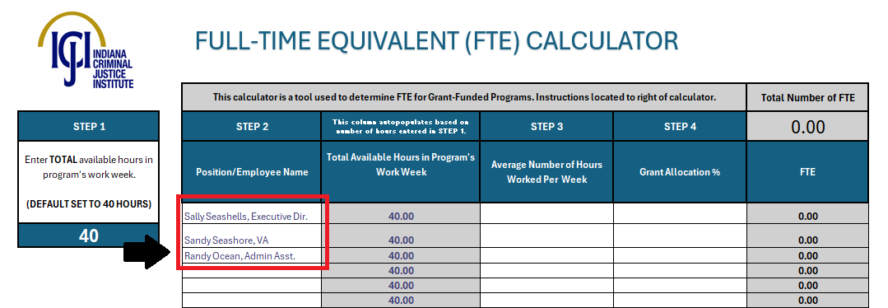
FTE Calculator (Step 2)
Step 2: Enter Name of Grant-Funded Personnel and/or Position Title in the white boxes under “the Step 2” column.
See resource page of website: https://www.in.gov/cji/victim-services/resources/ (first link under “Guidance”)

Slide 8
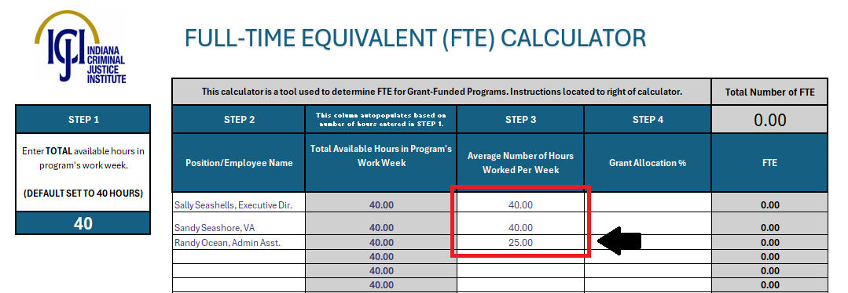
FTE Calculator (Step 3)
Step 3: Enter average number of hours employee works per week in the white boxes under the “Step 3” column.
Note: the Grey boxes to the left of these should NOT be edited. They were autopopulated in Step 1
See resource page of website: https://www.in.gov/cji/victim-services/resources/ (first link under “Guidance”)

Slide 9
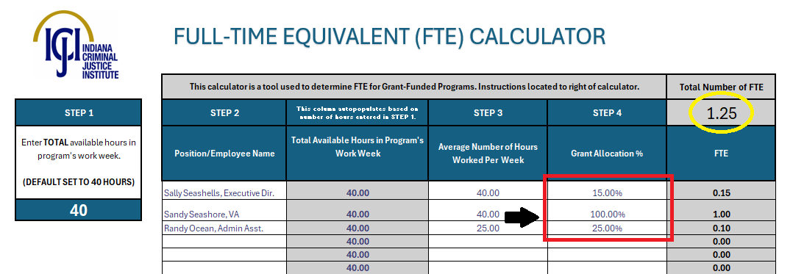
FTE Calculator (Step 4)
Step 4: Enter percentage of time allocated to the grant-funded program in the white boxes under the column labeled “Step 4”. The FTE for each employee will generate to the right (in decimal points).
Lastly: Once all Grant Allocation %’s have been entered, the FTE needed for your program report will be calculated at the top right (see yellow circle)
See resource page of website: https://www.in.gov/cji/victim-services/resources/ (first link under “Guidance”)

Slide 10
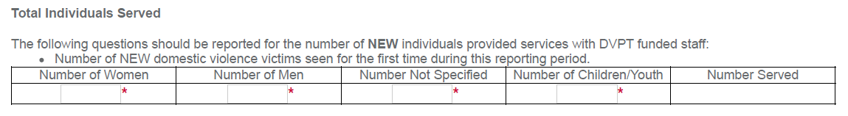
Individuals Served
Total Individuals
Both new and returning individuals for your DVPT program ONLY.
Returning individuals are individuals that were also served during the last reporting period for your grant.
For PR1, all individuals would be considered NEW even if your DVPT program is continuing from DVPT-2023
New Individuals
These individuals will be new to this reporting period for your DVPT program ONLY.
Only one table for sex of individuals, not divided by shelter and non-shelter clients.

Slide 11
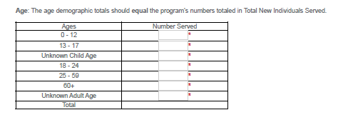
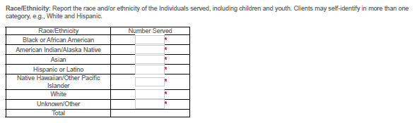
Demographics: Age & Race
Tables are for NEW INDIVIDUALS ONLY

Slide 12

Demographics: County
Tables are for NEW INDIVIDUALS ONLY

Slide 13
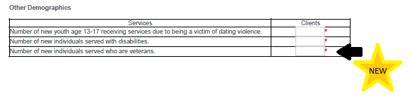
Demographics: Other
Tables are for NEW INDIVIDUALS ONLY

Slide 14
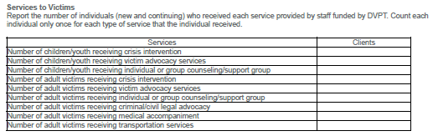
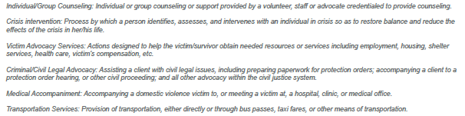
Services
Table is for BOTH new and continuing individuals

Slide 15

Community Education
Table is for TOTAL for DVPT

Slide 16
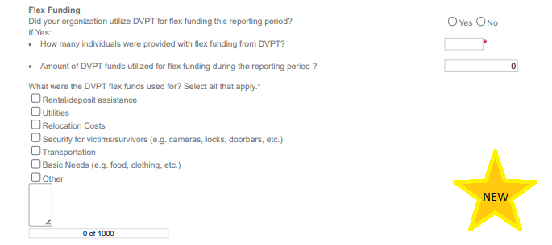
Flex Funding (NEW!)
How many individuals did you provide flex funding assistance to during this reporting period?
How much was spent?
What were the requests for?
Provide data on the reach and use of flex funds

Slide 17


Impacts and Challenges
Free Response Questions
Two text boxes: each text box has a limit of 4000 characters:
Describe the impact DVPT funding has had in this reporting period.
Describe any challenges that your DVPT funded program faced this reporting period.

Slide 18

Regarding Program Report due dates:
Regardless of if your agency requests monthly or quarterly fiscal reporting, all program reports will be due on a QUARTERLY reporting basis.

Slide 19


Questions?

Slide 20
THANK YOU
Katherine Barnes, Senior Grant Manager: katbarnes@cji.in.gov
Becky Venus, Senior Grant Manager: rvenus@cji.in.gov
Kim Lambert, Division Director: kilambert@cji.in.gov

