Slide 1

2023-2024 Family Violence Prevention and Services Act (FVPSA) RFP Webinar
June 15, 2023
Notes:
Good Afternoon and welcome to the 2022-2023 FVPSA RFP Webinar.
For those of you who don’t know me, my name is Dalayna Anderson and I am the program specialist here at ICJI.
Also on the call today is Becky Venus who is a Senior Grant Manager and will be assisting me today during the presentation. She is going to keep an eye on the chat and help answer questions.

Slide 2
Thanks for joining us today:
Please keep your lines muted during the presentation.
Webinar is being recorded. It will be posted on the ICJI website.
Questions and Answers at the end.
Feel Free to utilize the chat box during the webinar.
Notes:
Becky is going to keep an eye on the chat and help answer questions.

Slide 3
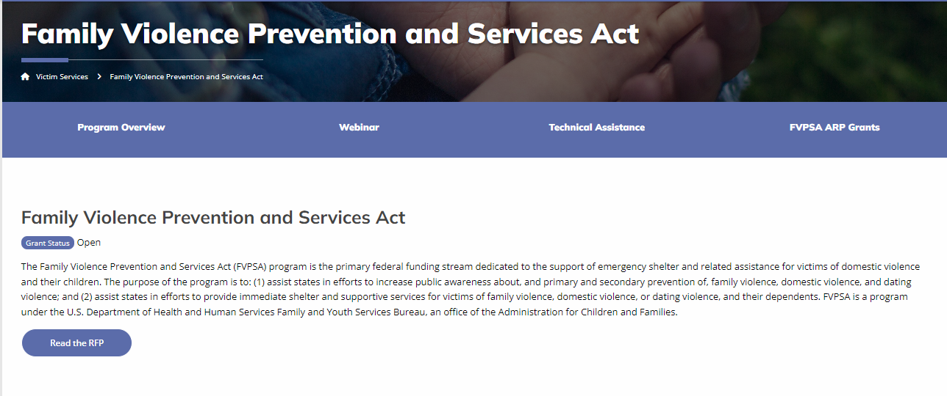
Accessing the RFP
Located on ICJI Website
https://www.in.gov/cji/victim-services/family-violence-prevention-and-services-act/

Slide 4
2023-2024 Family Violence Prevention & Services Act (FVPSA) Grant Application
Application opened: Monday, June 12th at 8 AM
Application closes: Thursday, July 20th at 11:59 PM
Applicants are strongly encouraged to submit applications 48 hours prior to the deadline.
Award Period for FVPSA: October 1, 2023 to September 30, 2024 (12-month award period)
Projects should begin on October 1, 2023 and must be in operation no later than 60 days after this date. Failure to have the funded project operational within 60 days from October 1, 2023 will result in the cancellation of the grant and the de-obligation of all awarded funds.

Slide 5
Overview:
The Family Violence Prevention and Services Act (FVPSA) is governed by the Department of Health and Human Services (HHS) Administration on Children, Youth and Families (ACYF)/Family and Youth Services Bureau (FYSB). The purposes of grants awarded through this program are to: (1) assist states in efforts to increase public awareness about, and primary and secondary prevention of, family violence, domestic violence, and dating violence; and (2) assist states in efforts to provide immediate shelter and supportive services for victims of family violence, domestic violence, or dating violence, and their dependents

Slide 6

FVPSA Funding Eligibility:
Local public agencies or nonprofit private organizations (including faith-based and charitable organizations, community-based organizations, tribal organizations, and voluntary associations) that assist victims of family violence, domestic violence, or dating violence, and their dependents, and have a documented history of effective work concerning family violence, domestic violence, or dating violence.
Other Requirements include:
  Registered UEI (Unique Entity ID) number
  Active and current registration with SAM.gov
  Good standing with the Department of Revenue (DOR), Department of Workforce Development (DWD), and Secretary of State (SOS)

Slide 7
Allowable Activities with FVPSA funds:
Prevention services such as outreach, parenting, employment training, educational services, promotion of good nutrition, disease prevention, and substance abuse prevention
Counseling with respect to family violence, counseling or other supportive services provided by peers, either individually or in groups, and referral to community social services.
Safety plan development and supporting the efforts of victims to make decisions related to their ongoing safety and well-being.
Culturally and linguistically appropriate services such as interpreters, having documents translated into other languages.
Technical assistance with respect to obtaining financial assistance under Federal and State programs.
Housing advocacy to assist in locating and securing safe and affordable permanent housing and homeless prevention services.
Medical advocacy including referrals for health-care services (including mental health and alcohol and drug abuse treatment), but shall not include reimbursement for any health-care services.
Notes:
To be mindful of everyone’s time, I am not going to read through all of these. But these are all listed in the RFP.

Slide 8
Continued Allowable Activities with FVPSA funds….
Legal advocacy to provide victims with information and assistance through the civil and criminal courts, and legal assistance
Children’s counseling and support services, and childcare services for children who are victims of family violence of the dependents of such victims, and children who witness domestic violence.
The following costs are allowable for shelters:
Operating expenses (rent, utilities, etc.) of the facilities for a shelter at a prorated amount
Supplies for shelter including clothing, toiletries
The following costs are allowable for the purpose of preventing future incidences of violence:
Transportation
Temporary refuge for emergency and immediate shelter including safe homes, rental subsidies, and hotel vouchers. This does not include transitional or permanent housing.

Slide 9
Ineligible Items
Administrative costs over 10% of the total grant budget including time to complete FVPSA required time and attendance sheets and programmatic documentation, reports, and required statistics; administrative time to collect and maintain satisfaction surveys and needs assessments used to improve services delivery within the FVPSA funded project.
Moving Costs for victims
(3) Direct financial assistance to a client such as cash, gift cards, or checks
(4) Food and beverages except emergency food and beverage for victims
(5) Lobbying,
(6) Fundraising (including financial campaigns, endowment drives, solicitation of gifts and bequests, and similar expenses incurred solely to raise capital or obtain contributions) and time spent procuring funding including completing federal and state funding applications,
(7) Purchase of real estate,
(8) Construction,
(9) Physical modification to buildings, including minor renovations (such as painting or carpeting),
(10) Vehicles,
(11) Overtime is allowed but to claim the increased rate, there must be a separate line item in the budget that includes the overtime rate of pay.

Slide 10
Initiating an application in IntelliGrants
https://intelligrants.in.gov

Slide 11
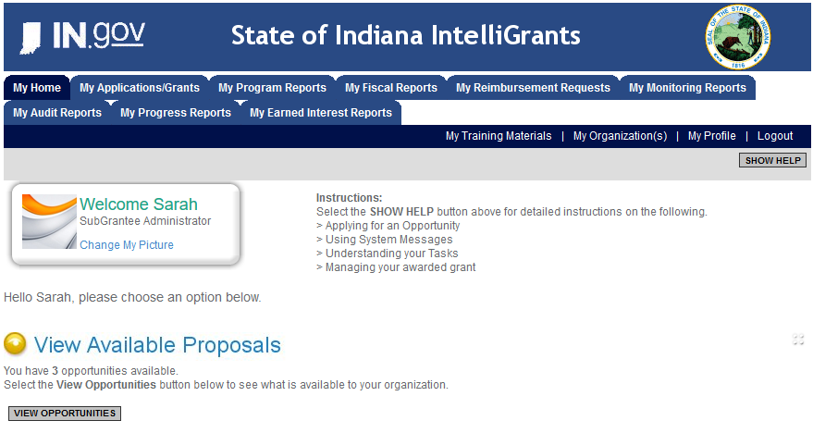
Log into your IntelliGrants account
  If you do not have an account, then you can obtain one on the home screen of intelligrants (New User?)
On the “MY HOME” page access the “VIEW AVAILABLE PROPOSALS” section
Click on VIEW OPPORTUNITIES
Intelligrants will take you to the My Opportunities page
Access the 2023 Family Violence Prevention & Services Act Grant (FVPSA) Application
Select “Apply Now”

Slide 12
FVPSA Application

Slide 13
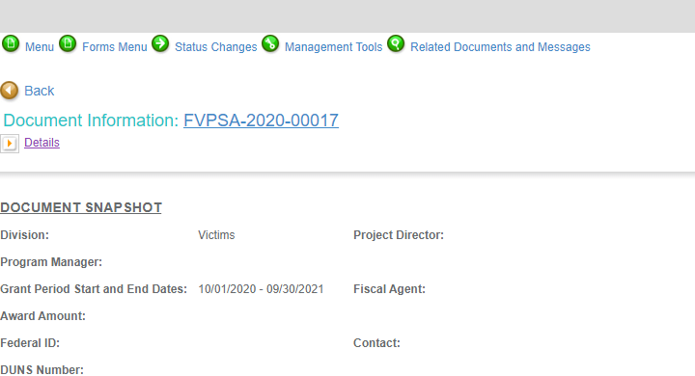
Notes:
To access the different components of the application you will need to navigate to the forms menu.

Slide 14
Forms that need to be completed:
Contact
Project Information
Programmatic Information
Problem Statement & Analysis
Goals, Objectives, & Outcomes
Program Descriptions
Evidence Based/Best Practices
Use of Volunteers
Budget
Budget Narrative
Attachments
Notes:
These are all the forms that will need to be completed

Slide 15
Contact
Points of Contact for the grant (CJI will notify these individuals of your award notice)
Project Information
SAMs Registration must be up-to-date
Audit
If you receive more than $750,000 in federal grant funds, you are required to have an audit. This will be requested if CJI is aware that you receive more than $750,000.
Programmatic Information
Information about your proposed FVPSA grant
Problem Statement & Analysis
All government agency’s audits are included in the County audit and should all have one attached
Forms that need to be completed Cont.

Slide 16
Goal, Objective, and Outcomes
The goal should directly address the problem identified in the Problem Statement.
Objectives are the steps needed to achieve goals. Objectives should be concrete, action-oriented, measurable and Specific, Measurable, Achievable, Realistic, Timely (SMART).
Example of Objective: By September 2023, a minimum of 300 survivors of family violence will be provided supportive service.
Outcomes measure objectives and are criteria for how the program is deemed to be effective.
Example of Outcome: 85% of survivors will participate in case management with an advocate.
Program Description
What? Who? Where? Why? When? How?
Evidence Based/Best Practice
Use of Volunteers
Forms that need to be completed Cont.

Slide 17
All grants from ICJI Victim Services are reimbursement grants, which means that agency must first occur the expense prior to CJI reimbursing for the expense. Verification of expenses along with verification of payment of expenses must be provided to ICJI on a monthly or quarterly basis prior to reimbursement of expenses by ICJI.
Match requirement for FVPSA is 20% of the project cost
Important Notes

Slide 18
MATCH REQUIREMENT
There is a 20% match requirement imposed on grant funds under this program.
Matching funds must:
  Be verifiable from the subgrantee’s records
  Not be included as contributions for any other federal award
  Be necessary and reasonable for the accomplishment of the project or program objectives
  Be allowable under 2 C.F.R. 200.400
  Not be paid by the federal government under another federal award, except where authorized by federal statue
  Be included in the subgrantee’s approved budget
  Conform to all other provisions of 2 C.F.R Part 200
Match is restricted to the same use of funds as allowed for federal funds. If an expenditure is not allowable with federal funds, it is not allowable with match funds. Applicants must identify all sources of the non-federal portion of the total project costs (i.e., match funds), and applicants must explain how the match funds will be used in the budget narrative section of the application within IntelliGrants.
Notes:
This grant does have a match requirement –
2 CFR Part 200 subpart 400

Slide 19
MATCH EXAMPLE
STEP 1: Award amount / % of Federal Share = Total Project Cost
STEP 2: Total Project Cost x % of Recipient Share = Required Match
EXAMPLE: A grant recipient is awarded $150,000 in federal funding and there is a 20% match requirement.
STEP 1: $150,000 / .80 = $187,500 Total Project Cost
STEP 2: $187,500 x .20 = $37,500 Recipient Share (Required Match)
Notes:
Example

Slide 20

Budget Narrative
Be sure all items in the Budget are included in the Budget Narrative.
  Ex: Office Supplies (copy paper, pencils, pens)
Grant reviewers are not required to contact you for clarification.
Any missing information in this section may disqualify that budget item for funding.

Slide 21

Attachments Required:
Total Agency Budget
  Found on ICJI’s website (https://www.in.gov/cji/victim-services/resources/) – Subgrantee Basic Budget (Nonprofit Applicant Budget Form)
Sustainability Plan
  Your plan to maintain the program once the grant funds expire
Timeline
  Outlining the completion of the project/ or expenditures of the grant funds
Letters of Endorsement
  For this program specifically
Miscellaneous
  Job Descriptions for any position listed in personnel
  If applicable any contracts
  EEOP
Notes:
At the end of this slide:
There is a couple of great resources on our website located in Victim Services under training
1 is the grant writing webinar and then there is also a training on the subgrantee basic budget that helps walk through the whole spreadsheet.

Slide 22
For technical assistance contact the ICJI Helpdesk at CJIHelpDesk@cji.in.gov. Help Desk hours are Monday – Friday, 8:00 am to 4:30 pm ET, except state holidays.
ICJI is not responsible for technical issues with grant submission within 48 hours of grant deadline.
For assistance with any other requirements of this solicitation, please contact The Victim Services Division at ICJI.

Slide 23
Questions?

Slide 24
Thanks for attending!
Presenter:
Dalayna Anderson, Victim Services Program Specialist
DaAnderson1@cji.in.gov
317-232-3482

