Slide 1
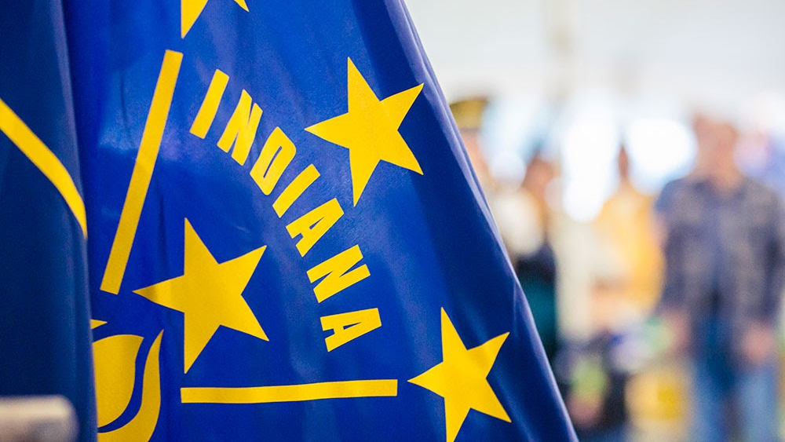

Youth Services
Requests for Funding 2026
Ellen Sheets
Division Director, Youth Services Indiana Criminal Justice Institute
Dalayna Anderson
Assistant Division Director, Youth Services Indiana Criminal Justice Institute

Slide 2

Overview
House Enrolled Act 1359 (2022) established the Juvenile Community Alternatives, Juvenile Diversion, and Juvenile Behavioral Health Competitive Grant programs.
Juvenile Diversion Grant: Indiana Code § 31-40-5-3
Juvenile Community Alternatives Grant: Indiana Code § 31-40-5-6
Behavioral Health Competitive Grant: Indiana Code § 31-40-6-3
Additionally, HEA 1359 established the Youth Justice Oversight Committee (YJOC). This committee was tasked by the legislature with a 5-fold purpose and has been meeting since July 2022.

Slide 3
Juvenile Diversion Overview
Prevent further involvement of the child in the formal legal system.
Provide eligible children with alternatives to adjudication that require the least amount of supervision and conditions necessary, consistent with the protection of the community and the child’s risk of reoffending, as determined by a risk screening tool.
Emphasize the use of restorative justice practices, defined in IC § 31-37-8.5-1(b) as services focused on repairing the harm caused to victims and the community as a result of a child’s behavior.
Reduce recidivism and improve positive outcomes for a child through the provision of research-based services, if warranted, that address the child’s needs.

Slide 4
Juvenile Community Alternatives Overview
Provide cost-effective, research-based alternatives in lieu of the use of secure detention, out-of-home placement, and department of correction facilities in the community.
Reduce the use of secure confinement and out-of-home placement.
Reduce recidivism and improve positive outcomes for children.

Slide 5

Juvenile Diversion and Community Alternatives Funding Formula
Juvenile Diversion County Funding Map
Juvenile Community Alternatives County Funding Map
NOTE: Total funding available for counties with population under 25,000 has increased since the previous grant cycle. If all or part of the funds assigned to these counties based on the original funding formula were previously utilized, check the funding map as the new funding formula amounts have been updated.

Slide 6
Juvenile Behavioral Health Overview
Intended to support jurisdictions, particularly in rural areas, to evaluate a child’s behavioral health needs and divert the child from formal court involvement and out-of-home placement into community or school-based mental health treatment. Grant recipients must use a validated mental health screening tool, and a full mental health assessment tool, if necessary, to conduct the following activities:
Partner with law enforcement to implement a program to divert a child from formal court proceedings.
Create crisis stabilization services and a mobile crisis unit.
Provide comprehensive case management for a child or family in crisis.
Identify strengthening community based intensive treatment and management services.
Establish telehealth services and programs.
Support mental health evaluations, which include the use of telehealth services.
Notes:
There is no funding formula for BHCPP.

Slide 7
2026 Grant Applications
RFFs Released: January 12, 2026
Proposal Submissions DUE: February 16, 2026, by 11:59 P.M. EST.
Applicants are strongly encouraged to submit applications 48 hours prior to the deadline.
Award Period: July 1, 2026 – June 30, 2028 (2 years)

Slide 8
Application Submission
PDF Application Template: ICJI Youth Services Resources
Excel Budget Template: ICJI Youth Services Resources
Additional Attachments:
Internal Control Policy/Plan
Collaboration Plan
Memorandums of Understanding
Job descriptions
Contract or proposal

Slide 9
IntelliGrants
There are two (2) forms that MUST be completed within the IntelliGrants application:
Contact Information
Project Information
Budget forms should remain blank. Budgets must be submitted on the Excel budget template.
All attachments mentioned in previous slide must be uploaded in the “Attachments” section of IntelliGrants

Slide 10
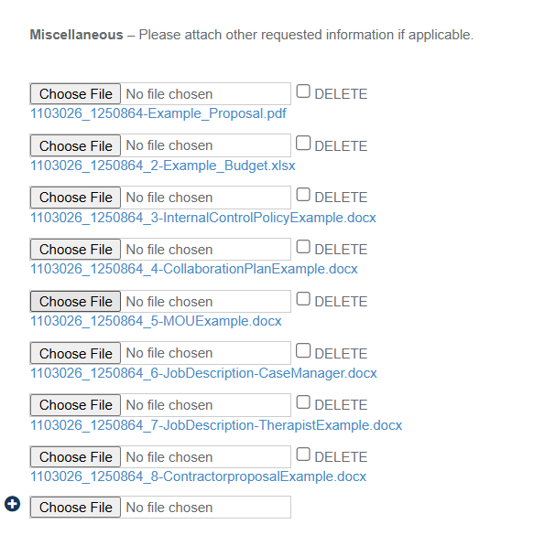
Application Submission

Slide 11
Q&A
All questions asked in this webinar will be included in our Q&A document, which will be posted to our website no later than February 2, 2026.
Please submit any additional questions to Youth@cji.in.gov no later than January 21, 2026, by 11:59 P.M. EST.
Any answers provided to questions outside of the Q&A document, including answers provided in this webinar, are non-binding.

Slide 12
Thank You

