Slide 1

2025 Title II
RFP Webinar
January 24, 2025

Slide 2


Thanks for joining us today:
Please keep your lines muted during the presentation.
Webinar is being recorded. It will be posted on the ICJI website.
Questions and Answers at the end.
Feel Free to utilize the chat box during the webinar.

Slide 3
What are Title II Funds?
The Juvenile Justice and Delinquency Prevention Act (JJDPA), signed into law on September 7, 1974, established the Office of Juvenile Justice and Delinquency Prevention (OJJDP) and created the Title II Formula Grants program.
In December of 2018, the Juvenile Justice Reform Act was enacted, reauthorizing and substantially amending the JJDPA.

Slide 4
What is the Indiana Criminal Justice Institute’s role with Title II Funds?
ICJI is the Agency in the State of Indiana that is designated as the Administering Agency for Title II.
ICJI applies for the Title II funds through OJJDP and once we are awarded funds then we create grant solicitations and accept applications for the Title II funds. ICJI is considered a pass-through agency. The Title II funds pass through ICJI to subgrantees in Indiana who are awarded funds by ICJI’s Board of Trustees.
After the grant funds are awarded then ICJI staff work with the subgrantee staff to ensure that the application has the correct information and that the budget is correct, has allowable items and that all of the attachments required are attached to the application.

Slide 5
What is the Indiana Criminal Justice Institute’s role with Title II Funds? con’t
ICJI staff then prepare the contracts/grant agreements to include the subgrantee specific information and process the contracts/grant agreements through the signature process.
After the grants have been fully approved and executed, the Youth Grant Coordinators ensure that fiscal and programming reports are completed timely and accurately.
ICJI will gather quarterly federal reporting information from subgrantees and submit to OJJDP as required.
ICJI Youth Division staff are available to assist with questions/concerns with any TII grant and to assist with training any new subgrantee with technical issues associated with IntelliGrants and/or general grant management.

Slide 6

What can Title II funds be used for?
The Title II Formula Grant Program provides funding to support state and local efforts to plan, establish, operate, coordinate, and evaluate policies and projects for the development of more effective education, training, research, prevention, diversion, treatment, and rehabilitation programs in the area of juvenile delinquency, as well as juvenile justice system improvement efforts.

Slide 7
Title II Priority Areas
Pursuant to Title II, Part B of the Juvenile Justice and Delinquency Prevention Act (JJDPA), in order to receive formula grants, states must develop and submit a Three-Year Plan that identifies goals for the juvenile justice system and programmatic priorities to be supported by grant funding. Therefore, ICJI will only consider grant applications that fall under one of the following priority areas and have the greatest impact on Hoosier youth.

Slide 8
Title II Priority Areas con’t
Indiana has identified the following priority areas for 2025 Title II funding:
Alcohol and substance abuse
Mentoring, counseling, and training programs
Mental health services
Rural area programs
Gender specific services
Diversion
Gangs
Delinquency prevention
After-school programs
Positive youth development
Deinstitutionalization of status offenders

Slide 9

2025 TII Grant Application
Application opened: Friday, January 17th
Application closes: Sunday, February 16th at 11:59 PM (EST)
Applicants are strongly encouraged to submit applications 48 hours prior to the deadline.
Award Period: April 1, 2025 – March 31, 2026

Slide 10

Eligibility
The following entities are eligible to apply for Title II funding:
Nonprofit organizations
Educational institutions
State agencies
Units of local government
Other requirements include:
UEI
Active System for Award Management (SAM) Registration
Good standing with Indiana Department of Revenue (DOR), Indiana Department of Workforce Development (DWD), and Secretary of State (SOS).

Slide 11

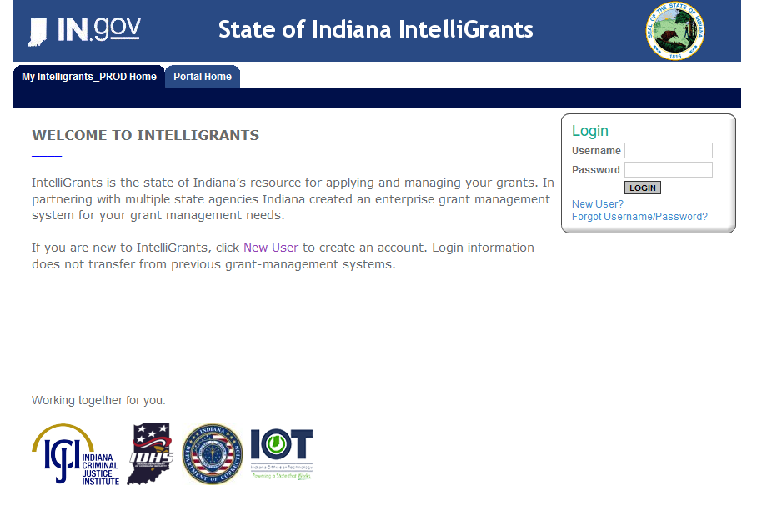
Initiating an application
https://indianaintelligrants.intelligrants.com/Login2.aspx?APPTHEME=INGRT
Notes:
Applications are to be submitted within our Intelligrants, our grant management system.
If you already have an account, you will log in, View opportunities and find the 2025 TII application.
If you do not have an account, you will first need to click on New User and create an account.

Slide 12

Match Requirement
There is a 10% match requirement imposed on grant funds under the Title II Program. A grant made under this program may not cover more than 90% of the total costs of the project being funded. The applicant must identify the source of the 10% non-Federal portion of the budget and how match funds will be used. Applicants may satisfy match with either cash or in-kind services.
Example of how to figure match is in the Request for Proposal or RFP on page 7.

Slide 13

Required Attachments
Total Agency Budget
Indirect Cost Rate (if applicable)
Sustainability Plan
Timeline
Letters of Endorsement
Suitability to Interact with Minors Certification
Miscellaneous
  EEOP Certification
  Lobbying Certification and Disclosure to Report Lobbying form
  Any other requested information (contracts, lease agreements, job descriptions)
Notes:
Total agency budget, suitability, EEOP, lobbying certification and disclosure forms are all linked in the RFP.

Slide 14
For technical assistance contact the ICJI Helpdesk at CJIHelpDesk@cji.in.gov. Help Desk hours are Monday – Friday, 8:00 am to 4:30 pm ET, except state holidays.
ICJI is not responsible for technical issues with grant submission within 48 hours of grant deadline.
For assistance with any other requirements of this solicitation, please contact The Youth Division at ICJI.

Slide 15
Q & A

Slide 16
Thanks for attending!
Presenters:
Ellen Sheets, Youth Division Director
ESheets1@cji.in.gov
Dalayna Anderson, Youth Assistant Division Director
DaAnderson1@cji.in.gov

