Slide 1

Indiana’s
Governor’s Challenge
To Prevent Suicide Among Service Members, Veterans, their Families and Caregivers (SMVF-CG)
Effective suicide prevention takes a combination of people, effort, and imagination. TOGETHER we can achieve far-reaching statewide improvements in policy, practice, and implementation.
Join us.

Slide 2
Upstream Suicide Prevention at the Community Level
Addressing the Mental Health Needs of Service Members, Veterans, Family, and Caregivers (SMVF-CG)​
​
Brad Harper​
Veteran Suicide Prevention Director
Indiana Department of Veterans Affairs​
Notes:
When some people hear suicide prevention, they may imagine a dramatic scene from a movie where a savior walks in at just the right moment and saves the day, in the nick of time. The reality is that these perfectly choreographed and timed moments that make for powerful drama on the silver screen, are rare in real life. Each one of us, whether we realize it or not, has the opportunity to be that hero. The day-to-day moments we are presented with where we can make a difference may not be as noticeable, but they are just as important. Each of us can help reduce suicide, especially among service members and veterans, if we embrace and adopt an upstream mindset when it comes to suicide prevention

Slide 3
Upstream Prevention
Community involvement plays a pivotal role in preventing military veteran suicides by fostering a supportive environment, increasing access to resources, and reducing social isolation among veterans​
Notes:
An upstream approach to suicide prevention is a way to leverage time and expand the opportunities for intervention from one single pivotal moment to a series of moments that might span years, months, weeks, or days. With the advantage of time to notice, reach out, engage, and connect – people experiencing increased stress, and the people who can support them, have more options. The idea behind an upstream approach is that rather than allow time to pass where a situation progresses to that pivotal point of crisis; systems, communities, people, and other support systems are there to provide access to resources and support to address situations as they arise before they escalate into a life-threatening crisis.

Slide 4

Upstream Prevention
Curating Connection and Communication
IDVA is leading a dedicated team to develop actionable, goal oriented, policies and programs.
"Coming together is a beginning, staying together is progress, and working together is success." -Henry Ford
Notes:
Curating-select, organize, and present (online content, merchandise, information, etc.), typically using professional or expert knowledge.
As you can see, we are all pieces of the puzzle coming together with our unique knowledge, information and skills.
Read Quote

Slide 5
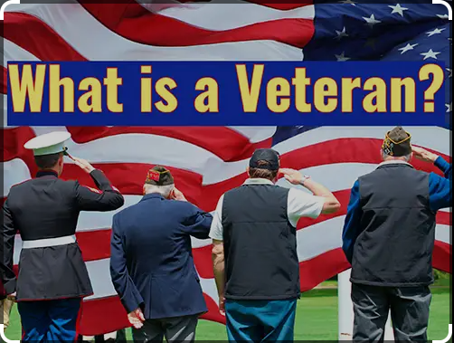
Notes:
A veteran is a person who served in the U.S. military, naval, or air service and was discharged or released under conditions other than dishonorable. This includes:
Active duty
Active duty for training (ADT)
Inactive duty for training (IADT)
Reservists or members of the National Guard called to federal active duty
The term "veteran" comes from the Latin word veteranus, which means "old" or "of long experience". The word was first used in 1509.
“Beware of an old man in a profession where men usually die young.
Old warriors did not get old by accident; they got old by being wise, having the right knowledge, and being tough. Never underestimate an old man who has grown up in a rough profession or a rough environment.
These men have been around. They have done things, and experienced things, that you probably have never even thought about. They are tough, their minds are tough, and they have the knowledge, the skill, and the will to finish the job"
-Bohdi Sanders

Slide 6

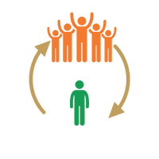


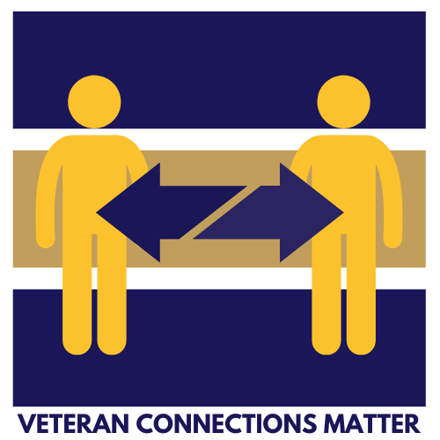
Curating Connection
Ways to Connect
Vet to Vet
Vet to Self
Community to Vet
Vet to Community
Notes:
There are 4 distinctive ways that we want to connect our vets. Those are Vet to Vet or Peer to Peer, Vet to Self, Community to Vet and Vet to Community. If you are like me, those are all just words on a screen, but what does it really mean?

Slide 7

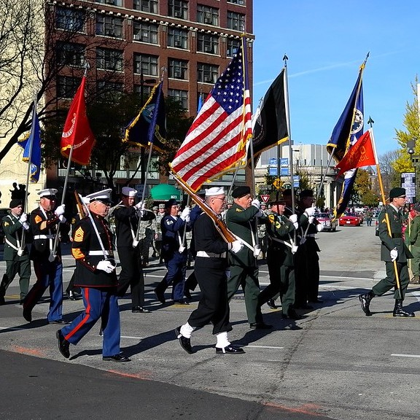
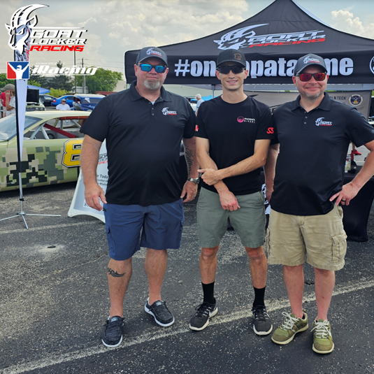
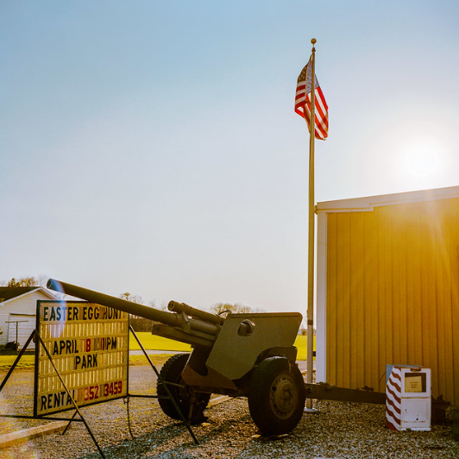
Curating Connection
Vet to Vet/Peer to Peer
Social
Recreational
Clinical
Service Based
Community to Vet
Celebrate veterans at existing community event
We are you; We welcome you
Vet to Community
Local veteran community invitation to the public
We are you; We welcome you
Vet to Self
Mental Health Wellness is Fitness
Exercise = strength, peace and well being
  Physically AND Mentally
Notes:
Vet to vet connection: The connection that can happen when veterans come together around a common interest. Building social support systems with Veterans in the community is an important part of ensuring Veterans’ overall health. Veterans Socials enhance communication and foster bonds among Veterans and others in the community. They are a place to meet friends, find resources, and have fun with other Veterans and community members. These Socials come in many forms, and we encourage hosts to shape them based on attendees’ needs and preferences. Some examples of Vet to Vet connections are coffee meetups or shooting clubs, Service based like neighborhood cleanups, clinical like therapy groups. This picture is one of our NPP's that I will discuss later, Goat Locker Racing.
Goat Locker Racing is an online racing community of veterans and first responders. Their races are broadcasted online and it is an opportunity for veterans to come together over a common interest which is online racing.
Community to veteran connection is a way to support veterans by celebrating them in your community. Memorial Day, 4th of July and Veterans Day events are great ways to celebrate the Veterans in your community. This can help veterans transition to civilian life and feel less isolated by showing them that you appreciate the sacrifices that they have made.
Vet to Community-Research shows that service provides benefits to military veterans, including: Comradery, Teamwork, Help addressing community needs, and A renewed sense of purpose. Veterans unselfishly continue to volunteer their time and money to their communities. In 2020-21 — at the height of the pandemic — veterans averaged more volunteer hours per year than their civilian peers, according to the Veterans Civic Health Index. Even outside of military and veteran-focused organizations, veterans can be seen volunteering to aid disaster relief efforts, in youth mentorship and other community programs.
Vet to self- In an online article by the Social Security Administration, they state "Mental health is a critical aspect of overall well-being — it’s integral to our happiness. Mental health issues can significantly impact a person’s quality of life by making it difficult to work, maintain relationships, and enjoy activities that they love. For our nation’s veterans suffering from post-traumatic stress disorder (PTSD), depression, and anxiety, these effects can be even more pronounced."
The Department of Veterans Affairs (VA) reports that approximately 20% of veterans who served in Iraq or Afghanistan experience PTSD or depression. Unfortunately, many veterans don’t seek help due to the perceived stigma surrounding mental health issues. They may worry that they’ll be seen as weak or that their military careers could be negatively affected. This often leads to veterans suffering in silence.
One way to prioritize mental health is to practice self-care. This can include getting enough sleep, eating a healthy diet, exercising regularly, and engaging in joyful and fulfilling activities. It is also important to seek help when needed. This may mean talking to a trusted friend or family member, or consulting with a mental health professional.
In recent years, there has been a growing awareness of the importance of mental health. This has led to an increase in resources and support for people who are suffering – whether from an illness, trauma, or other circumstances.

Slide 8
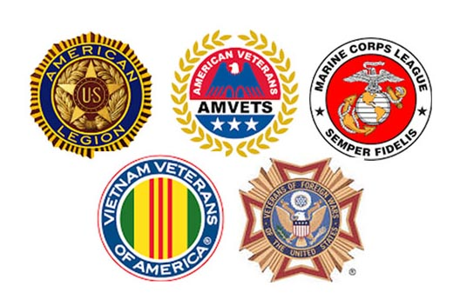



Where's the Vet?
Notes:
Find SMVF-CG (Vet Community)

Slide 9




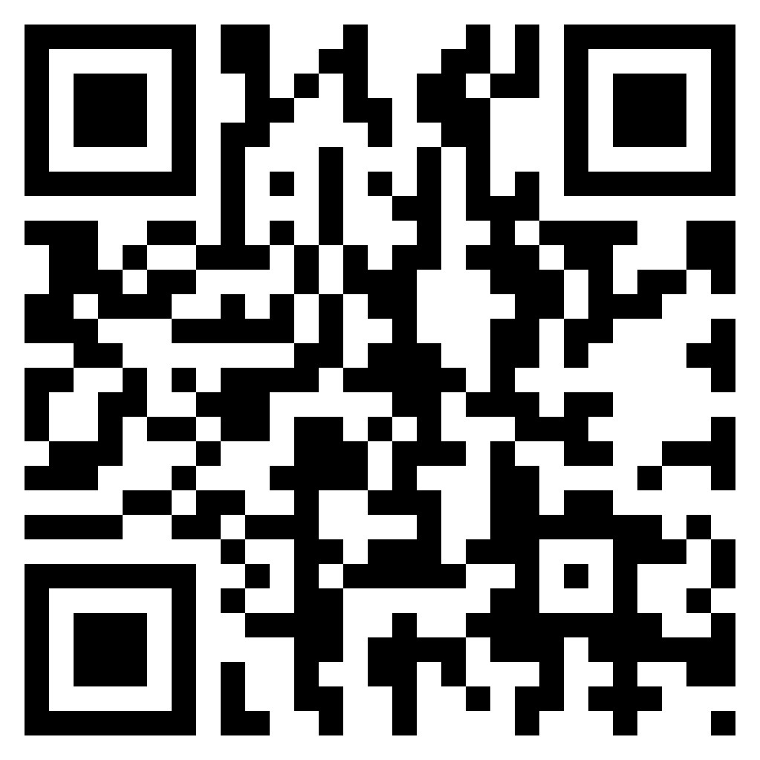

Event Sponsorship Program
Notes:
Up to $500
Must have a Vet Component
Can Be Existing Event or to Start One

Slide 10
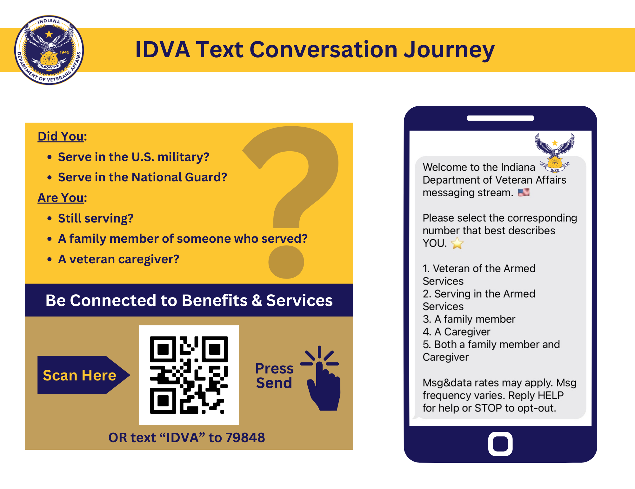
SMS
Journey

Slide 11



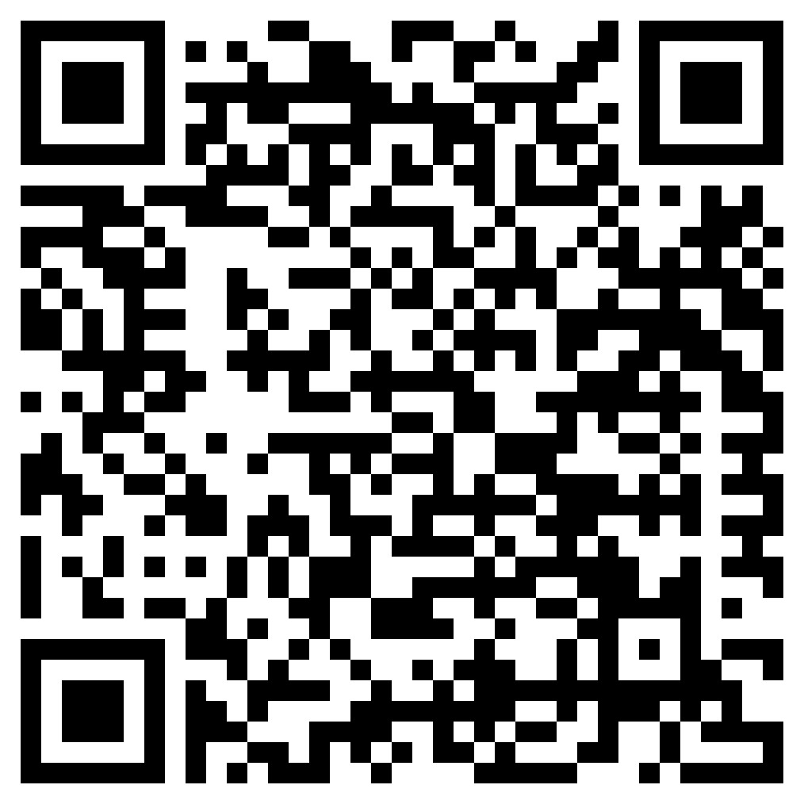




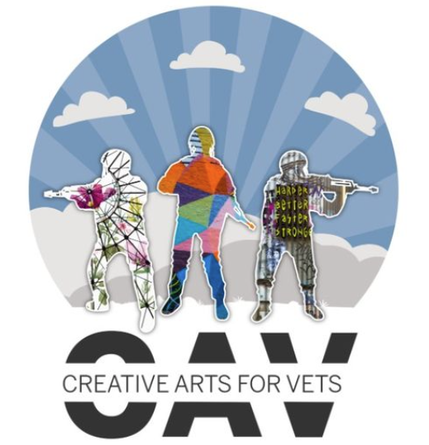






Non-Profit Grant Recipients
Indy Vet to Vet
Heroes Wildlife Adventures
Veteran’s Support Council
Recovery Café
NAMI Indiana
Goat Locker Racing
DAV IN Service Foundation
Mental Health America
Creative Arts for Vets
Haven for Healing
Reboot Recovery
Amazing Grace Equine Therapy
Armed Service Arts Partnership
Regional Health Systems
Notes:
Unique Opportunity

Slide 12
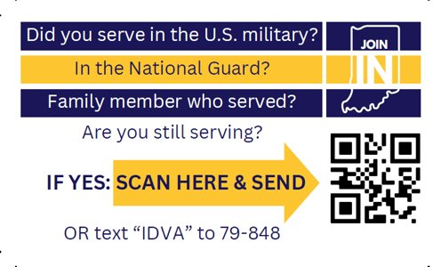
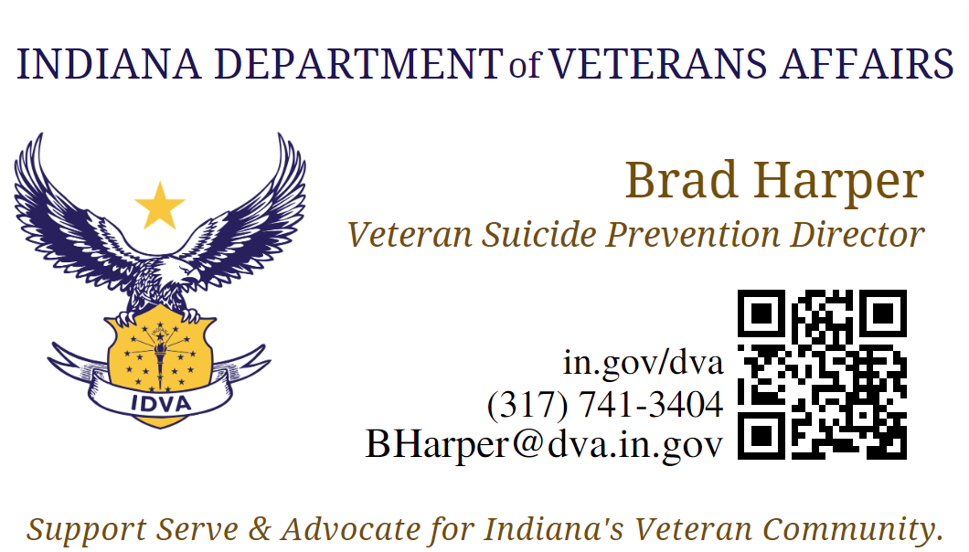
You can JOIN IN.
Indiana is making a difference, taking the lead, and changing lives. Be a part of the team, Join IN.

Slide 13
Suicide Intervention
at the Community Level
Addressing the Mental Health Needs of Service Members, Veterans, Family, and Caregivers (SMVF-CG)
Obadiah Smith Jr
Veteran Suicide Prevention Director
Division of Mental Health and Addiction
DMHA
Crisis Intervention
Crisis Intercept Mapping
Notes:
Those of you living in the community know your community better than anyone from outside looking in. ​

Slide 14

Crisis Intervention
"Crisis intervention is not just about saving lives; it's about offering hope, empathy, understanding, and support to those in the darkest moments of their lives. Together, we can be the beacon of hope and light that guides individuals to healing, resilience and well being”
Obadiah Smith Jr
Notes:
It is important because it emphasizes that crisis intervention goes beyond immediate life-saving actions. It highlights the human aspects of the intervention—hope, empathy, and understanding—which are essential for long-term recovery and mental well-being. By framing crisis intervention as a compassionate and supportive process, the statement underscores the significance of a holistic approach that addresses not just the crisis but also the emotional and psychological needs of individuals.​
Moreover, it calls for collective responsibility, encouraging everyone to play a part in offering support. This empowers communities to become active participants in guiding individuals through their struggles, fostering resilience, and promoting overall well-being. Essentially, it’s a call to action that reminds us that effective crisis intervention can transform lives, not just save them.

Slide 15

Crisis Intervention
Crisis: borrowed from the Latin, which in turn was borrowed from the Greek krinō, which means 'distinguish, choose, decide'.
Intervention: the Latin word intervenire, which means "to come between".
Notes:
It is important because it emphasizes that crisis intervention goes beyond immediate life-saving actions. It highlights the human aspects of the intervention—hope, empathy, and understanding—which are essential for long-term recovery and mental well-being. By framing crisis intervention as a compassionate and supportive process, the statement underscores the significance of a holistic approach that addresses not just the crisis but also the emotional and psychological needs of individuals.​
​Moreover, it calls for collective responsibility, encouraging everyone to play a part in offering support. This empowers communities to become active participants in guiding individuals through their struggles, fostering resilience, and promoting overall well-being. Essentially, it’s a call to action that reminds us that effective crisis intervention can transform lives, not just save them.

Slide 16

Crisis Intervention
What are some types of Interventions?
What is crisis intervention?

Slide 17

Crisis Intervention
Direct Services
Tough Love
Preventive
Therapeutic
Medical
Community-Based
Recovery
Peer to Peer
Types Of Interventions:

Slide 18
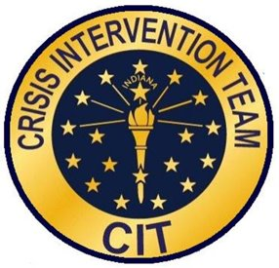
Crisis Intervention Teams
Crisis Intervention Teams (CITs) in Indiana are community-based programs that help people with mental health issues by de-escalating situations and connecting them with medical treatment.
Objectives:
Reducing stigma: CITs help reduce the stigma of mental illness.
Diverting individuals: CITs divert people with mental illness away from the criminal justice system and into treatment.
Improving interactions: CITs help create more effective interactions between law enforcement, mental health care providers, and communities.
Increasing safety: CITs help increase safety for people with mental illness and their families.
Increasing access to treatment: CITs help increase access to medical treatment for people with mental illness.
Developing partnerships: CITs help develop community partnerships.
https://www.cit-indiana.org/
Notes:
Crisis Intervention Teams (CIT): A Path to Recovery Crisis Intervention Team (CIT) programs unite community leaders with a common goal: to keep individuals with mental illness out of jail and on the path to recovery through proper treatment. By focusing on diversion, CIT programs not only reduce arrests of those with mental health challenges but also significantly increase the chances of individuals receiving the care they need.

Slide 19

Crisis Intervention Teams
Indiana
CIT programs bring community leaders together, they can also help keep people with mental illness out of jail and in treatment, on the road to recovery. That’s because diversion programs like CIT reduce arrests of people with mental illness while simultaneously increasing the likelihood that individuals will receive mental health services.

Slide 20
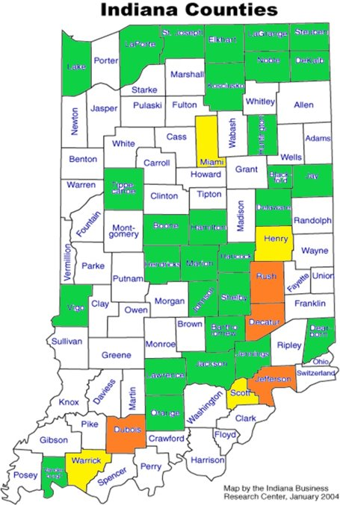
Crisis Intervention Teams
White: No CIT Team
Yellow: Interested in CIT: Henry, Miami, Scott, Warrick
Orange: In Planning for a Future CIT
Green: Have CIT Team:
List Counites Only

Slide 21
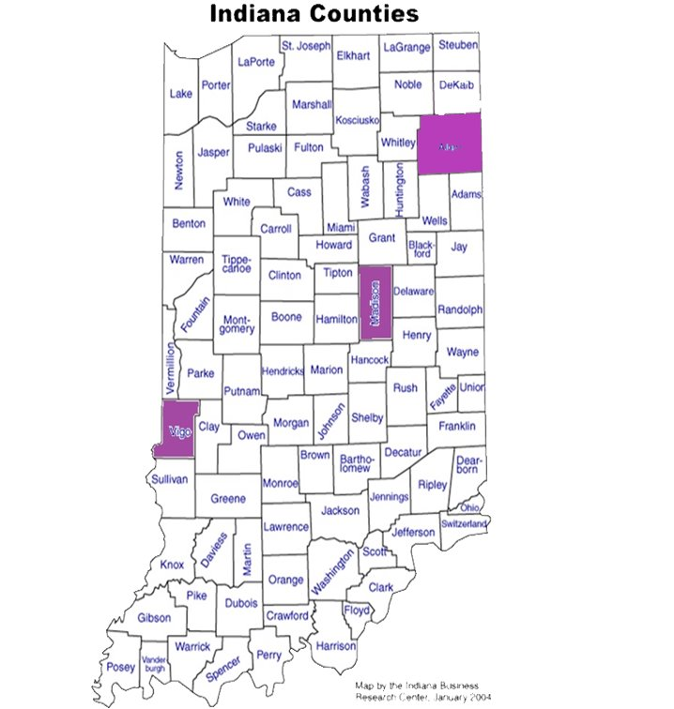
Crisis Intervention Teams
Indiana Governors Challenge
Crisis Intervention Teams
Target Counties:
Vigo
Madison
Allen

Slide 22

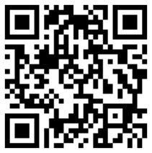
Crisis Intervention Teams
https://www.cit-indiana.org/
NAMI Indiana CIT Locator:

Slide 23
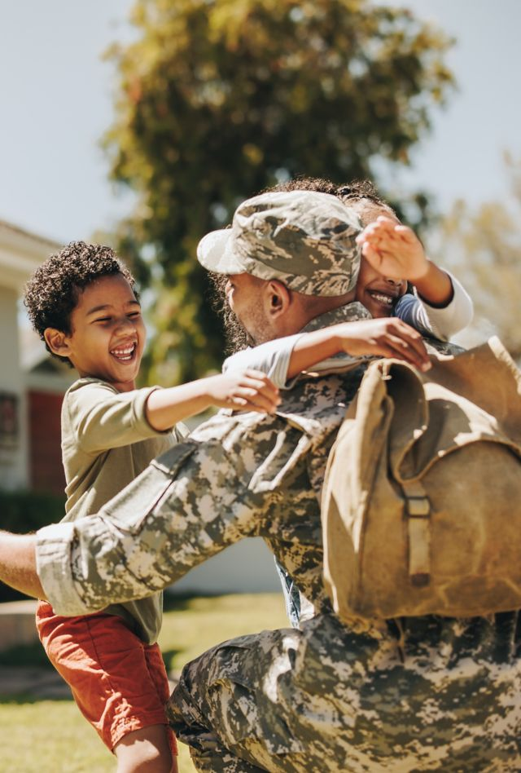
Crisis Intercept Mapping
For Service Members, Veterans, and their Families (SMVF)
Crisis Mapping Objectives
Assess and improve community crisis care systems and services
Strengthen partnerships among military and civilian community stakeholders
Develop a tailored crisis intercept map for your community hand-in-hand with an action plan to improve crisis care services
Develop interagency protocols for crisis care coordination
Implement best practices in SMVF suicide prevention
https://www.samhsa.gov/smvf-ta-center/crisis-intercept-mapping
Notes:
The objectives of Crisis Mapping are to assess and improve community crisis care systems and services while strengthening partnerships between military and civilian community stakeholders. A key goal is to develop a tailored crisis intercept map for the community, alongside an action plan aimed at enhancing crisis care services. Additionally, the initiative seeks to establish interagency protocols for coordinated crisis care and implement best practices in suicide prevention for Service Members, Veterans, and their Families (SMVF).​

Slide 24

Crisis Intercept Mapping
Assess and improve community crisis care systems and services
Objectives:
Strengthen partnerships among military and civilian community stakeholders
Develop a tailored crisis intercept map for your community hand-in-hand with an action plan to improve crisis care services
Develop interagency protocols for crisis care coordination
Implement best practices in SMVF suicide prevention
Notes:
Enhancing Community Crisis Care Systems​
• Evaluate and Enhance: Analyze existing crisis care frameworks and services, identifying areas for improvement to better support the community.​
Building Strong Partnerships​
• Foster Collaborations: Strengthen connections and collaboration between military and civilian organizations to create a unified approach to crisis management.​
Crafting a Customized Crisis Intercept Plan​
• Create a Strategic Map: Develop a personalized crisis intervention strategy for your community, complete with a detailed action plan to enhance care services.​
Establishing Crisis Coordination Protocols​
• Formulate Interagency Protocols: Develop and implement coordinated protocols across agencies to ensure smooth and effective crisis care management.​
Implementing Best Practices for Suicide Prevention​
• Adopt Proven Methods: Apply leading practices in suicide prevention, specifically tailored for Service Members, Veterans, and their Families (SMVF).

Slide 25
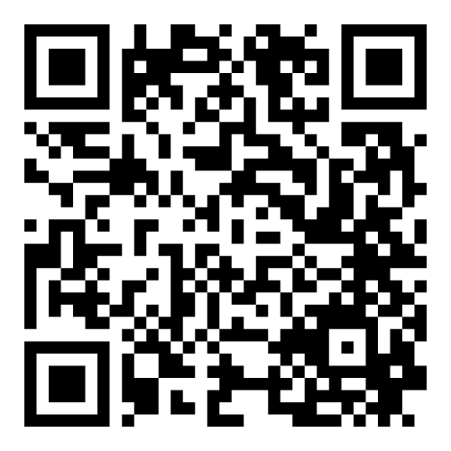
Crisis Intercept Mapping
Assess and improve community crisis care systems and services for veterans.
What are some intercept resources to help fill the gap for Service Members, Veterans, Caregivers, and their Families?
https://www.samhsa.gov/smvf-ta-center/crisis-intercept-mapping
Notes:
Enhancing Community Crisis Care Systems​
• Evaluate and Enhance: Analyze existing crisis care frameworks and services, identifying areas for improvement to better support the community.​
Building Strong Partnerships​
• Foster Collaborations: Strengthen connections and collaboration between military and civilian organizations to create a unified approach to crisis management.​
Crafting a Customized Crisis Intercept Plan​
• Create a Strategic Map: Develop a personalized crisis intervention strategy for your community, complete with a detailed action plan to enhance care services.​
Establishing Crisis Coordination Protocols​
• Formulate Interagency Protocols: Develop and implement coordinated protocols across agencies to ensure smooth and effective crisis care management.​
Implementing Best Practices for Suicide Prevention​
• Adopt Proven Methods: Apply leading practices in suicide prevention, specifically tailored for Service Members, Veterans, and their Families (SMVF).

Slide 26
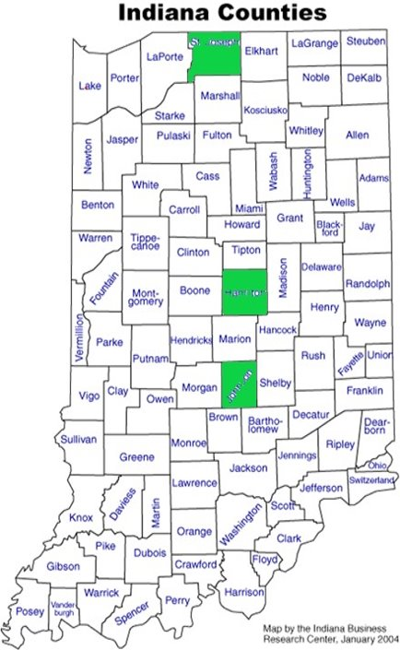
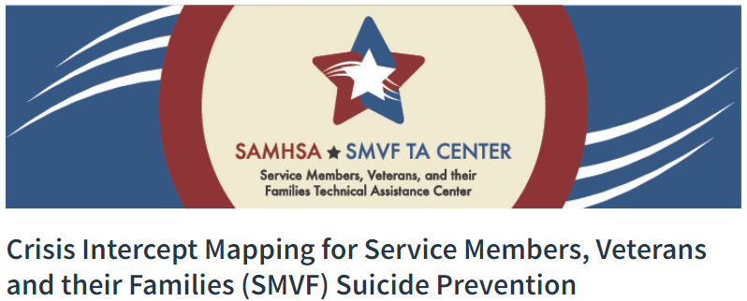
Crisis Intercept Mapping
SAMHSA/VA TA Center Trained Indiana Counties:​
​
St Joseph​
Hamilton​
Johnson

Slide 27


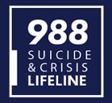
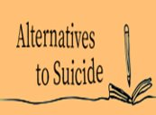
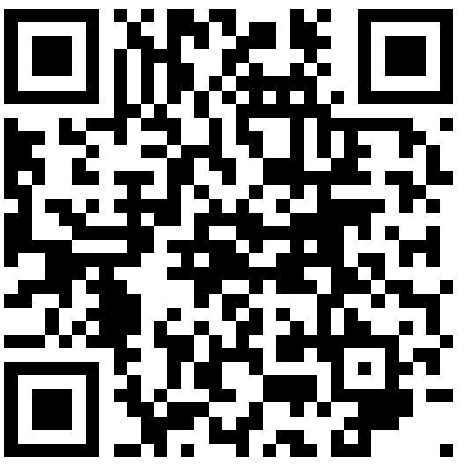
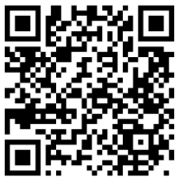
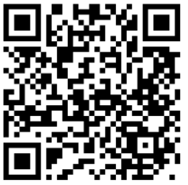
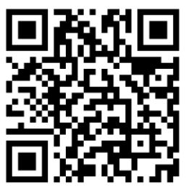
Crisis Intercept Mapping
988​ | MIRS​ | MIH​ | Alt2Su​
​ ​ ​ ​ ​ | ​ | ​ | ​
Suicide & Crisis Lifeline​ | Mobile Integrated ​ Response System ​ | Mobile Integrated Health​ ​ | Alternatives To Suicide ​ ​
​ A simple, short number for anyone experiencing mental health-related distress ​ ​ | ​ Provides peer recovery coaches in hospitals and in the community to address opioid and stimulant misuse and disorders.​ ​ | ​ Patient-centered model of care delivered in a patient's home in a mobile or telehealth environment​ ​ | ​ Peer support group for persons living with suicidal ideations.​ ​
https://www.in.gov/fssa/dmha/update-on-988-in-indiana/​ ​ | https://www.in.gov/fssa/dmha/files/MIRS-RFF-FAQ.pdf​ ​ | https://www.in.gov/fssa/dmha/files/MIRS-RFF-FAQ.pdf ​ ​ ​ | https://alt2su-nsw.net/about/​ ​
Notes:
988 short number but overall impact of connections, MIRS peer to peer relationships (National statistics) Opioid overdose fatalities have dropped to their lowest level nationwide in three years, according to provisional data from the Centers for Disease Control and Prevention. National surveys compiled by the CDC show drug deaths declined by 10.6% from April 2023 to April 2024; MIH focused on in-patient care a home-based model and Alt2 Suicide….beyond the clinical but peer to peer support groups that have proven to be effective.

Slide 28

Crisis Intercept Mapping
Alternatives to Suicide is a peer-based response to supporting people who have made suicidal attempts or who have experienced suicidal thoughts. The approach was developed in 2008 by the Western Massachusetts Recovery Learning Community (USA – now called The Wildflower Alliance).
“Community. A sense of belonging. A sense of connection, purpose, love… I think often that’s the antidote to distress.”
Notes:
Alt2Su peer support groups are for anyone 18+ years old with personal experiences of suicidal thoughts or actions to talk about suicidal experiences and other forms of emotional distress without fear of being put through a crisis management system. Alt2 Suicide is being considered within IDOC in an among the veteran population through the Governors Challenge.

Slide 29
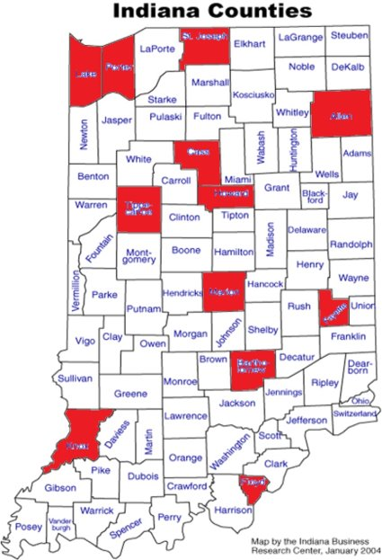
Crisis Intercept Mapping
Lake, Allen, Porter, St Joseph, Cass, Howard, Tippecanoe, Marion, Fayette, Bartholomew, Floyd, Knox

Slide 30
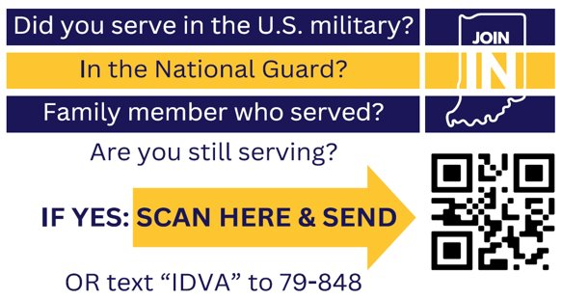
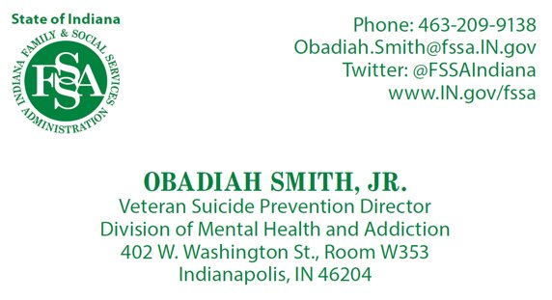
You can JOIN IN.
Indiana is making a difference, taking the lead, and changing lives. Be a part of the team, Join IN.

Slide 31
Suicide Postvention
at the Community Level
Addressing the Mental Health Needs of Service Members, Veterans, Family, and Caregivers (SMVF-CG)
Carlye Gibson
Veteran Suicide Prevention Director
Indiana Department of Health
Postvention
Community Initiatives
Community Support

Slide 32

What is Postvention?
Postvention
Suicide Postvention is a form of prevention
Statistically, a person is at a higher likelihood to die by suicide when they have known someone who died by suicide
Many people may feel that they do not need to prepare for a suicide death, which also means they are unlikely to be prepared to decrease future suicide risk.
Notes:
Picture a death by suicide as dropping a pebble in a pond. That pebble is going to initially cause a small ripple, and those ripples continually get bigger as they expand out across the body of water.

Slide 33
Postvention
Impact of Suicide
Inclusive of blood relatives, Dr. Julie Cerel at the University of Kentucky has reported the following additional impacts from a single death by suicide:
135 individuals exposed from a single death
53 experience a short-term disruption in life
25 experience major disruption in life
11 experience a devastating effect in their lives
Notes:
Impact is especially severe in small, tight-knit communities.

Slide 34
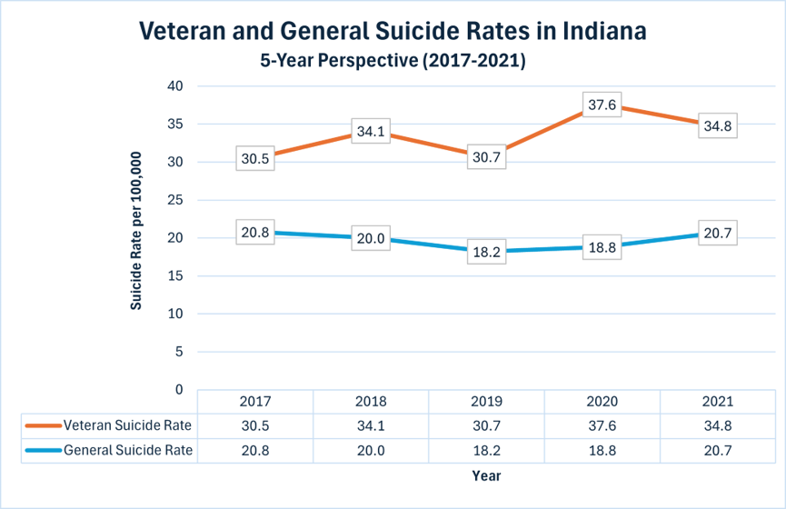
Postvention
Veteran vs Civilian Suicide Deaths 2017-2021

Slide 35
Community Initiatives
Creating Postvention Initiatives
in Your Community
Four key items for postvention initiatives:
Learning the communities’ needs and planning to address needs
Ability to provide immediate and long-term support to families and the community
Tailored response to survivors of suicide loss. Having resources and services that are specific to their needs
Knowing that lived experiences of survivors of suicide loss can help with planning and implementation of postvention efforts
Notes:
Those of you living in the community know your community better than anyone from outside looking in.

Slide 36
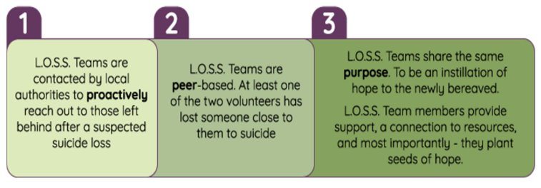
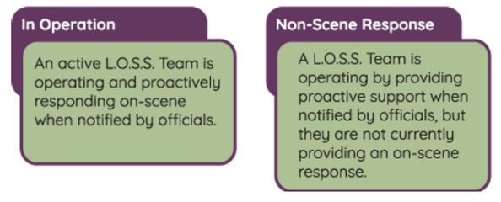
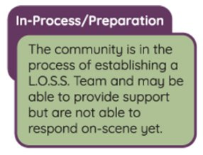
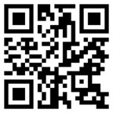
Community Initiatives
Local Outreach to Suicide Survivors (L.O.S.S.)
Two Types of Active Teams
Preparation for a Team

Slide 37
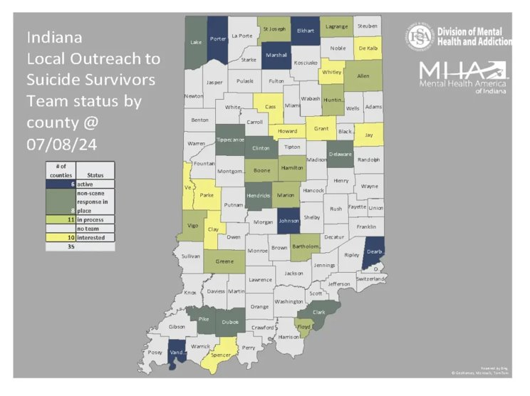
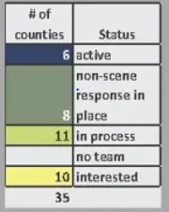
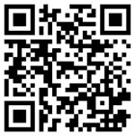
L.O.S.S.
Teams
Notes:
Currently Indiana has 6 counties with active teams, 8 that can respond, but not to the actual scene of the suicide, 11 in process and 10 that are interested. Many of the individuals on a loss team have lived experience with suicide and are able to reach out with understanding and empathy. ​

Slide 38
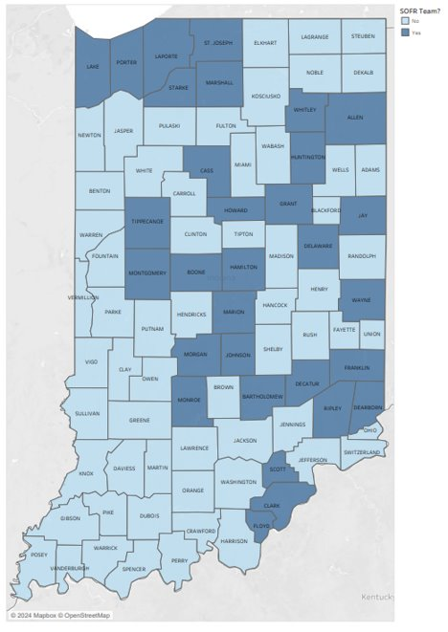
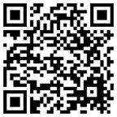
Indiana Suicide and
Overdose Fatality Review
Teams (SOFR)
Has a SOFR team
Does not have a SOFR team

Slide 39
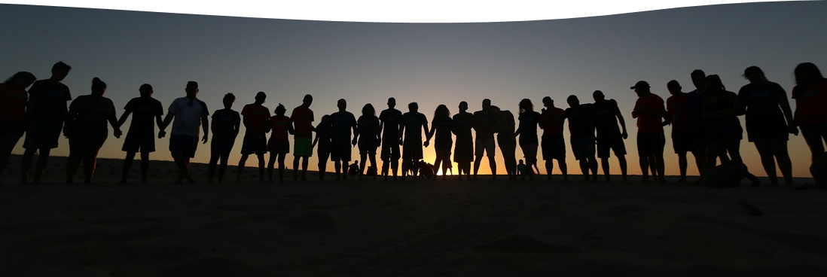
Community Support
Bereavement and Support Groups
Connectedness is one of the most important factors following a loss by suicide.
Studies show that those bereaved by suicide have lower mental health, higher symptoms of depression and are more likely to experience suicidal ideation.
Notes:
Communities and local agencies can do somethings as small as sending postcards to the bereaved or something large scale as a support group. Just letting those individuals going through loss that they are not alone can do so much to help.

Slide 40
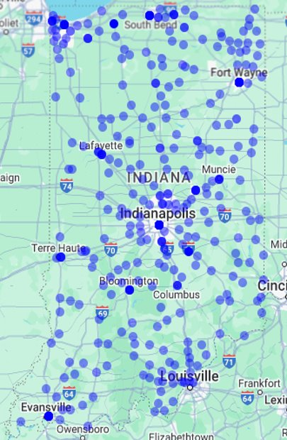
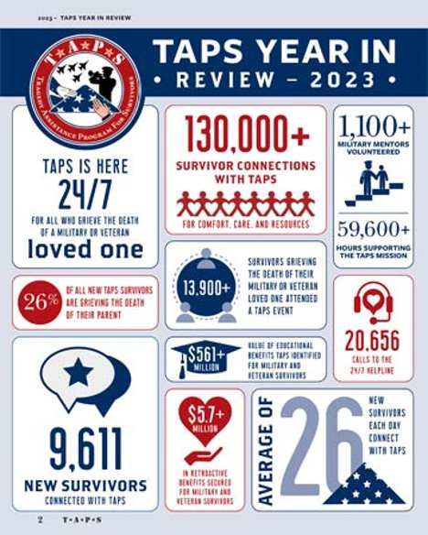
Community Support
Notes:
As you can see in the Tragedy Assistance Program for Survivors - TAPS data from 2023, they have been able to connect to many individuals who are survivors of suicide loss. The map is showing military survivors in Indiana. The brighter blue dots are the areas that have a higher population that is connected to TAPS. This just helps to show how important it is to have postvention resources in our communities due to how many lives a death by suicide touches.

Slide 41
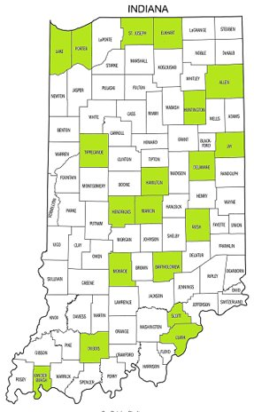
Community
Support
Counties in green have suicide specific grief groups.
Additional grief programs are available through hospitals, community mental health agencies, hospice locations and funeral homes.
Notes:
The counties in green have groups that are specific to those that their lives have been touched by suicide. ​

Slide 42
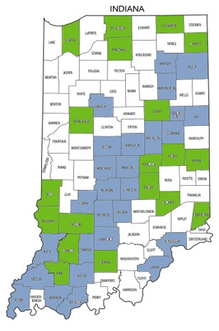
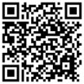

Community Support
Interested in program
Currently has program
Notes:
Exposure to trauma can disrupt brain development and interfere with a child’s ability to academically succeed. The Handle with Care (HWC) program is a notification system that enables law enforcement and other first responders to notify schools when a child has been at the scene of a potentially traumatic event, allowing schools and mental health partners to provide trauma-sensitive support. By ensuring children have safe, stable, and nurturing environments for healthy development and learning, the potential effects of trauma can be mitigated.​
​
If law enforcement or first responders encounter a child during a call, that child’s name and three words, Handle with Care, are forwarded to the school/childcare agency before school the next day. The school implements individual, class and whole school trauma-sensitive curricula so that traumatized children are “Handled with Care". If a child needs more intervention, on-site trauma-focused mental healthcare is available at the school.

Slide 43
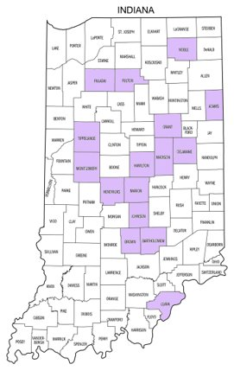
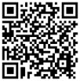
Community
Support
Purple Star Schools
in Indiana
This is an honor for schools that have displayed a significant commitment to service members, veterans, students and families connected to our nation's military.
These counties have at least 1 purple star school district.
Notes:
Purple star designated schools are required to have designated staff member at the school who serves as the liaison for service members, veterans, students and families. This staff member is required to complete specific training. The school will have a dedicated webpage to provide recognition and resources, a public military display, and will host an annual military program. There are also specifications for the school board to have passed a resolution supporting military students and families. Lastly the school will guarantee an interview for military service members and their immediate family member who meet the minimum qualification for job openings within the school.

Slide 44
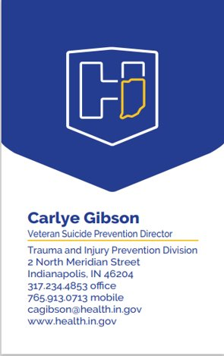
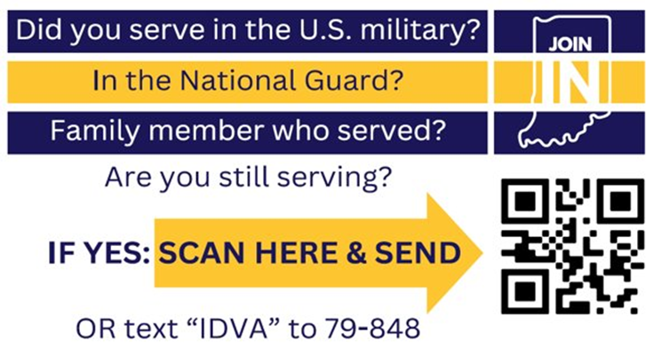
You can JOIN IN.
Indiana is making a difference, taking the lead, and changing lives. Be a part of the team, Join IN.

