Slide 1
2022 Title II RFP Webinar
September 20th, 2021

Slide 2
Thanks for joining us today: Please keep your lines muted during the presentation. Webinar is being recorded. It will be posted on the ICJI website. Questions and Answers at the end. Feel Free to utilize the chat box during the webinar.

Slide 3
Accessing the RFP
Located on ICJI Website
CJI.in.gov → Youth → “Title II Formula Grant Program” → “2022 Title II RFP”
https://www.in.gov/cji/behavioral-health/title-ii/

Slide 4
2022 Title II Grant Application
Application opened: Wednesday, September 15th at 9 AM
Application closes: Friday, October 15th at 11:59 PM
Applicants are strongly encouraged to submit applications 48 hours prior to the deadline.
Award Period for Title II: January 1, 2022 to December 31, 2022 (12-month award period)
Projects should begin on January 1, 2022 and must be in operation no later than 60 days after this date. Failure to have the funded project operational within 60 days from January 1, 2022 will result in the cancellation of the grant and the de-obligation of all awarded funds.

Slide 5
Overview:
OJJDP's Formula Grants Program supports state and local delinquency prevention and intervention efforts and juvenile justice system improvements. Within the program purpose areas, states can provide job training, mental health and substance abuse treatment, community-based programs and services, reentry/aftercare services, and school programs to prevent truancy.

Slide 6
Funding Eligibility:
Eligible entity types include:
State Agencies
Units of local government
Nonprofit organizations
Other Requirements include:
Registered DUNS number
Active and current registration with SAM.gov
Good standing with the Department of Revenue (DOR), Department of Workforce Development (DWD), and Secretary of State (SOS)

Slide 7
Other Requirements / Trainings:
Determination of suitability to interact with participating minors
Every 5 years additional background checks (fingerprinting, etc.) must be run on any grant/match funded employees (including volunteers) that interact with anyone under the age of 18
This is a required condition of any DOJ grant- for more details about the required checks please visit https://www.ojp.gov/funding/explore/interact-minors
Civil Rights Training
The DOJ requires all recipients and subrecipients of federal funds to comply with a variety of Federal civil rights laws. ICJI has a checklist that each subgrantee needs to complete on an annual basis to remain in compliance
CJI Grantee Training and Resources Link-
https://www.in.gov/cji/grantee-training-and-resources/
These requirements along with other trainings can be found at:

Slide 8
Initiating an application in IntelliGrants
https://intelligrants.in.gov

Slide 9
Steps to initiating an application in IntelliGrants (ICJI’s Grant Management system):
Log into your IntelliGrants account
If you do not have an account, then you can obtain one on the home screen of intelligrants (New User?)
On the “MY HOME” page access the “VIEW AVAILABLE PROPOSALS” section
Click on VIEW OPPORTUNITIES
Intelligrants will take you to the My Opportunities page
Access the 2022 Title II – Juvenile Justice and Delinquency Prevention ACT (TII) Application
Select “Apply Now”

Slide 10
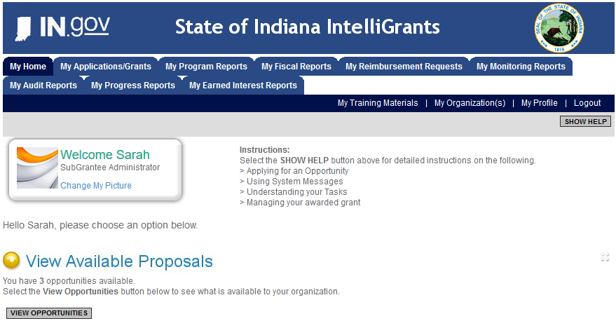

Slide 11
Title II Application

Slide 12
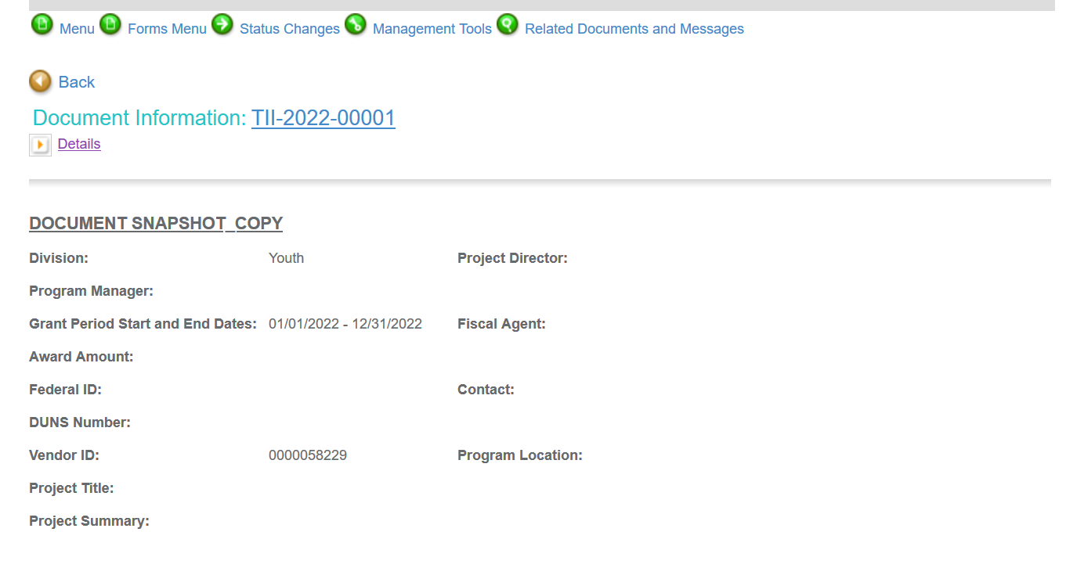
Notes:
To access the different components of the application you will need to navigate to the forms menu.

Slide 13
Forms that need to be completed:
Contact Information
Project Information
Programmatic Information
Problem Statement & Analysis
Goals, Objectives, & Outcomes
Program Descriptions
Evidence Based/Best Practices
Use of Volunteers
Budget
Budget Narrative
Attachments

Slide 14
Contact
Points of Contact for the grant (CJI will notify these individuals of your award notice)
Project Information
SAMs Registration must be up-to-date
Audit
If you receive more than $750,000 in federal grant funds, you are required to have an audit. This will be requested if CJI is aware that you receive more than $750,000.
Programmatic Information
Information about your proposed Title II grant
Problem Statement & Analysis
All government agency’s audits are included in the County audit and should all have one attached
Forms to be Completed (continued):

Slide 15
Goal, Objective, and Outcomes
The goal should directly address the problem identified in the Problem Statement.
Objectives are the steps needed to achieve goals. Objectives should be concrete, action-oriented, measurable and Specific, Measurable, Achievable, Realistic, Timely (SMART).
Example of Objective: By September 2022, a minimum of 50 culturally and linguistically appropriate support groups for survivors of domestic violence will be provided.
Outcomes measure objectives and are criteria for how the program is deemed to be effective.
Example of Outcome: 85% of participants will indicate that they have learned ways to act in their own best interest.
Program Description
What? Who? Where? Why? When? How?
Evidence Based/Best Practice
Use of Volunteers
Forms to be Completed (continued):

Slide 16
Important Notes:
All grants from ICJI Behavioral Health Division are reimbursement grants, which means that agency must first incur the expense prior to CJI reimbursing for the expense. Verification of expenses along with verification of payment of expenses must be provided to ICJI on a monthly or quarterly basis prior to reimbursement of expenses by ICJI.
Match Requirement for Title II is 10%

Slide 17
Funding Categories:
Compliance Monitoring
Delinquency Prevention
Indigent Defense
Mental Health Services
Mentoring, Training, and Counseling
Racial and Ethnic Disparities (RED)
Substance and Alcohol Abuse
Juvenile Justice System Improvement
Eligible expenses will depend on the funding category applied for. For additional information on the funding categories, please go to https://ojjdp.ojp.gov/programs/formula-grant-areas.

Slide 18
Ineligible Budget Items
Administrative costs over 10% of the total grant budget
Direct financial assistance to a client such as cash, gift cards, or checks
Food and beverages
Lobbying and/or fundraising
Immigration fees
Purchase of real estate
Construction,
Physical modification to buildings, including minor renovations (such as painting or carpeting)
Vehicles

Slide 19
Budget Narrative
Be sure all items in the Budget are included in the Budget Narrative.
Ex: Office Supplies (copy paper, pencils, pens)
Grant reviewers are not required to contact you for clarification.
Any missing information in this section may disqualify that budget item for funding.

Slide 20
Attachments Required:
Total Agency Budget
Found on ICJI’s website (https://www.in.gov/cji/victim-services/resources/) – Nonprofit Applicant Budget Form
Sustainability Plan
Your plan to maintain the program once the grant funds expire
Timeline
Outlining the completion of the project/ or expenditures of the grant funds
Letters of Endorsement
For this program specifically
Miscellaneous
Job Descriptions for any position listed in personnel
If applicable any contracts
Consultation Form – example on the last page of the RFP
EEOP Certification
Legal Services Certification Form – example also included in the RFP

Slide 21
For technical assistance contact the ICJI Helpdesk at CJIHelpDesk@cji.in.gov. Help Desk hours are Monday – Friday, 8:00 am to 4:30 pm ET, except state holidays.
ICJI is not responsible for technical issues with grant submission within 48 hours of grant deadline.
For assistance with any other requirements of this solicitation, please contact The Victim Services Division at ICJI.

Slide 22
Thanks for attending!
Presenter:
Adam WInkler
adwinkler@cji.in.gov
317-234-6121

