Slide 1
21st Century Scholars
30th anniversary
Scholars Day Re-cap and June 4 Celebration
Indiana Commission for Higher Education
February 2020

Slide 2
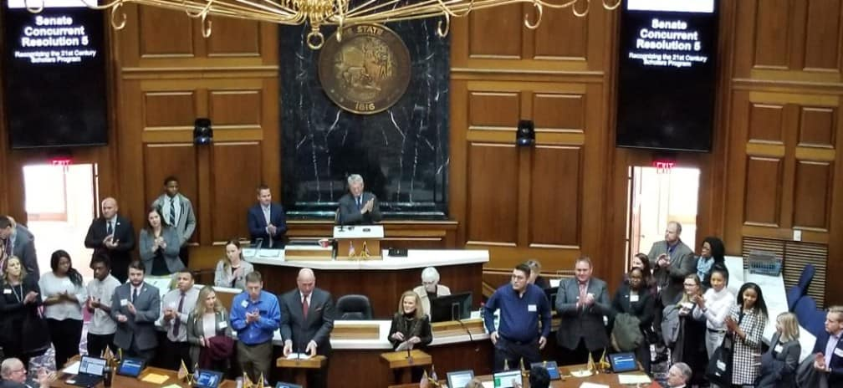
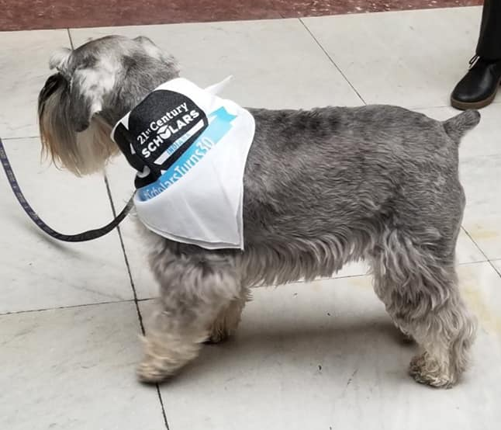
Scholars Day
21st Century Scholars – 3oth anniversary
February 11 events included:
  Scholar alumni brunch and meet-and-greet with legislators
  Concurrent resolutions approved on the Senate and House floors; recognition of Scholar alumni and the success of the program; remarks from the Commissioner
  Scholars Day activities included tabling with community and university partners, opportunities for networking and connecting with Scholar alumni

Slide 3
Scholars Day results
21st Century Scholars – 3oth anniversary
About 50 alumni attended the brunch, coming from around the state and around the country; many were present the entire day
Social media impact: some of our most engaging social media posts over the past several months on Twitter were on Scholars Day or mentioning the 30th anniversary. #ScholarsTurns30
Garnered statewide news coverage of the program, its impact and results since the end of January
Engagement through universities and community partners

Slide 4
June 4 – Anniversary celebration
21st Century Scholars – 3oth anniversary
  Location: Biltwell Event Center
  Expected audience: up to 500 Scholar alumni and current Scholars, key stakeholders, Commission members and staff, community partners, participating Indiana colleges and universities
  Special guest: former Governor Evan Bayh is planning to attend
  FAFSA and Scholar Success Program Awards: 3-4:30 p.m.
  21st Century Scholar Archives and Exhibitors with reception and outdoor entertainment: 4:30-5:30 p.m.
  Program, including panel of distinguished alumni and viewing of 30th anniversary video, etc.: 5:30 to 7:15

Slide 5
Goals for march through June
21st Century Scholars – 3oth anniversary
  The celebration in June will coincide with graduation time and honoring new alumni of the program, as well as new college Scholars; pitching that angle to media
  Continue to connect with alumni of the program and grow the alumni network
  Tell the impact of the 21st Century Scholars program through current Scholars and alumni stories with the 21st Century Scholars 30th anniversary magazine, as well as social media and through traditional and digital media
  Continue working with colleges and universities and pitch to college journalists
  Use data and stories to continue making the case for the 21st Century Scholars program

Slide 8
Next Level Jobs
Workforce Ready Grant update
Indiana Commission for Higher Education
February 2020

Slide 9
Workforce Ready Grant
Next level jobs
In January, Governor Holcomb announced more than 10,000 Hoosiers have earned a certificate with the Workforce Ready Grant. That number is nearing 11,000.
As of Feb. 24:
  792,597 total visits to NextLevelJobs.org
  479,583 unique visits to NextLevelJobs.org
  76,562 leads routed to Ivy Tech, Vincennes University, WorkOne, etc.
As of Feb. 1 2020:
  23,725 Hoosiers have enrolled in high-demand certificate program at Ivy Tech, Vincennes or other eligible training providers
  10,620 Hoosiers have completed a Next Level Jobs Workforce Ready-eligible certificate program

Slide 10
Lead breakdown by industry sector
Next level jobs
Health & Life Sciences: 30,717 (52%)
IT & Business Services: 22,450 (38%)
Advanced Manufacturing: 12,113 (21%)
Building & Construction: 9,226 (16%)
Transportation & Logistics: 6,644 (11%)
Other (non-WRG eligible sectors/credentials): 6,571 (11%)

Slide 11
Statwax marketing update
Next Level Jobs
  Total conversions: at least 3,966 completed applications through the Next Level Jobs web site since August 2019 (when campaigns began)
  Only 23% of these completed applications were from users signaling a knowledge of the Next Level Jobs or Workforce Ready Grant program (could have come from the search/display ads)
  Over 38% came from users who were not searching for Next Level Jobs or any kind of school/job training program
Notes:
Nearly 4,000 completed applications
We’re reaching people who were not searching for NLJ or school/job training.
At least 4,000 completed applications – but likely more due to changes in tracking.
Places for expansion – those that aren’t searching for NLJ/job training/vocational training

Slide 12
Costs compared to industry averages
Next level jobs
  The current Cost per Completed Application (CPA) averages $35 since December 1; well below the industry average for higher education, job training or vocational training program (typically in the $100-$200 range)
  Brand awareness campaigns have been extremely successful compared to industry averages. These campaigns have spent $51,757 so far, which has led to:
    26 million impressions for a Cost Per Thousand Impressions (CPM) of $.50
    766 conversions with a Cost Per Application (CPA) of $67
Notes:
Explain Pay-Per-Conversion and how that has impacted the update – more cost effective than paying per click
Worth noting that most Brand Awareness campaigns don’t reliably convert – but these campaigns are reaching people who were note even searching NLJ or related products.

Slide 13
Ad insights
Next level jobs
Brand awareness campaigns continue to improve in efficiency:
  Click through and conversion rates have improved after a change in strategy – using Pay-Per-Conversion
  Conversion rates for search fell slightly this period (Feb. 10-23), causing the Cost-Per-Acquisition to rise by a similar proportion. Similar changes during the same timeframe last month shows there might be a seasonality emerging (middle of the month)
Notes:
Meaning that we don’t pay unless they convert into applications

Slide 14
Ad insights
Next level jobs
Because of the new efficiency, Statwax can target users based on unrelated searches that have implications for their economic status or needs
Forward-looking: Working on re-targeting and re-marketing to individuals who arrive on the site via different sources; building out new audiences for re-marketing
Expanding brand awareness campaigns to target vulnerable populations that could be within the target market for Next Level Jobs program offerings
Notes:
Example for bullet 1: expanding into users searching for services such as Payday loans, for example
What are the “vulnerable” populations? Those in economic hardship (SNAP benefits, housing vouchers, etc.)

