Slide 1
Ivy Tech Community College Accelerating Greatness Commission for Higher Education October 9, 2010

Slide 2
Adults 18 – 34 Enrolled in College
3
Notes:
2

Slide 3
Lumina’s Big Goal
6,454+ Graduates / Per Year
If Ivy Tech produces:
75 percent = 4,840+
50 percent = 3,227+
25 percent = 1,613+
5
Notes:
3

Slide 4
Complete to Compete (NGA)
Reclaim the nation’s rank as first in the world in college attainment
Need to produce an additional 8.2 million college graduates
Cannot be met with recent high school graduates alone
Need to focus on improving educational attainment among adults.
7
Notes:
4

Slide 5
American Graduation Initiative
To lead the world with the highest proportion of college graduates by 2020
5 million more community college graduates
8
Notes:
5

Slide 6
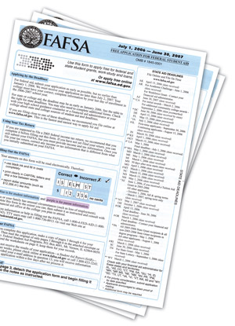
60% receive financial aid
13
Notes:
6

Slide 7
Avg. age – 27.3
10
Notes:
7

Slide 8
Approximately 25% are single moms
11
Notes:
8

Slide 9
13,000 African-American students
12
Notes:
9

Slide 10
Nearly 10,000 students on food stamps
16
Notes:
10

Slide 11
Measuring Success
Notes:
11

Slide 12
Measuring Success
Graduate: 15.4%
Grad/Transfer: 3.2%
Transfer: 15.8%
Still Enrolled: 6.0%
Total: 40.5%
20
Notes:
12

Slide 13
Success Unknown = 60%
Left Ivy Tech because:
Credential
Job
Money
Time
Family
Aptitude
20
Notes:
13

Slide 14
Accelerating Greatness
Ensure that students achieve their educational goals
Ensure that Indiana's citizens, workforce, and businesses are globally competitive
Ensure optimal quality and efficiencies statewide
Ensure an adequate and sustainable resource base
22
Notes:
14

Slide 15
New Initiatives – Fall 2010
Mandatory Orientation
Mandatory Advising Prior to Remediation
Financial Aid Priority Processing Dates
Decreased Textbook Variance
24
Notes:
15

Slide 16
More New Initiatives
Accelerated Associate Degree Program
Adult Degree Completion Program
Manufacturing Institute Partnership
Tennessee Completion Model
25
Notes:
16

Slide 17
Support for our Students
Appropriation Per FTE Student
26
Notes:
17

Slide 18
Support for our Students
Appropriation Per Ivy Tech FTE Student
27
Notes:
18

Slide 19
Reinvesting Savings into our Students
Initiative | One Time Impact | FY2008 Impact | FY2009 Impact | FY2010 Impact | FY2011 Impact
Bookstore Outsourcing & Privatization | $ 7,650,000 |  | $ 3,800,000 | $ 3,682,000
Single Source Advertising Agency | $ 300,000
Health Insurance- Self-Insurance-Claims Mgt-Plan Changes |  |  | $ 3,400,000 | $ 1,600,000
PC Buy Consolidation with Dell & Price Reductions |  | $ 325,000 | $ 1,035,610 | $ 95,150
Bond Rating Increase from A+ to AA- (Present Value) | $ 2,638,000
Build America Bond Savings – PV (Elk/War/Sel/Ind) (Present Value) | $ 2,700,000
Property and Casualty Insurance Modification & Re-negotiated Contract |  |  | $ 200,000 | $ 500,452
Central Indiana Food Service |  |  | $ 96,180
Waste Disposal Contract Negotiations |  |  | $ 10,900 | $ 10,900
Distance Ed Headsets and Cameras | $ 9,700 | $ 9,700
Energy (Gas) Audit | $ 9,699 |  | $ 4,148
HP PC Negotiation | $ 14,763
Stateside Copier Consolidation - IKON | $ 100,000 |  | $ 100,000 | $ 400,000
RCI Telecommunications Audit | $ 17,769 |  | $ 4,500 | $ 48,090
Oracle License Negotiation - Sunguard | $ 770,720
Print Marketing Consolidation |  |  | $ 75,000 | $ 75,000
Phase 1 Financial Aid Commonization |  |  |  | $ 50,000
Autodesk CAD Software License Negotiation |  |  | $ 1,357 | $ 6,786
VOIP - Ft. Wayne BAFO Negotiation & 3-G Interactive Intelligence |  |  |  | $ 270,085
Marketing Postage Savings through Jackson Group |  | $ 29,071 | $ 115,256 | $ 120,000
One Time Salary Freeze |  |  |  | $ 7,000,000
Architecture A & E Standards |  |  | $ 240,096 | $ 330,390
Network Equipment Consolidation – RCP- Brocade & Cisco |  |  |  | $ 550,000
Furniture Standards and Buy Consolidation |  |  |  |  | $ 1,000,000
Guaranteed Energy Savings Contract – Indianapolis | $ 7,300,000
Total Savings from Executed Initiatives | $ 21,510,651 | $ 363,771 | $ 9,083,047 | $ 14,738,853 | $ 1,000,000
28

Slide 20
Savings (Millions)
Annual = $25.2
One Time = $21.5
29

Slide 21
Unfunded Formula Based Submission
2009-2011 biennium performance formula funding should have resulted in $47,000,000 more for Ivy Tech Community College.
Serving over 165,000 students yet we are operating with a funding model of just 120,000 students.
Depending on funding for 2011-2013 Ivy Tech may be short $150,000,000 in performance funding over the last two biennia.
30
Notes:
21

Slide 22
Submission Based on CHE Formula
Formula Basis 2011-12 2012-13
Successfully Completed Credit Hours $55,417,450 --
Dual Credit Completed Credit Hours $5,484,944 --
Change in Degrees $4,368,000 --
Low Income Degrees $832,000 --
Capital Request
Muncie New Construction $35,000,000
Lafayette New Construction $25,000,000
South Bend New Construction $25,000,000
Ft. Wayne New Construction $25,000,000
Columbus New Construction $30,000,000
31
Notes:
22

Slide 23
Debt Service
$1,236
$1,234
$1,058
$854
$647
$549
$377
Costs Per Estimated FTE Student
32
Notes:
23

Slide 24
73% of our students are working adults
14
Notes:
24

Slide 25
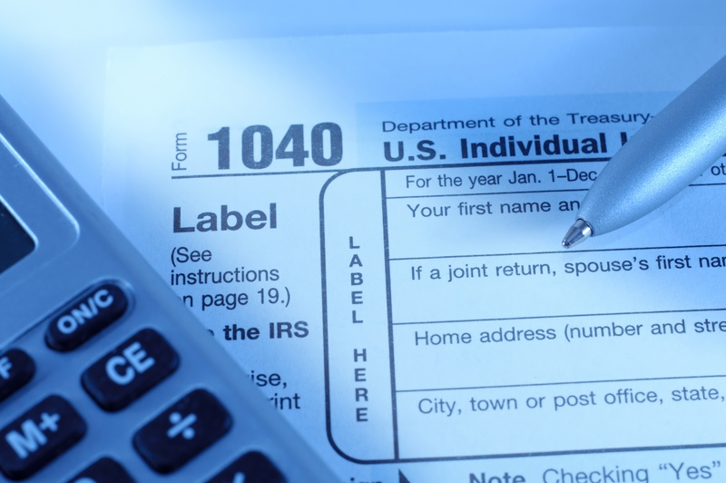
Average Income
$25,073
Median Income
$19,103
15
Notes:
25

Slide 27
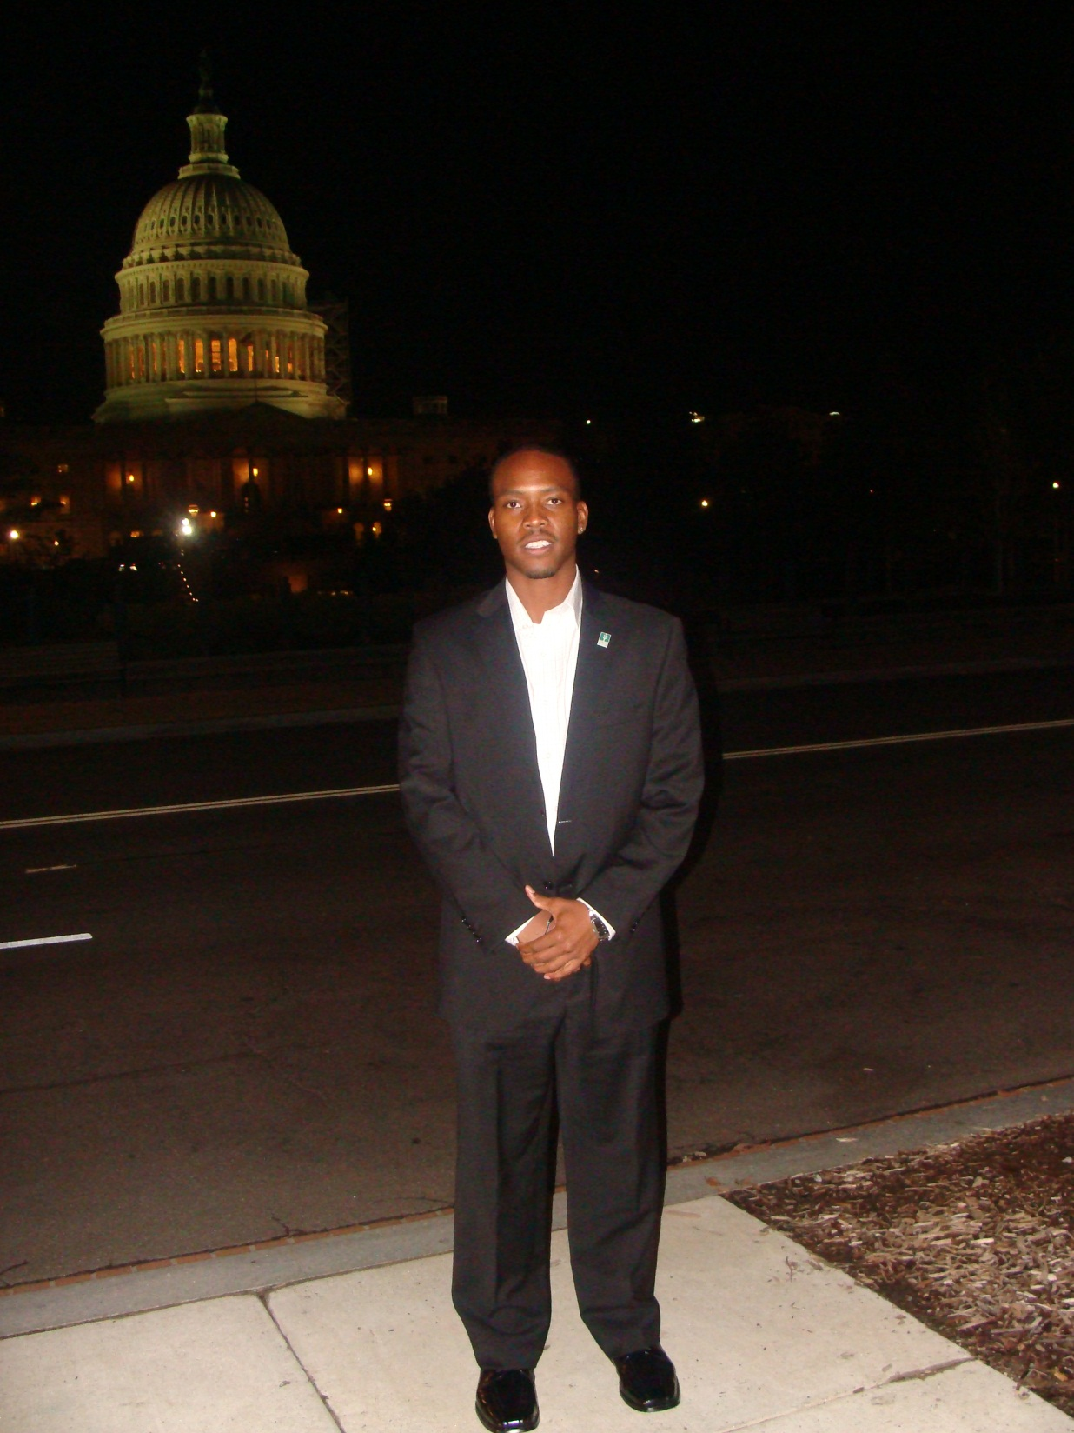

Slide 28
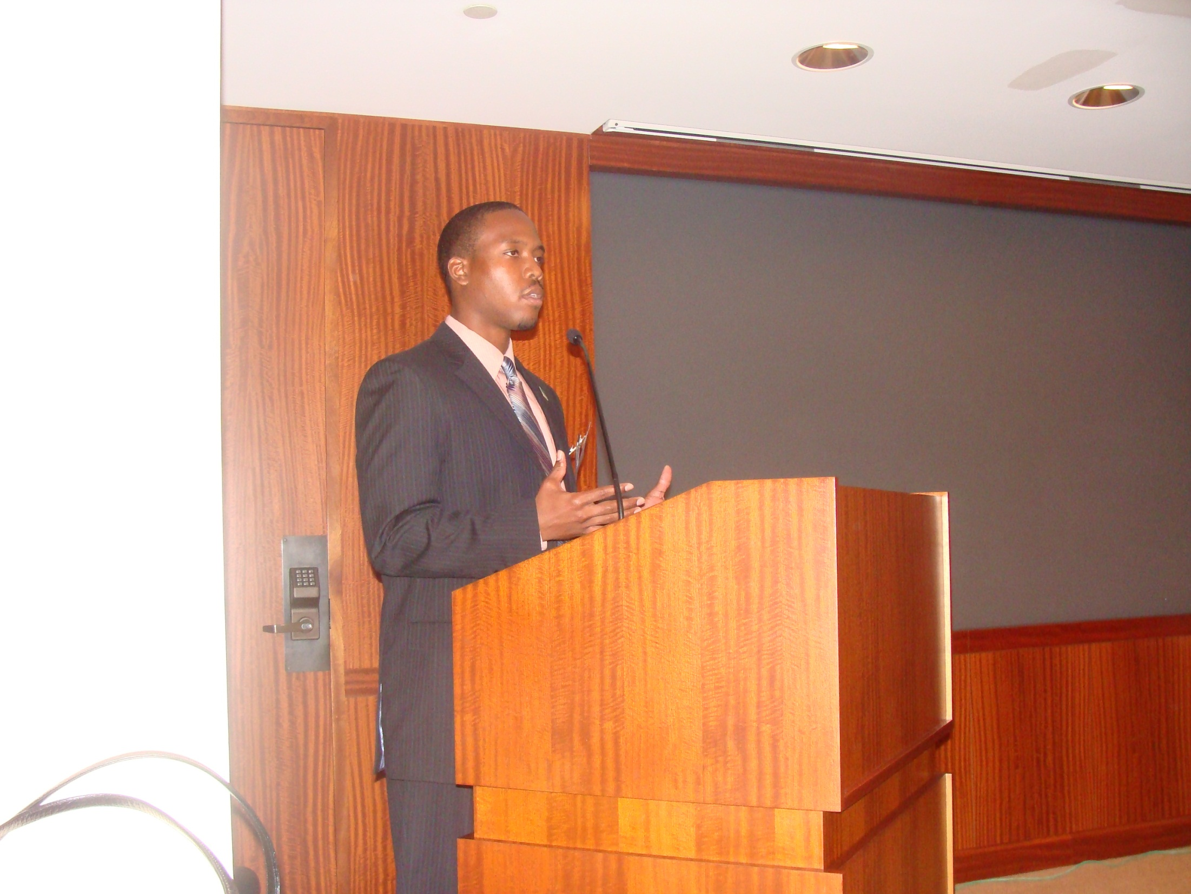

Slide 29
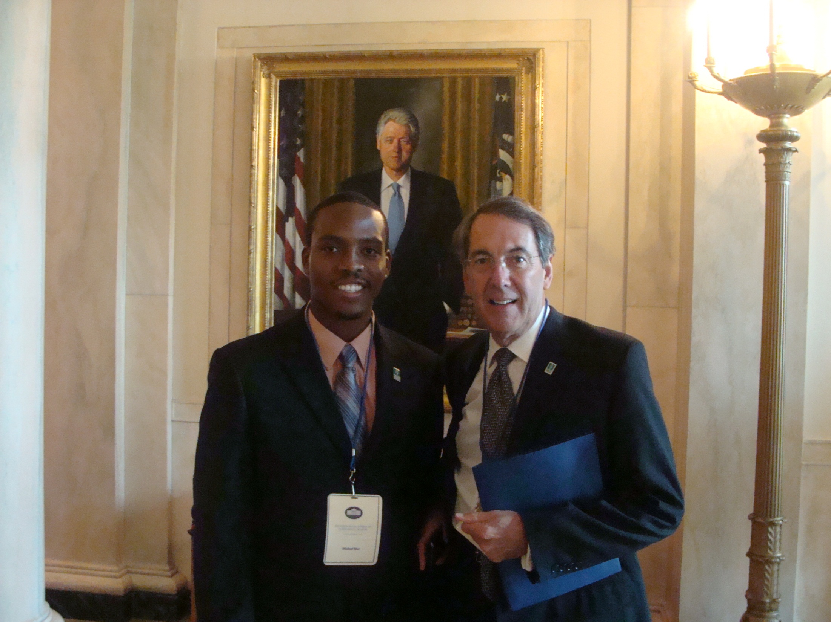

Slide 30
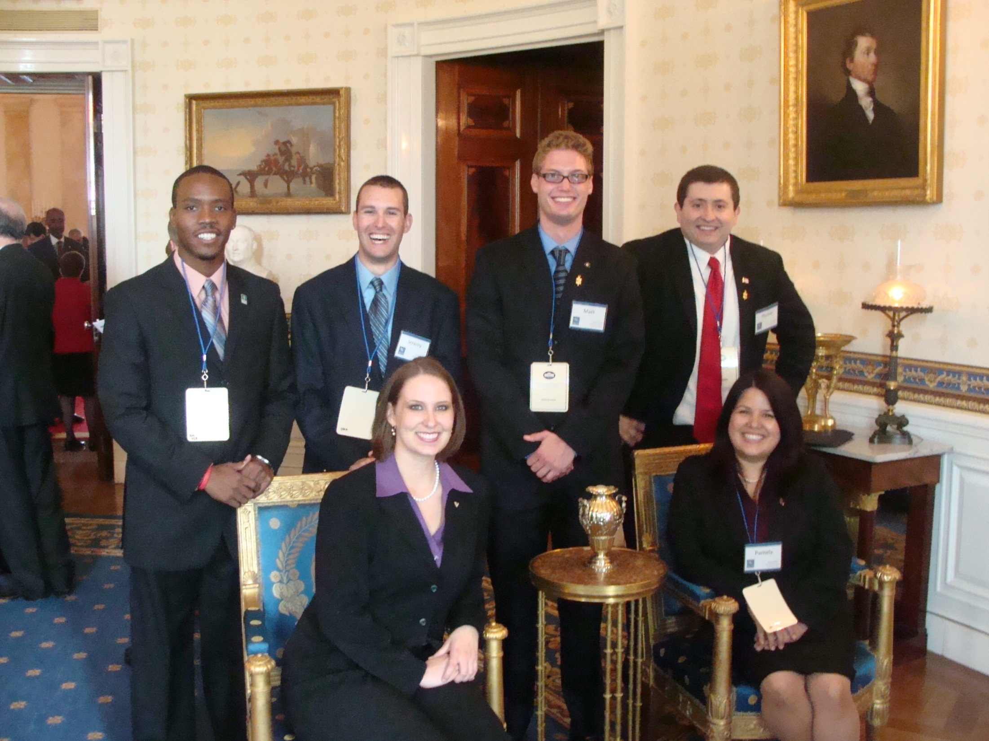

Slide 32
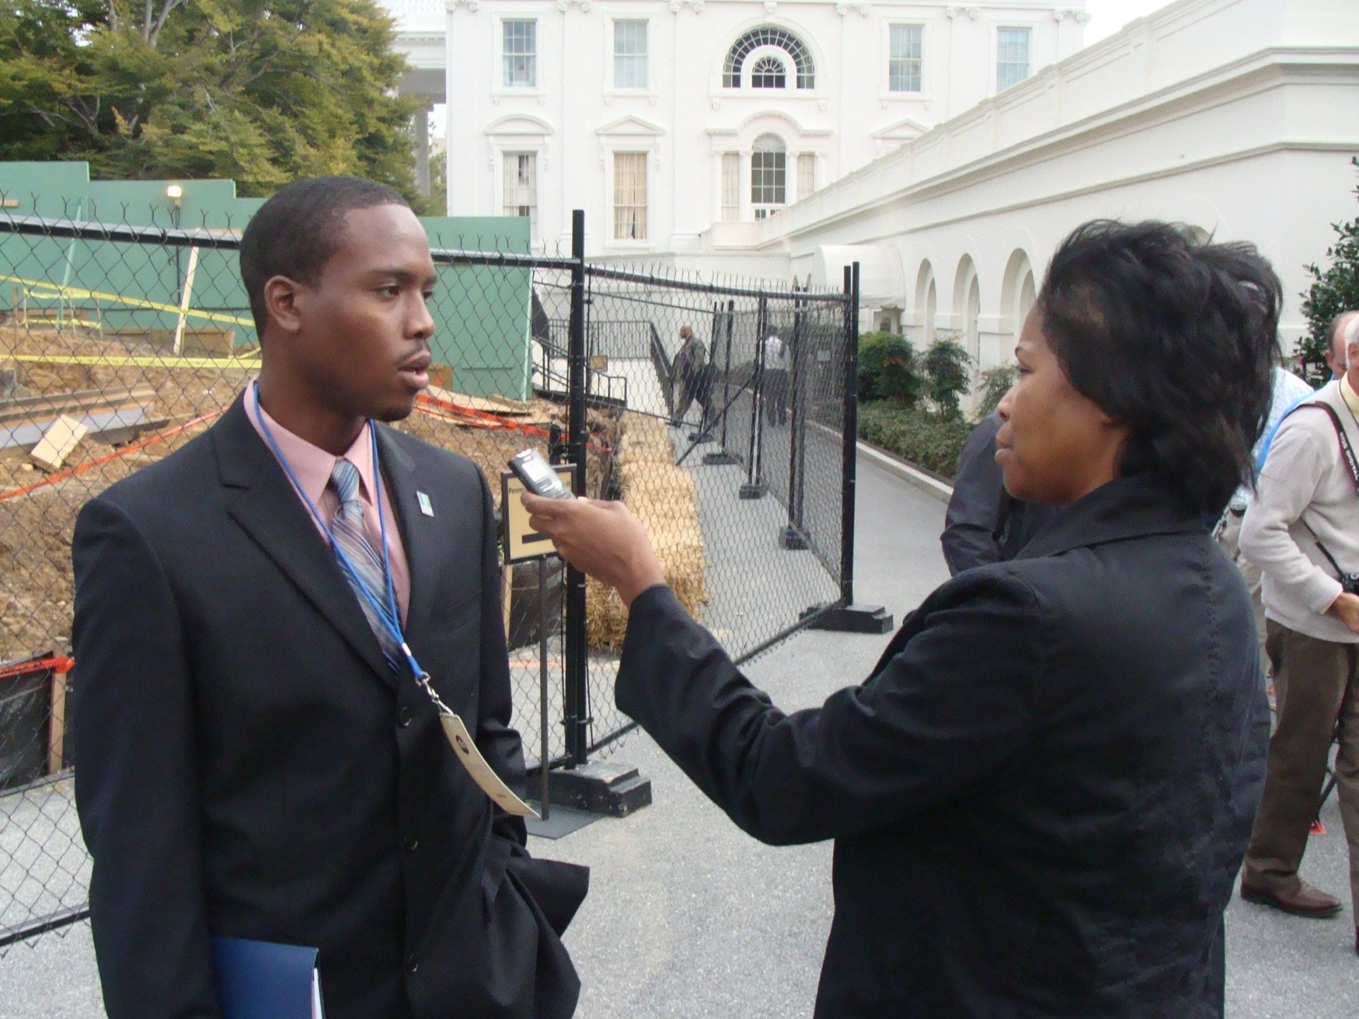

Slide 34
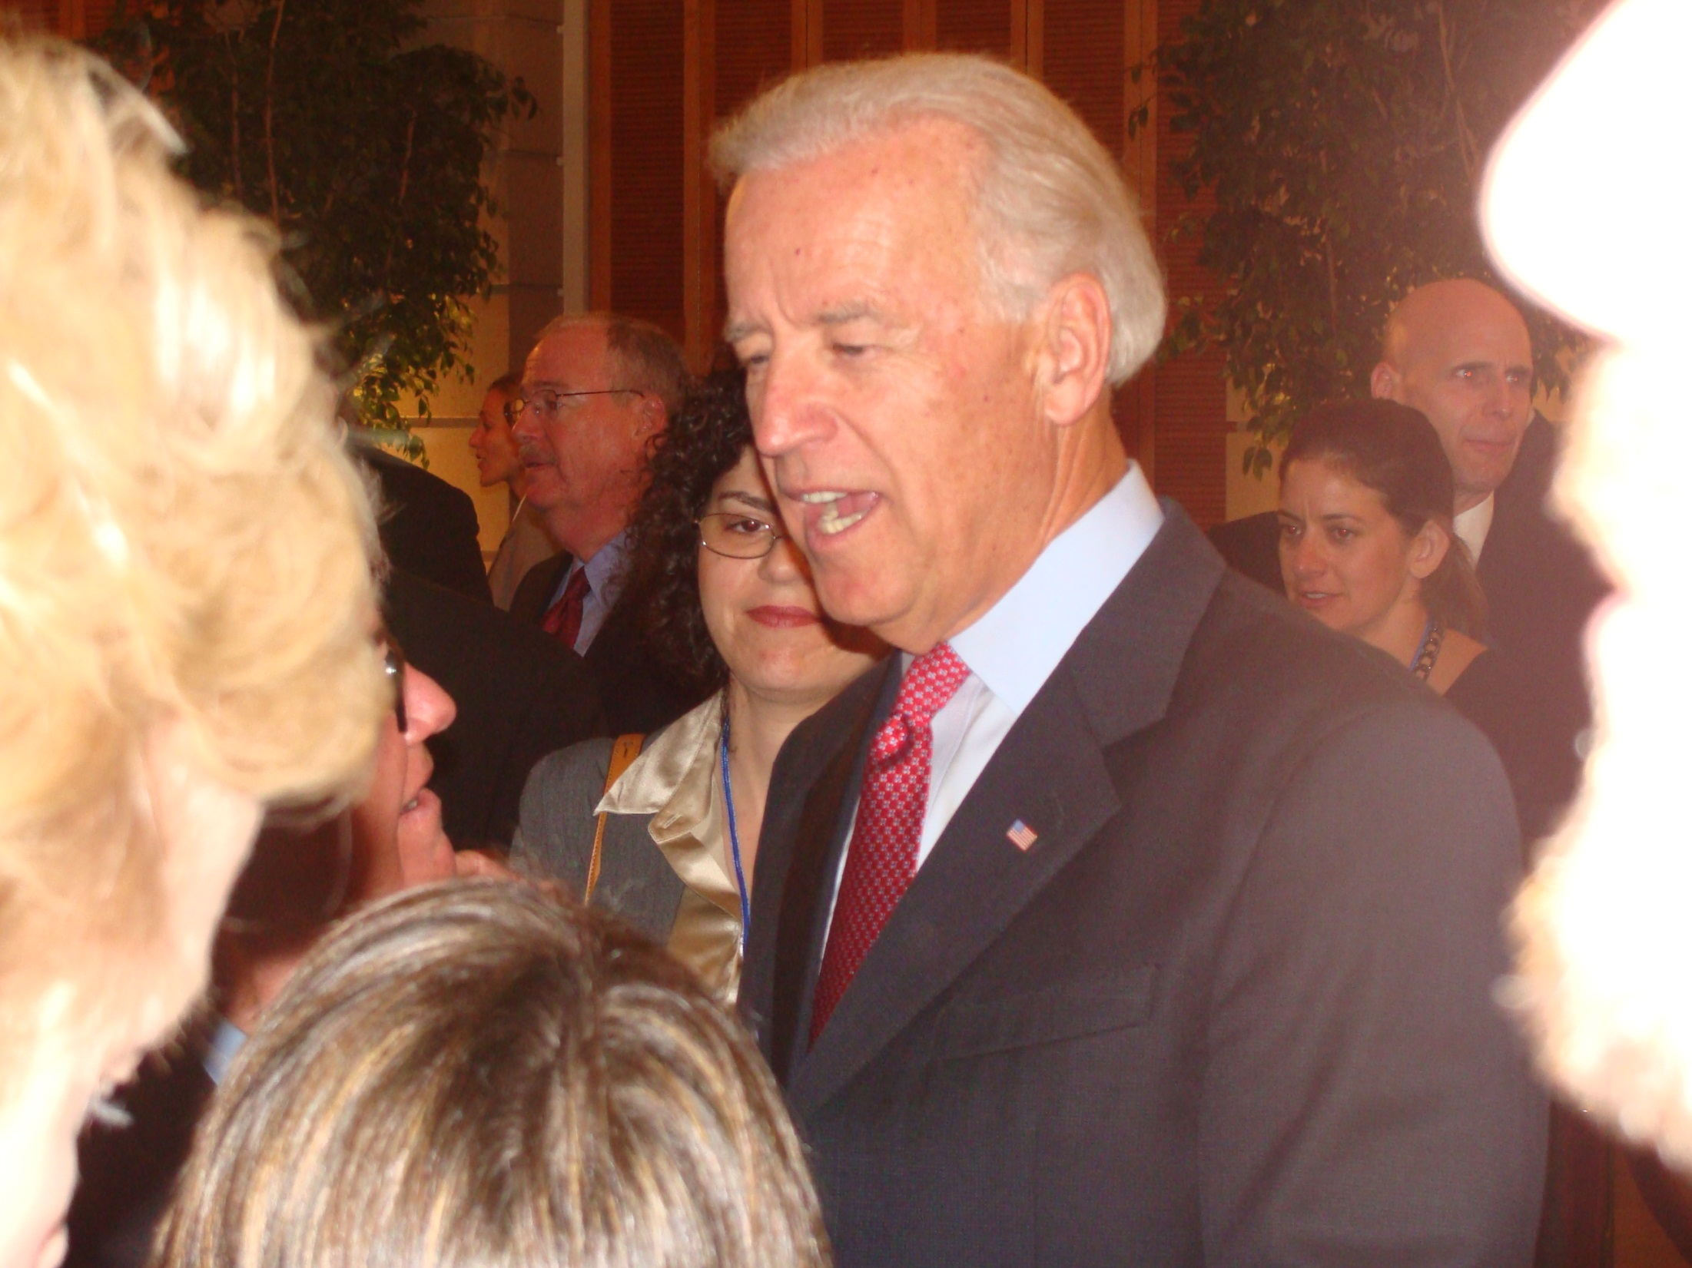

Slide 35
