Slide 1

Biennial Presentation
FY 2011-13

Slide 2
Six Principles of Excellence
Education
Faculty
Research
International Dimension
Health Sciences & Health Care
Engagement & Economic Development

Slide 3
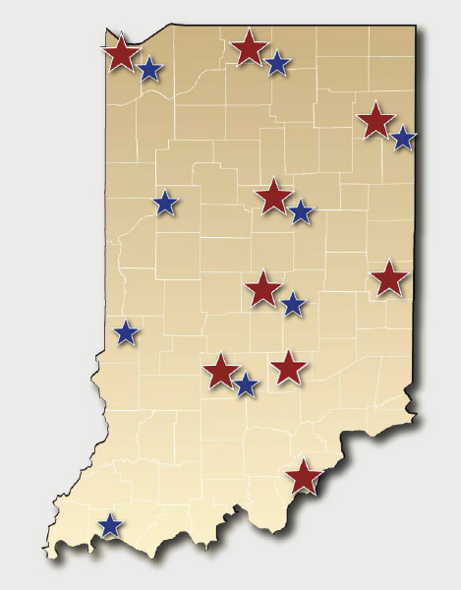
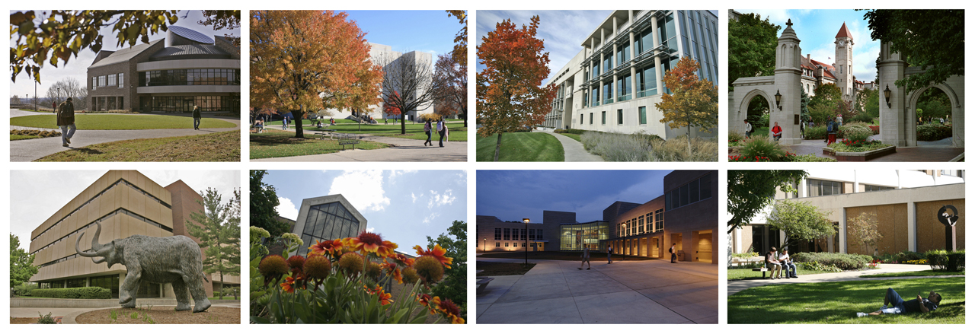
Serving Hoosiers Statewide
IU Southeast IU Northwest IUPUI/IUPUC IU Bloomington
IPFW IU East IU Kokomo IU South Bend
IU Campuses
Centers for
Medical Education

Slide 4

Excellence in Academics
Faculty excellence—Nobel Prize
recipient Dr. Elinor Ostrom
Outstanding academic programs
Student success—preparing the
next generation of Hoosiers for
lifelong contributions

Slide 5

Research Growth
Record $604 million in sponsored
program awards in FY 2010
National prominence in life sciences,
IT, and international studies
Increased emphasis on translational research
Job creation

Slide 6
Engagement Activities
Innovate Indiana initiative
Recent accomplishments:
  Innovate Indiana Fund
  Angel Learning transaction
  IU Innovation Center at Bloomington
IURTC technology commercialization

Slide 7
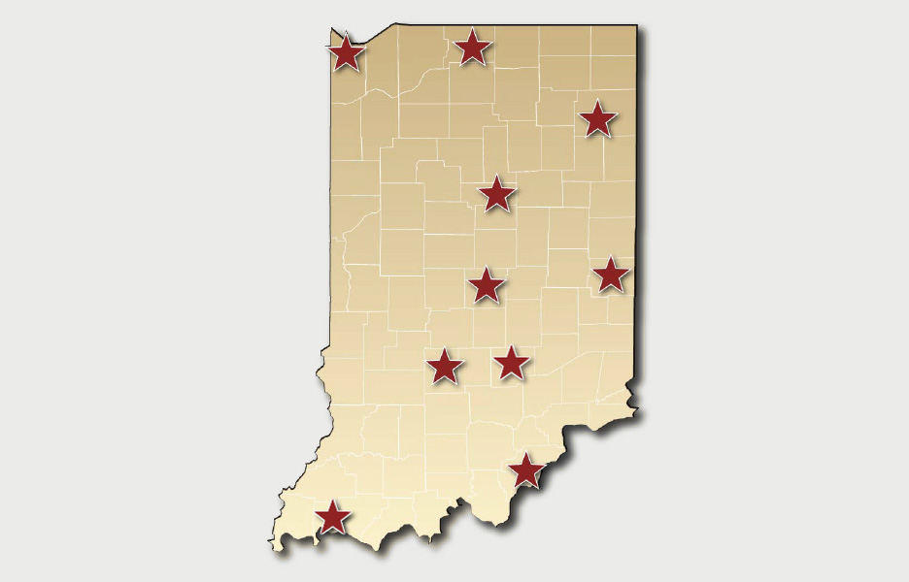
Engagement Activities
FORT WAYNE
IPFW Office of Engagement
GARY
Northwest Health & Human Services
SOUTH BEND
Cancer Research
Center
KOKOMO
Inventrek Technology
Park
INDIANAPOLIS
IU Emerging Technologies Center
RICHMOND
Online Course Market
Identification
BLOOMINGTON
IU Innovation Center
COLUMBUS
Learning Center
NEW ALBANY
Southeast Indiana Small Business Development Center
EVANSVILLE
Engagement Office

Slide 8
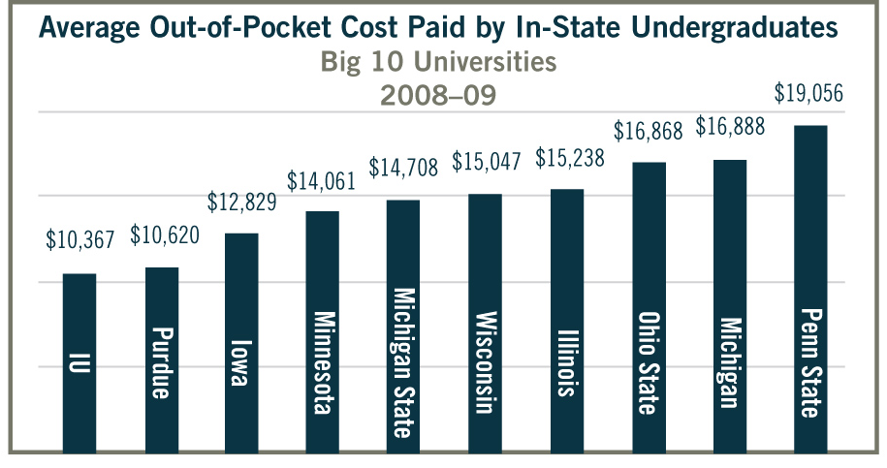
Value & Affordability
Modest tuition increases—IUB lowest net cost
in the Big 10
IU’s expanded scholarship and grant programs

Slide 9
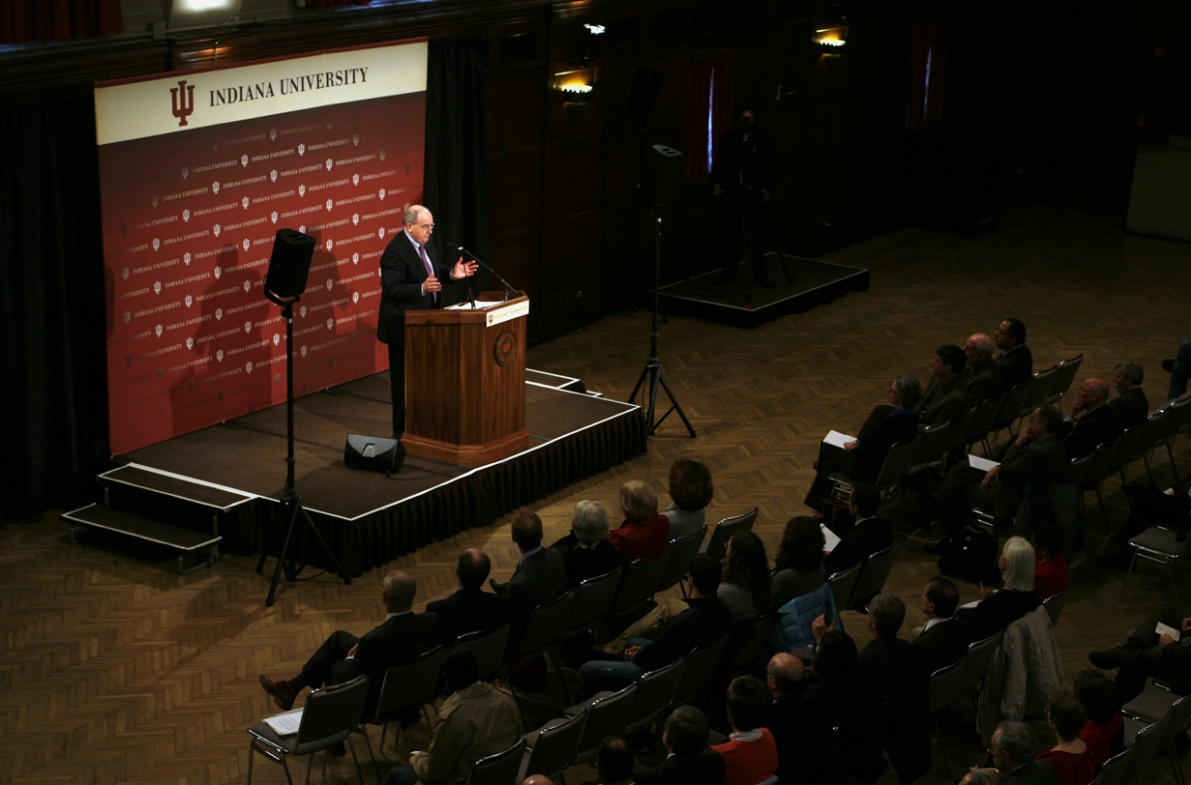
Prudent Financial Stewardship
State funding cuts—actions taken
to reduce spending
Moody’s Investor Services Aaa rating
External fundraising successes

Slide 10
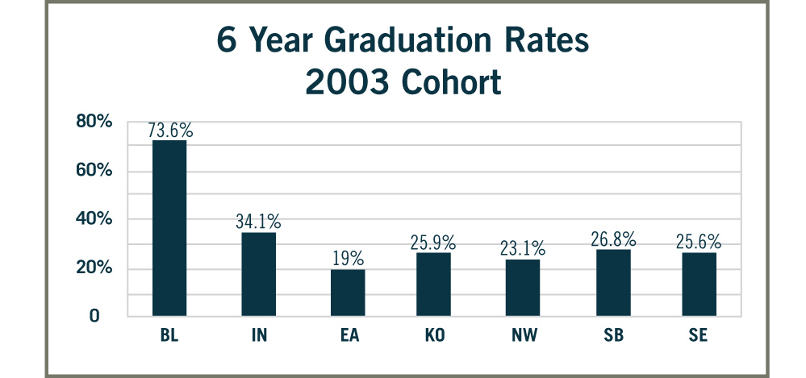
Embracing Change and Transformation
Regional campus plan:
“Blueprint for Student Attainment”
New Directions in Learning initiative
New Academic Directions

Slide 11
ICHE Strategic Directions Action Items
College access to degree success
Preparing K-12 teachers, leaders, and students for college success
Making college affordable
Community college collaborations
Strengthening the role of IU’s research campuses
Embracing accountability

Slide 12
FY 2011-13 Operating Request
Formula Driven Adjustments:
  Research Support $11.2 M
  Completed Credit Hours 11.6 M
  Degree Production 3.2 M
  On-Time Degrees .2 M
  SUBTOTAL $26.2 M
Maintenance of Operations $0
Fee Replacement ($3.7) M
Net Funding Increase $22.5 M

Slide 13
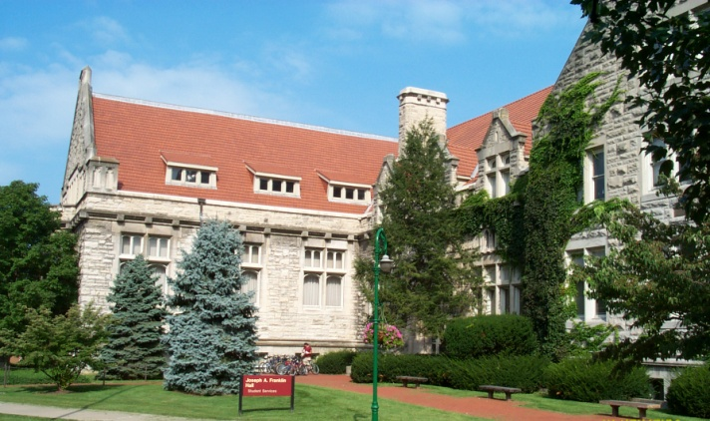
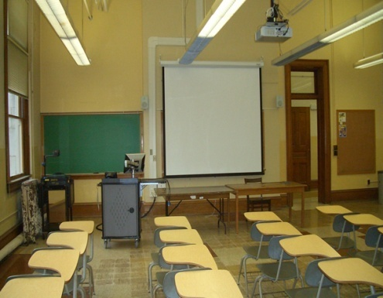
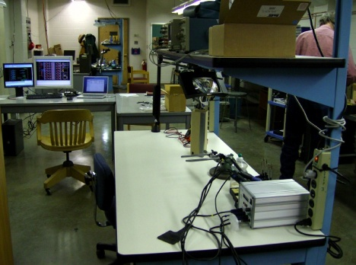
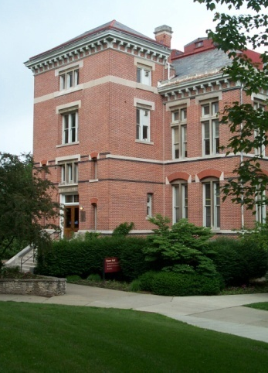
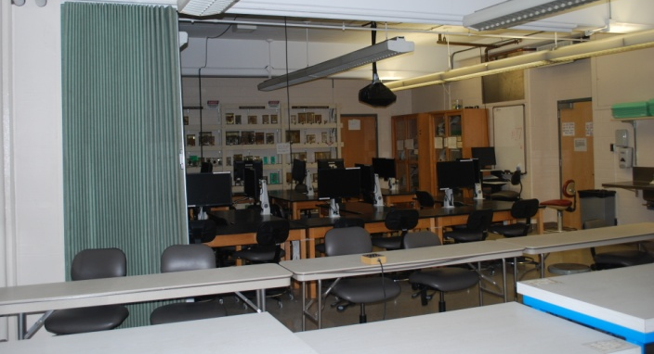
Maintaining Current
Facilities: IU’s Top Capital Priority
Regular R&R formula-generated funds: $64 M
Special R&R bonding authority for select
major facility renovations
Franklin Hall
Kirkwood Hall
Swain Hall
Van Nuys Building
Owen Hall

Slide 14
FY 2011-13
Capital Projects Request
IUB Academic Core Renovation
and Utility Improvements $57 M
IUB Wells Library Renovation Phase I $30 M
IUPUI Science & Engineering
Lab Bldg Phase II $15 M
IUPUI Van Nuys Lab Renovation
Phase III $22 M
Regional Campuses Special R&R $29 M

Slide 15

“More than a parchment to hang on the wall,
a truly excellent education gives students the knowledge, values, and habits of mind that
will enable them to contribute and thrive in
the world they inherit.”
—President McRobbie

