Slide 1
Smarter Choices, Faster Completion:
Indiana’s Complete College America Grant Initiative

Slide 2
National nonprofit founded in 2009
Focused on supporting state policy reforms that boost college completion:
  Increasing the number of students successfully completing college degrees and certificates of value
  Closing the college attainment gap for underrepresented populations

Slide 3


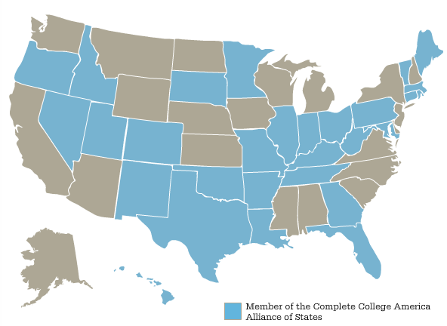
Arkansas
Colorado
Connecticut
Florida
Georgia
Hawaii
Idaho
Illinois
Indiana
Kentucky
Louisiana
Maine
Maryland
Massachusetts
Minnesota
29 Member States
Missouri
Nevada
New Mexico
Ohio
Oklahoma
Oregon
Pennsylvania
Rhode Island
South Dakota
Tennessee
Texas
Utah
Vermont
West Virginia

Slide 4
The Completion Innovation Challenge
$1 million national grant competition open to all 50 states
33 states entered contest, 10 states selected
Winners receive 18-month grant to implement innovative, high-impact completion initiatives

Slide 5
Core Completion strategy Themes
Time
Choice
Structure

Slide 6
Smarter Choices, Faster Completion
KEY STRATEGIES:
Remediation Redesign
Structured Student Support
State Policies, Metrics & Incentives
IMPLEMENTATION PARTNERS:
Ivy Tech Community College
Indiana University (Regional Campuses)
Commission for Higher Education

Slide 7
Redesigning Remediation
CHALLENGE:
More than two-thirds of Indiana’s community college students require remediation
Fewer than 25% of students placed in remedial courses ever earn a degree
OPPORTUNITY:
Targeted identification of student need
Tiered Interventions:
  Co-Requisite Component
  Modular/Emporium Component

Slide 8
Structured Student Support
CHALLENGE:
Less than a third of college freshman graduate within four years (29.5%)
Just over half graduate within six years (52.6%)
OPPORTUNITY:
“Smart Choices” degree maps and advising
Block scheduling (including summer coursework)
Cohort-based enrollment opportunities

Slide 9
State Policy Priorities
Clear Completion Targets
  Type: Degrees and Certificates
  Level: State, Institution, Campus
Performance Funding Formula Refinements
New Strategic Plan: Reaching Higher 2.0

Slide 10
NEXT STEPS
Planning & Design
  August 2011 to December 2011
Implementation & Evaluation
  January 2012 to December 2012
Replication & Scaling
  January 2013 and Beyond

Slide 11


