Slide 1





Indiana Higher Education Commission
May 13, 2011
Presented by:
Pamela Tate
President and CEO
The Council for Adult and Experiential Learning

Slide 2
About CAEL
CAEL is the Council for Adult and Experiential Learning
A 501(c)3 non-profit organization with 37 years of lifelong learning and workforce development experience
Mission to remove barriers to learning for the adult workforce
CAEL connects learning and work
CAEL has national network of hundreds of colleges and universities

Slide 3
CAEL’s Intermediary Role
CAEL is unique in its knowledge of adult/employee learning practices and in its ability to work as an active intermediary between :
Colleges & universities
Corporations
Labor unions
Government, community and philanthropic entities
Public Policymakers

Slide 4

Why Does College Completion Matter to Our Nation?
U.S. position as a world leader in education has slipped in recent years, from 4th place in 1997 to 11th place in 2009
By 2018, 63% of jobs will require some college or above
But only 42% of adults 25-34 have attained a post secondary degree
Source: Help Wanted: Projections of Jobs and Education Requirements through 2018, Georgetown University, Center for Education and the Workforce, June 2010
Notes:
Great and growing need for the nation’s workforce to acquire more postsecondary credentials to compete
Many pushing for greater success and persistence among college enrollees
Prior Learning Assessment is one way to make a positive contribution to this national goal

Slide 5
Why Do Degrees Matter?
Degrees* Produced from
2005 to 2025 with Current Rate of Production plus Population Growth
41,860,914
Degrees Needed to Meet
Best Performance** (55%)
63,127,642
0
20
40
60
80
Millions
We need to increase the rate of degree production in the U.S. by 50.8%.
* Degrees includes both Associates and 4-year degrees.
** Best performance is the average of the top three states.

Slide 6
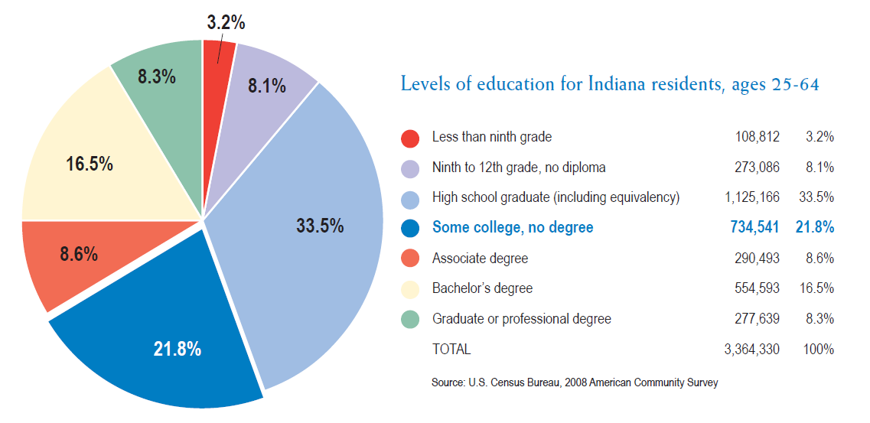
Indiana
In 2008, 730,000 residents have completed some college without earning a degree (nearly 21.8% of the state’s adult population)

Slide 7

IndianA
By 2018, 55% of Indiana’s jobs will require postsecondary education
Indiana will need to fill about 930,000 job vacancies between now and 2018. Of these vacancies, 506,000 will require postsecondary credentials
Help Wanted: Projections of Jobs and Education Requirements Through 2018, Georgetown University Center on Education and the Workforce, June 2010

Slide 8

CAEL’s response
The evaluation for college credit of the knowledge and skills adults gain from:
employment
military service
non-credit instruction/training
travel
hobbies
civic activities
volunteer service

Slide 9
CAEL’s Response:
Grant Credit for College Level Learning from Work and Life Experience
Called “Prior Learning Assessment” (PLA) by educators
Evaluations of learning are conducted by faculty experts
PLA accelerates progress toward degrees and credentials by not requiring adult learners to take college courses for learning already acquired

Slide 10
PLA Methods
Standardized exams
    Advanced Placement (AP)
    College Level Examination Program (CLEP)
    Excelsior College Exams
    DANTES Subject Standardized Tests (DSST)
Challenge exams
Individual student portfolios
Evaluation of non-college training
    Corporate or Military Training
Evaluation of non-credit instruction

Slide 11

CAEL’s History as Leader in Prior Learning Assessment (PLA)
CAEL founded in 1974 as a project of the Educational Testing Service
Question: is it possible to conduct valid and reliable assessment of learning gained from work or life experience?
Answer: Yes, with appropriate procedures and processes in place to evaluate that learning.

Slide 12
CAEL’s History as Leader in Prior Learning Assessment (PLA)
For 37 years, nationally recognized as the leader in the assessment of learning from life and work experience
Wrote the standards and best practices followed by colleges and universities
Trained hundreds of faculty and colleges in how to assess learning
Recognized by regional accrediting bodies

Slide 13
5 Academic Standards
Credit or its equivalent should be awarded only for learning, and not for experience.
Assessment should be based on standards and criteria for the level of acceptable learning that are both agreed upon and made public.
Assessment should be treated as an integral part of learning, not separate from it, and should be based on an understanding of learning processes.

Slide 14
5 Academic Standards
4. The determination of credit awards and competence levels must be made by appropriate subject matter and academic or credentialing experts.
5. Credit or other credentialing should be appropriate to the context in which it is awarded and accepted.

Slide 15
5 Administrative Standards
If awards are for credit, transcript entries should clearly describe what learning is being recognized and should be monitored to avoid giving credit twice for the same learning.
Policies, procedures, and criteria applied to assessment, including provision for appeal, should be fully disclosed and prominently available to all parties involved in the assessment process.
Fees charged for assessment should be based on the services performed in the process and not determined by the amount of credit awarded.
All personnel involved in the assessment of learning should pursue and receive adequate training and continuing professional development for the functions they perform.
Assessment programs should be regularly monitored, reviewed, evaluated, and revised as needed to reflect changes in the needs being served, the purposes being met, and the state of the assessment arts.

Slide 16
CAEL Research on Value of PLA
48-institution study of PLA and academic outcomes (funded by Lumina Foundation)
62,475 total adult students in sample (adult = age 25 or older)
PLA increases graduation rates and persistence; decreases time to degree completion
Fueling the Race to Postsecondary Success,
Council for Adult and Experiential Learning, March 2010

Slide 17
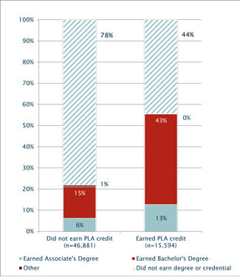
How Can PLA Help?
PLA’s Effect on Graduation Rates
Fueling the Race to Postsecondary Success, CAEL, March 2010

Slide 18
Summary – Graduation Rates
PLA students in this study had better graduation rates than non-PLA students:
regardless of institutional size, level (two-year or four-year) or control (private for-profit, non-profit, or public)
regardless of the individual student’s academic ability or grade point average
regardless of the individual student’s age, gender, or race/ethnicity
regardless of whether or not the individual student receives financial aid

Slide 19

Summary – Time to Degree
PLA students earned bachelor’s degrees faster, compared with non-PLA students – between 2.5 and 10.1 months faster, depending upon the number of PLA credits earned.
PLA earners with associate’s degrees saved on average between 1.5 and 4.5 months in earning their degrees, compared to non-PLA students earning associate’s degrees.

Slide 20
Need to Scale Up PLA
Only 66% of higher education institutions offer portfolio method; most serve very few students annually
Research indicates a need at institutions for more PLA, but a lack of capacity and resources
      Specialized training for assessors, advisors, administrators
      Time intensive program
      Salaries, space, training, marketing

Slide 21

Why CAEL Created LearningCOunts.org
Not enough colleges granting credit for prior learning
Need for consistent standards
Adult learners are not aware of PLA so they often repeat what they already know
Need for a national, on-line approach with easy access
Ability to use faculty experts nationwide to review learning portfolios in various disciplines

Slide 22


Slide 23
Learningcounts.org
LC.org educates students (adult learners), colleges, universities, employers and workforce organizations about the various ways individuals can earn college credit for learning acquired from work and life experience
LC.org provides CAEL 100: Prior Learning Assessment Theory and Practice, a 3-credit , 6-week on-line course, and also provides an online portal where students can build and submit, to faculty in appropriate subject areas, a portfolio that demonstrates their learning. Learning must be at the college level to receive credit.

Slide 24
Learningcounts.org
ACE CREDIT has evaluated CAEL 100: Prior Learning Assessment Theory and Practice and recommended it for 3 lower-division credits
ACE CREDIT will transcript credit recommendations made by LearningCounts.org faculty. To view a list of colleges and universities that accept ACE CREDIT transcripts, please visit http://www2.acenet.edu/programs/ccrs/adult_learners/
Partners in LearningCounts.org are the American Council on Education (ACE CREDIT) and the College Board

Slide 25
LEARNINGCOUNTS.org fact sheet
Website first online class launched January 24, 2011
Two sections completed, two currently running, with another 3 to begin before July
Over 500 LearningCounts.org faculty assessors
Over 80 partner institutions have agreed to send students to LC.org for assessment and to accept the credit recommendations in transfer
We are recruiting more colleges, universities and community colleges as partner institutions, and we are beginning to reach agreements with state systems

Slide 26
LearningCounts.org costs
Initial phone and email-based advising: No charge
6-week, three-credit portfolio preparation course: $500
Assessment costs for the evaluation of the portfolio: $250 for every 1-6 credits attempted in the same discipline; $500 for every 7-12 credits attempted in the same discipline, etc.

Slide 27
















Sample Partner Institutions
Over 80 colleges and universities serving as LearningCounts.org partner institutions

Slide 28



WhoM Will It Serve?

Slide 29

Whom Will It Serve?
Individuals Already Enrolled in School

Slide 30

Whom Will It Serve?
Unaffiliated individuals not yet in college such as active duty military and veterans, workers in transition, and lower-income workers

Slide 31

Whom Will It Serve?
Industries and Employer Groups

Slide 32
Outreach and marketing efforts
CAEL
Colleges and state HE systems
Employers
Military
National associations & regional initiatives
Workforce boards and state systems
International Associations

Slide 33

Collaboration with Employers
2nd quarter, 2011—Launching campaign to educate employers about LearningCounts.org
Pilot launched in February 2011 with Starbucks
Working with McDonald’s Corporation , Brunswick, BJC Healthcare, Verizon Wireless and Verizon to bring LC.org to their employees and pay for the costs from their tuition benefit programs
Interested in working with more employers in targeted urban areas

Slide 34

Outreach & Marketing:
Back to college initiatives
Graduate! Philadelphia
Back To College (Chicago)
Louisville: 55,000 Degrees
Northeast Ohio Talent Dividend

Slide 35


New developments: Urban strategy
Selecting 6-8 urban areas /regions for a targeted outreach campaign to promote LearningCounts.org
To date: San Antonio, El Paso, Houston, Boston, Seattle, Philadelphia, Chicago are candidates; others can be added
Approach regional and local foundations for support
Open to other urban areas where there are active partner colleges

Slide 36

New developments: walmart learning stipends
114 stipends to cover cost of CAEL 100 and assessment fees for 1-6 credits
Targeting low-income, underserved adults
Working with Veterans Upward Bound and The Cara Program

Slide 37
Examples of Policy Change We Would Like to See In Indiana to support learningcounts.org
General Policy letter in support of PLA
PLA in State WIA Plan and other state plans
State or local policy letter from State WIB/Governor to agencies/contractors/providers verifying ITA usage for PLA
PLA Assessment classified as a core and intensive service in WIA system
Allow state financial aid to pay for assessment fees
Other?

Slide 38
Questions for Discussion
What are your priorities as you advance PLA in the state?
What are the opportunities and challenges?
How can CAEL help?

Slide 39
Discussion of next steps needed to work together
Pamela Tate
ptate@cael.org
312-499-2681

