Slide 1
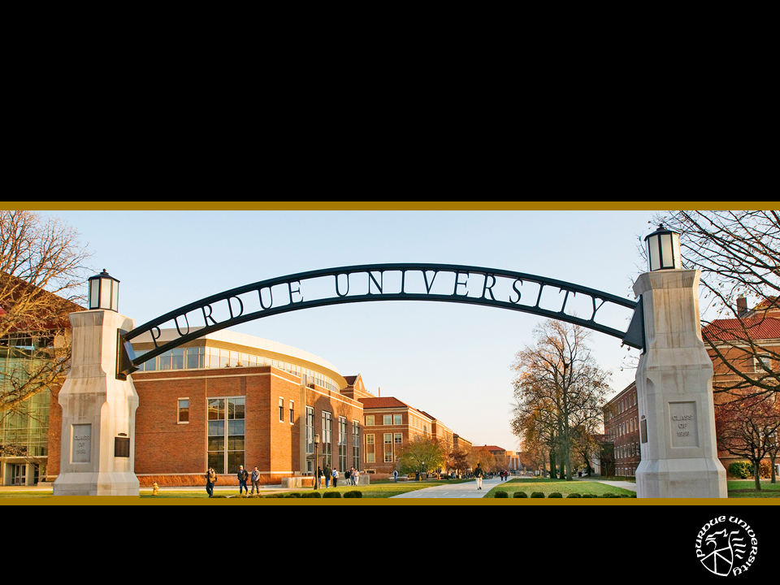
Indiana Commission for Higher Education
September 10, 2010 • President France A. Córdova

Slide 2
Purdue’s Strategic Plan
Launching Tomorrow’s Leaders
Discovery with Delivery
Meeting Global Challenges

Slide 3
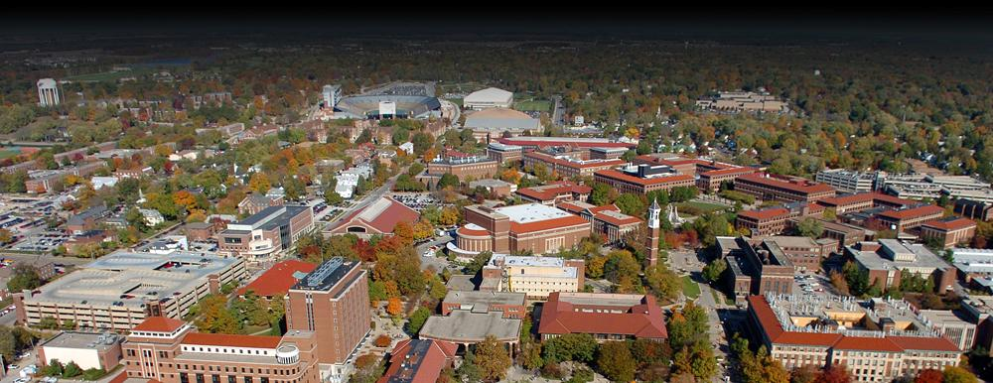
Meeting Budget Challenges
Achieve cost reductions through savings and new revenue
Strategic Sourcing
Information Technology
Energy Conservation
Administrative Review
Compensation and Benefits
Academic Program Review

Slide 4
Improving Our Reputation
18th among public universities
56th among all universities
Among Top 12 universities for undergraduate teaching quality

Slide 5
“…a reputation as big as space itself, and a student body trained to think locally as well as globally.”
– U.S.News & World Report

Slide 6
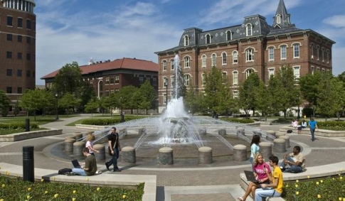
Improving Our Reputation
Highest annual net ROI among Indiana’s higher education institutions
$1 million earning potential

Slide 7
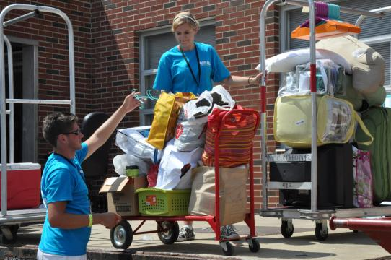
Launching Tomorrow’s Leaders
Preparedness
Affordability
Retention

Slide 8
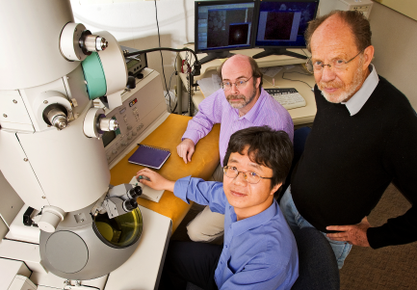
Discovery with Delivery
$440 million sponsored program awards
28% increase from FY 2009
3,000 undergraduate students

Slide 9
Meeting Global Challenges
Global Policy Research Institute
Agriculture
Environment
Security
Health
Economy
Energy Systems
Society and Leadership

Slide 10
2011-2013 Legislative Request Base Adjustments
BASE ADJUSTMENT | WEST LAFAYETTE | REGIONAL CAMPUSES | TOTAL
Research Support Adjustment | $11,136,221 |  | $11,136,221
Successfully Completed Credit Hours |  | $6,301,900 | $6,301,900
Successfully Completed Credit Hours for Dual Credit Students | $116,875 | $645,150 | $762,025
Degree Change | - $5,000 | $1,240,000 | $1,235,000
Time to Degree | $388,937 | - $28,628 | $360,309
Low-Income Degree Completion | $452,500 | $295,000 | $747,500
TOTAL | $12,089,533 | $8,453,422 | $20,542,955
Debt Service* | $1,862,945 | $8,600,441 | $10,463,386
*Cumulative

Slide 11
2011-2013 Capital Request
BASE ADJUSTMENT | PRIORITY | CASH | BONDING REQUEST | NON-STATE FUNDING | TOTAL
Repair & Rehabilitation (R&R) |  | $48,412,189 |  |  | $48,412,189
Special R&R – Fort Wayne (Helmke Library Renovation) | Four |  | $13,500,000 |  | $13,500,000
Special R&R – North Central (Chiller Power Plant) | Five |  | $3,500,000 |  | $3,500,000
New Construction – WL (Agricultural and Life Sciences Building) | One |  | $38,000,000 | $20,000,000 | $58,000,000
New Construction – Calumet (Emerging Technologies Building) | Two |  | $27,600,000 |  | $27,600,000
New Construction – North Central (Science Building) | Three |  | $33,400,000 |  | $33,400,000

Slide 12
Regional Campuses
Purdue University Calumet
Indiana University-Purdue University Fort Wayne
Purdue University North Central

Slide 13
Indiana Commission for Higher Education
September 10, 2010 • President France A. Córdova

