Slide 1
March 14, 2013
Closing Indiana’s Achievement Gap
Elizabeth R. Gutierrez
Director of State Policy
Lumina Foundation
Presented to Indiana Commission for Higher Education

Slide 2
The Nation and Indiana’s Challenge
U.S. Attainment and Achievement Gaps
Indiana’s Attainment and Achievement Gaps
Preview of A Stronger Nation Through Higher Education report (April 2013 release)

Slide 3
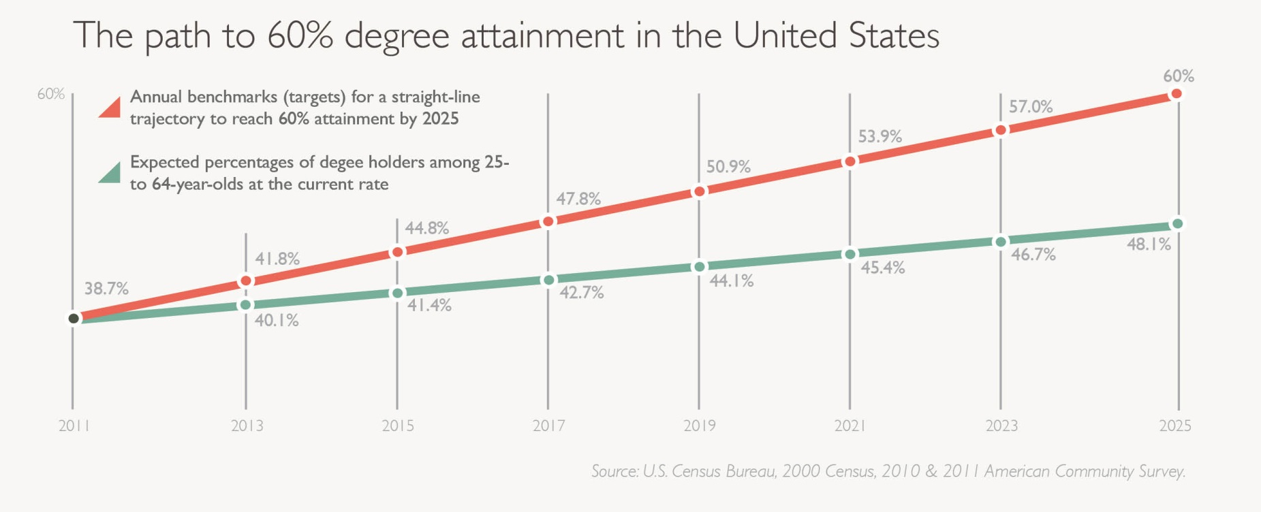

Slide 4
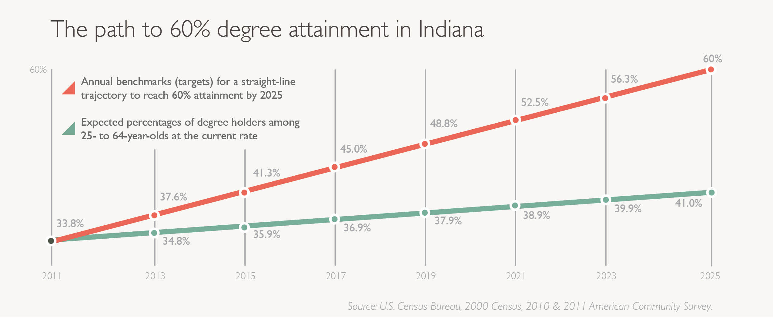

Slide 5
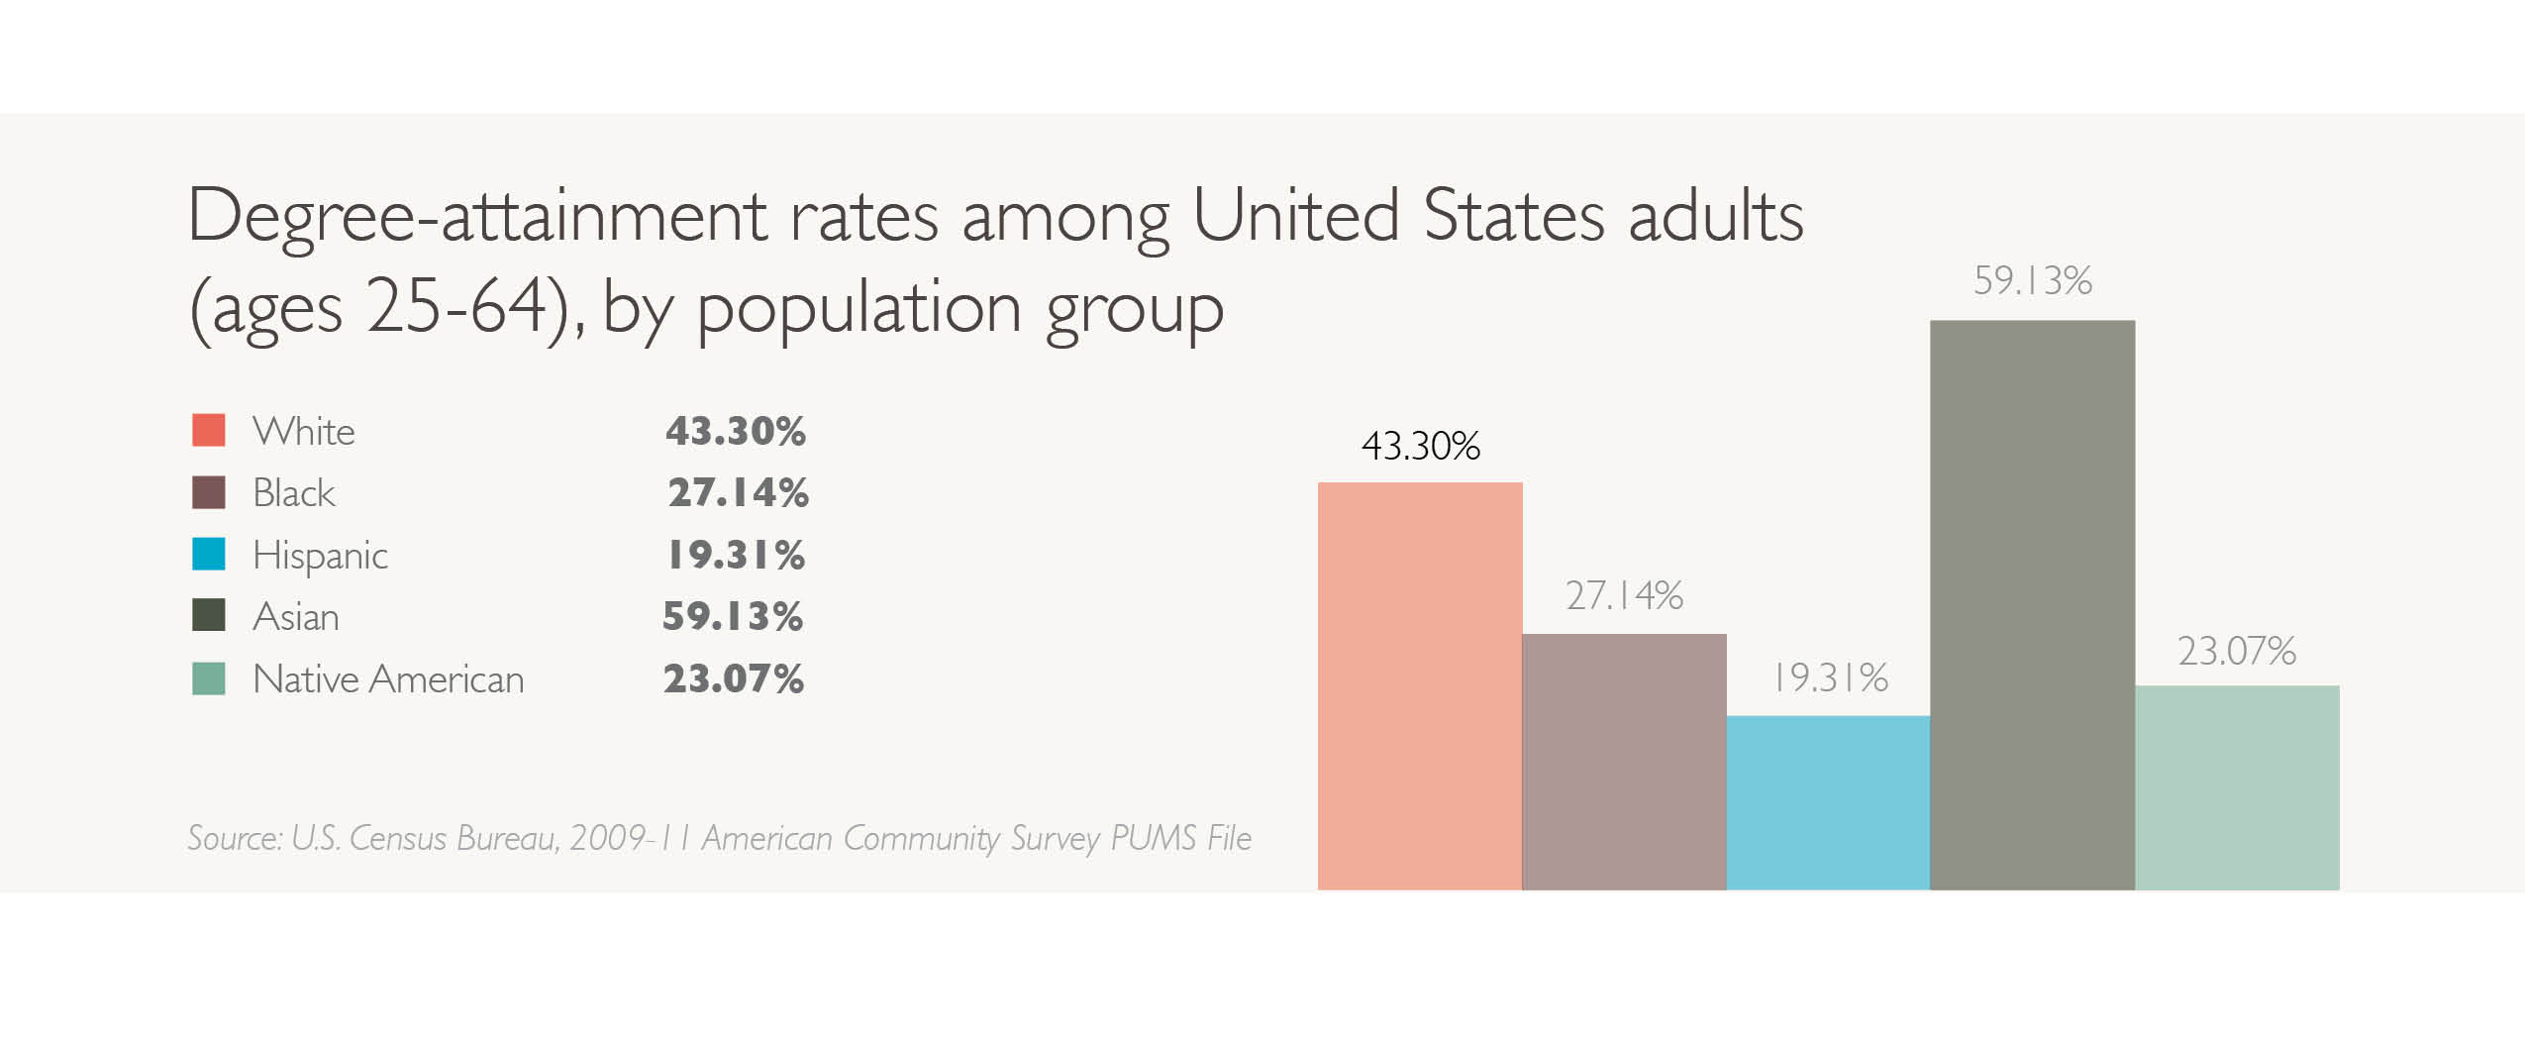

Slide 6
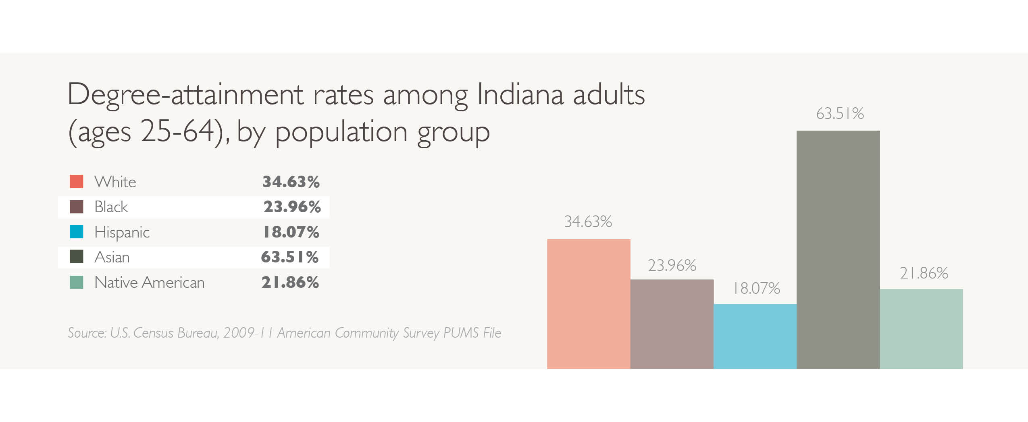

Slide 7
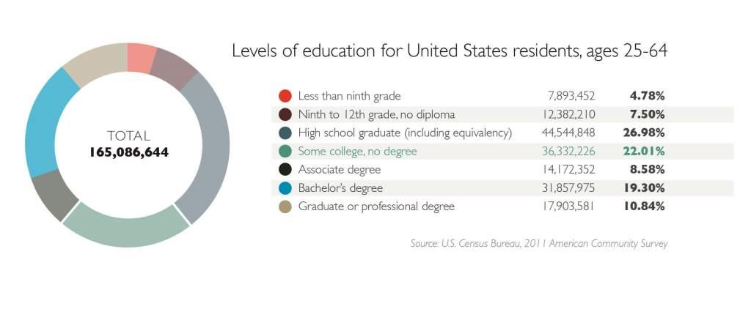

Slide 8

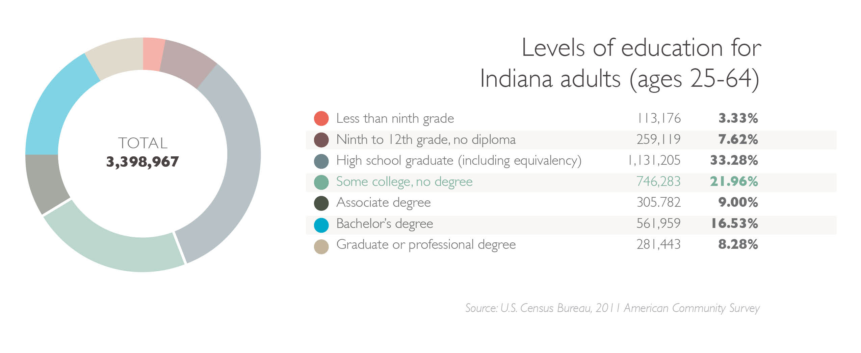

Slide 9
Indiana’s Challenge & Opportunity
Growing Latino population
Younger than the general population
Opportunity to prepare students
Connect higher education policy with K12 policy efforts
(for example, Common Core State
Standards for college readiness)
Learn from other states’ experiences
Use data as a guide

