Slide 1

Indiana’s 2011 Cash for College Campaign

Slide 2

Learn More Indiana
VISION
Learn More Indiana is a state-led communication and outreach initiative working to help all Hoosiers succeed in school, complete college and connect to careers.
MISSION
In print, in person, on the phone and on the web,
Learn More Indiana helps Hoosiers plan, prepare and pay
for college and career success.

Slide 3
Campaigns
Three annual statewide campaigns:
  College GO! Week (Planning) –– FALL
  Cash for College (Paying) –– WINTER
  KnowHow2Go (Preparing) –– SPRING/SUMMER
Guiding principles:
  Clear college success focus for each campaign
  Specific, practical steps for students at each level
  State driven, locally led

Slide 4

Student Perceptions
70%
of first-generation college students think they can’t afford college

Slide 5
Indiana Affordability Facts
Indiana college tuition and fees have grown by nearly 300 percent since 1990.
Indiana’s college debt load ranks 15th highest in the country.
Nearly two-thirds of Hoosiers graduate with college debt –– and those who do not graduate are 10 times more likely to default on their college loans.

Slide 6
The Reality
Financial aid is available:
Federal government gives out $83 billion
State provides an extra $250 million
Indiana’s public colleges give out $170 million
Indiana’s private colleges give out $519 million

Slide 7
Cash for College Campaign
Goal:
  Help Hoosier students and families prepare to pay for education and training after high school
  Raise awareness about the billions of dollars in financial aid available.
Strategy:
  Share practical tips and resources with students and local communities leading up to Indiana’s March 10 FAFSA filing deadline.
  Offer student incentives to turn awareness into action.

Slide 8
Grade-specific student goals
Action steps for students focused on:
  Saving: college savings plans, budgeting, etc.
  Applying: FAFSA filing, scholarship options, etc.
  Paying: borrowing tips, payment plans, etc.

Slide 9
ELEMENTARY SCHOOLS: Start Saving
Open an Indiana CollegeChoice 529 Savings Plan
Ask parents about joining UPromise
Think about your future:
  What career do you want?
  Which college do you want to attend?
  Do you have a plan to make it happen?

Slide 10
MIDDLE SCHOOLS: Manage Money
Learn the “cash for college” lingo
Create a budget/savings plan
Open a checking/savings account (w/ parent permission)
Contribute to a CollegeChoice 529 Savings Plan
Ask parents about joining UPromise
Sign up for Twenty-first Century Scholars (if eligible)

Slide 11
HIGH SCHOOLS: Finish Strong
Every senior will file the FAFSA online
Every junior will scout out scholarships
Every sophomore will calculate the cost of college
Every freshman will take the tough courses

Slide 12
COLLEGE STUDENTS:
Complete & Continue
Annual FAFSA filing
Work study, fellowships and other programs offering tuition discounts and/or stipends
Loan forgiveness and payment plans
College savings plans and tax credits

Slide 13
ADULT STUDENTS:
Research & Return
Comparing college costs (IndianaCollegeCosts.org)
FAFSA filing
College aid for part-time students
Employer tuition reimbursement programs
College savings plans and tax credits

Slide 14
Cash for College Resources
Student Contests: K-8, High School, College/Adult
Events: FAFSA Friday, College Goal Sunday
Website: CashForCollegeIndiana.org
Services: Indiana College Costs Estimator
Videos: Step-by-Step FAFSA guide
Promotional Materials: Cash for College 101, Posters, etc

Slide 15
Student Scholarship Contests
Cash for College Smartphone App Contest - $10,000
Cash for College Student Campaign Contest - $5,000
College Goal Sunday Scholarship Drawings - $1,000
College 529 Savings Plan Essay/Poster Contest - $529

Slide 16
Indiana College Costs Estimator
Expected Family Contribution (EFC) estimates
Side-by-side cost comparisons of Indiana colleges
Live “Ask the Experts” sessions
“What if” scenarios
And more…

Slide 17
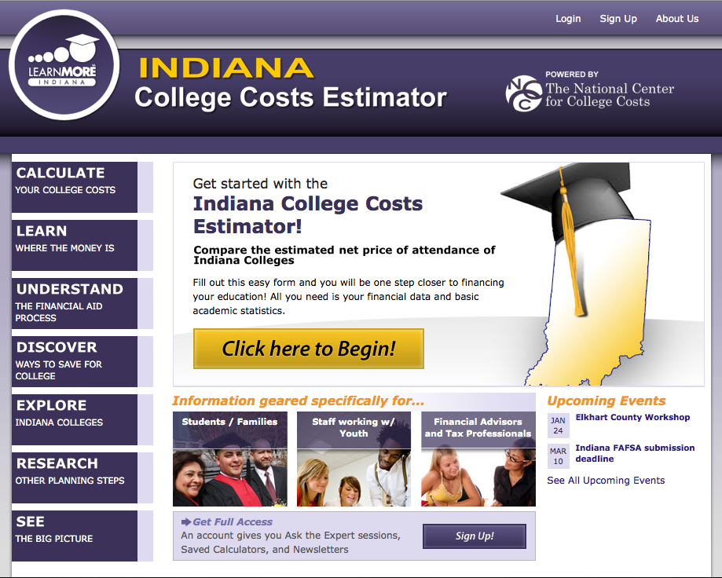
IndianaCollegeCosts.org

Slide 18

Events

Slide 19

CashforCollegeIndiana.org

Slide 20

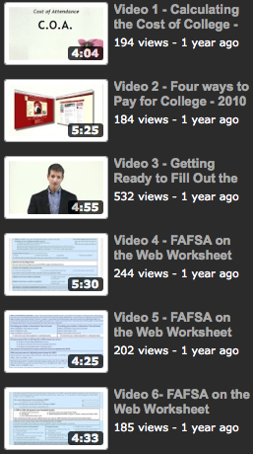
FAFSA Videos

Slide 21

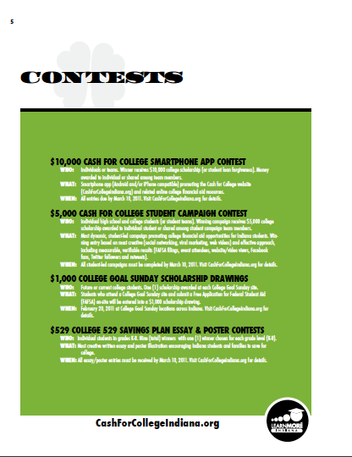


Implementation Guide

Slide 22


Slide 23


Slide 24


Slide 25


Slide 26


Slide 27


Slide 28


Slide 29


Slide 30
FEEDBACK

