Slide 1
Indiana CTE
New & Newer Teachers
Workshop
September 21, 2017
Indiana Department of Education
In collaboration with Indiana ACTE

Slide 2
Celebrate CTE
Amanda McCammon, Director
PK-16 Division
Indiana DOE

Slide 3

What is CTE?
Career and Technical Education (CTE)
Indiana’s cutting-edge, rigorous and relevant K-12 Career and Technical Education programs prepare youth for success in future careers. Students in Indiana’s secondary CTE programs gain knowledge, skills, and abilities needed for success in post-secondary education and economically viable career opportunities.

Slide 4
Indiana’s CTE Programs
Agriculture
Business, Marketing, IT and Entrepreneurship
Engineering and Technology
Family and Consumer Sciences
Health Science
Trade and Industry
Programs are delivered through Area CTE Districts, in which schools collaborate to maximize the CTE course sequences and pathways offered.

Slide 5








www.doe.in.gov/CTE

Slide 6
DOE’s CTE Team
Amanda McCammon, Director of PK-16
Kris Campbell, Support for CTE and Perkins
Chris Deaton, State Director for Career & Technical Ed
Celya Glowacki, Career Pathways, Agriculture
Sue Henry, Health Science, Health & Wellness, Physical Ed
Alyson McIntyre-Reiger, Work Based Learning & FACS
Davis Moore, Trade & Industry, Civil Rights
Eric Ogle, Perkins Administrator
Mary Rinehart, Engineering & Technology, TSA Adviser

Slide 7
Indiana’s Career Pathways
A Career Pathway is
an aligned sequence of secondary and postsecondary courses
that leads to industry certification and/or a college credential or degree
in a high wage, high demand occupation

Slide 8
Indiana’s Career Pathways
Pathways are organized by Career Clusters
Clusters are groupings of occupations
    Based on economic sectors and
    Common knowledge & skills required
Nationally – 16 clusters
Indiana – organized into 12 clusters

Slide 9
Indiana’s Career Clusters
Agriculture
Agribusiness
Life Sciences
Horticulture
Architecture & Construction
Construction Trades
Facilities Management
Drafting & Design
Education & Training
Early Childhood Education
Education Careers
Health Science
Biomedical
Health Care Specialties
Nursing Dental
Hospitality Human Services
Culinary Arts Hospitality
Human & Social Services Cosmetology
Arts, AV & Communications
Digital Communications
Visual Arts
Business, Finance & Marketing
Finance & Accounting
Entrepreneurship
Marketing
Manufacturing & Logistics
Advanced Manufacturing
Electronics Logistics Machining Welding
Public Safety
Criminal Justice
EMT/Paramedics
Fire & Rescue
Transportation
Automotive Diesel
Collision Repair Aviation
Mobile Equipment
Tractor Trailer
Information Technology
Programming
Network Support
STEM
Technical & Professional
Careers integrating
Engineering Technology
Science Mathematics

Slide 10
Indiana’s Career Pathways
Career Pathway Plans include
Sequenced CTE courses
Labor market need and wage information
Needed industry skills standards
Making students ready for the next steps

Slide 11
www.doe.in.gov/pathways

Slide 12
Indiana’s Career Pathways
Pathways is a philosophy
      Logical sequence of courses
      Plan for high school into college and career
Customize and individualize the state models
Use the templates to build other pathways
The state EXPECTS students to explore careers and develop a Pathway Plan along with their 4-year graduation plans

Slide 13
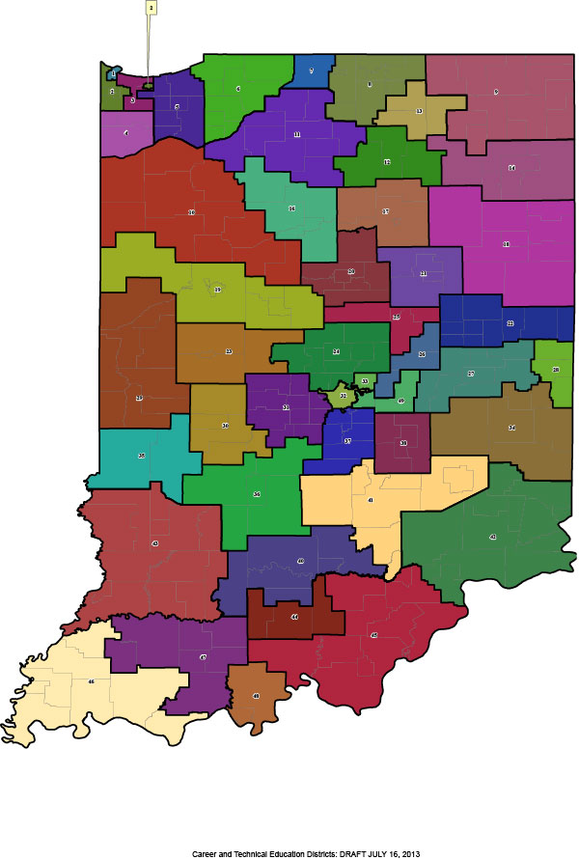
Area CTE Districts
47 districts representing over 95% of Indiana’s public school corporations.
Visit www.iacted.org

Slide 14
Celebrate
Notes:
Amanda- As a CTE teacher, we must help others understand the benefits of CTE for students. The following a few important points to include when sharing with others about how CTE is learning that works for Indiana. Enrollment in CTE programs continues to grow. 54.4% of students participated in CTE in 2016.

Slide 15
Celebrate

Slide 16

Celebrate
In 2015, 13,615 CTE concentrators earned an industry certification. This represents approximately 20% of all students who completed high school in 2015.

Slide 17
Celebrate
Dual Credit Attainment Earning dual credits (high school credit that also counts for college credit) during high school can help prepare students for postsecondary success.
Notes:
For CTE concentrators who left high school in 2015, just over half (52 percent) earned dual credits. This was a significant increase from the previous year (40.7 percent) and represents an increase of nearly 15 percentage points since 2013.

Slide 18
Celebrate
Prospective Parents and Students are Attracted to the “Real World” Benefits of CTE
Prospective parents and students want to hear about the tangible outcomes from CTE programs. The opportunity to gain “real world” skills.
College and Career Success are Both Important Goals for Parents and Students
“College” and “careers” are often presented as separate paths-or even pitted against one another-but parents and students see these as complementary and desire both.
Notes:
This is from Advance CTE research. They conducted focus groups with parents and students to discover more about CTE messaging

Slide 19
Parents

Slide 20
Students

Slide 21
Celebrate
You!
We are ALL CTE!

Slide 22
Celebrate
Thank you!
Notes:
Sue will do a brain break

Slide 23
New & Newer Teacher Workshop
Workshop Overview

Slide 24

Indiana Department of Education
www.doe.in.gov

Slide 25
Workshop Overview
Today’s Agenda, Action Planning
Breakout Sessions
Networking and Lunch
CTSOs Sessions
Non-traditional Initiatives

Slide 26
Workshop Overview
Today’s Agenda, Action Planning
Breakout Sessions
Networking and Lunch
CTSOs Sessions
Non-traditional Initiatives

Slide 27
Action Planning
Good ideas to implement
    Within the next week
    By the end of this semester
    By the end of the school year
Notes:
Eric

Slide 28
Workshop Overview
Today’s Agenda, Action Planning
Breakout Sessions
Networking and Lunch
CTSOs Sessions
Non-traditional Initiatives
Notes:
Alyson

Slide 29

Business & Industry Connections
  Industry Partnerships
  Advisory Boards
  Work Based Learning
  Resources
  Support
Notes:
Davis

Slide 30

Classroom Management 101
  Tips and tricks of the trade
  Thriving
  Motivating
  Managing
  Measuring
Notes:
Celya

Slide 31

Teaching to the Standards - ? ?
  What’s that mean?
  Where?
  How?
  Who?
  When?
Notes:
Mary

Slide 32
Workshop Breakout Sessions
    Conflicts in the Classroom
          Veterans Hall 1 Blue Green Red
    Utilizing Standards in the Classroom
          Veterans Hall 2 Red Blue Green
    Connecting to Business and Community
      Veterans Hall 3 Green Red Blue
Notes:
Sue

Slide 33
Workshop Overview
Today’s Agenda, Action Planning
Breakout Sessions
Networking and Lunch
CTSOs Sessions
Non-traditional Initiatives
Notes:
Kris

Slide 34
Workshop Overview
Today’s Agenda, Action Planning
Breakout Sessions
Networking and Lunch
CTSOs Sessions
Non-traditional Initiatives
Notes:
Eric

Slide 35








Indiana’s CTSO’s
Notes:
Eric

Slide 36
Workshop Overview
Today’s Agenda, Action Planning
Breakout Sessions
Networking and Lunch
CTSOs Sessions
Non-traditional Initiatives
Notes:
Alyson

Slide 37

Video
Notes:
Alyson

Slide 38
What is non-traditional
A ‘non-traditional’ CTE student is considered one who is pursuing a career or technical education program related to an occupation which employs less than 25% of their gender.
Example: A female student enrolled in engineering
Example: A male student enrolled in early childhood education
Notes:
Amanda-Federal funding for Career and Technical Education (CTE) programs includes the stipulation that schools seek to reduce gender stereotypes in career preparation programs for occupations employing less than 25% of one gender. To reach this goal, schools and states must set targets, and annually report progress in increasing the percentage of “non-traditional” students who enroll and complete CTE programs.

Slide 39
Non-traditional courses
Non-traditional courses exist for both male and female students
Notes:
Amanda- Identify the courses you teach from the list in your packet. If your course is on the list, you need to work on non-traditional enrollment

Slide 40
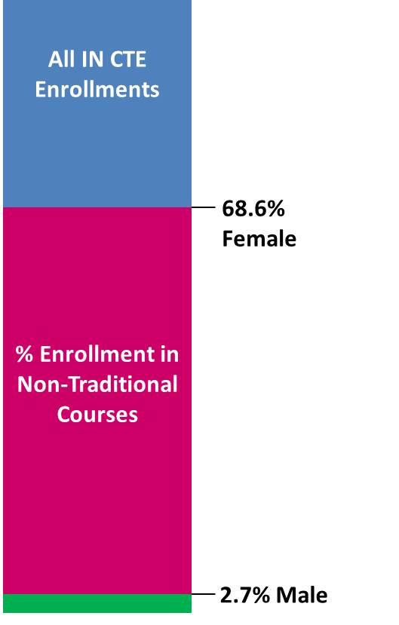
Why should we focus on non-traditional?
Male/Female
Enrollments in CTE Non-Traditional Courses
Notes:
Amanda

Slide 41
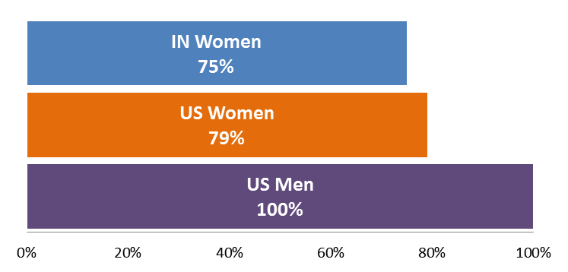
Why should we focus on females?
US Median Annual Earnings of Women
as a % of Men’s Median Annual Earnings
https://www.doe.in.gov/sites/default/files/cte/17-changing-equation-non-traditional-report-final.pdf
Notes:
Amanda

Slide 42
Why should we focus on males?
Males can find great career fulfillment because the work connects directly to students interests and not just gender norms
Males have the opportunity to find employment in crowded job markets
Males in traditionally female professions can be beneficial to individuals, business, society and the economy
Notes:
Davis

Slide 43
What now?

Slide 44
Students were surveyed
Question: What Would Help You Consider a Non-Traditional CTE Course?
“I had a clear understanding of what was involved in the course (expectations were clear)”
“I was given more information about the course”
Notes:
Alyson

Slide 45
Student Responses
Question: Were There Factors that Helped you Decide to Enroll in a Non-Traditional Course?
The course or pathway aligned to my career goals and future plans, or
A friend, parent, teacher or counselor recommended I take the course.
Notes:
Alyson

Slide 46
Five Key Strategies
Be Data Intentional
Brainstorm Creative Recruitment/Enrollment Strategies
Proactively Reach Out to Students Expressing Interest
Find and Remove Potential Barriers
Provide Supports for Non-Traditional Students
Notes:
Alyson

Slide 47
Five Key Strategies
Be Data Intentional
Brainstorm Creative Recruitment/Enrollment Strategies
Proactively Reach Out to Students Expressing Interest
Find and Remove Potential Barriers
Provide Supports for Non-Traditional Students

Slide 48
Non-traditional Plan of Action
Recruitment
-Summer non-traditional camps
Support
-Mentoring groups
Notes:
Eric

Slide 49
Instructions
Develop one plan of action for recruiting non-traditional students into your program
Develop one method of support for non-traditional students enrolled in your program
Share at your tables

Slide 50

Workshop Overview

Slide 51
Workshop Breakout Sessions
    Conflicts in the Classroom
          Veterans Hall 1 Blue Green Red
    Utilizing Standards in the Classroom
          Veterans Hall 2 Red Blue Green
    Connecting to Business and Community
      Veterans Hall 3 Green Red Blue
Notes:
Sue

Slide 52
Indiana CTE
New & Newer Teachers
Workshop Concluding Session
September 21, 2017
Indiana Department of Education
In collaboration with Indiana ACTE

Slide 53
Concluding Session
Key Takeaways / Action Planning
  Career Pathways
  Good News about CTE
  Partnerships
  Classroom Management
  Standards
  Networking
  CTSOs

Slide 54
Concluding Session
Key Takeaways / Action Planning
Workshop Evaluation
PDP or PGP Points
Sub Pay Reimbursement

Slide 55
Wrap up
Thank You –
We’re Glad You Came!

