Slide 1
How to Use Standards in the Classroom
New and Newer Teacher Workshop
Mary Rinehart
Sue Henry, BSN, RN

Slide 2
Brain Drainer Directions
A
Share
Best Guess
B
Notes:
Mary

Slide 3
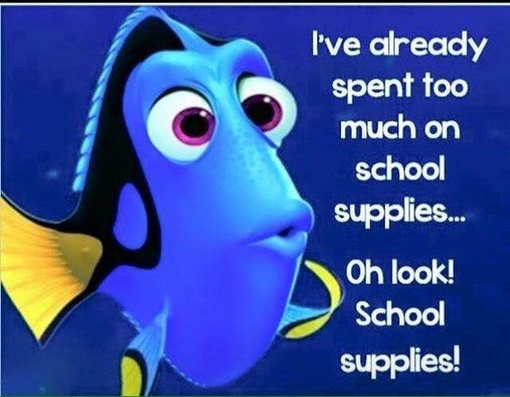
Share!
Notes:
Mary

Slide 4
Session Objectives
Participants will be able to…
Define a standard.
Download standards for courses taught from the IDOE webpage.
Connect standards to course objectives and activities.
Describe types of planning guides including pacing guides, semester plans, unit/block plans, weekly plans, and daily plans.
Notes:
Sue

Slide 5
Session Outline
What is a Standard?
Standards Location
Building a Lesson
Planning Guides
CTSOs
Pathways
Notes:
Sue

Slide 6
What is a Standard?
Educational Standards are….
benchmark measures that define what students should know and be able to do at the end of the grade level or course.
Notes:
Sue
Educational standards are the learning goals for what students should know and be able to do at each grade level. Education standards are not a curriculum. Local communities and educators choose their own curriculum, which is a detailed plan for day to day teaching. In other words, the standards are what students need to know and be able to do, and curriculum is how students will learn it.
Learning standards are concise, written descriptions of what students are expected to know and be able to do at a specific stage of their education. Learning standards describe educational objectives—i.e., what students should have learned by the end of a course, grade level, or grade span—but they do not describe any particular teaching practice, curriculum, or assessment method (although this is a source of ongoing confusion and debate).

Slide 7
What is a Standard?
Standards…
Should be used as the basis for curriculum and instructional development
Are NOT a curriculum
Used as a map to develop or choose a curriculum (local choice)
Standards are what students need to know and be able to do, and curriculum is how students will learn it

Slide 8
Activity #1
Directions:
Find the standards for one of the classes you teach
Download and save
http://www.doe.in.gov/standards
Time: 3 minutes
Individual Discovery
Notes:
Mary

Slide 9
Notes:
Mary

Slide 10
Framework
Content Standards
Domain
Core Standard
Standards / Competencies / Indicators
Notes:
Mary

Slide 11
Course Title and Description
Course/Code #, Grade Level(s), Prerequisite(s), Credits, Diploma Info
CTSO Opportunities
CONTENT STANDARDS
Notes:
Mary

Slide 12
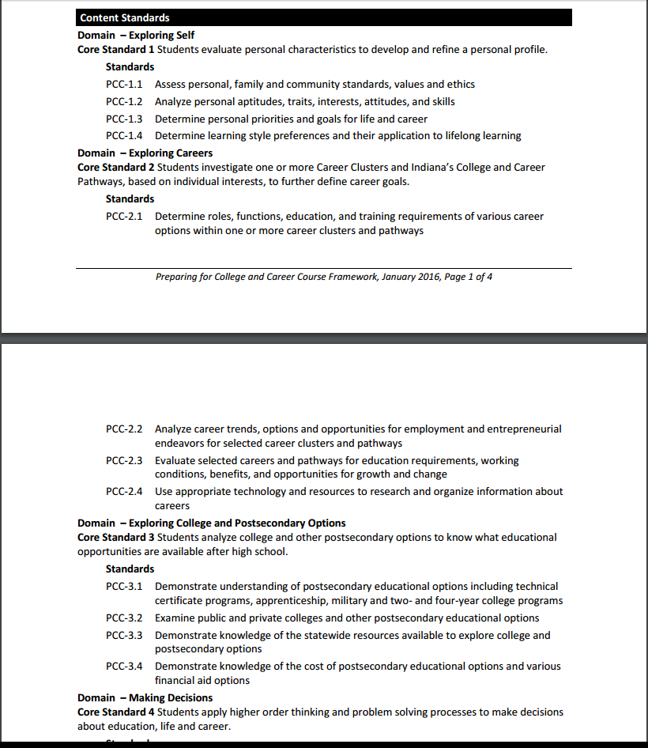
CONTENT STANDARDS
DOMAIN
STANDARDS
CORE STANDARD
Notes:
Mary

Slide 13
Framework
Content Standards
Domain
Core Standard
Standards / Competencies / Indicators
Notes:
Mary

Slide 14
focus on the end
TARGET…
Notes:
Mary

Slide 15
Building a Lesson
What is the Standard to met?
What is the topic of the lesson?
What do I want students to learn?
What do I want them to understand and be able to do at the end of class?
What are the learning objectives?
What do I want students to learn?
What teaching and learning activities will I use?
How will I check for understanding?
Reflection on lesson and how the standard was met.
What worked well and why?
What could I do better next time?
What questions will I ask students to check for understanding
What will I have students do to demonstrate that they are following?
What will I do to explain the topic?
What will I do to illustrate the topic in a different way?
How can I engage students in the topic?
Notes:
Sue
http://www.crlt.umich.edu/gsis/p2_5
Objectives
Unit/topics
Activities
Materials needed
Other?
Add to this? And beyond….

Slide 16
Activity #2:
Directions –
Work with a partner to “quickstorm” ways of teaching standards PCC-7.1
What activities would help teach these standards?
Time: 3 minutes
Small group to whole group
Notes:
Sue/Mary

Slide 17
Planning to Teach
Course Planning Tools:
Pacing Guides
Semester Plans
Block Plans
Weekly Plans
Daily Lesson Plans
Notes:
Mary

Slide 18
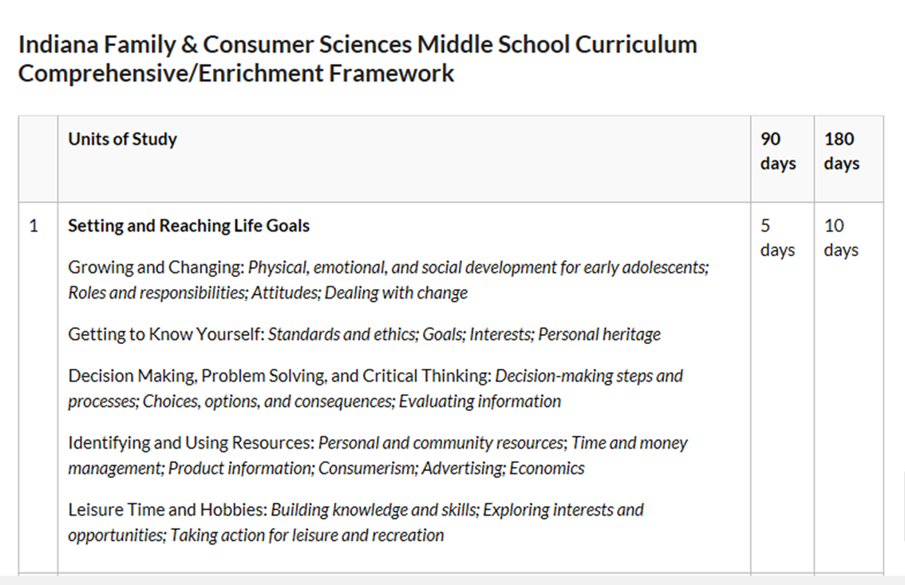
Pacing Guides
Set the “pace”
Communicate to students and others
Notes:
Mary

Slide 19
Semester Plans
A layout of the units, week by week, for the semester.
Usually included in the syllabus.
Great to give to students and post in the classroom to show them what is next and help keep everyone on track.
Notes:
Mary

Slide 20
Unit/Block Plans
A “snapshot” of the topics you will cover on each day of a unit
Ranges from a few days to a few weeks or a month.
Notes:
Mary

Slide 21
Weekly Plans
Contain the details for each lesson for the week, including
Materials
Learning goals/objectives
Standards
Assignment(s)
Assessment(s)
Notes:
Mary

Slide 22
Daily Lesson Plans
Details for a day
Learning experiences
Timing
Standards
Objectives
Materials Needed
Student Assignments and Follow-up
Scripting as needed
Notes:
Mary
Includes..
Methods
Learning experiences
Timing
Standards
Objectives
Materials Needed
Student Assignments and Follow-up
Scripting if needed…

Slide 23
Activity #3
Directions -
Choose a partner in the same content area
Select a lesson planning tool (semester, block, weekly, or daily plan)
Insert some standards and “quickstorm” an IDEA for a lesson
Finish the rest when you are back in your classroom!
Time: 5 minutes
Small Group/Whole Group
Notes:
Mary

Slide 24
Career and Technical Student Organizations
Key components of a strong CTE program
Ready-made teaching resources
Instructional Strategies
Visit the CTSO website and contact the state advisor to connect competitive events to standards in your content area
Notes:
Sue

Slide 25
Career Pathway: Entrepreneurship
Notes:
Mary

Slide 26
Career Pathways
Find the pathway for your courses: http://www.doe.in.gov/cte
Help each student have a pathway plan
Foster understanding of how courses fit pathway
Notes:
Mary
each student should have a pathway plan and regardless of the course they teach, they need to get kids to see how this particular course fits into the pathway plan. So maybe instead of the big picture bullets you have on slide 46, you could simply focus on their responsibility to see that kids have a pathway plan and help them find the pathway plans their courses are on.

Slide 27
Contact Information
Mary Rinehart
Sue Henry, BSN, RN
Engineering and Technology Specialist
317-232-0815
mrinehart@doe.in.gov
@IndianaETE
Health Science/Health & Wellness/PE Specialist
317-234-0217
suhenry@doe.in.gov

