Slide 1
Naloxone for Entities & Laysavers
Aaron Kochar, J.D.
akochar@yahoo.com
Notes:
“Laysaver”—Chief Deputy AG Matt Light & Dr. Joan Duwve

Slide 2
Talk Takeaways
Indiana’s legal framework has been revised to promote widespread distribution of naloxone to all Hoosiers
Indiana Laws written to remove barriers
Existing and
Perceived
Notes:
Liability for prescribers, dispensers, and those that administer naloxone
AG’s Advisory Opinion promotes widespread distribution of naloxone—Top Law Enforcement Official

Slide 3
The Opioid Problem
Lethal Drug dose is the leading cause of accidental death in Indiana and America
43,982 drug overdose deaths in 2013
37% caused by prescription opioids
19% caused by heroin
Almost 2x as many lethal doses from prescription opioids than from heroin
Notes:
This isn’t just background for this group; this is about STIGMA reduction

Slide 4
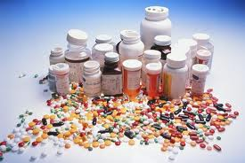
The Opioid Problem
Paths to Prescription Drug Addiction
39 year-old with back pain
17 year-old riffling through their friend’s grandma’s medicine cabinet
Grandma forgetting that she already took her pill that morning
Star DE doubling his prescribed dose to make the big game
Notes:
999 drug overdose deaths in Indiana in 2012
40.6% of those deaths were of Hoosiers 45 or older
Ages 45 to 54: 252
Ages 55 and up: 153
It’s not just teenagers.

Slide 5
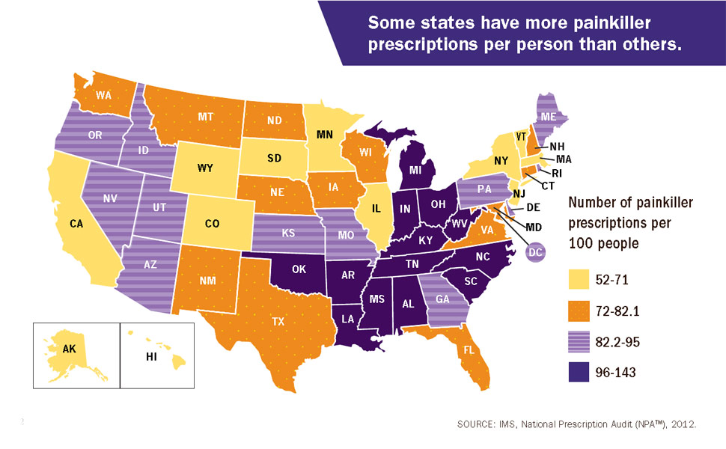
Indiana Ranks 9th Highest in the Nation
For every 100 Hoosiers, 109 Opioid Prescriptions are Written

Slide 7
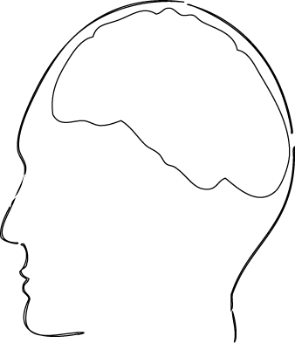
How do opioids affect breathing?
Opioid Receptors, brain
Opioid

Slide 8
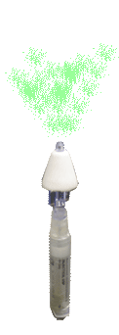
How does naloxone affect overdose?
Neutralizes opioid’s effect on receptors

Slide 9
Why Use Naloxone?
No Euphoric effect
Safe
Even if a person isn’t overdosing on an opioid
Similar to: CPR, AEDs, EpiPens
Proven track record
From 1996 through June 2014:
152,283 laypersons trained
26,463 reversals reported
Saves Money
A life saved can be a life restored

Slide 10
Myths: Why Not Use Naloxone?
If those with substance use disorder know that Naloxone can save their life, they will abuse more drugs
Naloxone will keep people from seeking treatment
People can be violent after receiving Naloxone
Notes:
JAMA April 28, 2015 ED Naloxone distribution study (v. referral, S-BIRT)

Slide 11
Training Benefits
Stigma Reduction
The face of a person with opioid or heroin SUD
“The suspect and the victim are the same individual,”
Tammy Watson, Executive Master Trooper, ISP
SUD has a higher correlation to ACE factors than obesity does to diabetes
Harm Reduction Benefits
Provide health care to people even in circumstances that are not ideal

Slide 12
Naloxone Delivery Devices
Intravenous
Intramuscular
Needle draw and injection
Autoinjector: Evzio
Intranasal
Amphastar with MAD
Indivior
Notes:
Pros/Cons:
Cost
Ease of Use
Safety
Effectiveness

Slide 13
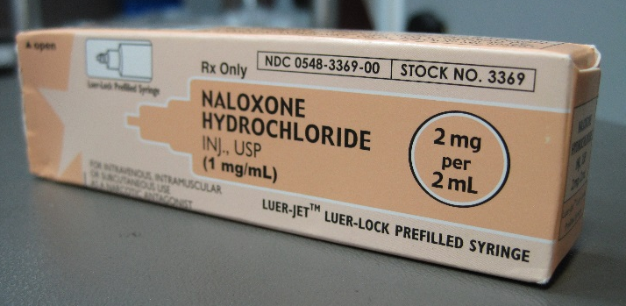
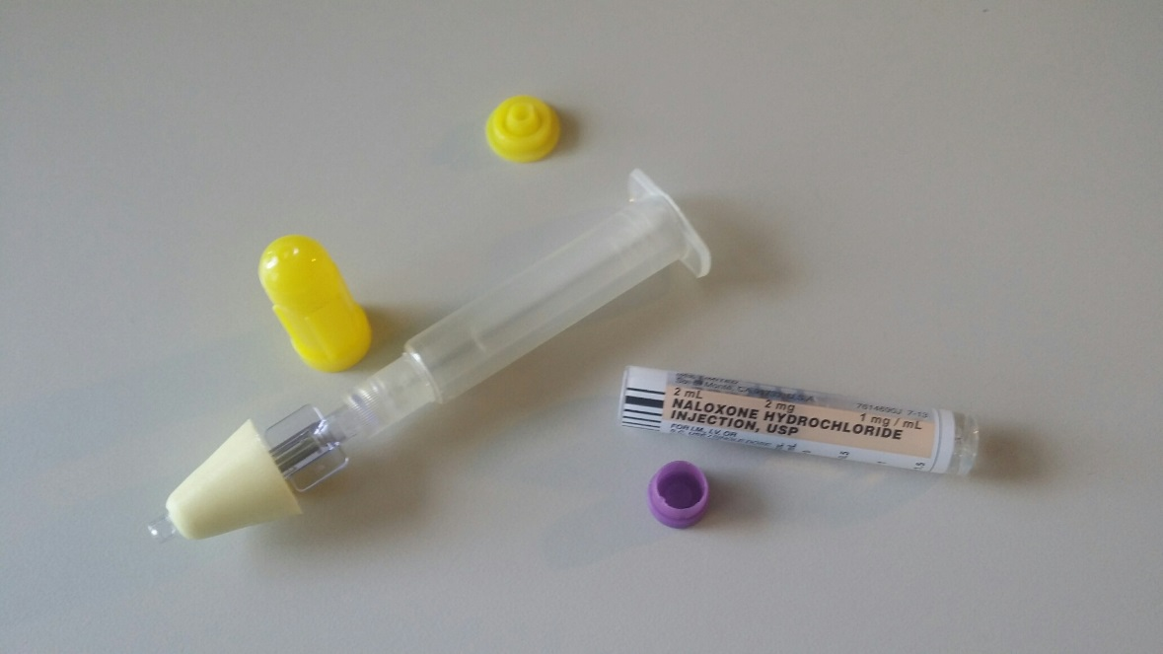
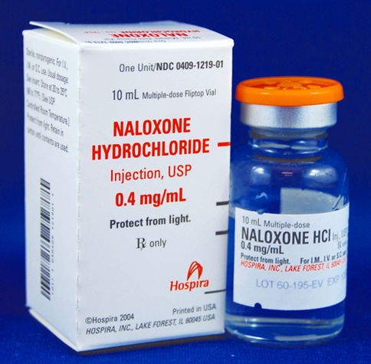
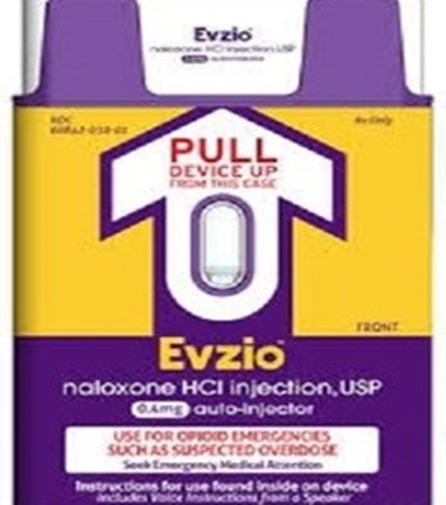

Slide 15
Indiana’s Naloxone Legal Framework
SEA 227 (2014): The Lifeline Law
“Make Good Decisions -- Make the Call”
First Responders
SEA 406 (2015): Aaron’s Law
Laysavers
Entities
Standing Orders
Notes:
Sen. Jim Merritt
Finblooms and FYSB

Slide 16
Legal Basis: AG’s Advisory Opinion
Indiana law allows certain medical procedures to be performed by non-health care workers with training
CPR, AEDs, EpiPens
Factors:
Risk of Injury from intervention/skill required,
Risk of inaction/time critical, and
Ease of training

Slide 17
Notes:
Path 1: Prescriber provides direct prescription; filled by pharmacy
Path 2: Prescriber writes standing order to entity; pharmacy fills order to entity; entity distributes
Path 3: Pharmacy registers as entity; Prescriber writes standing order to Pharmacy Entity; Pharmacy distributes “behind the counter”

Slide 18
SEA 227 – The Lifeline Law
Authorizes first responders to carry and administer naloxone
Broadly defines “First Responders”
EMS (all tiers):
Paramedic
Advance Emergency Medical Technician
Emergency Medical Technician
Emergency Medical Responder
Firefighter or Volunteer Firefighter
Law Enforcement Officer

Slide 19
SEA 227 – The Lifeline Law
Civil Immunity provided to first responders
Requirements:
Follows standards of their agency, and
Doesn’t commit gross negligence or willful misconduct
Notes:
Civil Immunity is more about PERCEIVED barrier…no known cases

Slide 20
SEA 227 – The Lifeline Law
Prescribers broadly defined:
A “health care provider”
who is licensed in Indiana and whose
scope of practice includes prescribing
may write:
Prescription,
Drug order, or
Protocol
Dispensers broadly defined:
A pharmacist licensed under IC 25-26
may dispense in the name of first responder

Slide 21
SEA 406 – Aaron’s Law
Authorizes anyone to carry and administer naloxone
Authorizes Entity Distribution to laysavers
Authorizes Standing Order prescriptions
Provides Civil Immunity to
Prescribers,
Dispensers,
Entities, and
Laysavers

Slide 22
Entity Distribution
Allows an entity to register with the ISDH annually
http://optin.in.gov
Must have a standing order
Must educate those receiving naloxone:
Call 911,
Drug overdose and treatment,
How to administer naloxone, and
Provide drug treatment information and referrals (including those that provide Vivitrol)
Notes:
ODL
Entity registration very easy

Slide 23
Standing Order Prescription
Allows a prescriber to use a Standing Order to authorize the dispensing of naloxone:
to one the prescriber has not directly examined, or
to an entity
Other Standing Orders in Indiana:
Injectable epinephrine prescribed to schools
Pharmacist administration of immunizations

Slide 24
Standing Order Prescription
Standing Orders are Important:
Low health care access by those suffering SUD
Low desire to utilize health care available by those suffering SUD
Difficult to fill prescription for family/friends when they aren’t the intended medication recipient

Slide 25
Civil Immunity
Except for an act of gross negligence or willful misconduct
Prescriber who dispenses or prescribes, or
Pharmacists who dispenses
are immune from civil liability arising from those actions
Individual or Entity is immune from civil liability from:
Obtaining naloxone,
Administering naloxone in good faith, and
Acting under a standing order

Slide 26
First Responder Programs
Authorized under both laws
Aaron’s Law provides prescribers and pharmacists explicit civil immunity

Slide 27
Next Steps
Doctors to increase individual prescriptions
Pain Clinic co-prescribing
Pharmacists increase education to those filling opioid prescriptions
Pharmacies registering as Entities
Offer Rescue Kits to incarcerated people at risk

Slide 28
Next Steps
Emergency departments distribute upon discharge
420,040 ED Visits due to Prescription Opioids
258,482 ED Visits due to Heroin
EMS distribution
Treatment providers (FQHCs, CMHCs, MATs) to provide naloxone rescue kits
Naloxone distribution with Sterile Syringe Exchange programs

Slide 29
Talk Takeaways
Indiana’s legal framework has been revised to promote widespread distribution of naloxone to all Hoosiers
Indiana Laws written to remove barriers
Existing and
Perceived

