Slide 1
Candidate Petition
Processing 2024
Presented by:
Brad King, Republican Co-Director,
Indiana Election Division
Election Administrator’s Conference
December 11-13, 2023
Indianapolis, Indiana

Slide 2
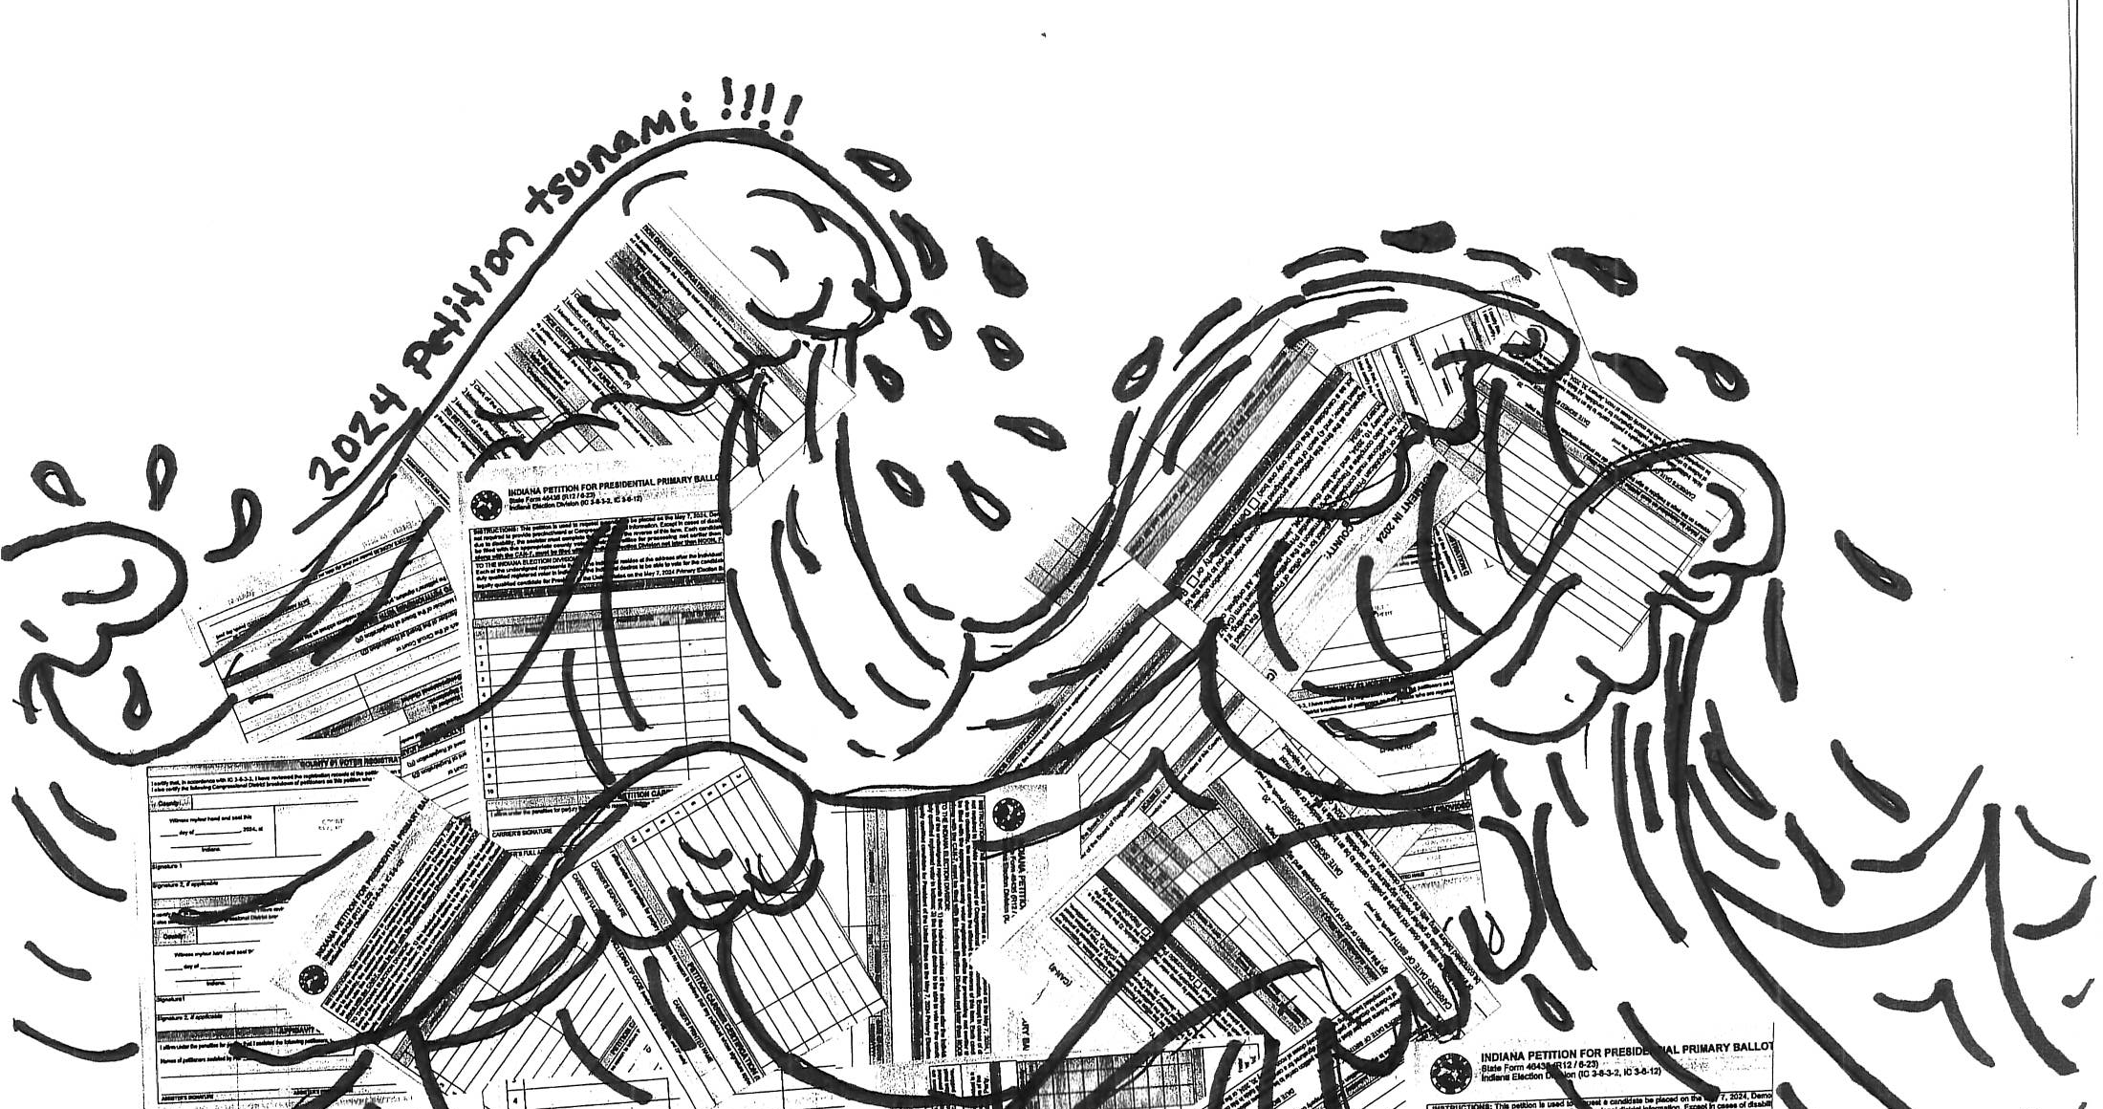
2024 Petition Tsunami!!!

Slide 3
Petitions
Candidates for President, U.S. Senate and Governor will file petitions for signature verification to get on the May 2024 primary ballot.
In each case, county voter registration office must verify the signatures are registered voters of their county.
Wednesday, January 10, 2024
First day to file a petition of nomination with a county.
Tuesday, January 30, 2024
NOON DEADLINE for a (R,D) candidate for Presidential Primary to file petition of nomination with the county.
Tuesday, February 6, 2024
NOON DEADLINE for a (R, D) candidate for U.S. Senator or Governor for Primary Nomination to file petition of nomination with the county.
Friday, February 9, 2024
DEADLINE, by noon, Indianapolis time, for (R, D) President, U.S. Senator, or Governor candidate to file a
declaration of candidacy and petitions for placement on the primary election ballot with the election
division following certification of petition signatures by county voter registration offices.

Slide 4
County Process Examples
Count the pages while the carrier is there and have them enter the number. Pro Tip: look at front and back.
File stamp each page.
Carrier completes form.
Once verification is complete, carrier is called to retrieve petitions.
When carrier arrives, do a second verification count, enter it on the form and have the carrier sign.
Copies of all form and filed stamped petitions are then kept for future reference. This includes petitions filed with the state.

Slide 5
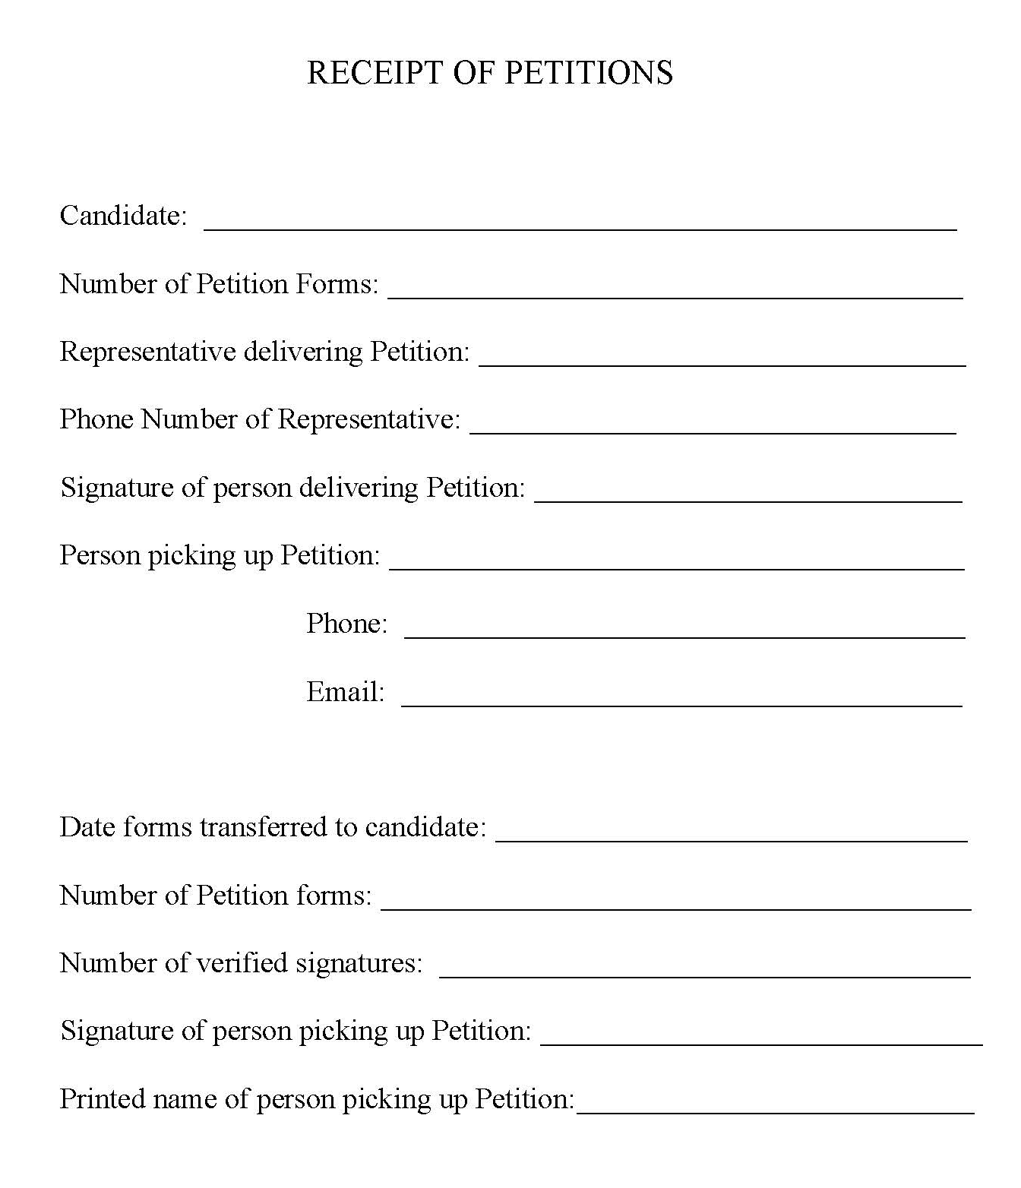
Hamilton County Examples
First come, first serve basis
Petition carrier completes the form.
Count the pages twice while carrier is there.
Time stamp each page
County does required daily work (registrations and cancellations) before petition processing.
Make copies of petitions
Call the contact for pick up.
Carrier must sign form with date and time petitions were picked up.
If requested to send to IED, county sends as soon as they are done.

Slide 6

Ballot Access Through Petition
Forms for Primary Election 2024
Major Party Presidential Primary Candidate
Declaration of Candidacy (request for Placement on Ballot) (CAN-7)
Petition for Primary Ballot Placement (CAN-8)
            IC 3-8-3-1 |IC 3-8-3-2

Slide 7
Ballot Access Through Petition
Forms for Primary Election 2024
U.S. Senator (Democratic or Republican candidates only)
Declaration of Candidacy (CAN-2)
Petition for Primary Ballot Placement (CAN-4)
            IC 3-8-2-8

Slide 8
Ballot Access Through Petition
Forms for Primary Election 2024
Governor (Democratic or Republican candidates only)
Declaration of Candidacy (CAN-2)
Petition for Primary Ballot Placement (CAN-25)
Statement of Economic Interest (CAN-12)
            IC 3-8-2-8

Slide 9
Ballot Access Through Petition
Forms for Primary Election 2024
Minor party and independent candidates
WHO WANT THEIR NAME TO APPEAR ON THE BALLOT
Petition of Nomination Form for Federal, State, State Legislative, or Certain Local Offices (CAN-19)
  Judge and prosecuting attorney candidates ONLY since these petitions ultimately filed with the State
Candidate’s Consent (CAN-20)
Statement of Economic Interest will be filed later with appropriate state agency
            IC 3-8-1-33 |IC 3-8-6-2

Slide 10
Petition Signature Counts
Major Party Presidential Primary Candidates, U.S. Senator, and Governor
  Minimum 500 certified signatures from registered voters in each of the NINE Congressional districts to qualify for Democratic & Republican primary election ballot.
School Board
  Minimum 10 certified signatures from registered voters (for most school board positions) Some variation based on type of school corporation: “community” versus “metropolitan” school corporations, and others.
Minor Party & Independent Candidates
  Minimum certified signatures of registered voters totaling 2% of total votes cast for all candidates in 2022 SOS Race for election district sought
    See back of 2024 Candidate Guide for county-by-county and statewide totals
      IED calculates signature requirement for state legislative candidates
      County calculates signature requirement for local offices
      where the election district is smaller than the county
      Small town minimum: 5 registered voters must sign petition if town is located entirely within one precinct, but does not include ENTIRE precinct.
Individuals signing a petition of nomination must be registered voters within the election district when the petition is processed by county officials.
IC 3-8-2-8 | IC 3-8-2.5-2 | IC 3-8-3-2 | IC 3-8-6-2 | IC 20-23-4-29.1 (CSC) | IC 20-23-7-8.1 (MSC)

Slide 11
Filing Process, Generally
Submit petitions to the county VR official for review and certification
  For CAN-21 & CAN-34 petitions (local office and school board), the CAN-12 must be submitted when petitions are filed for review in MOST counties, including Lake, Porter & Tippecanoe
    In the few counties with a separate Board of Registration, the CAN-12 is to be filed with the certified petitions
    Failure to file CAN-12 at this point in the process requires the CAN-21 or CAN-34 petitions to be rejected
  Candidate MAY collect certified petitions from county VR official
    Candidates are encouraged to leave contact information with county to call when petition review is completed
File certified petitions along with candidate’s consent and statement of economic interests to appropriate agency.
County VR official may ONLY review information for voter residing in their county.
Exception: school board candidates where school corporation is in more than one county.
IC 3-8-1-33 | IC 3-8-9-5

Slide 12
Deadline to Submit Petition for Review?
Primary Election
Presidential Primary Candidates
    January 10, 2024 through NOON (local prevailing time) January 30, 2024
U.S. Senate and Governor Primary Candidates
    January 10, 2024 through NOON (local prevailing time) February 6, 2024
General Election
Minor Party/Independent Candidates
  Submit CAN-19 or CAN-21 petitions to counties for review & certification:
    January 10, 2024 through NOON (local prevailing time), July 1, 2024 (transferred from Sunday, June 30, 2024)
    Don’t forget to file the CAN-12 with the CAN-21!
School Board
  Submit CAN-34 to counties for review & certification:
    NEW! May 21, 2024, through NOON (local prevailing time), June 20, 2024
    Don’t forget to file the CAN-12 with the CAN-34!
IC 3-8-2-10 | IC 3-8-3-4 | IC 3-8-2.5-4 | IC 3-8-6-10

Slide 13
Required Petition Elements

Slide 14
Required Petition Elements
CAN-21
CAN-19

Slide 15
Required Petition Elements
CAN-4 (US Senate)
Candidate’s name, address and office sought
Note – petitioners are not required to provide precinct and congressional district info.
While it’s helpful if the candidate’s name and address on the
CAN-4, CAN-19 & CAN-21 corresponds with their Indiana voter registration record, it does not need to do so. Instead, the CAN-2 and CAN-20, respectively, establishes this information for purposes of communication after candidate filing and the candidate’s ballot name.

Slide 16
Required Petition Elements
CAN-19 & CAN-21
Minor Party Candidates
Candidate name(s)
Up to 4 individuals from the same political party may circulate the same petitions & those tallies apply to each candidate, if they are running in the same election district
Candidate(s) address & office sought
Independent Candidates
Candidate name, address & office sought
Only ONE independent candidate may be included on a petition because an independent candidate is not affiliated with a political party.
“Independent” means not affiliated with any political party.
IC 3-8-6-4| IC 3-5-2-26.6

Slide 17
Required Petition Elements
Signature of voter
  Must reasonably conform to the registration record
  Check for voter assistance affidavit on the back
Printed first and last name
  Name should reasonably conform to registration record
Residence Address
  Voter is to be registered at the address indicated on the petition at the time the petition is reviewed by county VR officials
  IC 3-5-6-4 & IC 3-5-6-5 discuss minor & substantial variations in addresses
IC 3-5-6-6 | IC 3-5-6-4 | IC 3-5-6-5

Slide 18
Required Petition Elements
Best possible notice must be given to a petition carrier if the “petition carrier certification” is incomplete. If petition carrier does not correct their affidavit by the petition certification deadline, then the petition is not to be reviewed by county VR officials.
(IC 3-6-12-7; IC 3-6-12-8; IC 3-6-12-9
Petition Carrier Affidavit
  ALL petition carriers (including candidates!) MUST complete the affidavit on the bottom of the form (petition side).

Slide 19
Other Petition Elements
Date of Birth is NOT a required petition element
  Included on form to assist county in identifying registered voter
  May not reject a signature if DOB is missing
Don’t forget to update the “Office Use Only” section(s) of the CAN-4, CAN-19,or CAN-21 paper form, and do NOT mark through a petitioner’s name!

Slide 20
Finalizing Review
Once petition is reviewed, VR official will:
  Complete back of petition form
  Note number of certified signatures
    If Pres/Senate/Gov include how many signatures came from which CD
  Sign document (seal is not required)
Certified forms
  Candidate can collect them from VR office
OR
  VR can send to the Indiana Election Division, if candidate is running for statewide, state legislative, or federal office
No statutory deadline to finish verification process; however, any cricial delay could lead to court action by candidate or party

Slide 21
Petition Certification

Slide 22
Petition Certification
Back of petition includes certification for county VR officials to complete
Up to two counties can use this certification, if petition includes signatures from more than one county
After signature review, county completes ONE certification box
Look in the Purple VR Guidebook
            Extra box below in case petition has signatures of individuals who live in differing counties
          Only one signature line is required for MOST counties
              Second signature required if county has a bi-partisan Board of Voter Registration
How am I going to remember all of this in January?

Slide 23
FAQS
Who can circulate petitions?
Can anyone sign a petition?
What if the person updates their registration at the same time they sign the petition?
ANYONE can be a petition carrier, even a candidate
Yes, but only properly registered Indiana voters living in the election district count toward the total, assuming the individual’s residence address on their registration record is substantially similar to the residence address included on the petition at the time the petition is processed by county VR officials
  Depends on the timing
  Current residence address indicated on petition must be substantially similar to the one on the person’s voter registration record at the time the petition is reviewed and processed. Minor variation in addresses is permitted.
    Registration updated BEFORE petitions are reviewed, then it’s likely OK
    Registration updated AFTER petitions are reviewed, then signature is rejected

Slide 24
FAQS
Do all the signatures on the same petition have to come from the same county?
  No, not under state law
  Possible all ten signature lines on a petition form could be completed by voters living in ten different counties
  Practically speaking, this is a headache for candidates AND counties
    Candidates would hope county A finished their work before the deadline in order to submit the remainder to county B on time for verification and so on

Slide 25
FAQS
Do signatures have to be original?
  YES! Absolutely no copies of signatures, emails or faxes containing signatures, electronic, digital, or digitized signatures.
Can a voter with a disability be provided assistance in completing the petition?
  YES. Person providing assistance must complete the affidavit on the back side of the petition.
Do we reject a petition for signature review if the “back side” of the petition form is not part of the submission? Or front/back of petition is stapled together?
  Common sense should prevail
  Counties can make additional certification sheet copies to attach to the petition, if necessary
    However, omitting the second page of the form may result in a rejected signature if a person requested assistance from another individual and the completed affidavit of assistance is missing.

Slide 26
FAQS
Do we reject a petition if it's not on the current version of the form (or a form grandfathered as noted on the IED order)?
Do we reject a petition if it’s filed with the county after the submission deadline?
Do we reject a petition if the CAN-12 was due at the time the CAN-21 or CAN-34 petition was filed for review?
  Yes. State law requires you to reject the petition.
    EXCEPTION: In the few counties with a separate board of VR,
    the CAN-12 is filed with the certified petitions & candidate’s consent
IC 3-5-4-1.9 | IC 3-5-4-8 | IC 3-8-1-33 | IC 3-8-9-5

Slide 27
Filed Certifed Petitions
Independent/Minor Party Local Candidates for general election
  Candidate’s consent (CAN-20), certified CAN-21 petitions & CAN-12 filed not later than noon (local prevailing time), July 15, 2022
IC 3-8-6-10

Slide 28
Certification of Petition Signatures
For CAN-19, CAN-34 petitions, if candidate does NOT file enough signatures to meet the filing requirement, then county clerk MUST notify the candidate that they failed to qualify for the ballot. This can be done:
  In person, if the candidate files the petition in person; or
  By certified mail.
A candidate may file a CAN-1 challenge by the stated deadline to appeal the decision at a CEB hearing
IC 3-8-2.5-6 I IC 3-8-6-12

Slide 29
Thanks!
Do you have any questions?

