Slide 1
2024 INDIANA ELECTION ADMINISTRATORS’ CONFERENCE
INSVRS
Help Desk Transformation

Slide 2
Help Desk Survey Overview
INSVRS Help Desk Transformation
The last survey requesting county feedback on Help Desk services received 113 responses across 84 counties. Thank you for your feedback!
Results and ideas from survey responses have been grouped into Help Desk related enhancements for counties to rank
Exercise: I like, I wish, I wonder…
After contact information (which is optional in case counties wish to remain anonymous), the survey includes only 3 questions
I Like… – Fill in the blank
I Wish… – Counties rank 7 options from highest priority to lowest priority
I Wonder… – Fill in the blank (County submission of ideas not ranked in the “I Wish” section)
County Survey Deadline: December 29, 2023
Notes:
Thank you for your participation in our recent SVRS Help Desk survey! Your feedback has been invaluable in our efforts to continuously improve the SVRS Help Desk. Those results have been reviewed with Civix and the Core Team and have been grouped into a variety of potential Help Desk related enhancements that can be evaluated for implementation. Building on the previous survey, we invite you to engage in a short exercise to share your thoughts on potential new ideas for the Help Desk service. This short survey will be available through the end of the month, so the team can begin determining which enhancements are feasible and can be implemented.
The Core Team wants to make sure that what the counties like is maintained which is featured as an “I like” question
Review how all of you would rank these the Help Desk improvements which is featured as an “I wish” question
And an “I wonder” question for any Help Desk enhancements you may have that are not currently included in the prior question that we are asking for your ranking

Slide 3
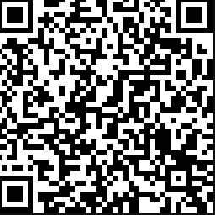
INSVRS Help Desk Exercise
Link: https://www.surveymonkey.com/r/Q9HDSMY
I like…
I wish…
I wonder…

Slide 4
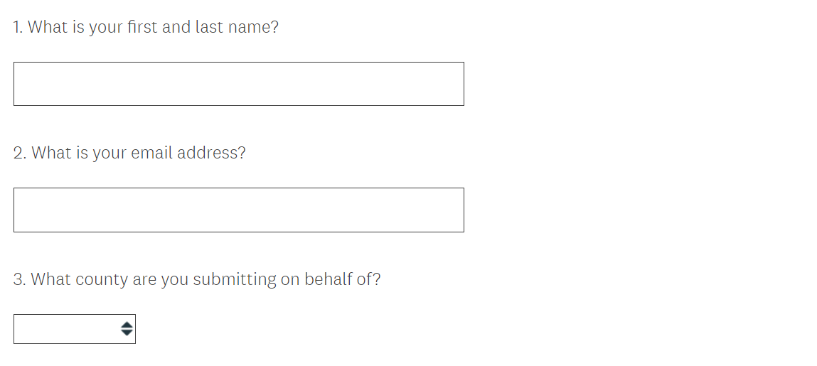
County contact information
INSVRS Help Desk Exercise Overview
Contact name, email address, and county name are not required fields in case you wish to remain anonymous.

Slide 5
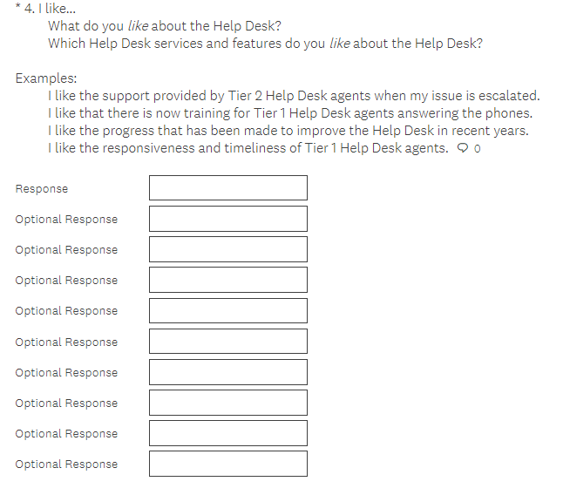
I like…
INSVRS Help Desk Exercise Overview
Examples:
…the support provided by Tier 2 Help Desk agents when my issue is escalated
…Tier 1 Help Desk has read-only access to SVRS
…that I can submit Help Desk questions to an email inbox
…that the Help Desk doesn’t answer policy-based questions and those questions are re-directed to IED

Slide 6
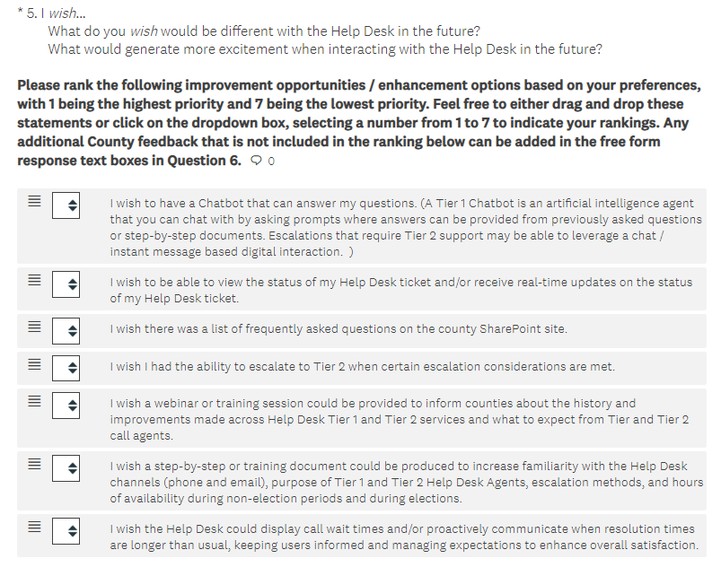
I wish…
INSVRS Help Desk Exercise Overview
Rank each response by clicking and moving the option to your selected ranking OR click the up or down arrow for each option until the list is in your preferred ranking order
1 = Highest priority
7 = Lowest priority

Slide 7
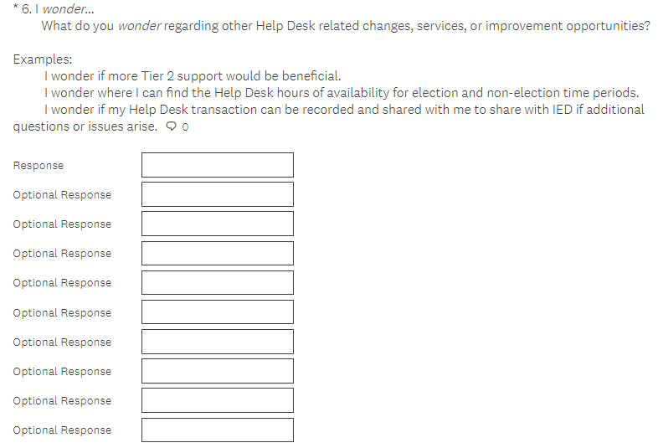
I wonder…
INSVRS Help Desk Exercise Overview
Examples:
…if more Tier 2 support would be beneficial
…where I can find when the Help Desk hours of availability for election and non-election time periods
…how I might be able to get an answer to my question quicker

