Slide 1

Filing a Candidate’s Statement of Organization (CFA-1)
Image by blossomstar on Freepik
Presented by:
Angie Nussmeyer
Co-Director, Indiana Election Division
2024 Election Administrator’s Conference
December 11-13, 2023 | Indianapolis, Indiana

Slide 2

Image by studiogstock on Freepik
“WHEN” to file a CFA-1 is determined, generally, by the salary for the elected office in a calendar year:
More than $5,000 -OR- Less than $5000.

Slide 3

Offices Paying MORE THAN $5K
For offices paying MORE THAN $5,000 in a calendar year:
  In 2024, candidates NOT running for office in 2024 file a CFA-1 by noon, ten days after raising or spending more than $100 toward running for office.
    “More than” is $100.01+
Image available on Freepik
IC 3-9-1-3 | IC 3-9-1-5
Image by vectorjuice on Freepik

Slide 4
Offices Paying MORE THAN $5K
For offices paying MORE THAN $5,000 in a calendar year:
  In 2024, candidates running for office in 2024 must open a campaign finance committee (whichever comes first):
    by noon, ten days after raising or spending more than $100 toward running for office; OR
    by noon, seven days after the filing deadline to put their name on the ballot
      Example: Sue files to be on the Democratic Party primary ballot on the last day – February 9, 2024. The office pays more than $5,000. She must file CFA-1 by noon, February 16, 2024.
Image available on Freepik
IC 3-9-1-3 | IC 3-9-1-5
<a href="https://www.freepik.com/free-vector/regular-money-transfer-cash-transaction-planned-payment-online-banking-remittance-personal-account-management-money-addresser-cartoon-character-vector-isolated-concept-metaphor-illustration_12083651.htm#from_view=detail_alsolike">Image by vectorjuice</a> on Freepik

Slide 5

Offices Paying LESS THAN $5K
For offices paying LESS THAN $5,000 in a calendar year
  File CFA-1 by noon, ten days after raising or spending more than $500 toward running for office.
    “More than” is $500.01+
    No “triggering” event when filing a declaration of candidacy
  Rule also applies to school board candidates
NOTE: Candidates running for party office (PC & delegate) DO NOT need to open a campaign finance committee.
IC 3-9-1-3 | IC 3-9-1-5 | IC 3-9-1-5.5
Image available on Freepik

Slide 6
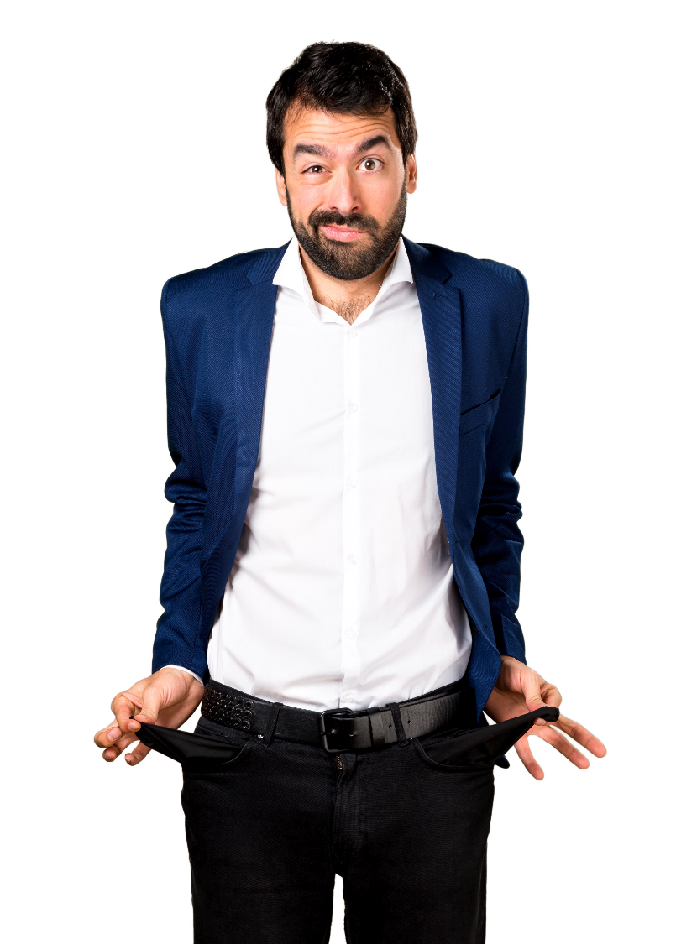
But I’m not going to raise or spend any money? Do I need to file a CFA-1 or campaign finance reports?
If the office pays more than $5,000 in a calendar year and you filed to be on this year’s ballot, YES!
The CFA-1 needs to be filed AND all applicable CFA-4 reports such as pre-primary, pre-election & annual, until committee is disbanded.
Didn’t raise or spend money? Report zeroes on CFA-4 Summary Page.
Image by luis_molinero on Freepik

Slide 7
When to File a CFA-1:
Administratively Open
What happens when candidate required to open a committee does not?
  CEB MUST open a campaign finance committee for delinquent candidates by noon, fourteen days after the filing deadline
    For Democratic & Republican primary candidates, the CEB must act to administratively open a committee not later than noon, February 23, 2024
    File a CFA-1 on the candidate’s behalf:
      Use contact information from CAN-2 to complete the top portion
      Enter office sought
      Name the candidate as treasurer AND chairperson of the committee
      No signature required
        Might write a note in the “Office Only” space the committee was administratively opened on <INSERT DATE>
IC 3-8-1-1.6 | IC 3-9-1-6

Slide 8

OPEN committees
are responsible for TIMELY FILING
ALL campaign finance reports,
according to the state’s filing schedule UNTIL the committee files a final/disbands report
Image by storyset on Freepik

Slide 9
Where to File CFA Forms
Statewide & State Legislative Office:
Candidates file only with the Indiana Election Division
County, City, Town or Township Office (INCLUDES JUDGES):
Candidates file with the County Election Board
PACs and Legislative Caucus Committees:
Support Statewide or State Legislative Candidates or Public Questions
  File with the Election Division
Support County, City, Town or Township Candidates or Public Questions
  File with County Election Board
Supporting more than one of these categories
  File with the Election Division
IC 3-9-5-2 | IC 3-9-5-3 | IC 3-9-5-4

Slide 10
2024 Reporting Deadlines
2023 Annual Report Wednesday, January 17, 2024 (NOON)
ALL Candidates and PACs
Regular Party Committees Monday, March 1, 2024 (NOON)
Pre-Primary Report Friday, April 19, 2024 (NOON)
Candidates on the ballot for reporting period ending Friday, April 12, 2024
PACs and Party Committees
Pre-General Report Friday, October 18, 2024 (NOON)
Candidates on the ballot for reporting period ending Friday,
PACs and Party Committees October 11, 2024
2024 Annual Report Wednesday, January 15, 2025 (NOON)
ALL Candidates and PACs for reporting ending December 31, 2024
Regular Party Committees Monday, March 3, 2025 (NOON)
IC 3-9-5-6 | IC 3-9-5-10

