Slide 1
Theodore Roosevelt College & Career Academy
March 8, 2017
State Board of Education Report

Slide 2
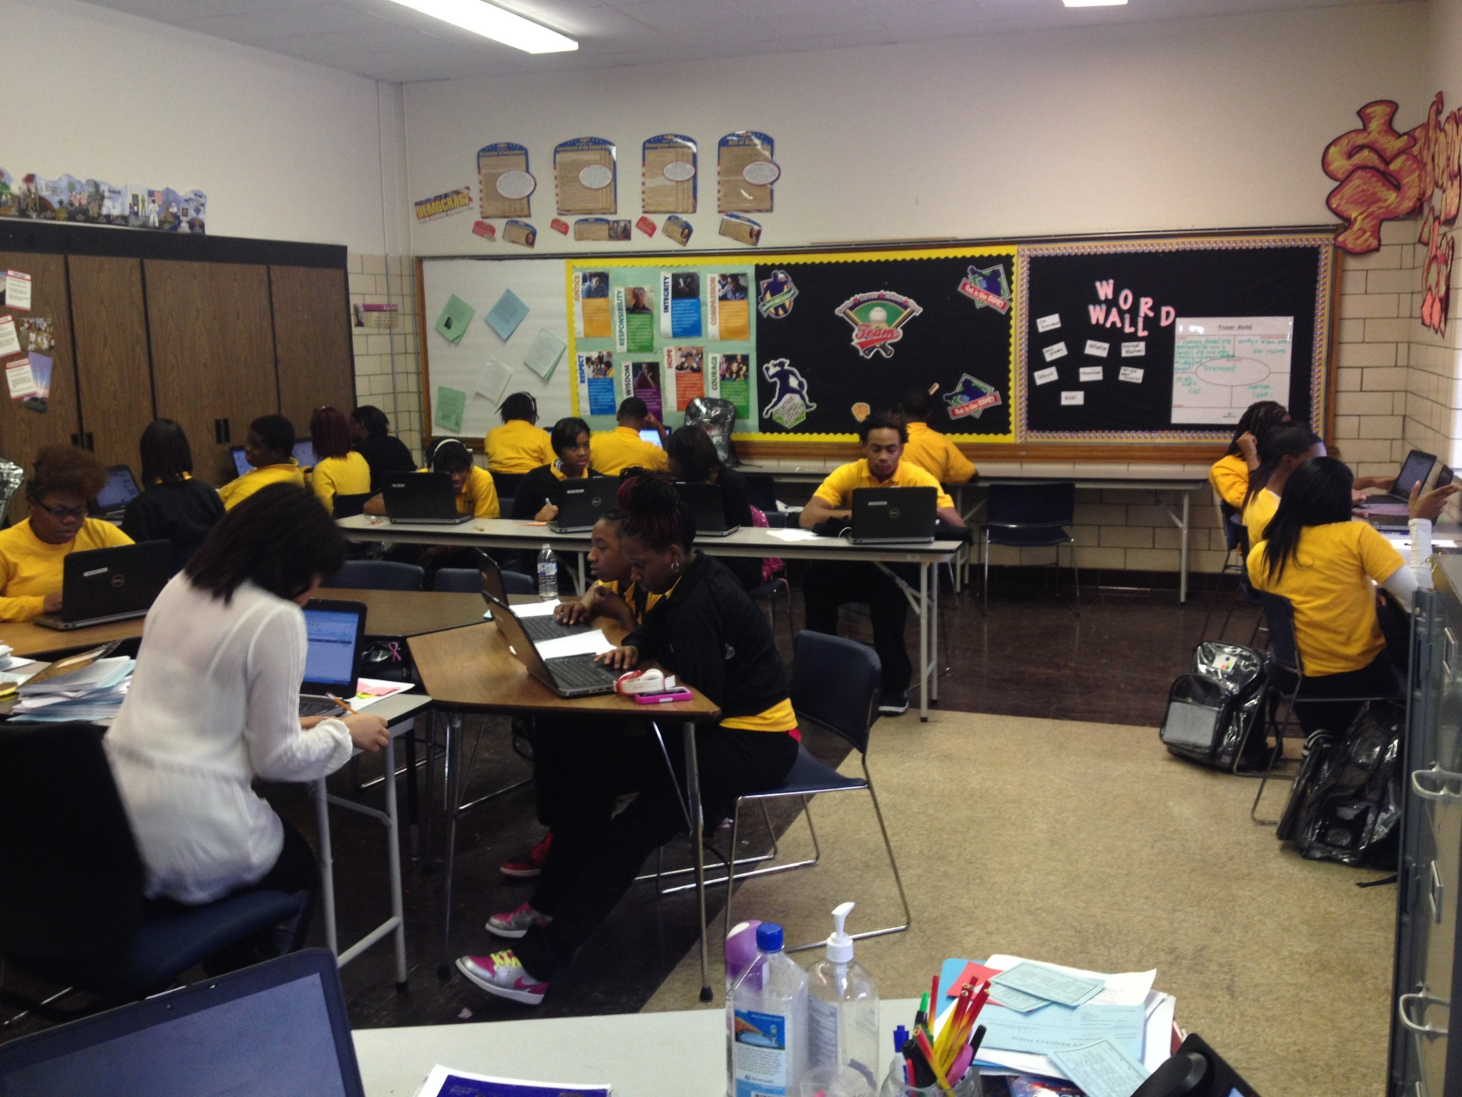
Our Vision
Every Student Proficient and Prepared for College and Careers

Slide 3
Our Mission:
The mission of Theodore Roosevelt College and Career Academy is to maximize the potential of each student, creating the urgency to reach proficiency and assuring that students are given the greatest opportunity to learn and perform at high levels through premium-quality teaching and leadership as well as an effective, supportive learning environment.

Slide 4
In The Beginning… Strategic Plan Development with All Stakeholders
Conducted a Collaborative Quality Analysis (CQA) using our proprietary School Design Rubric to assess the school’s current strengths and areas of opportunity

Slide 5
Systematic Challenges Pre-EdisonLearning
Fear - lack of School Safety
ODR - average of 180 monthly referrals
Suspensions – 1,827 in the first year
67% Attendance Rates
Lack of a consistent, comprehensive Behavior Management System

Slide 6
Academic Challenges Pre-EdisonLearning
41% Graduation Rate
75% of students read fell far below grade level in Reading according to SRI & LevelSet
60% of graduating seniors enrolled in a 2-4 year college or vocational program
58% average of under-accredited students

Slide 7
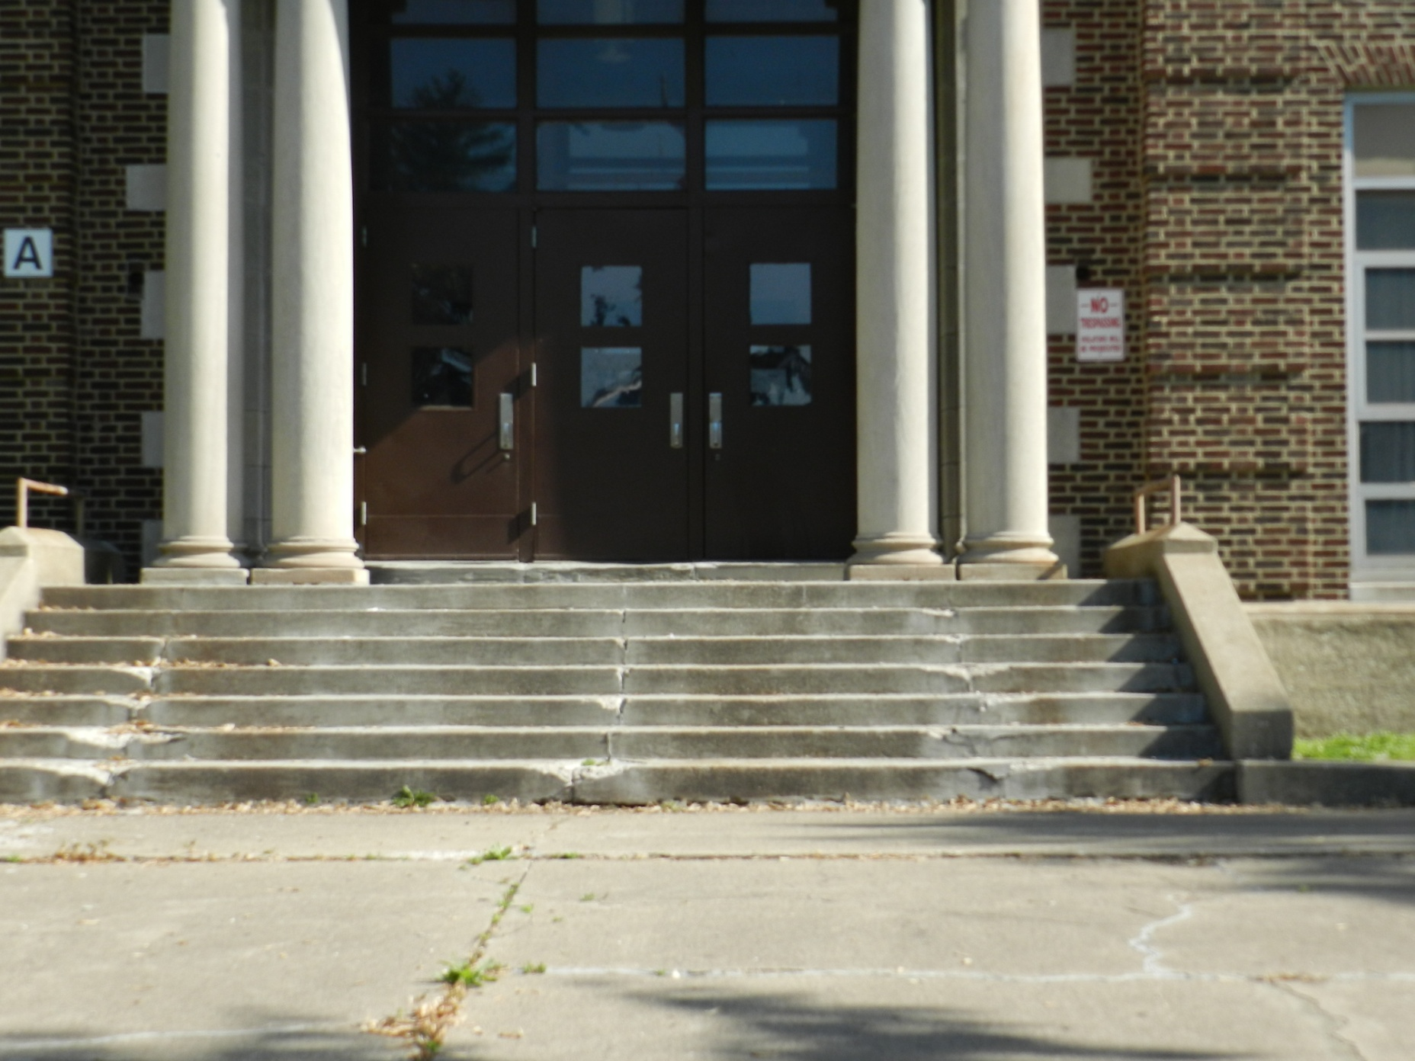
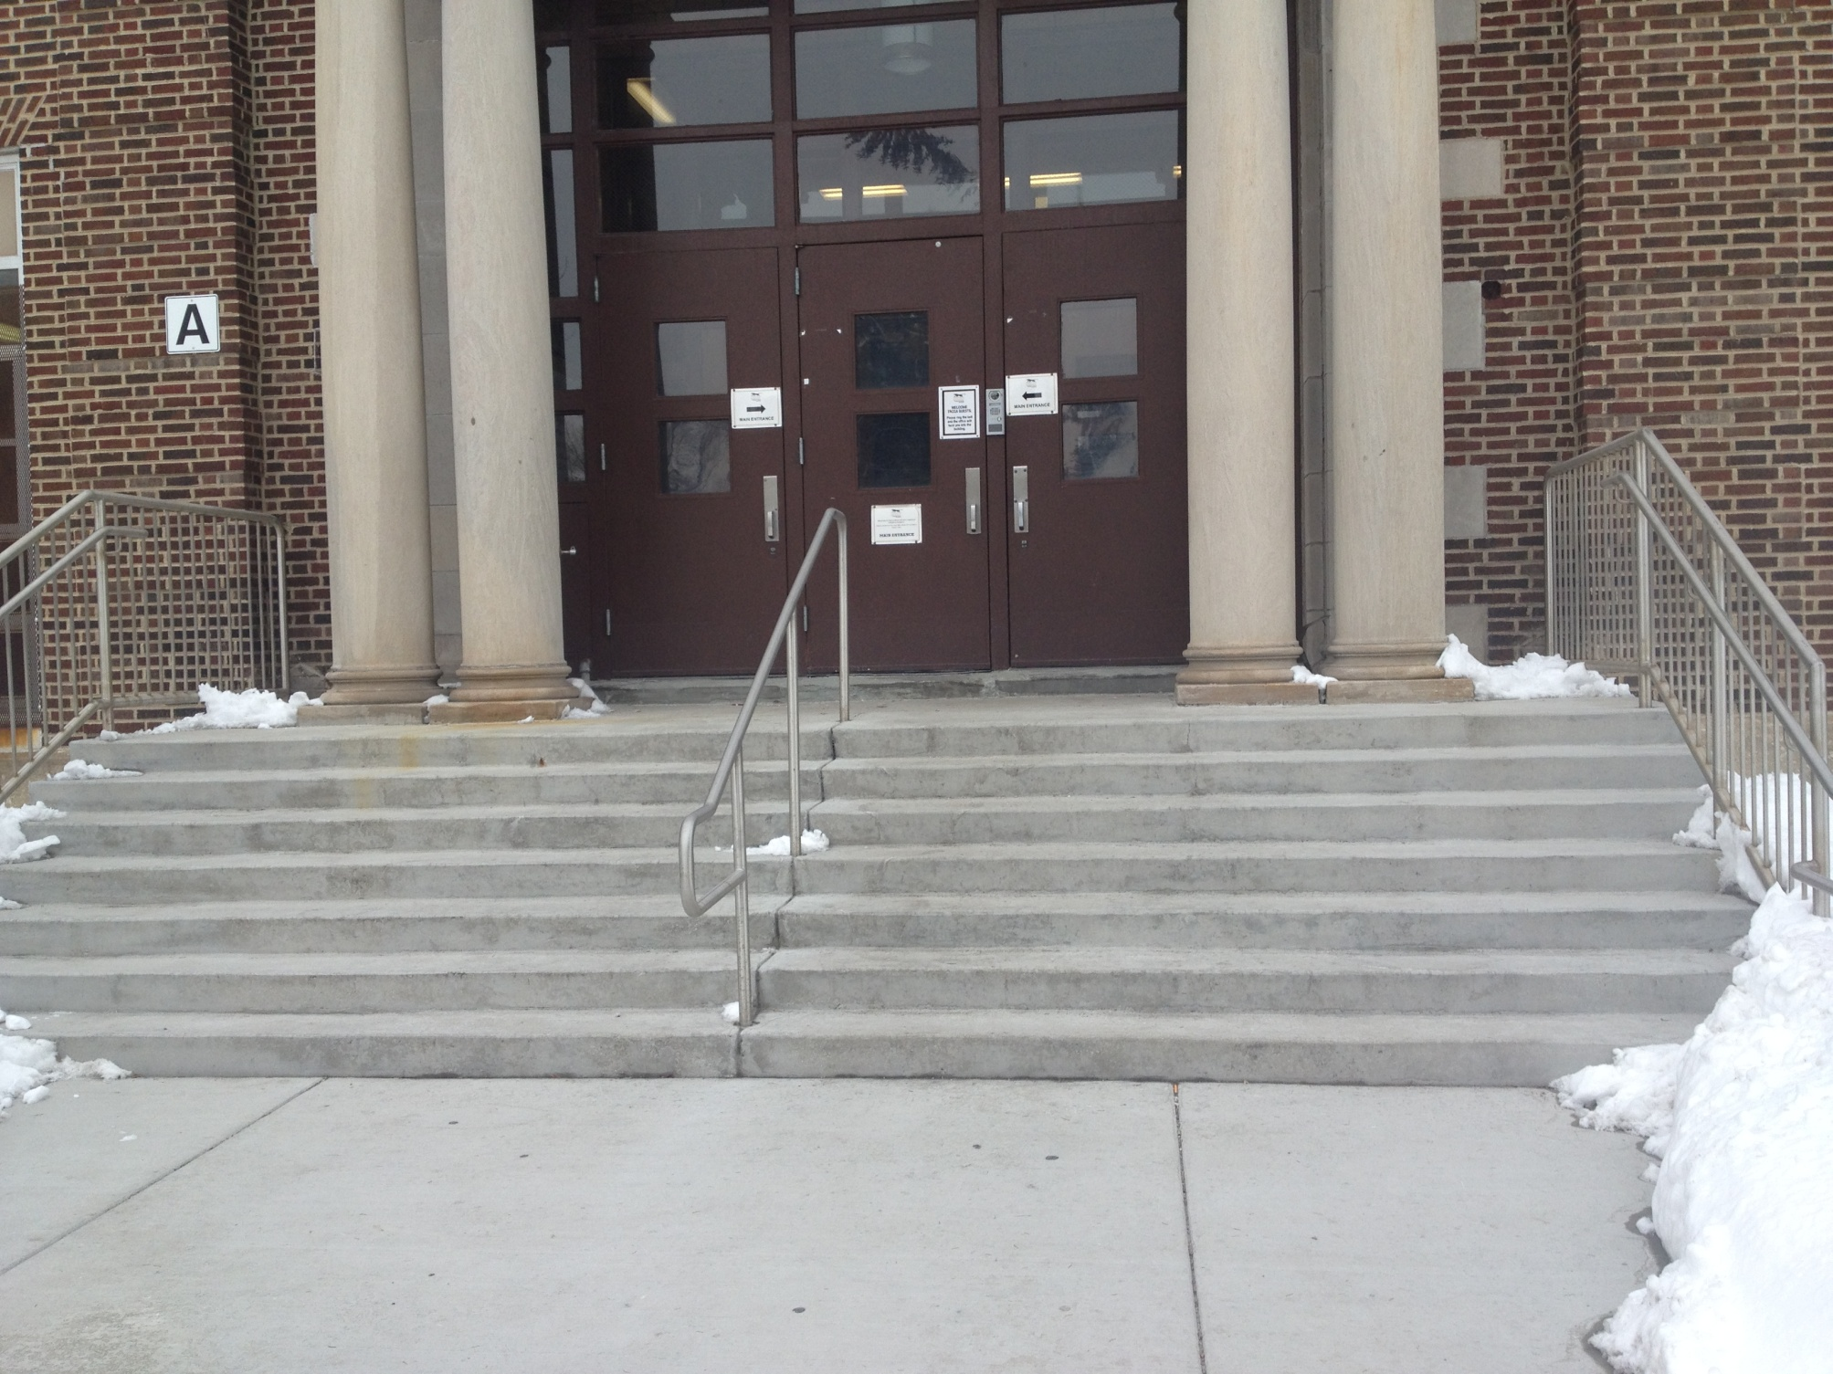
Pre-EdisonLearning EdisonLearning

Slide 8
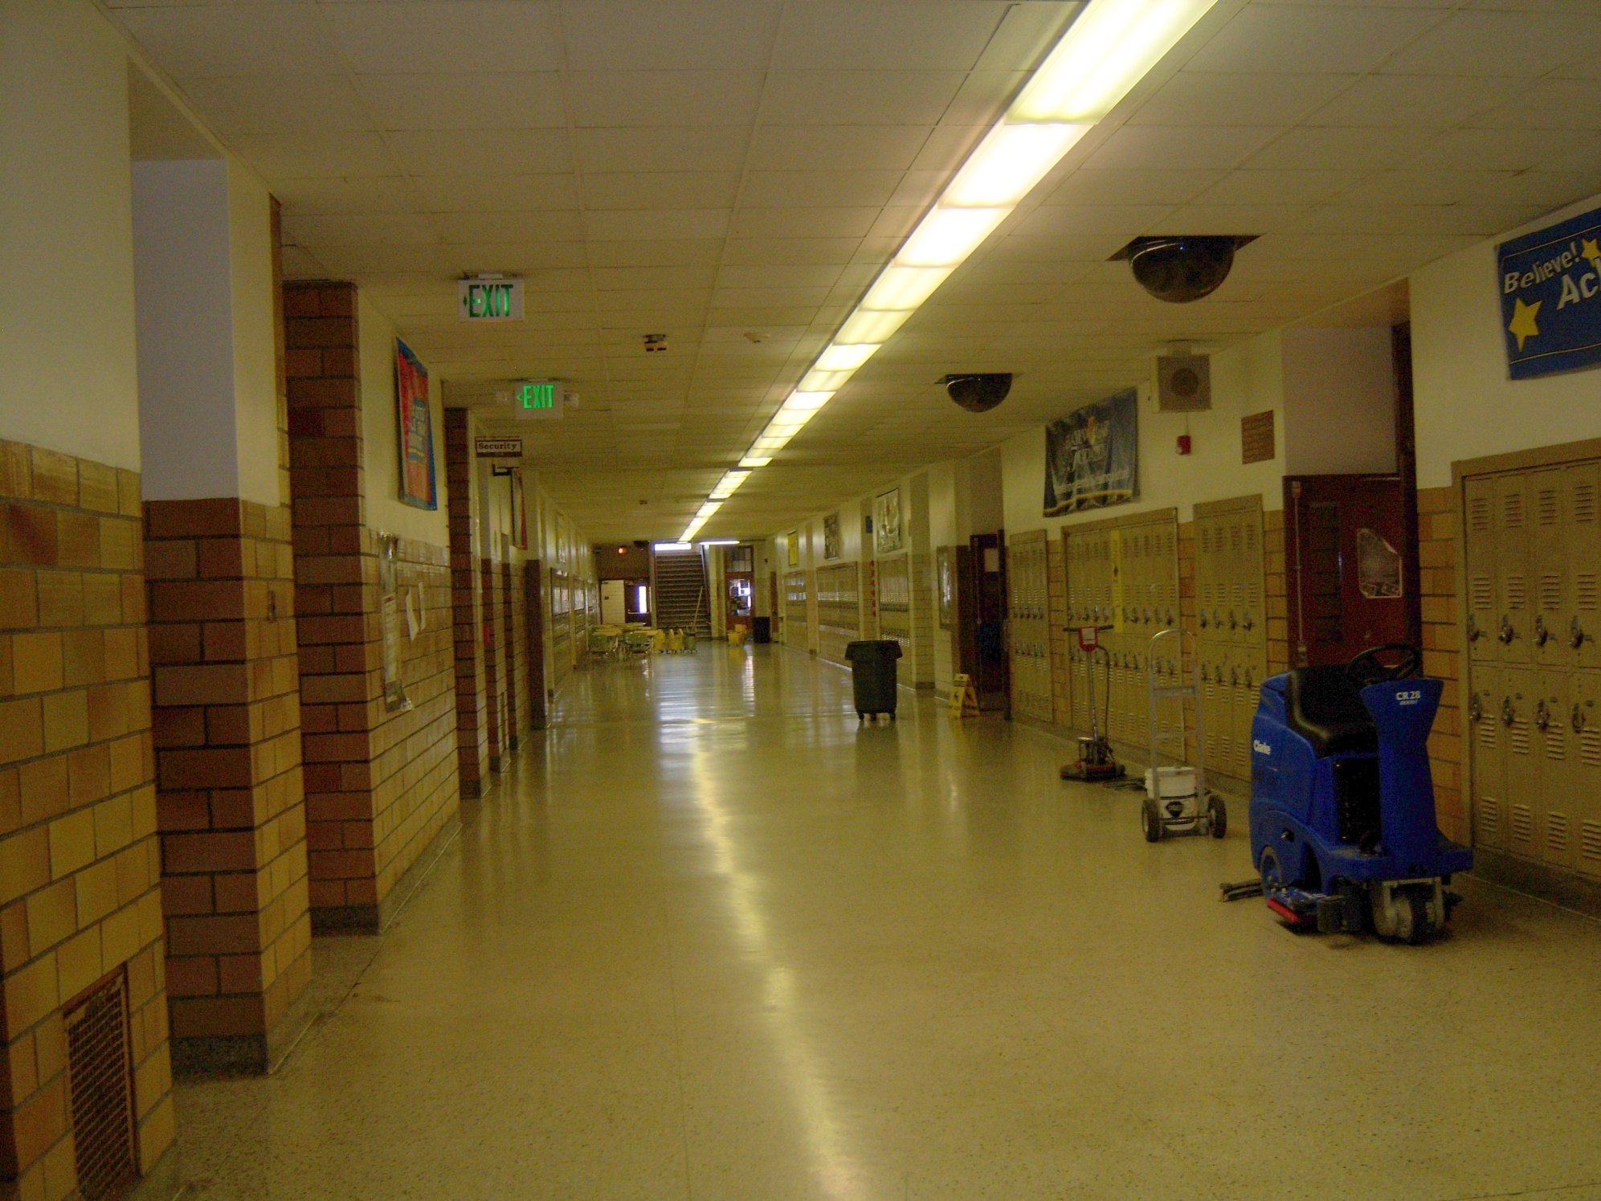
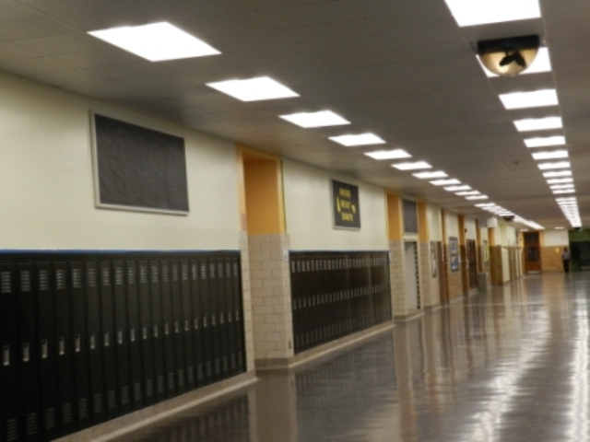
Pre-EdisonLearning EdisonLearning

Slide 9
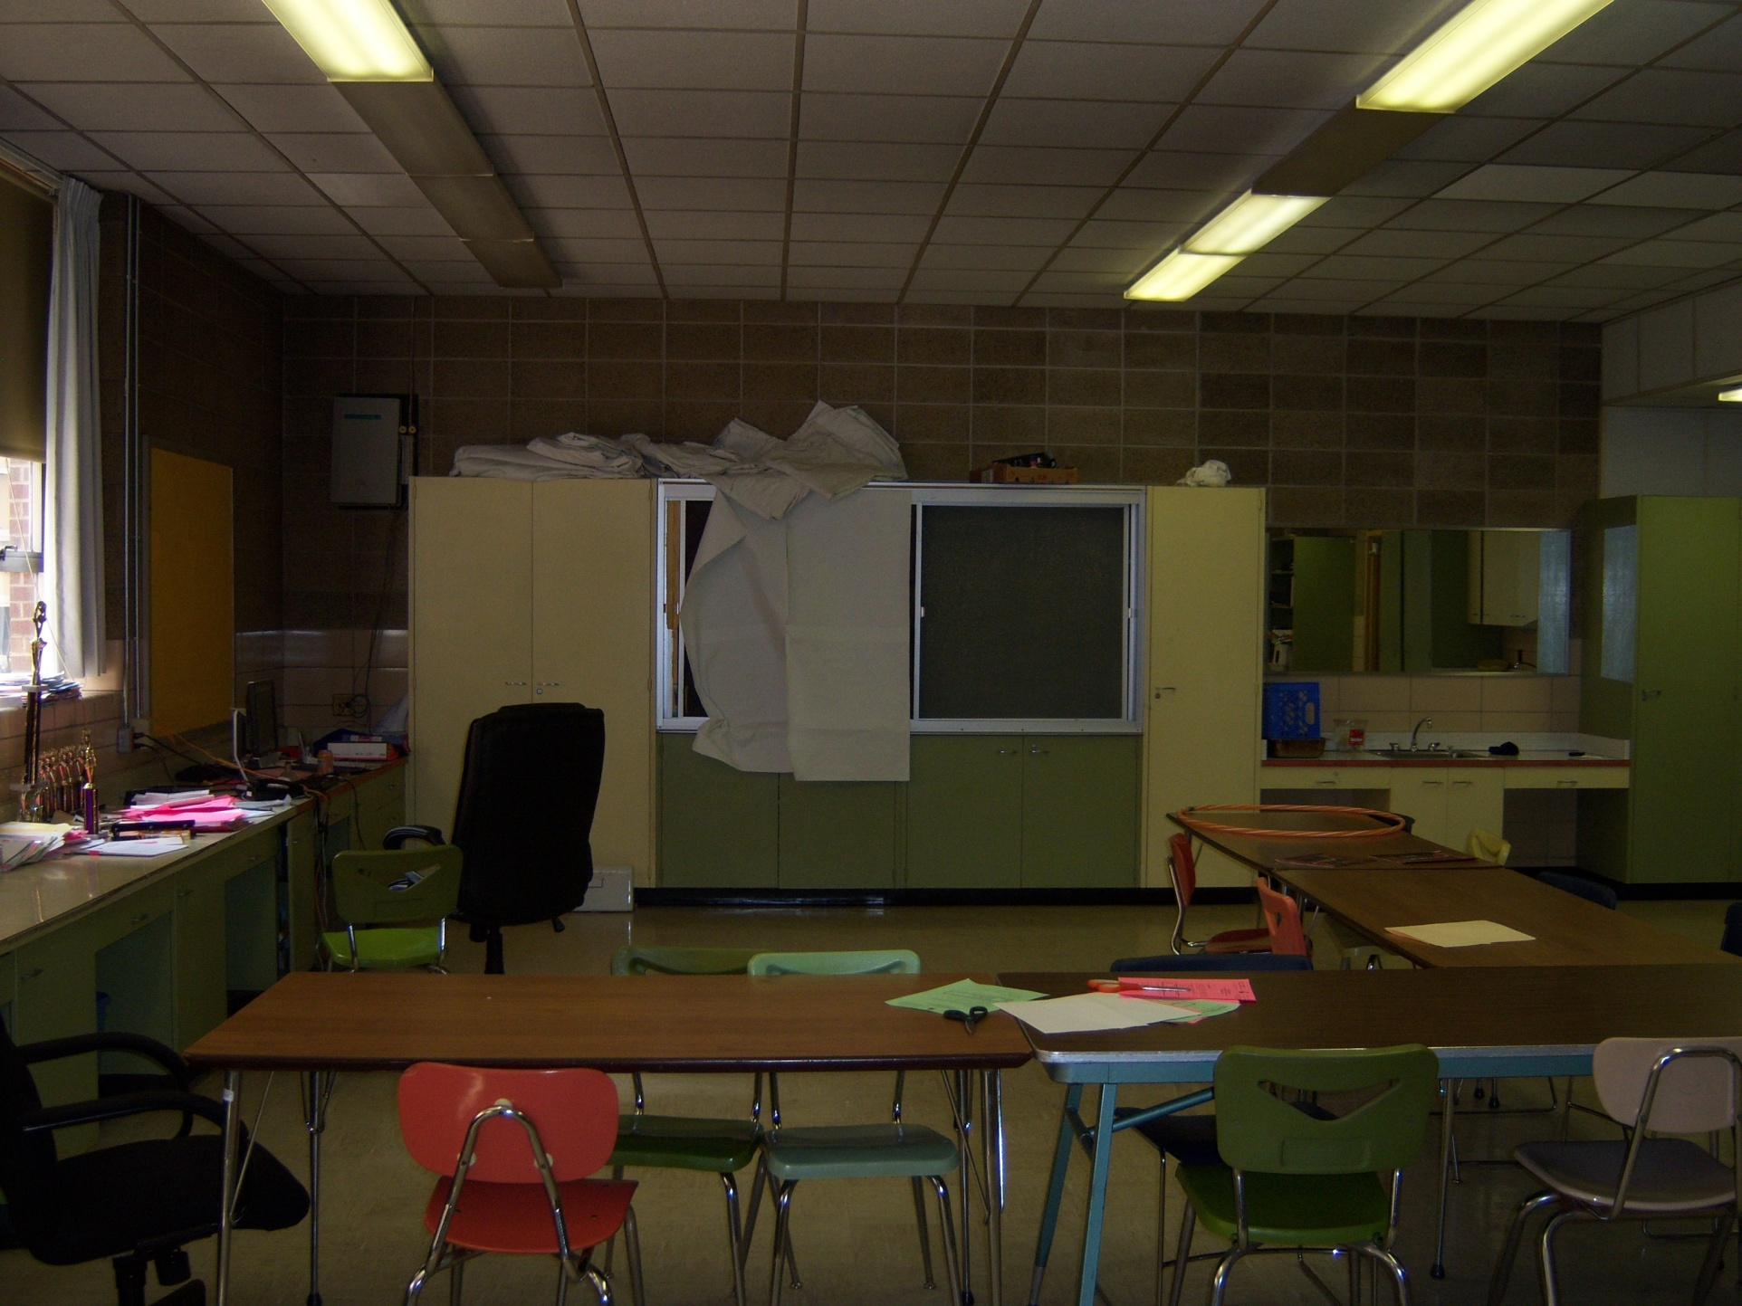
Pre-EdisonLearning EdisonLearning

Slide 10
High Impact Systematic Changes since 2012
Distributed Leadership to focus on student achievement & school improvement
Re-designed the school day to meet the needs of students
Established reading, math and social interventions based on triangulated data
Established the VIP attendance incentive program to motivate students /increase attendance
Established a College-Going Culture (college tours, financial workshops, scholarship search)
Implemented a comprehensive School Safety & Positive Behavior Discipline/Intervention Plan

Slide 11
Systematic Success – Met 24 of 27 Contractual Metrics
57% Graduation Rate (vs. 41% in 2012)
85% of graduating seniors enrolled in a 2-4 year college or vocational program (vs. 60% in 2012)
54% Reduction of out-of-school suspensions
91.6% attendance vs. 71.4% (2013)
Average of 5% in ISTEP and 6% on ECA, except for 2015 when the test changed
State recognition for a safe, orderly, and caring learning environment
Quality school leaders and teachers

Slide 12
Data Dashboard Summary – Student Enrollment
Notes:
Slide 12 Tombstone - Challenge: Building condition continues to impact enrollment and retention. Solution: Need capital improvements funding.

Slide 13
Data Dashboard Summary – Student Attendance
Notes:
Slide 13 Tombstone - Challenge: Building condition continues to impact learning environment. Solution: Need capital improvements funding.

Slide 14
Data Dashboard Summary - Behaviors
Suspensions Referrals
Notes:
Slide 14 Suspensions Tombstone - MET - Goal 4: TRCCA will reduce rates of out-of-school suspension by 10% from previous year. 32% reduction in FY 16-17
Slide 14 Referrals Tombstone - Challenge: Students with substantial disciplinary issues transferred to TRCCA post count. Solution: Collaborate with GCSC to provide alternative education programs.

Slide 15
Cohort Data Dashboard Summary – NWEA Math
Notes:
The chart demonstrates the NWEA Math scores of each Grade level matriculating from SY 15-16 to the next Grade level in SY 16-17. The SY 15-16 Seventh Graders demonstrated positively trending scores from the Fall 15-16 assessment to the Spring 15-16 assessment. Upon entering Eigth grade in SY 16-17, the students continued to demonstrate academic growth.
Slide 15 Tombstone - Challenge: Each year's 7th Grade cohort substantially behind the previous year's. Solution: Need to address K-6 challenges more comprehensively and proactively

Slide 16
Cohort Data Dashboard Summary – NWEA Reading
Notes:
The chart demonstrates the NWEA Reading scores of each Grade level matriculating from SY 15-16 to the next Grade level in SY 16-17. The SY 15-16 Seventh Graders demonstrated positively trending scores from the Fall 15-16 assessment to the Spring 15-16 assessment. Upon entering Eigth grade in SY 16-17, the students continued to demonstrate academic growth.
Slide 16 Tombstone - Challenge: Each year's 7th Grade cohort substantially behind the previous year's. Solution: Need to address K-6 challenges more comprehensively and proactively

Slide 17
Data Dashboard Summary - Staff Retention & Attendance
Staff Retention Staff Attendance
Notes:
Slide 17 Staff Attendance Tombstone - MET - Goal 2: TRCCA will have at least 90% staff attendance Annually. FY 16-17 Staff Attendance average is above 95%

Slide 18
Data Dashboard Summary
Professional Development – Unified & Differentiated
Unpacking standards
Lesson Planning
School-wide Literacy (Informational Text & Strategies)
Writing Objectives
Measuring Learning

Slide 19
Effective Turnaround School Leadership
Goal: Set high expectations for all students and staff by ensuring student work is intellectually challenging, and demonstrates mastery of standards, and ensure that students receive meaningful feedback
Intervention: The administrative team meets weekly to review and discuss progress indivual and group progress on standards-based lesson plans, aligned assessments and student progress toward mastery. Teachers and curriculum leaders analyze lesson data and develop action plans to adjust classroom instruction, differentiating according to students academic needs and identified deficiencies.
Research: http://www.ncte.org/library/NCTEFiles/Resources/Journals/EJ/1031-sep2013/EJ1031Better.pdf; http://www.ascd.org/publications/educational-leadership/dec13/vol71/num04/How-Good-Is-Good-Enough%C2%A2.aspx ;
Evidence of Progress:
Distributed leadership model with key leads identified and supporting implementation and monitoring goals
Standards-based lesson plans showing alignment of differentiated activities, strategies and assessments
Adjusted master schedule to reflect boot camp courses (Saturday School) to meet needs of all student
Student work and students’ ability to articulate how to get to the next level in their learning

Slide 20
Effective Instruction that meets the needs of all students and is aligned with state standards
Goal: Ensure teachers are using a variety of high impact pedagogical strategies to address learning gaps and engage students in their learning
Intervention: School leaders conduct regular, consistent classroom observations of all staff to ensure that effective instruction is taking place and to provide constructive feedback for ongoing improvement
Supporting Research: Marzano, Robert. What Works in Schools; Lemov, Doug. Teach Like A Champion. http://tntp.org/assets/tools/NSA-USI%20Increasing%20Rigor%20Throughout%20the%20Lesson-Data-Driven%20Classroom%20Best%20Pratices%20TSLT_0311.pdf
Evidence of Progress:
Admin create and adhere to an observation schedule where an average of 17 observations are conducted followed by individual and team feedback and coaching conversations
Teachers use feedback from coaching conversations and pd to improve their practice, specifically the selection of pedagogical strategies that best align to student deficiencies

Slide 21
Using data to differentiate instruction and provide interventions
Goal: Strategically align professional development to staff differentiated needs based upon teacher observations, formative assessment data, and school-wide goals
Intervention: Teachers and administrators agree upon professional and personal goals, mapping out and monitoring growth plans. Using subject-specific data and feedback from staff, administrators align professional develop to meet the needs of teachers that ultimately impact school goals.
Supporting Research: Bambrick-Santoyo, Paul. Driven by Data; Hattie, John. Visible Learning; The Keys to Adult Learning: Theory and Practical Strategies. Philadelphia: Research for Better Schools
Evidence of Progress: Administrators share data and work with teachers and teacher teams during professional development to analyze triangulated data such as NWEA, Achieve level-set, classroom data and observation and plan lessons and activities accordingly. Through observations and feedback conversations, administrators and teachers are able to agree upon professional development needs for individual teachers and teacher teams.

Slide 22
Community and Stakeholder Input and Engagement
The Roosevelt Admin and Leadership Team shares progress and gains input from community stakeholders in a variety of formats:
Board Meetings
Title I Parent Meeting & Monthly Parent Meeting
Open Houses
Capital City Partnership
Purdue University Extension Program (Nutrition class for pregnant/parenting teens)
Nurse-Family Partnership Program support to our pregnant teens for two years after their child's birth.

Slide 23
Next Steps
Goal 1: Strategically align professional development to staff differentiated needs based upon teacher observations, formative assessment data, and school-wide goals
Superintendent/Student Success Director will continue to debrief with the Principal to discuss individual and collective pd needs of teachers based on formative assessment data trends and class observations. Achievement Team meetings will continue to meet to analyze NWEA data and monitor student progress on reading and math interventions. Weekly Administrative meetings to evaluate and modify professional development and training.
Goal 2: Ensure teachers are using a variety of high impact pedagogical strategies to address learning gaps and engage students in their learning
Observations of best practices through nstructional rounds and weekly lesson plan reviews Coaching sessions with Achieve 3000 partners.
Goal 3: Set high expectations for all students and staff by ensuring student work is intellectually challenging, and demonstrates mastery of standards, and ensure that students receive meaningful feedback.
Review winter NWEA score reports with students and create goals. Student recognition for NWEA achievement.

Slide 24
At TRCCA…
School Achievement is urgent & mandatory!

