Slide 1
Promoting Positive Postsecondary Transitions through Accountability
Indiana State Board of Education Work Session
Ryan Reyna
August 23, 2018

Slide 2
Agenda
Reflections from research and experience
Components of a strong CCR measurement
Approaches to prioritization
Review of measures
Other issues to consider

Slide 3
Lessons learned about multiple measure accountability systems

Slide 4
Reflections from research and experience
Link measures to goals
How does each measure help IN meet its postsecondary attainment goal?
Measures should be
Meaningful
Objective and research-based
Actionable
Limited
There are multiple components of an accountability system
Big “A” accountability
Little “a” accountability and reward
This is a process – and can/should evolve over time

Slide 5
K-12 is increasingly prioritizing college and career readiness

Slide 6
2012
WA
MT
ND
ME
OR
MN
NH
ID
SD
WI
NY
VT
WY
MI
MA
PA
RI
NE
IA
CT
NV
IN
OH
NJ
UT
IL
DE
CA
CO
KS
WV
VA
MO
KY
MD
TN
NC
AZ
NM
OK
SC
AR
MS
AL
GA
LA
TX
AK
FL
HI

Slide 7
2015
WA
MT
ND
ME
OR
MN
NH
ID
SD
WI
NY
VT
WY
MI
MA
PA
RI
NE
IA
CT
NV
IN
OH
NJ
UT
IL
DE
CA
CO
KS
WV
VA
MO
KY
MD
TN
NC
AZ
NM
OK
SC
AR
MS
AL
GA
LA
TX
AK
FL
HI

Slide 8
2018
WA
MT
ND
ME
OR
MN
NH
ID
SD
WI
NY
VT
WY
MI
MA
PA
RI
NE
IA
CT
NV
IN
OH
NJ
UT
IL
DE
CA
CO
KS
WV
VA
MO
KY
MD
TN
NC
AZ
NM
OK
SC
AR
MS
AL
GA
LA
TX
AK
FL
HI

Slide 9
What makes a strong college- and career-ready accountability system?

Slide 10
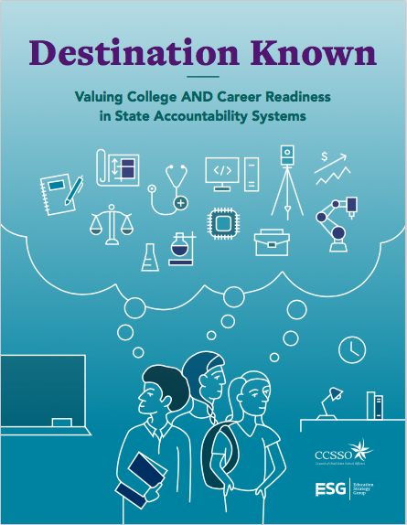
Destination Known
Provides a roadmap for the measures and strategies states can use in an accountability system to support all students in reaching their destination: success after high school.
It’s a matter of equity, as fewer youth from traditionally underserved subgroups transition to and successfully complete postsecondary education and training.

Slide 11
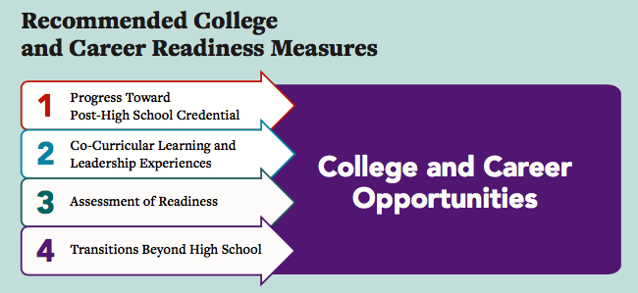
Four Categories for States to Measure College and Career Readiness

Slide 12
MEASUREMENT CATEGORY 1: Progress Toward Post-High School Credential
MEASURE: Successful progress toward credential of value beyond high school
PLUS: Attainment of 1+ postsecondary credits while in high school
Exceptional
PLUS: Completion of a state-defined pathway of 3 or more credits that is aligned to the student’s academic and career plans
Advanced
Completion of state defined college- and career-ready course of study
Fundamental

Slide 13
MEASUREMENT CATEGORY 2: Co-Curricular Learning and Leadership Experiences
MEASURE: Successfully completed a co-curricular experience aligned to their identified interests
PLUS: Third-party evaluation that student met expectations and demonstrated gain of academic, technical and/or professional skills
Exceptional
PLUS: Alignment between student’s academic and career plans and Learning and Leadership experience
Advanced
Completion of a state-defined co-curricular Learning and Leadership experience*
Fundamental
* Learning and leadership experiences include extended work-based learning (such as pre-apprenticeship program or internship), service learning or co-curricular activity

Slide 14
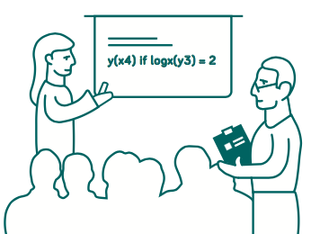
MEASUREMENT CATEGORY 3: Assessment of Readiness
MEASURE: Scored at the college- and career-ready level
PLUS: Performance-based demonstration of professional skills within an academic or technical context (e.g., capstone)
Exceptional
PLUS: Completion of a pathway-aligned assessment or demonstration of technical skills (e.g., AP, IB, IRC)
Advanced
Attainment of state-defined college- and career-ready level on high school summative assessment
Fundamental

Slide 15
MEASUREMENT CATEGORY 4: Transitions beyond High School
MEASURE: Successfully transitioned to postsecondary or the workforce within 12 months of graduation
Enlistment in military, enrollment in certificate or registered apprenticeship program, or employment in a field identified in the state’s WIOA plan
Exceptional
Enrollment in IHE without remediation or employment at a state-defined wage threshold
Advanced
Enrollment in 2- or 4-year institute of higher education (IHE) or postsecondary training
Fundamental

Slide 16
Approaches for prioritizing key measures

Slide 17
Within formal accountability system
Approaches
Discussion
Measures
Separate
“Metaindicator”
Weight
Calculation
Distance to goal
Adjusted performance
Status or improvement
Bonus points
What is the appropriate balance between simplicity and accuracy?
Will the measure(s) actually matter given the weights?
Are there measures that should come off the table?
What is the process/timeline for transition to new indicators?

Slide 18
Beyond formal accountability system
Approaches
Discussion
Report
School report card
College Readiness report
Challenge
Internal
External
Reward
Create award
Highlight in communications
Facilitate sharing best practices
How can the state leverage its school report card redesign to prioritize specific measures?
How can the state further promote CHE’s College Readiness report?
What opportunities exist to engage school and district administrators in conversations about the data?
How can the state promote success and improvement?

Slide 19
Discussion of key measures beyond the current accountability system

Slide 20
What else can be measured?
What happens to students after they leave high school?
What steps are students taking to prepare for college and career throughout K-12?
What climate exists to support students on their path to college and career readiness?

Slide 21
Postsecondary transitions
Measure | Benefit | Challenge | Example
Postsec enrollment | Connected to attainment goal & data are available | May not signify readiness | CT, CO & MO
Postsec enrollment without remediation | Powerful indicator of student preparation for success | Definitions of remediation change & out-of-state data not generally available | GA
Registered Apprenticeship | Combination of education and training leading to employment | Data access | NA
Employment (at $X wage level) | Engagement in labor market | Data access | VT
Military enlistment | Service and employment | Data access | NA
Summer melt | Large transition hurdle | Data access | NA

Slide 22
Key Questions
To what extent are all postsecondary transitions “equal”?
What data are available and can the state make cross-sector matches?
Given that these measures are lagged, what is the “appropriate” response for high schools?
To what extent would the state want/need to measure performance based on starting point for these metrics?
What are appropriate wage level(s)? And after what amount of time – 6 months, 1 year, etc.?

Slide 23
Transition preparation
Measure | Benefit | Challenge | Example
College and career plans | Connects learning and activities | Measurement of use | PA & AZ
8th grade credit accumulation | Prepared for promotion | May not offer new insight | LA
9th grade on-track to graduation | Research-backed predictor | Measurement definition | IL & DE
FAFSA | Predictor of postsec enrollment | Complexity of completing form | LA - reporting
College scholar activities | Clear set of postsec preparation activities | Communication that not just for program applicants | NA

Slide 24
Key questions
How can the state encourage preparation prior to senior year of high school? To what extent should measurement begin prior to high school?
To what extent / how would these measures interact with Graduation Pathways requirements?
How can the state leverage high-impact strategies to prepare students for life beyond high school? To what extent should that be through the formal or informal accountability system?

Slide 25
Climate
Measure | Benefit | Challenge | Example
Climate survey | Conditions of learning | Data access and “gaming” | NM & NV
Student SEL survey | Complement to academic preparation | Data access and “gaming” | CA CORE
Science / Social Studies | Prioritizing courses beyond ELA/math | Limited grades | Many
Access to well-rounded education* | Prioritize activities/courses beyond core coursework | Measurement and data access | LA & KY
* Interests & Opportunities (LA): schools select from a menu of state-defined options in the following areas: visual and performing arts; world languages; health and fitness; technology and engineering; and, life skills and career preparation. Specific measures are still in development

Slide 26
Key questions
What level of reliability/validity is necessary to include a measure?
To what extent should a student’s experience in school – in terms of both climate and access – be considered in an accountability system?
What other areas beyond core content (ELA and math) are priorities for the state?
To what extent do these measures need to be “paired” with other measures to provide a complete picture of “school quality”?

Slide 27
Issues to consider

Slide 28
Key questions
If the state chooses to add additional measures in the future, what is an appropriate timeline and how best to signal that?
To what extent should any new measures be included in the formal accountability calculations versus public reporting or reward?
How will data access and quality affect or be affected by the answer?
To what extent should any new measures be based on improvement over time (or take into account starting point)?
What is an appropriate way to measure “success”?

Slide 29
Thank You
Ryan Reyna
rreyna@edstrategy.org
@RyanEReyna

Slide 30
Resources
Destination Known: Valuing College and Career Readiness in State Accountability Systems
Mapping Career Readiness in ESSA
Shining a Spotlight on K-12 and Higher Education Alignment
Aligning K-12 and Postsecondary Credential Attainment Goals to Support Success for All Students
Strategies to Support Students’ K-12 to Postsecondary Transitions

