Slide 1
Caze Elementary School
May 2017

Slide 2
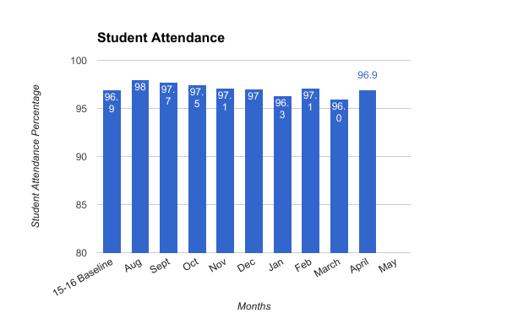
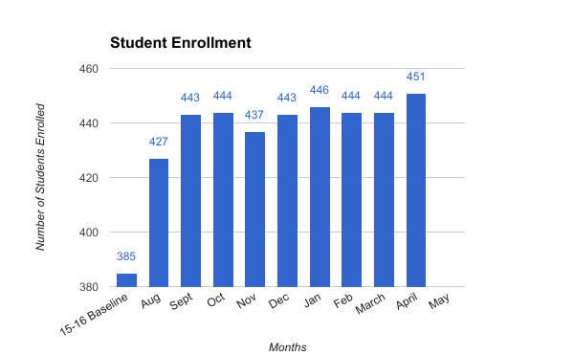
Data Dashboard Summary - Student Attendance, Enrollment

Slide 3
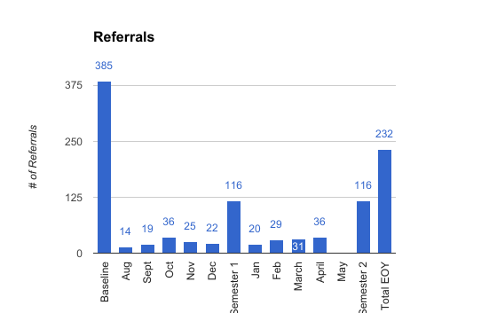
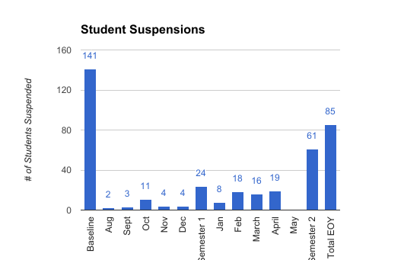
Data Dashboard Summary - Behavior

Slide 4
Data Dashboard Summary - ELA Student Performance (First Year NWEA)

Slide 5
Data Dashboard Summary - Math Student Performance (First Year NWEA)
Highlight:
Reached MOY school projected growth goal!

Slide 6
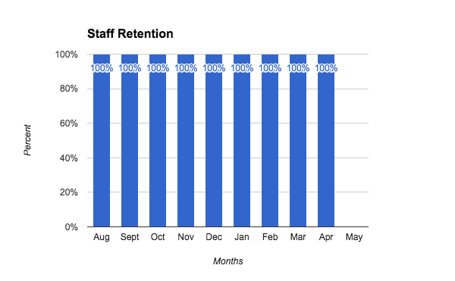
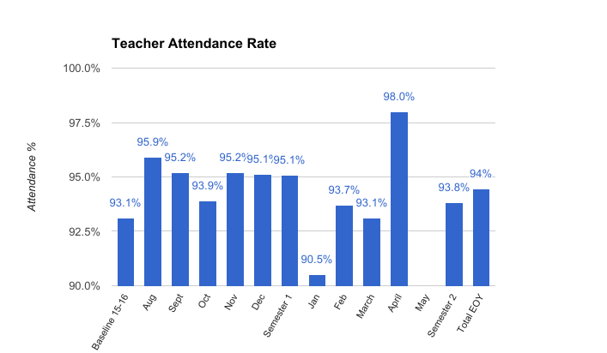
Data Dashboard Summary - Staff Retention, Staff Attendance

Slide 7
Data Dashboard Summary - Professional Development

