Slide 1
State Board of Education Meeting August 6, 2014 Robert A. Marra, Executive Director Office of Charter Schools

Slide 2
Vision and Mission
Education Redefined by Innovative Choices
Ensure High-Quality Schools
Improve Public School Options for Families
Means to Foster Excellent Schools that Meet Needs

Slide 3
Enrollment History

Slide 4
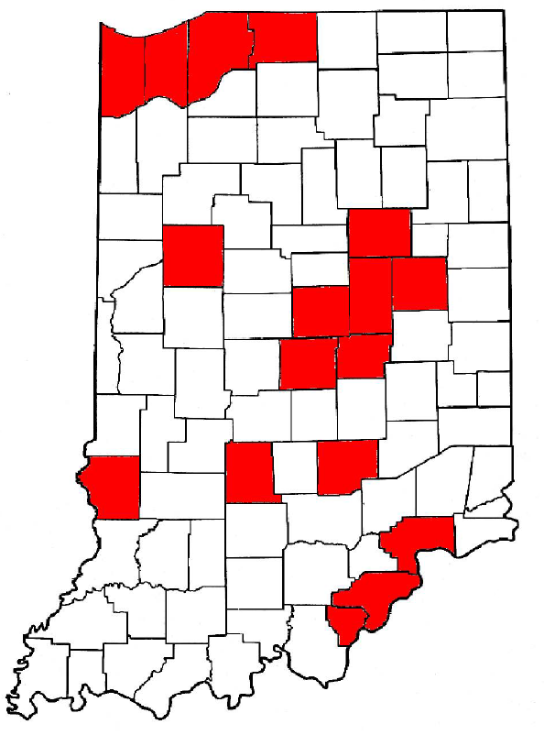
BSU Charter Schools Around the State
(As of July 1, 2013)
32
14
17
28
33
6
10
8
31
24
1
15
11
3
1. 21st Century Charter School at Gary 2005 (Lake)
2. Anderson Preparatory Academy 2008 (Madison)
3. Aspire Charter Academy 2008 (Lake)
Bloomington Project School 2009 (Monroe)
Canaan Community Academy - Canaan 2012 (Jefferson)
Career Academy of South Bend 2011 (St. Joseph)
Community Montessori 2002 (Floyd)
Discovery Charter School 2010 (Porter)
Dr. Robert H. Faulkner Academy 2008 (Grant)
East Chicago Lighthouse Charter School 2006 (Lake)
East Chicago Urban Enterprise Academy 2005 (Lake)
Fall Creek Academy 2012 (Marion)
Fountain Square Academy 2012 (Marion)
Gary Lighthouse Charter School 2005 (Lake)
Gary Middle College 2012 (Lake)
Geist Montessori Academy 2006 (Hancock)
Hammond Academy for Science and Technology 2010 (Lake)
Hoosier Academy - Indianapolis 2008 (Marion)
Imagine Indiana Life Sciences Academy West 2009 (Marion)
Indiana Connections Academy 2012 (Virtual)
Indiana Math and Science Academy 2007 (Marion)
Inspire Academy 2013 (Delaware)
International School of Columbus 2009 (Bartholomew)
Neighbor’s New Vista High School 2012 (Porter)
New Community School 2002 (Tippecanoe)
Options – Carmel 2004 (Hamilton)
Options – Noblesville 2006 (Hamilton)
Renaissance Academy 2007 (La Porte)
Rock Creek Community Academy 2010 (Clark)
Rural Community Academy 2004 (Sullivan)
Thea Bowman Leadership Academy 2003 (Lake)
Veritas Academy 2002 (St. Joseph)
Xavier School of Excellence 2009 (St. Joseph)
9
25
2
22
27
26
18
12
16
21
13
19
23
30
4
7
5
29

Slide 5
2012-13 School Data
Demographic | Number for BSU schools | Number for Indiana | % for BSU schools | % for Indiana | Range for BSU Schools
Black | 8,686 | 127,657 | 37.92% | 12.3% | 0-97%
White | 10,779 | 746,026 | 47.05% | 71.6% | 0-98.2%
Hispanic | 2,113 | 100,044 | 9.22% | 9.6% | 0.6-63.8%
Multiracial | 1,118 | 45,452 | 4.88% | 4.4% | 1-13.9%
Asian | 160 | 18,704 | 0.69% | 1.8% | 0-7.8%
American Indian | 43 | 2,834 | 0.19% | 0.3% | 0-1%
Native Hawaiian/pacific island | 9 | 594 | 0.04% | 0.1% | 0-0.2%
Total Enrolled | 22,908 | 1,041,311
Free Lunch | 11,905 | 426,665 | 51.88% | 41.0% | 10.7-89.3%
Reduced Lunch | 1,837 | 83,913 | 8.01% | 8.1% | 1-16.1%
Special Education | 2,917 | 150,454 | 12.74% | 14.4% | 7-32.1%
English Language Learner | 866 | 51,893 | 3.77% | 5.0% | 0-31.3%

Slide 6
Make-up of BSU Charter Schools
2012-2013 | 2013-2014 | 2014-2015
Total authorized: 41 Schools – covering 19 counties Virtual schools: 2 (one virtual/one blended) K-6 – 2 K-8 – 11 K-10 – 1 K-12 – 11 6-11 – 1 7-12 – 3 9-12 – 4 (drop out recovery) | Total authorized: 33 Schools – covering 17 counties Virtual schools: 2 (one virtual/one blended) K-5 – 1 K-6 – 2 K-7 – 2 K-8 – 10 K-12 – 11 6-12 – 1 7-12 – 3 9-12 – 4 (drop out recovery) | Total authorized: 30 Schools – covering 17 counties Virtual schools: 2 (one virtual/one blended) K-5 – 1 K-6 – 2 K-7 – 1 K-8 – 10 K-12 – 8 5-12 – 1 6-12 – 2 7-12 – 1 9-12 – 4 (drop out recovery)

Slide 7
Key Components for the Transformation of the Office of Charter Schools to Assure Quality Authorizing
Thorough NACSA Authorizer Evaluation in March of 2011
Received Performance, Management, Replication and Closure Grant from NACSA in October 2012
Developed accountability frameworks in academics, finances and organization
Reviewed and revised all OCS policies and procedures based upon national standards
Streamlined the amendment process
Created CSAPPHIRE (Charter School Appliance Providing Portable Handling of Institutional Records Electronically), a web-based document management and data handling system,
Created dashboards for the three performance frameworks
Annual reporting to the school boards on all three performance frameworks

Slide 8
Key Components for the Support of Quality Charter Schools
Re-aligning OCS personnel to better ensure high quality charter schools
Executive Director
Application Process
Academic Performance Framework
Financial Performance Framework
Organizational Performance Framework
New School Development Coordinator
Academic Performance Coordinator
Fiscal Analyst
Compliance and Special Education Coordinator

Slide 9
2012-13 Performance Analysis
ISTEP+ | BSU Schools | Indiana | Range for BSU Schools
% Pass ELA | 67.3% | 78.8% | 38.4%-95.0%
% Pass Math | 66.3% | 82.5% | 26.3%-92.0%
% Pass Both | 56.2% | 73.0% | 19.9%-90.3%
 | BSU Average | Indiana Average | Range for BSU Schools
2013 Total Graduation Rate | 57.8% | 88.6% | 5.0% - 100%
2013 Non-Waiver Graduation Rate | 51.7% | 81.7% | 5.0% - 94.7%
2013 Waiver Graduation Rate | 6.1% | 6.9% | 0.0% - 25.9%

Slide 10
2012-13 School Non-Renewals
Charter School of the Dunes - 1/18/13 school advised of non-renewal decision; 1/29/13 school formally requested reconsideration of non-renewal decision; subsequently withdrew its reconsideration request - currently authorized by Calumet University of St. Joseph.
Hoosier Academy – Muncie - Voluntary closure – 1/16/13 school advised OCS of its intent not to seek renewal of its contract.
Imagine Indiana Life Sciences Academy East – 1/18/13 school advised of non-renewal decision; 2/5/13 school requested reconsideration of non-renewal decision; Appeals Hearing held on 5/7/13; 5/14/13 President confirmed non-renewal decision.
Imagine MASTer Academy - 1/18/13 school advised of non-renewal decision; 1/28/13 school requested reconsideration of non-renewal decision; Appeals Hearing held on 4/28/13; 5/14/13 President confirmed non-renewal decision. Now operating as a private school, Horizon Christian Academy.
Imagine Schools on Broadway - 1/18/13 school advised of non-renewal decision; 1/28/13 school requested reconsideration of non-renewal decision; Appeals Hearing held on 4/16/13; 5/14/13 President confirmed non-renewal decision. Now operating as a private school, Horizon Christian Academy.
Kenneth A. Christmon STEMM Leadership Academy (formerly Galileo Charter School) - 1/18/13 school advised of non-renewal decision; 1/29/13 school requested reconsideration of non-renewal decision; Appeals Hearing held on 5/6/13; 5/14/13 President confirmed non-renewal decision.
LEAD College Preparatory Charter School - 1/18/13 school advised of non-renewal decision; 1/29/13 school requested reconsideration of non-renewal decision; Appeals Hearing held on 4/3/13; 5/14/13 President confirmed non-renewal decision.
Timothy L Johnson Academy - 1/18/13 school advised of non-renewal decision; 1/31/13 school requested reconsideration of non-renewal decision, but subsequently withdrew its reconsideration request - currently authorized by Trine University.
West Gary Lighthouse Charter School - Voluntary closure; 1/16/13 school advised OCS of its intent not to seek renewal of its contract.

Slide 11
2012-13 Administrative Fees
21st Century | $94,437.65
Anderson Prep | $156,540.56
Aspire | $150,576.47
Bloomington | $39,436.29
Canaan Community Academy | $6,979.28
Career Academy of South Bend | $46,036.98
Charter School of the Dunes | $75,098.26
Community Montessori | $75,273.28
Discovery | $56,250.04
East Chicago Lighthouse | $118,563.74
East Chicago Urban | $89,464.98
Fall Creek Academy | $81,973.86
Faulkner | $35,143.68
Gary Lighthouse | $149,792.16
Gary Middle College | $20,948.82
Geist Montessori | $34,217.56
Hammond | $79,135.31
Hoosier - Indy | $71,749.46
Hoosier - Indy (virtual) | $340,056.18
Hoosier - Muncie | $17,001.93
Imagine Broadway | $79,230.33
Imagine East | $135,092.52
Imagine MASTer | $130,257.20
Imagine West | $111,326.50
IMSA - Indy | $101,054.29
Indiana Connections Academy | $273,455.59
International School of Columbus | $15,357.82
Kenneth A. Christmon STEMM | $43,549.20
LEAD | $71,303.27
Neighbors' New Vistas High School | $11,381.51
New Community | $35,511.35
Options - Carmel | $23,552.61
Options - Noblesville | $23,572.40
Renaissance | $28,986.80
Rock Creek | $57,783.64
Rural Community | $21,152.49
Thea Bowman | $269,796.62
Timothy L. Johnson | $58,471.74
University Heights Preparatory Academy | $54,418.46
Veritas | $19,301.32
West Gary Lighthouse | $133,611.79
Xavier | $65,080.32
Total 2012-13 Administrative Fees | $3,501,924.24
Ball State University receives an administrative fee of three percent
(3%) of the total amount the organizer receives during the state fiscal year from basic tuition support (as defined in IC 20-43-1-8) as permitted pursuant to pursuant to IC 20-24-7-7. This chart reflect the amounts of those fees collected from each of its charter schools during the 2012-13 fiscal year.

Slide 12
2012-13 Expenditures
Expenditure | Amount
Salaries (2012-13 7 full-time; 3 graduate assistants) | $527,127.38
Benefits | $158,884.03
Consultants and Contract Services | $87,987.39
Legal | $51,312.50
NWEA | $243,734.20
Education Resources | $3,675.00
Board Training/Board Audits | $3,190.35
Fitzgerald Isaac - Annual Financial Audits | $284,300.00
Charter Proposal Review Panel | $3,070.15
Reconsideration Hearing Panel | $18,041.20
Office Supplies | $3,014.66
Minor Equipment | $1,590.98
Dues and Memberships | $3,000.00
Repair and Maintenance | $119.70
Printing | $10,720.41
Postage, FedEx, UPS charges | $1,112.62
Telephone | $2,730.73
Conferences/Meetings Facility Rentals and Meals | $5,894.98
Travel | $20,638.27
Overhead and Support Services | $1,067,848.00
Total 2012-13 Expenditures | $2,497,992.55

Slide 13
How We Invest in Our Schools
The Office of Charter Schools (OCS) has a staff of 6 full-time employees. In addition, the OCS reimburses for expenses the women and men who take time away from their normal activities to review the charter school proposals. These individuals are not employees of the University. The university provides office space, access to university counsel, media consultation and other university resources and personnel. In addition, it provides the following benefits to all of its schools :
Board Training for all its schools
NWEA Testing for all its schools
NWEA Regional Workshops (i.e., Regional Growth & Goals Workshop, Climbing the Data Ladder Workshop, etc.)
Annual Fiscal Audits
Academic Site Visits
A new innovative web-based file/data handling system)
Staff support with expertise in the area of finance and special education which is a unique attribute among authorizers in Indiana
“Charter Schools: Patterns of Innovation, a New Architecture for a New Education,” an immersive learning project which was completed in June of 2012
“Best Practices in Indiana’s Charter Schools,” a research project which was also completed in 2012
A Research study on Leadership in Charter Schools - collaborating with the Educational Leadership Department on this current research project

Slide 14
FOR IMMEDIATE RELEASE
NATIONAL ASSOCIATION OF CHARTER SCHOOL AUTHORIZERS COMMENDS BALL STATE UNIVERSITY FOR SUPPORTING QUALITY CHARTER SCHOOLS
January 22, 2012 (Chicago) – Greg Richmond, president and CEO of the National Association of Charter School Authorizers, issued the following statement today in recognition of the thoughtful charter school renewal decisions by the Office of Charter Schools at Ball State University:
“Ball State University is to be commended for establishing clear standards for charter schools, carefully analyzing each school’s performance, and making thoughtful decisions about which schools to renew and not renew. Supporting the growth and development of new, excellent charter schools requires the courage to hold all schools accountable, and to close them when they fail. While school closure is never easy, Ball State's actions today will ultimately give more children in Indiana the chance to attend a great school.”
The National Association of Charter School Authorizers (NACSA) is committed to advancing excellence and accountability in the charter school sector and to increasing the number of high-quality charter schools across the nation. To accomplish this mission, NACSA works to improve the policies and practices of authorizers—the organizations designated to approve, monitor, renew, and, if necessary, close charter schools. NACSA provides training, consulting, and policy guidance to authorizers. It also advocates for laws and policies that raise the bar for excellence among authorizers and the schools they charter. In late 2012, NACSA launched its One Million Lives campaign to give one million more children the opportunity to attend a great school. Visit www.qualitycharters.org
# # #
Contact:
Lynne Baker, 312.376.2321, lynneb@qualitycharters.org

