Slide 1
Certificate of Completion
Office of Special Education
Dr. Pamela Wright, Director
Office of Special Education
June 2017

Slide 2
PURPOSE of MEETING
Share information on changes to the Certificate of Completion
Describe the connection between the Certificate of Completion (COC) work and the Every Student Succeeds Act (ESSA)
Explain Next Steps

Slide 3
BACKGROUND
511 IAC 7-43-4(h) requires that the IEP of a student entering grade 9 or becoming 14 years of age must contain documentation regarding whether the student will pursue a high school diploma, as defined in 511 IAC 6-7.1-1(e), or a certificate of completion.
The term “certificate of completion” is not further defined, but is interpreted to be a document awarded to a special education student who has been taken off of the diploma path but completes the public school educational program prescribed in the student’s IEP.
The term “Certificate of Completion” may only be used to refer to a document awarded for completion of the special educational program outlined in a student’s IEP, and may not be used in any other circumstances.
Notes:
Basis in Indiana code and regulation
School corps can issue diplomas or certificates of graduation to SWD, but diplomas that are issued to SWD can not be different from diplomas provided to students without disabilities.
Article 7 – In grade 9 or at age 14, a decision needs to be made as to whether a swd will pursue a high school diploma or COC
Certificate of Completion may only be used to refer to a document awarded for completion of the special education program outlined in a student’s IEP.

Slide 4
ENROLLMENT DATA

Slide 5
EXIT DATA
 | 2015 | 2016
Total SWD who exited | 7223 | 8102
Total SWD who exited with Certificate of Completion | 795 | 1326
Percentage of SWD who exited with COC | 11% | 16%

Slide 6
2016 COC Distribution by Disability

Slide 7
IMPETUS FOR CHANGE
2014 - Indiana’s Alternate Assessment shifted focus from functional to academic skills.
2015 - Vocational Rehabilitation and Workforce Development Partners expressed concerns about the readiness of students who receive the COC to enter the workforce.
2015 - Parents expressed concerns about the ability of their children to access the workforce without a high school diploma
2015 - Schools report receiving minimal guidance on serving students on a Certificate of Completion track. The students have no documentation of their academic or employability skills.
May 2016 – The number of students exiting high school with a certificate of completion significantly increased.
Notes:
Basis in Indiana code and regulation
School corps can issue diplomas or certificates of graduation to SWD, but diplomas that are issued to SWD can not be different from diplomas provided to students without disabilities.
Article 7 – In grade 9 or at age 14, a decision needs to be made as to whether a swd will pursue a high school diploma or COC
Certificate of Completion may only be used to refer to a document awarded for completion of the special education program outlined in a student’s IEP.

Slide 8
IMPETUS FOR CHANGE
November 2015 – A Dear Colleague Letter (DCL) from the Office of Special Education Programs clarified the definition of a Free Appropriate Public Education including access to grade level standards.
December 2015 - Every Student Succeeds Act (ESSA) requires Equity and Access for all students. Challenging academic content standards apply to all public schools and students in the State; for students with significant cognitive disabilities, alternate achievement standards must be aligned with state academic standards.
Notes:
Basis in Indiana code and regulation
School corps can issue diplomas or certificates of graduation to SWD, but diplomas that are issued to SWD can not be different from diplomas provided to students without disabilities.
Article 7 – In grade 9 or at age 14, a decision needs to be made as to whether a swd will pursue a high school diploma or COC
Certificate of Completion may only be used to refer to a document awarded for completion of the special education program outlined in a student’s IEP.

Slide 9
CERTIFICATE OF COMPLETION WORKGROUP
The Certificate of Completion Work Group, a subset of the Interagency Transition Council, began meeting monthly in September 2015 to examine the issues related to the Certificate raised by schools, parents, students and the community and to develop a plan to address the issues.
The group is comprised of representatives from Vocational Rehabilitation, Workforce Development, FSSA, ARC of Indiana, ICASE, INSOURCE, Indiana Resource Network, the Small Manufacturing Association and various members of the Dept. of Education.
Notes:
In September, 2015 the SPI asked that we as an agency look into the COC and address some of the concerns raised during the Diploma hearings. So a committee was formed

Slide 10
PROBLEM STATEMENTS
Students who are on a Certificate of Completion track are often removed from academic classes or have limited access to pathways that lead to successful employment.
Students with disabilities who have had appropriate academic and vocational instruction and who leave high school without a diploma, are capable and willing to work; however, the existing Certificate of Completion is not recognized as a meaningful document by the employment community.
Currently, a Certificate of Completion is not defined in statute; little guidance has been provided to schools other than it is awarded to a student with a disability who does not meet the requirements for a HS diploma but has remained in school and has aged out or met IEP goals.
Certificate of Completion does not require any level of academic exposure or achievement and holds little value for the student, employer or adult agency provider.

Slide 11
POSITION STATEMENT: Diploma First
The majority of students with disabilities are capable of earning a high school diploma if given appropriate instruction, supports and services.
Students who have been removed from the diploma track by the case conference committee must be presented with and follow a course of study that raises expectations, is aligned with grade level standards and/or alternate standards, and provides opportunities to gain employability skills.

Slide 12
COC TASKFORCE CONCLUSION:
A Certificate of Completion Course of Study needs to be developed that meets ESSA and Dear Colleague guidance and provides pathways to student employment or post-secondary education.
Notes:
If not a diploma, then

Slide 13
Certificate of Completion
Course of Study
Course Descriptions
Support from P-16
Instruction
Professional Development
Support from VR/DWD/Transition
Assumptions
Assessment decisions
Aligned to Core 40, Content Connectors and Workplace Essentials
Support high standards and Assumptions
Considers all students and schools
Academic Instruction
Transition Planning
Employability
Development Process
Notes:
As the COC subcommittee has worked on making the COC a more robust and meaningful document, we have broken it down into how to make it work..
Refer to the COC/COS hand out – this document defines a course of study for the student who has been taken off of the diploma track – and the student can earn credits (as any other student might earn for the same course) or they can earn applied units. There are assumptions included on the document.
The course of study: Mirrors regular diploma in requirements (Minimum 40 units or credits with emphasis on academics)
Employability Skills are an integral part of the plan
COC capstone is a requirement
Can be earned through any combination of units and credits
Aligned with Statewide Assessment (ISTAR or ISTEP)
Allows Multiple Pathways
The workgroup would like your input on the type of professional development needed
Professional Development Provided by Project Success to LEAs on aligning instruction with alternate achievement standards
Summer Institutes planned

Slide 14
DEVELOPMENT OF COC COURSE OF STUDY
Mirrors regular diploma in requirements (Minimum 40 units or credits with emphasis on academics)
Employability Skills are an integral part of the plan
COC capstone is a requirement
Can be earned through any combination of units and credits
Aligned with Statewide Assessment (ISTAR or ISTEP)
Notes:
If not a diploma, then

Slide 15
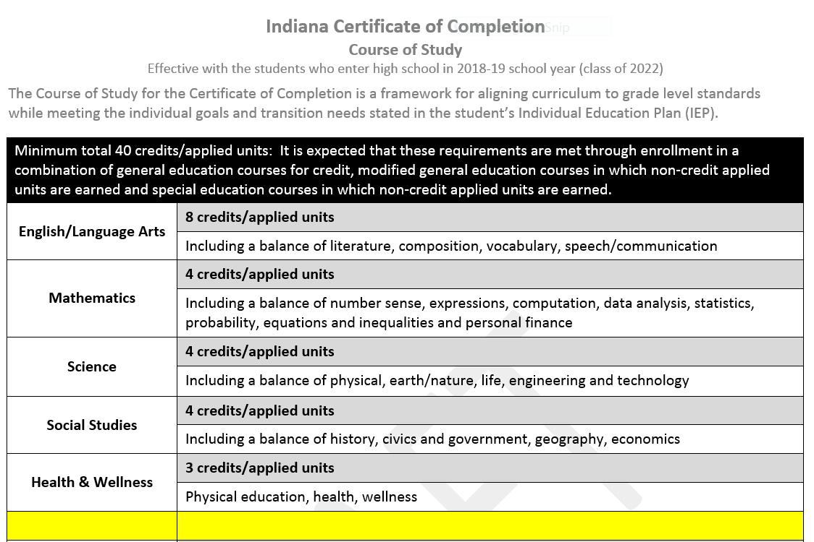
Notes:
NZ – I REPLACED WHAT YOU HAD WITH A MORE CURRENT VERSION

Slide 16
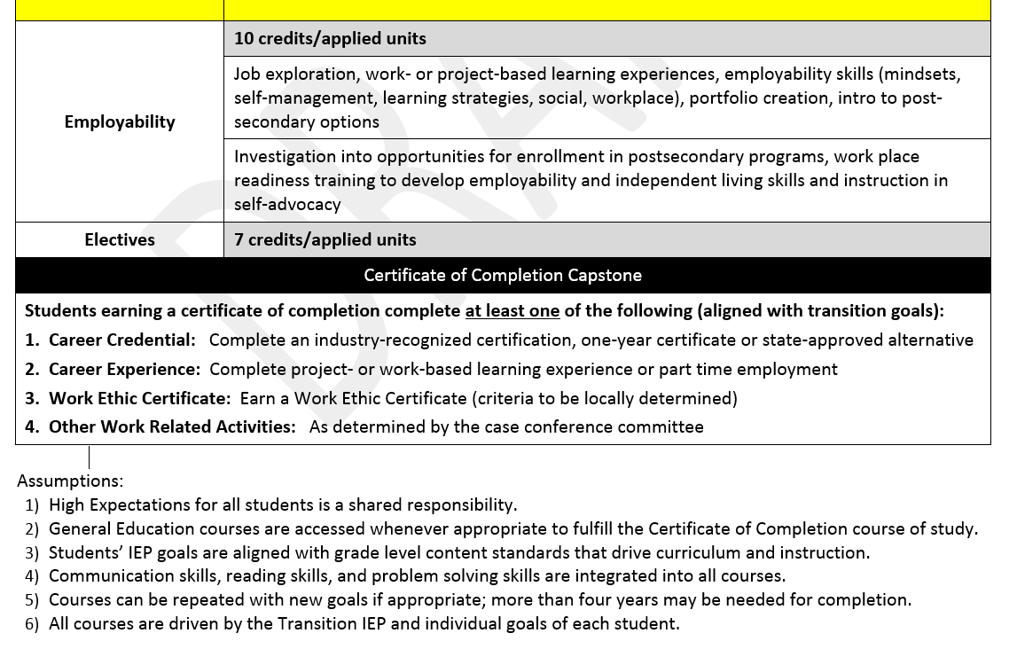

Slide 17
COC ASSUMPTIONS
High Expectations for all students is a shared responsibility
General Education classes are accessed whenever appropriate to fulfill COC Course of Study
Student’s IEP goals are aligned with grade level content standards that drive the curriculum
Communication skills, reading skills, problem solving skills are woven into all classes
Classes may be repeated with new goals if appropriate; more than four years may be needed for completion
Course selection is driven by the Transition IEP and individual goals of students

Slide 18
Course Descriptions
Reviewed existing Course Descriptions and developed “Applied” Versions earning units instead of credits.
Aligned to Academic Standards or Content Connectors and cross walked with Workforce Development Workplace Essentials
Worked with CCR and PK-16 Office to ensure alignment with credit based courses.

Slide 19
Course Descriptions
Notes:
The Indiana Course Descriptions were used to begin the process of developing courses that would meet the unit requirement of the certificate of completion. The related content connectors (alternate achievement standards assessed on ISTAR) and workplace essentials (skills assessed by DWD) were aligned.

Slide 20
Plan Examples
Notes:
Recognizing that students earning a certificate of completion will do so in a variety of paths, we are developing sample plans. The plans will highlight a combination of credits and units and multiple courses for employability/capstone requirements. Examples will include at least the following scenarios:
Student with most significant needs earning certificate of completion
Student earning certificate of completion in six years
Student earning certificate of completion in four years
Student who transitioned from diploma to certificate of completion after beginning high school

Slide 21
ALIGNING INSTRUCTION
Aligned to Course Descriptions, Academic Standards, including Alternate Achievement Standards (Content Connectors)
Includes content, practice and application
Includes exposure to grade level content standards
Includes workplace essentials, employment, soft skills and job experiences.
Professional Development Provided by Project Success to LEAs on aligning instruction with alternate achievement standards
Summer Institutes in process

Slide 22
ADAPTING INFRASTRUCTURE
Working with two districts to help with development (Avon and Michigan City)
Began meeting with Guidance Counselors in Michigan City to determine infrastructure changes (scheduling, transcripts, grading, etc.) in order to support the revised system
Determine implementation phases with the assistance of the two districts
Goal for Statewide implementation of new COC: August 2018
Notes:
The COC/COS work group has had discussion This is some of the work that is being done in advance to inform professional development and technical assistance. We are asking for your input to assist in the same quest – what questions do you know will need to be answered as this is introduced?

Slide 23
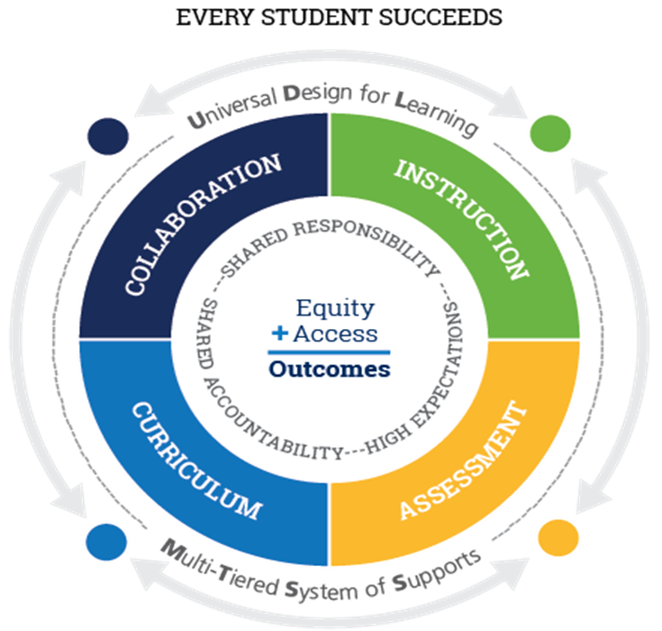
ESSA ALIGNMENT
Assessment and Standards – the COC Course of study provides a structure for schools that allows students to make progress toward either the Academic Standards or Alternate Achievement Standards (aka Content Connectors); Alternate Standards have been developed and Alternate Assessment Aligns with the standards.
Supporting All Students – the revised requirements for earning a Certificate of Completion, as encourages equity (course of study that mirrors a diploma) and allows flexibility through the credits or units for accessing both the Academic Standards and Alternate Achievement Standards.

Slide 24
ESSA ALIGNMENT
Supporting Excellent Educators – the Certificate of Completion, as revised, requires a more rigorous curriculum for students who have been
removed from the diploma track. Professional Development is available to
all teachers who are working with students who are not on a diploma track,
particularly those who have significant cognitive disabilities.
Accountability – the Certificate of Completion, as revised, meets the requirements of an Alternate Diploma for students with significant cognitive disabilities. ESSA allows for 1% of students assessed in the state with significant cognitive disabilities to take an Alternate Assessment that could count favorably in the school accountability formula.
School Improvement - As DOE works with districts on improvement, all subgroups must be considered. The Certificate of Completion, as revised, raises expectations for students who have been removed from the diploma track. Raised expectations = Improved Outcomes.

Slide 25
Next Steps: By August 2018
Share Course of Study with field and gather input
Finalize Course of Study and share with field
Complete Course Descriptions
Share with other stakeholder groups: Superintendent’s Association, Principals’ Association, School Boards Association, Guidance Counselors Association, ICASE, INSOURCE, SAC, Summer workshops and trainings.
Share with the State Board of Education
Determine implementation phases with the assistance of two districts
Provide extensive Professional Development and Technical Assistance to schools

Slide 26
ADDITIONAL SUBCOMMITTEE WORK
Revision of the Summary of Performance format to provide skill/work experience detail
Plan ways to inform employment community
Other activities to be determined by stakeholders

Slide 27
ANY QUESTIONS? THANK YOU

