Slide 1
Nutritional Issues in Older Adults
Ronni Chernoff, PhD, RD, CSG, FADA

Slide 2
Life Expectancy of Selected Populations

Slide 3
Older adults may seem to have an acceptable nutritional profile but then may decompensate when faced with a physiologic crisis

Slide 6
Malnutrition in the elderly
Caloric intake declines by up to 500 kcal/day between 65 and 85 years
Older adults do not consume
adequate protein, calcium, vitamin D and folic acid
Nutrition Screening Initiative. 2004. www.eatright.org/Public/Files/nutrition(1).pdf
Notes:
It is well known that body weight and lean body mass (muscle) decrease with increasing age. Even in developed countries, average caloric intake can decline as much as 500 kcal/day between the ages of 65 and 85.
Notably, 90% of older Americans do not regularly consume the dietary reference intakes (DRIs) for calcium and folic acid, nutrient markers for bone and heart health.
Reasons for poor eating include bad oral health (tooth decay and gum disease); deleterious effects of drugs prescribed for chronic diseases on appetite and metabolism; and unrecognized illnesses that reduce ability to shop, prepare, or consume an adequate diet.

Slide 7
Malnutrition in the elderly
  Impaired eating
    Poor oral health
    Side effects of prescription drugs
    Undiagnosed illnesses
    (dementia, depression)
Nutrition Screening Initiative. 2004. www.eatright.org/Public/Files/nutrition(1).pdf
Notes:
It is well known that body weight and lean body mass (muscle) decrease with increasing age. Even in developed countries, average caloric intake can decline as much as 500 kcal/day between the ages of 65 and 85.
Notably, 90% of older Americans do not regularly consume the dietary reference intakes (DRIs) for calcium and folic acid, nutrient markers for bone and heart health.
Reasons for poor eating include bad oral health (tooth decay and gum disease); deleterious effects of drugs prescribed for chronic diseases on appetite and metabolism; and unrecognized illnesses that reduce ability to shop, prepare, or consume an adequate diet.

Slide 8
Body composition changes will impact on how we assess and recognize nutritional problems in older adults

Slide 9
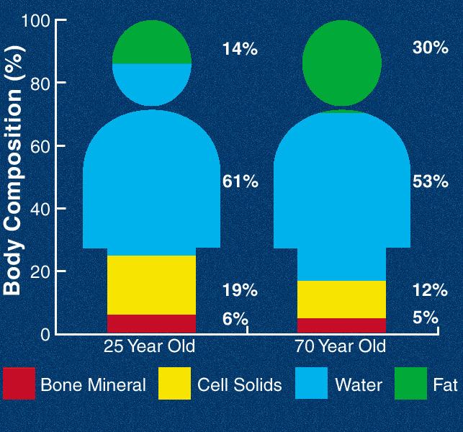

Slide 10
Nutritional Assessment

Slide 11
To rely only on commonly used measures of nutritional status may yield a false picture of the nutritional status of an older adult since so many indicators are impacted by non-nutritional factors

Slide 12
Only using the common measures of nutritional status may mask an underlying loss of reserve capacity

Slide 13
Older adults may seem to have an acceptable nutritional profile but then may decompensate when faced with a physiologic crisis

Slide 14
Just because older adults may appear “well-nourished” does not mean that they are

Slide 15
Commonly Used Measures of Nutritional Status
Anthropometric measures
Laboratory/hematologic measures
Immunological measures
Dietary assessment
Drug profiles
Socioeconomic factors

Slide 16
Anthropometry will be affected by:
Loss of height due to vertebral compression, osteopenia
Body composition changes
Shifts in body compartments
Loss of muscle strength and skin tone
Lack of age-appropriate standards

Slide 17
Anthropometric measures
Height
Weight
Skinfolds
Circumferences
Strength assessment

Slide 18
Weight changes (losses or gains) may be related to a variety of risk factors

Slide 19
Weight change factors include:
Decrease in activity
Decreased basal metabolic rate
Disease-related anorexia
Disease-related cachexia
Effects of drugs
Changes in eating habits/diet
Increasing disability

Slide 20
If energy intake does not decline but activity level does, the result is a gain in weight

Slide 21
Weight gain factors include:
Decrease in activity
Decreased basal metabolic rate
Effects of drugs
Changes in eating habits/diet
Increasing disability

Slide 22
Weight loss should be slow and steady and easy to manage

Slide 23
Lifestyle changes need to be made to sustain effective weight loss in older adults

Slide 24
Weight loss factors include:
Disease-related anorexia
Disease-related cachexia
Effects of drugs
Changes in eating habits/diet
Increasing disability

Slide 25
Some older adults experience an unintended weight loss

Slide 26
The goal should be to maintain an acceptable weight before disability associated with obesity becomes an extraordinary burden

Slide 27
One of the factors in weight change is hydration status, fluid shifts, and fluid intake

Slide 28
Laboratory measures may be affected by age because of:
Hydration status
Impact of multiple drug use
Chronic disease
Acute illness episodes
Changes in organ function

Slide 29
Commonly used laboratory measures include:
Albumin
Transferrin
Prealbumin
Retinol-binding protein
Hemoglobin/hematocrit
Electrolytes
Renal function tests

Slide 30
Albumin is an indicator of many processes that do not have to do with nutritional status

Slide 31
Albumin levels may be affected by:
Bed rest
Fluid balance
Acute physiologic stress
Chronic inflammatory processes
Dysfunctional protein metabolism
    Advanced liver disease
    Congestive heart failure
    Nephrotic syndrome
    Protein-losing enteropathies

Slide 32
Transferrin may not be a reliable indicator because:
Total body iron stores increase with age
Chronic infection, hepatic, renal diseases, cancer, all impact on serum transferrin
It is not very specific for nutritional status

Slide 33
Prealbumin/Retinol-binding protein
Negative acute phase reactant in response to inflammatory processes
Declines in liver disease, iron deprivation
Increases in renal failure and with steroid therapy
RBP is primarily a carrier protein for vit A

Slide 34
Drug profile may be affected by:
Polypharmacy
Drug-drug interactions
Food-drug interactions
Use of OTC nutritional supplements
Poor reporting of OTC compounds

Slide 35
Socioeconomic factors:
Fixed income limitations
Living arrangements
    With whom
    Where
Cooking facilities
Limitations in ADLs
Purchasing priorities

Slide 36
For older adults other dimensions should be evaluated, including oral health and functional ability

Slide 37
Oral health evaluation in older adults:
Teeth may be loose or missing
Dentures may not fit
Oral lesions may be present
Taste sensitivity may be impaired
Saliva production may be affected by drugs or disease
Chewing/swallowing difficulties may exist

Slide 38
Functional status is usually evaluated by 2 commonly used scales

Slide 39
Activities of Daily Living
Toileting
Feeding
Dressing
Grooming
Ambulating
Bathing

Slide 40
Instrumental Activities of Daily Living
Ability to use phone
Shopping
Food preparation
Housekeeping
Laundry
Ability to travel
Manages own medications
Handles finances

Slide 41
Nutrition Interventions

Slide 42
Changes may include dietary patterns, activity levels, nutrition education, cooking suggestions

Slide 43
Weight loss is a difficult problem to address

Slide 44
Approaches to try with anorectic older people may include dietary modifications, supplements, tube or IV feeding, or medications

Slide 45
Dietary changes may include adding calories to food products, eg. butter, milk solids, calorie supplements, other fats or oils

Slide 46
Small meals, snacks, shakes, oral supplements, nighttime enteral infusions, peripheral parenteral nutrition are all options

Slide 47
Appetite stimulants and anabolic agents have been investigated but the results are mixed

Slide 48
Fluid requirements have become an issue of interest

Slide 49
Dehydration may be associated with:
hypotension
elevated body temperature
constipation
nausea/vomiting
mucosal dryness
decreased urinary output
mental confusion

Slide 50
Fluid intake can be estimated at 30 ml/kg body weight with a minimum of 1500 ml/day

Slide 51
Recommendations for 8 glasses of fluid per day may be an overestimation of fluid needs for older adults

Slide 52
Thirst is actually a bigger issue

Slide 53
Thirst may be impaired because:
decrease in aortic baroreceptors
decrease in renal function and osmoreceptors
voluntary limited intake
brain injuries

Slide 54
Fluid can be consumed in many forms such as juices, other beverages, frozen desserts, anything liquid at room temperature

Slide 55
Voluntary intake may be compromised for many reasons
mild incontinence
inconvenience
decreased thirst sensitivity
dementia

Slide 56
Sometimes involuntary intake is inadequate too

Slide 57
Meeting fluid requirements is often an issue in wound healing protocols

Slide 58
Tube feedings are made of solids dispersed in liquid and approximately 25% of TF volume needs to be added as free water to actually meet fluid needs

Slide 59
In addition to changes in overall energy and fluid needs, requirements for other essential nutrients change too

Slide 60
Nutrient Requirements

Slide 61
Nutrient requirements may change with age due to physiological, health status, body composition, and activity level changes

Slide 62
Key nutrient requirement changes:
Protein
Vitamin B12
Vitamin A
Vitamin D
Calcium
Energy related to decreased activity level

Slide 63
Protein requirements are affected by:
decrease in total LBM

Slide 64
Protein requirements are affected by:
decrease in total LBM
loss of efficiency in protein turnover

Slide 65
Protein requirements are affected by:
decrease in total LBM
loss of efficiency in protein turnover
increased need to heal wounds, surgical incisions, repair ulcers, make new bone

Slide 66
Protein requirements are affected by:
decrease in total LBM
loss of efficiency in protein turnover
increased need to heal wounds, surgical incisions, repair ulcers, make new bone
infection

Slide 67
Protein requirements are affected by:
decrease in total LBM
loss of efficiency in protein turnover
increased need to heal wounds, surgical incisions, repair ulcers, make new bone
infection
immobilization

Slide 68
RDA for adults is 0.8 g/kg/body weight
For older adults, requirements are for 1.0 g/kg/body weight or more

Slide 69
Studies by Gersovitz, in early 80s, and Campbell et al in late 90s and early 2000+ support the need for 1 or more g/protein/kg body weight

Slide 70
Vitamin B₁₂

Slide 71
Assuring adequate vitamin B₁₂ is a challenging goal throughout the life cycle but particularly in older adults

Slide 72
Vitamin B₁₂
Is primarily available in animal protein sources
Has a complex transfer and absorption pattern
Has a vague presentation of deficiency
May be associated with a decline in cognitive function

Slide 73
Vitamin A

Slide 74
Vitamin A requirements are altered by age due to alterations in hepatic vitamin A metabolism

Slide 75
Vitamin A is needed for cell differentiation

Slide 76
Cell differentiation processes allow for the development of different tissues

Slide 77
There has been discussion about lowering recommendations for preformed vitamin A in older adults

Slide 78
Vitamin A requirements in wound healing should not exceed 200% of the RDA

Slide 79
Beta carotene does not have any negative side effects other than its accumulation in serum, potentially causing discolored epidermis

Slide 80
Beta carotene seems to have a protective effect for epidermal tissue cancers

Slide 81
Vitamin D

Slide 82
Vitamin D is a nutrient that older adults are at risk for deficiency

Slide 83
Risk factors for vitamin D deficiency
inadequate dietary intake
inadequate sunlight exposure
decreased synthesis in skin (7-dehydrocholesterol)
diminished renal function – reduced hydroxylation

Slide 84
Vitamin D is essential to manage:
  Falls and fractures prevention
  Osteoporosis and dentition
  Cognition
  Immune function
  Blood pressure
  Colon cancer (?)

Slide 85
Energy Needs

Slide 86
To maintain weight, 20-25 kcals/kg body weight is usually adequate in a relatively sedentary adult

Slide 87
For stress, wound healing, infection, fracture, energy needs may increase to as much as 35 kcals/kg body weight

Slide 88
Energy needs decline with a reduction in metabolically active cell mass: protein and bone

Slide 89
Energy needs increase with demands for wound healing, fracture repair, infection response

Slide 90
To avoid or heal wounds of any type, nutrient needs must be met to support homeostasis

Slide 91
Key nutrients needed for wound healing
Protein
Energy
Vitamin A
Vitamin C
Zinc

Slide 92
Protein Needs

Slide 93
Protein needs may be as high as 2+ g/kg body weight

Slide 94
Albumin levels may be affected by:
Bed rest
Fluid balance
Acute physiologic stress
Chronic inflammatory processes
Dysfunctional protein metabolism

Slide 95
Albumin levels may be affected by:
Dysfunctional protein metabolism
    Advanced liver disease
    Congestive heart failure
    Nephrotic syndrome
    Protein-losing enteropathies

Slide 96
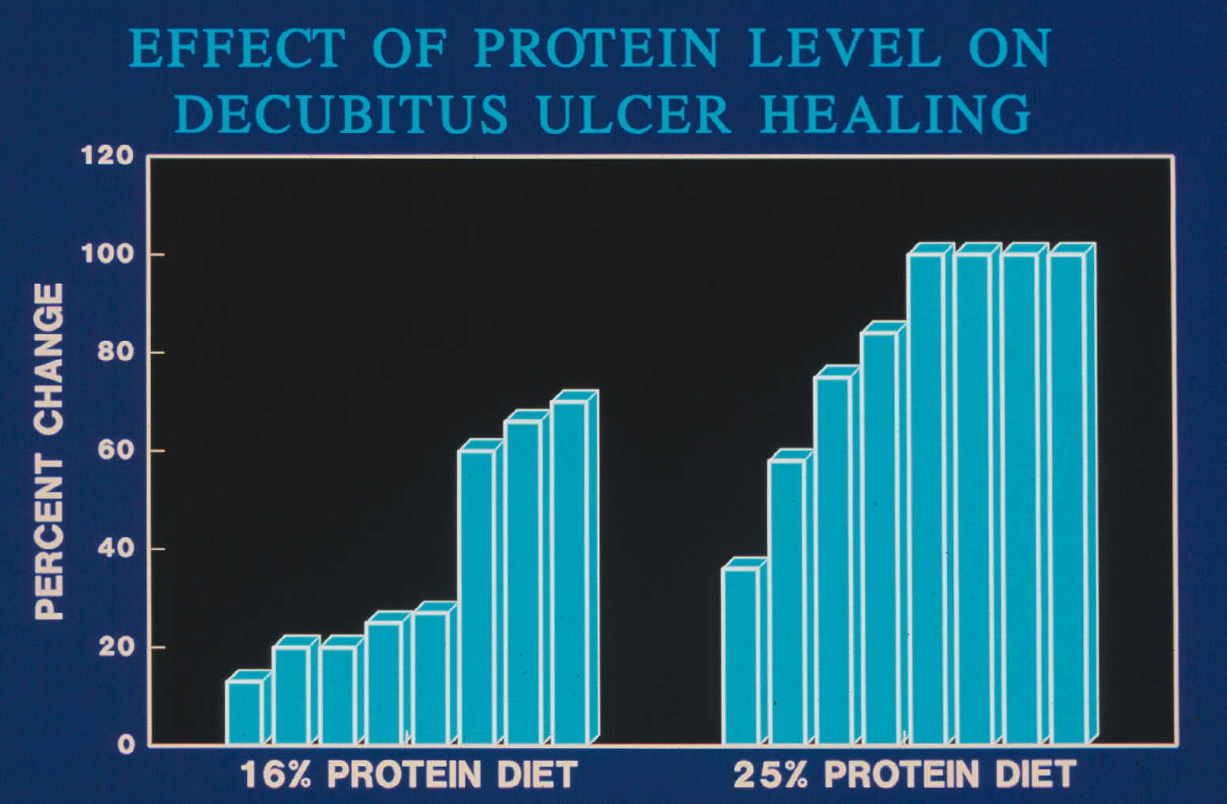

Slide 97
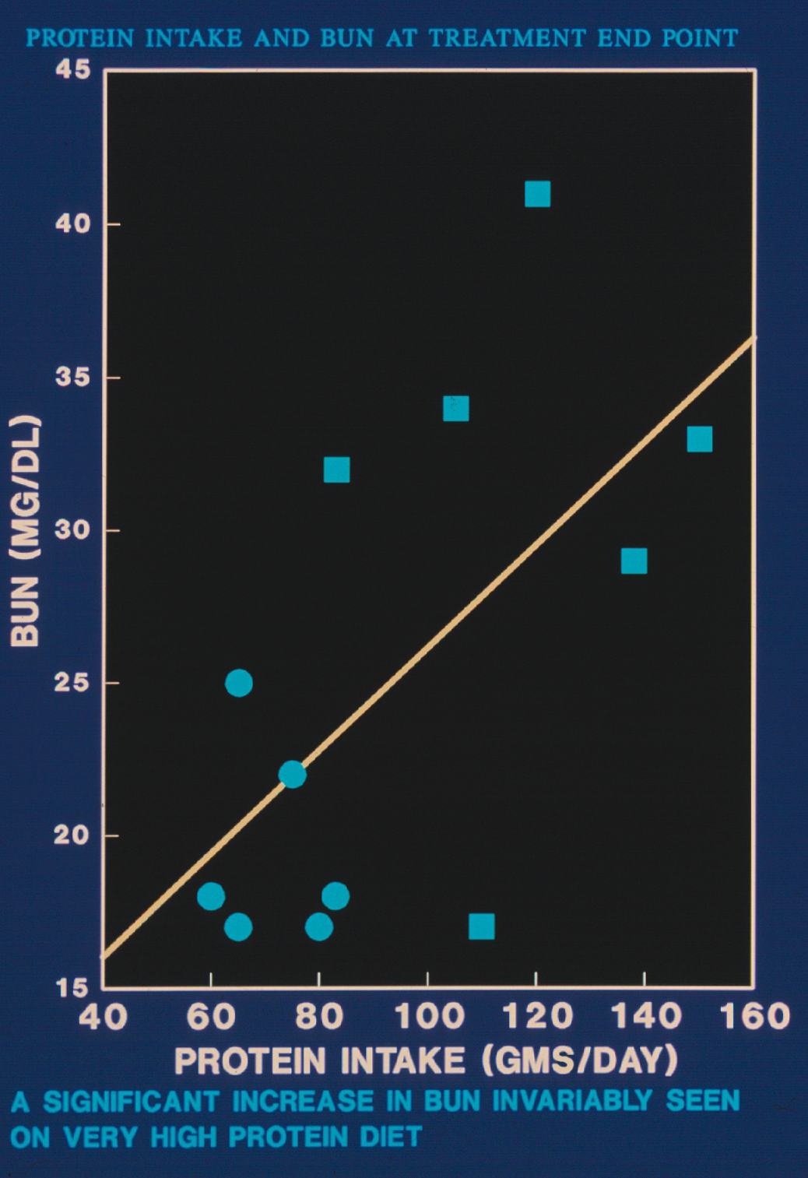

Slide 98
Vitamin C

Slide 99
Vitamin C
Status is related to dietary intake
Institutionalization, hospitalization and illness lead to sharp decreases in vitamin C intake

Slide 100
Vitamin C
Decreases seen with chronic disease including atherosclerosis, cancer, senile cataracts, lung diseases, cognition, and organ degenerative diseases

Slide 101
Vitamin C is easily replaced
Smokers may need 2x RDA just to meet requirements

Slide 102
Vitamin C is important in wound healing because of its role in hydroxylation but tissue saturation is achieved easily and large doses are excreted in urine

Slide 103
Zinc
Most older adults are not zinc deficient
Increased levels may be needed for wound healing but do not have to be very high (225mg/day in divided doses)

Slide 104
Zinc
Large amounts of zinc interfere with absorption of other divalent ions

Slide 105
Copper, iron, magnesium, manganese may be affected by large doses of zinc

Slide 106
Getting old in America is challenging but nutritional challenges can be managed with creativity and ingenuity and patience

