Slide 1
Dementia and Alzheimer Disease:
Current Realities and Future Possibilities
Peter V. Rabins, MD, MPH
Johns Hopkins School of Medicine

Slide 2
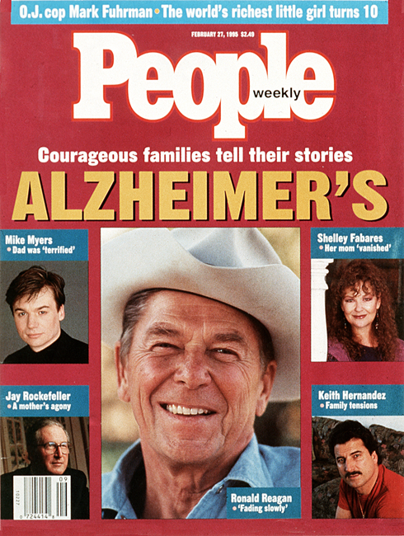

Slide 3
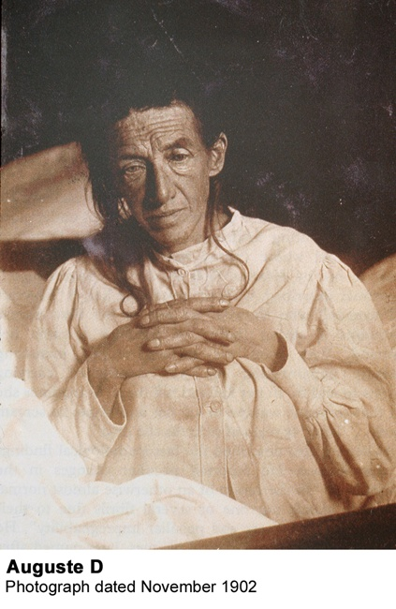

Slide 4
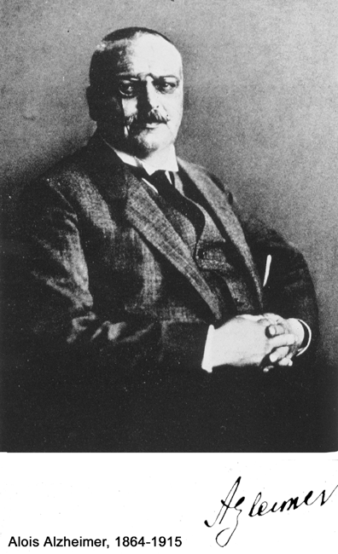

Slide 5
Dementia Syndrome
Declines in 2 or more cognitive capacities
Normal level of consciousness and alertness
Onset in adulthood

Slide 6
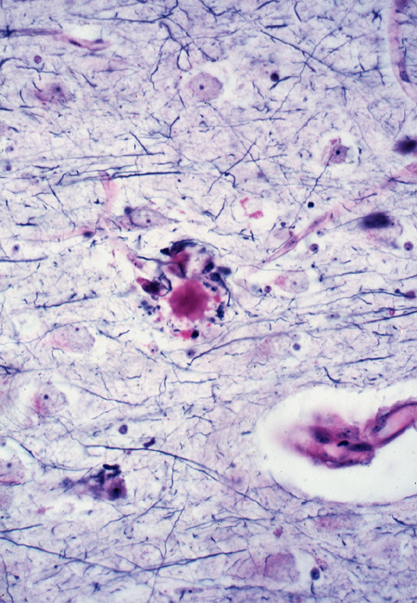

Slide 7
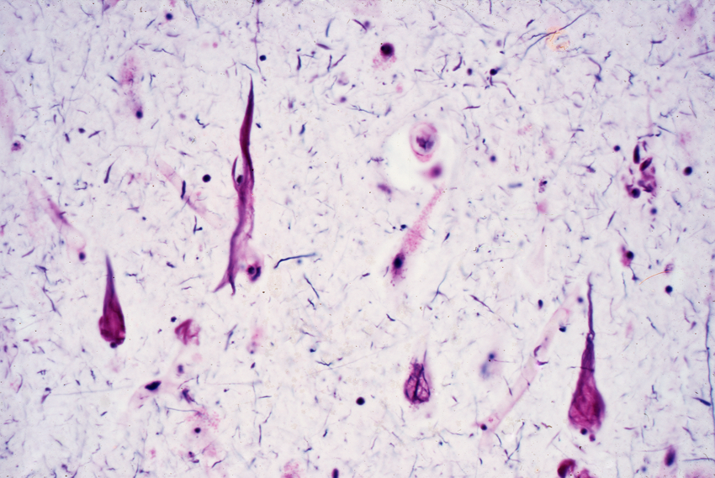

Slide 8
Diagnostic Features of
Alzheimer Disease
Slowly progressive dementia
No other etiology identified:
non-contributory neurological examination, laboratory evaluation and brain imaging
Decline in memory plus either:
-aphasia
-apraxia
-agnosia

Slide 9
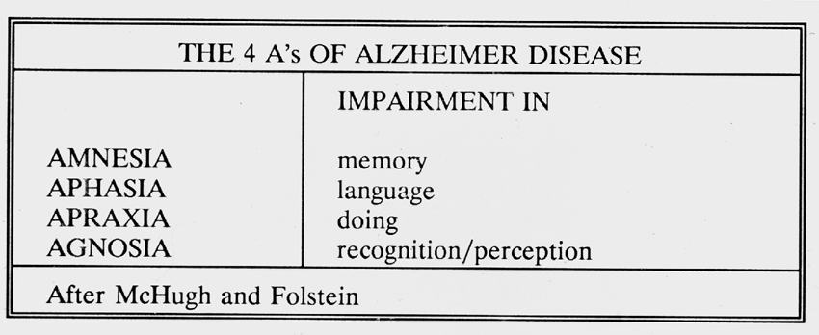

Slide 10
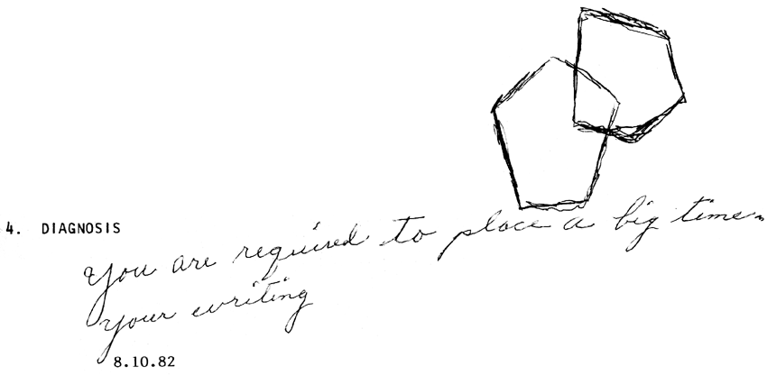

Slide 12
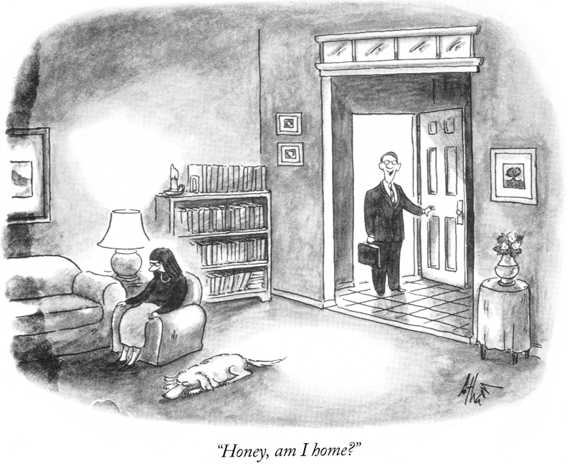

Slide 13
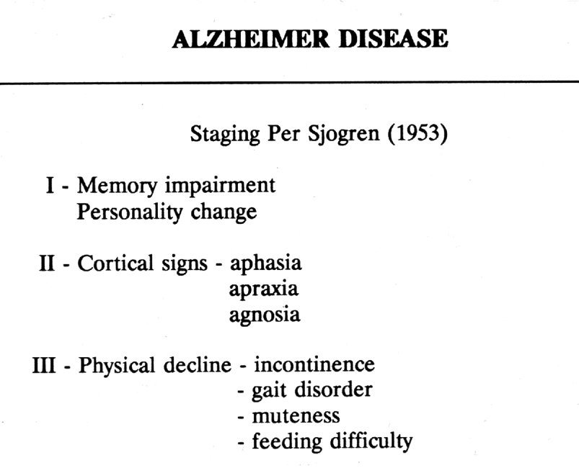

Slide 14
COMMON CAUSES OF DEMENTIA
Alzheimer disease 66%
Vascular dementia 15-20%
Dementia with Lewy bodies 8-15%
Fronto-temporal dementia 5%

Slide 15
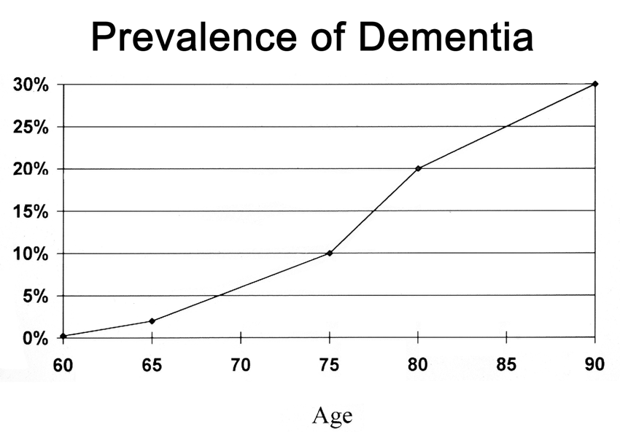

Slide 16
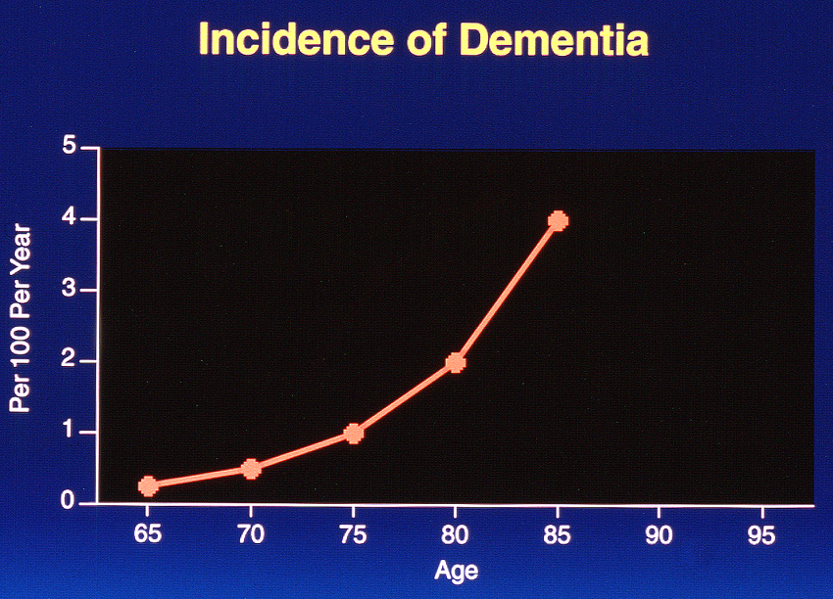

Slide 17
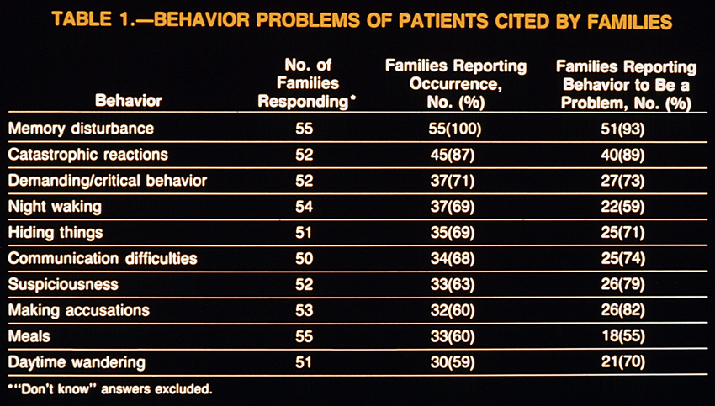

Slide 18
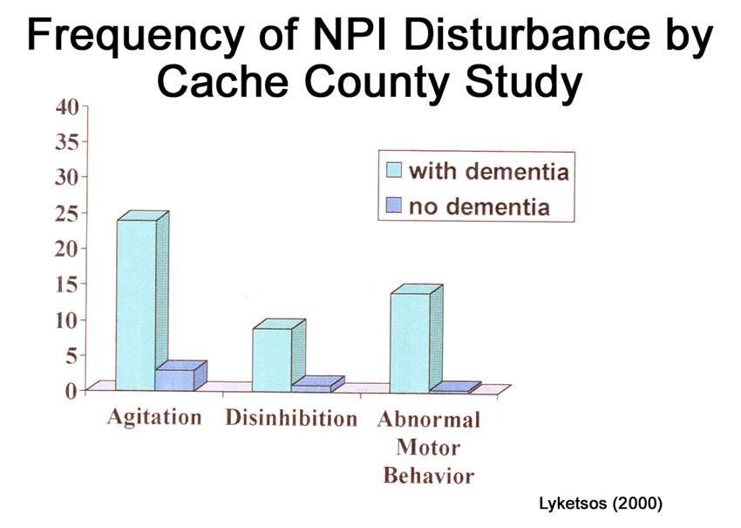

Slide 19
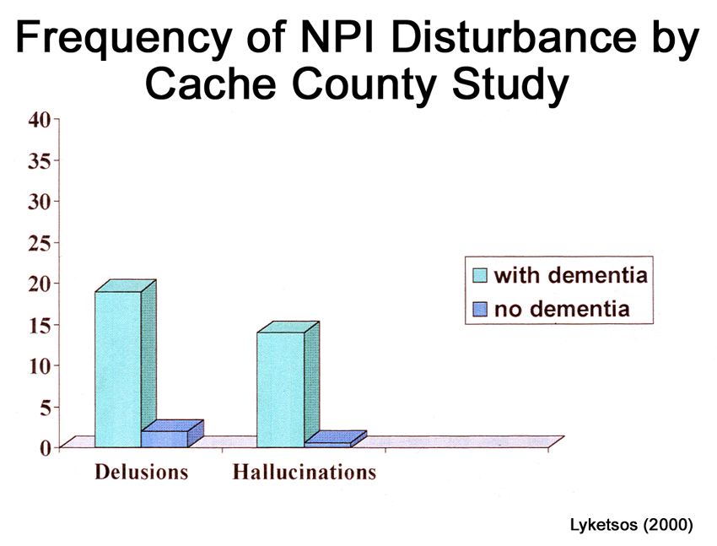

Slide 20
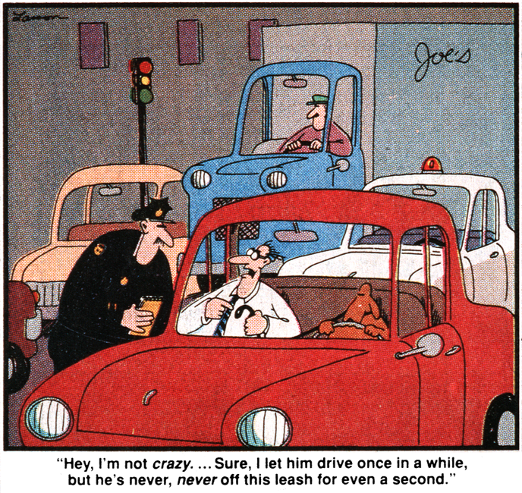

Slide 21
Epidemiologic Approach:
Risk and Protective Factors
RISK FACTORS
Older age
Down syndrome
Family history
Head injury
Female
?low education
?depression earlier
Estrogen
PROTECTIVE FACTORS
NSAIDS
??Estrogen early
?low cholesterol
?lipid lowering drugs
?more education
?higher activity level
?moderate alcohol
?vitamin E/antioxidants

Slide 22
GENETIC ISSUES
Abnormalities in 3 genes are known to cause AD
APP gene on chromosome 21
PS-1 gene on chromosome 14
PS-2 gene on chromosome 1
Account for fewer than 2% of cases of AD
Function of these genes unknown

Slide 23
Genetics Cont.
Between 30-60% of AD is under genetic influence
APOE gene linkage well established
-APOE E4 gene increases risk
-APOE E2 gene may decrease risk
-These genes are “normal”
-APO genes carry cholesterol

Slide 24
Genetics Continued: 3 Recently Discovered Genes (2009)
Clusterin
PICALM
CR1 (complement receptor 1)
Need to be replicated
May account for 10% of cases

Slide 25
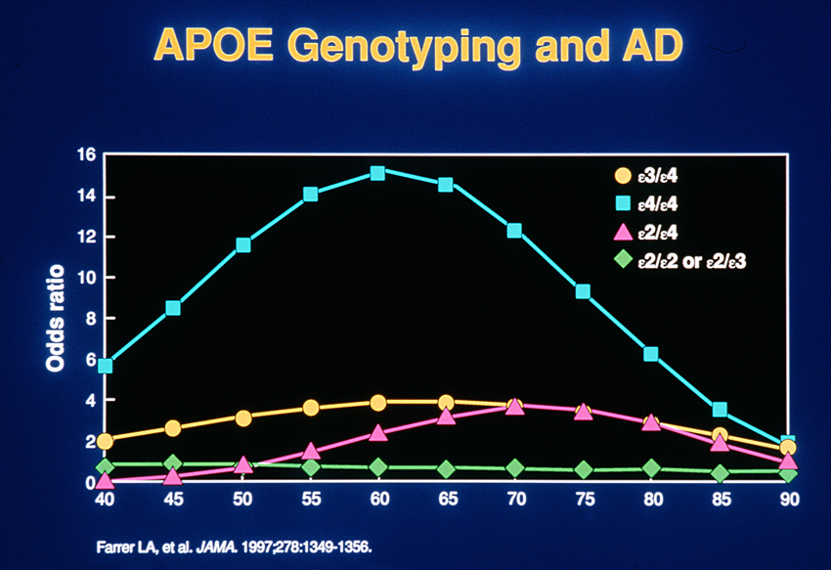

Slide 27
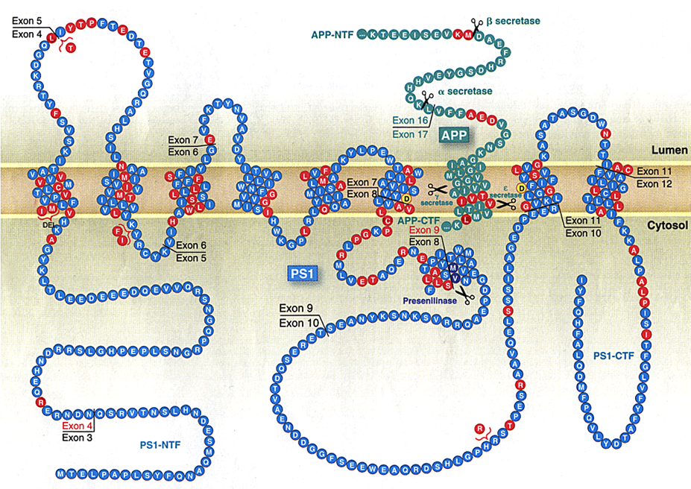

Slide 28
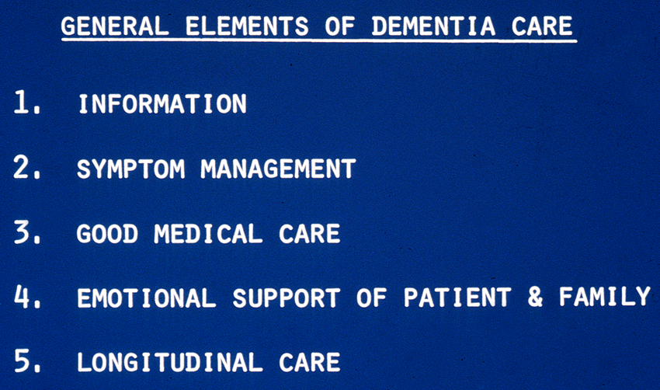

Slide 29
Sertraline vs. Placebo
70
Exact p=0.0057
60
50
40
Nonresponse
Percent
Partial response
30
Full response
20
10
0
Placebo
Sertraline
Lyketsos et al, Arch Gen Psych, 2003

Slide 30
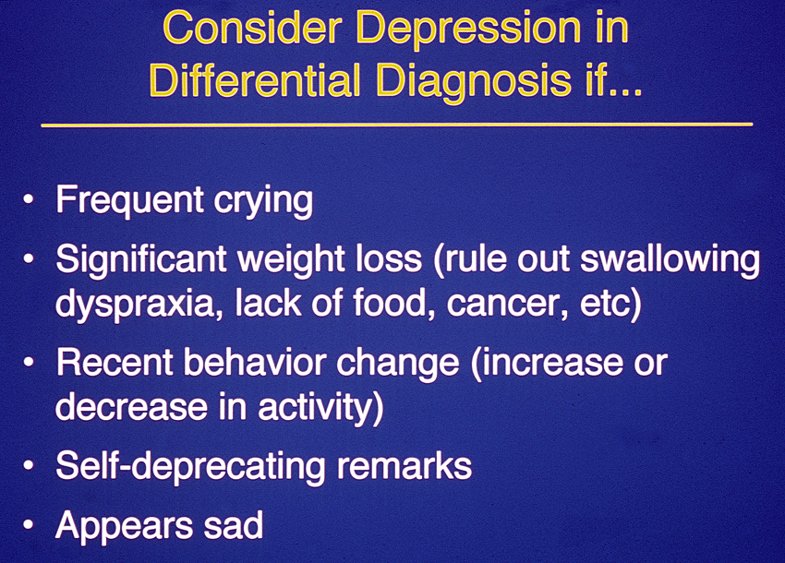

Slide 31
Does the Treatment of Dementia Improve Quality of life (QOL)?
No evidence that pharmacotherapy improves QOL
Modest evidence that psychosocial interventions improve QOL in AD
No evidence that environmental design improves QOL
In more than 30 studies, caregiver QOL is improved by intervention. A combination of education and emotional support is most effective in improving QOL

Slide 32
Common Ethical Challenges
(Practical Dementia Care, 2nd Ed. Chapter 13, in press)
The person who doesn’t want to be evaluated
The person who lives alone
The person who demands to drive
The use of medication and restraints to control behavior and protect from harm
The use of lying to better patient’s life and prevent harm
The person with poor oral intake
Medical decision making for the severely incapacitated

Slide 33
Legal Options for the Incapacitated
(Maryland recognizes financial and health decision making)
Guardianship | Advance Directives | MD Substituted Consent Statute
Legally adjudicated | Prepared while capacitated | 2 Physicians declare incapacitated
Judge reviews decisions | Becomes in force when incapacitated
 |  | spouse
 | -Living Will (“terminal”) | parent
 | -Durable Power of Attorney (a person) | child
 | -Advance Directive (wishes) | other relative, friend

Slide 34
Frequency of Medical Decisions Faced by Caregivers (n = 72)
Type of Treatment | Faced with Decision N (%) | Only Decided For % |  | Ever Decided Against %
Hospital admission | 38 (52.8) | 13.1 | 86.8
Blood test/ diagnostic test | 29 (40.3) | 44.84 | 55.2
Feeding tube | 25 (34.7) | 8.0 |  | 92.0
X-ray | 21 (29.2) | 66.7 |  | 33.3
Infection treatment | 25 (34.7) | 64.0 |  | 36.0
Respirator/ ventilator | 17 (23.6) | 23.5 |  | 76.5
Resuscitate | 14 (19.4) | -- |  | 100
Surgery | 4 (5.6) | -- |  | 100.0

Slide 35
Difficulty with Decision
Decision To Treat |  | Decision To Limit
Not Difficult | Any Difficulty | Not Difficult | Any Difficulty
87.7 % | 12.3 % | 55.2 % | 44.8 %
Satisfaction with Decision
Decision To Treat |  | Decision To Limit
Somewhat Satisfied | Very Satisfied | Somewhat Satisfied | Very Satisfied
28.8 % | 71.2 % | 19.4 % | 80.6 %

Slide 36
Risk of Incident Dementia in 2,442 Married Older Adults as a Function of Whether Spouse Had Dementia, Adjusted for Covariates: Total Sample and Stratified According to Spouse’s Sex
 | Hazard Ratio (95% Confidence Interval)
Predictor Variable | Total Sample | Husband as Index Subject | Wife as Index Subject
Having spouse with dementia | 6.01.23- 16.17) | 11.93 (1.67- 85.52) | 3.66 (1.15- 11.61)
Female | 0.80 (0.61- 1.03) | - | -
Age at baseline interview | 1.06 (1.01- 1.12) | 1.02 (0.98- 1.07) | 1.15 (1.06- 1.24)
Number of apolipoprotein E a4 alleles (reference: 0)
1 | 1.45 (1.11- 1.90) | 1.42 (1.00- 2.02) | 1.55 (1.01- 2.38)
2 | 4.54 (2.86- 7.23) | 4.91 (2.74- 8.79) | 3.83 (1.68- 8.72)
Husband’s occupation (reference: machine, misc.)
Professional, technical, management | 0.64 (0.44- 0.93) | 0.67 (0.41- 1.09) | 0.56 (0.30- 1.04)
Clerical, sales | 0.66 (0.40- 1.10) | 0.57 (0.28- 1.15) | 0.79 (0.38- 1.66)
Service | 0.98 (0.48- 2.01) | 1.01 (0.41- 2.50) | 0.67 (0.19- 2.31)
Agriculture | 0.81 (0.57- 1.15) | 0.93 (0.60- 1.46) | 0.59 (0.33- 1.06)
Husband’s education, years | 1.00 (0.95- 1.05) | 1.00 (0.94- 1.06) | 1.00 (0.93- 1.08)
Norton, et al. 2010

