Slide 1

New Interchange at I-69 and 106th Street
Fishers City Hall Auditorium
Thursday, September 10, 2015

Slide 2
Welcome
Rickie Clark, INDOT Office of Public Involvement
Purpose/explanation of public hearing
Public hearing format
Visit our sign-in table
Informational handouts
Submitting public comments for hearings transcript
Project display area

Slide 3
Welcome
Introduction of INDOT Project Team
  Project Management
  Public Involvement
  Greenfield District – INDOT Regional Office
  Environmental Services
  Real Estate
  The Corradino Group
    Environmental Analysis Team
  United Consulting Engineers
    Design Team
Recognition of elected and local public officials

Slide 4
Public Hearing
Sign-in at attendance table to be added to project mailing list
A public hearing notice was mailed to known property owners within project area
Announcement of this hearing was posted to INDOT website. A media release was also issued
A copy of presentation and project documentation is available on-line via INDOT website
Legal notice publishing:
  Indianapolis Star
    August 24th, 25th, 31th , September 8th 2015

Slide 5
Project Stakeholders
Indiana Department of Transportation
Indiana Division Federal Highway Administration
Hamilton County
City of Fishers
Elected public officials
Indianapolis Metropolitan Planning Organization
Community residents and citizens
Commuters
Businesses
Emergency services
Schools

Slide 6
Project Development Process
Interchange Justification
Project Selection
Early Coordination
Environmental phase begins
Purpose & Need
Develop alternatives
Preliminary design phase
Release environmental document for public review and comment
Additional work to finalize environmental document and project design
Real Estate Acquisition
Construction
Public Hearing
Notes:
6

Slide 7
Interchange Justification
  Focused on traffic operations and safety
  Required area-wide traffic modeling
  Reviewed by Federal Highway Administration
    Satisfied the required eight (8) policy points

Slide 8
Environmental Document
  Requirement of the National Environmental Policy Act (NEPA)
  Requires INDOT to analyze and evaluate the impacts of a proposed project to the natural and socio-economic environments
  Impacts are described in environmental document
    Environmental Assessment - type of document required for projects of greater impact
    The proposed action to construct a new interchange involves environmental impact
  Environmental document released for public involvement
    August 2015
    Is available for review via public repositories

Slide 9
Environmental Document
Environmental Process
  Establish Purpose and Need
  Develop a number of possible alternatives
    The “Do Nothing” alternative is a baseline for comparison
  Evaluate and screen alternatives
  Identify a preferred alternative
  Solicit public comment on environmental document and preliminary design plan
  Solicit, address and fully consider public comment as part of decision making process
  Finalize and approve environmental document

Slide 10
A number of items are evaluated
Environmental Documentation
  Right-of-way
  Streams, Wetlands, and Other Waters
  Floodplains
  Endangered Species
  Farmland
  Cultural Resources (Historic/Archaeological)
  Parks and Recreational Lands (Trails)
  Air Quality
  Noise
  Community Impacts
  Environmental Justice
  Hazardous Materials
  Permits
  Mitigation
Public Involvement
Commercial Development

Slide 11
Noise
Noise analysis was required in accordance with FHWA regulations and INDOT’s Traffic Noise Policy
  Noise study report prepared May 2015
Noise abatement within the project limits was determined to not be reasonable or feasible
  A noise barrier that cannot achieve an acoustic reduction of at least 5dB(A) is considered to not be feasible
  The cost effectiveness of noise abatement is considered when determining if a noise barrier is reasonable to construct
  If noise abatement were determined to be reasonable and feasible, then impacted stakeholders are contacted

Slide 12
Air Quality
Project has been determined to generate minimal air quality impacts
FHWA led an inter-agency coordination group which concurred that the new I-69 interchange at 106th Street is not a project of air quality concern
Project does not require additional air quality analysis

Slide 13
Environmental Documentation
INDOT Greenfield District Office
Planning & Programming Department
32 South Broadway
Greenfield, IN 46140
(855) 463-6848; eastcentralin@indot.in.gov
INDOT Website location: http://www.in.gov/indot/2704.htm
INDOT Office of Public Involvement, IGCN Room N642
100 North Senate Avenue, Indianapolis, IN 46204
(317) 232-6601; rclark@indot.in.gov
Fishers Public Library
5 Municipal Drive
Fishers, Indiana 46038
(317) 579-0300

Slide 14
New Interchange
Purpose and Need
  Reducing congestion at the existing I-69 interchanges with 96th Street and 116th Street
  Improving traffic safety within the project study area
  Providing direct access between I-69 and 106th Street to serve existing land uses and growth patterns

Slide 15
Project Overview
New interchange along I-69 at the 106th Street overpass in Hamilton, County
  Preferred alternative is an interchange configuration with a two lane, oval-shaped roundabout centered over the I-69 centerline, Construction Cost $34,000,000
  Project Cost Participation
    INDOT/FHWA – 66%
    Fishers – 28%
    Hamilton County – 6%
  Proposed interchange will provide for all four turning movements to and from I-69
  Project limits along 106th Street extend from Crosspoint Blvd. to USA Parkway

Slide 16
Project Overview
New interchange along I-69 at the 106th Street overpass in Hamilton, County
  106th Street widened to 2 lanes in each direction
  Curb and gutter along 106th Street
  8 foot Side Path along north side of 106th Street
  I-69 roadway work will be limited to construction of ramps for new interchange
  New Corridor signing
  Lighting of interchange and 106th Street
  Drainage Improvements including detention prior to both RJ Craig Drain and Margaret O’Brien Drain

Slide 17
Preferred Alternative

Slide 18
Alternatives Considered
No Build
Transportation Management Systems (TSM) for I-69
Improvements to 96th and 116th Street Interchanges
New 106th Street Interchange Alternatives
  Tight Diamond Interchange (TDI)
  Single Point Urban Interchange (SPUI)
  Diverging Diamond Interchange (DDU)
  Roundabout Interchange – Preferred Alternative

Slide 19
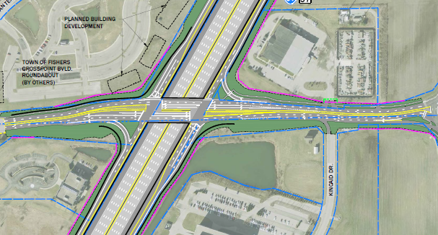
Alternatives Considered
Tight Diamond Interchange (TDI)

Slide 20
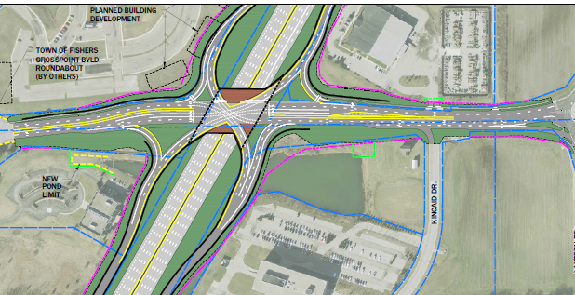
Alternatives Considered
Single Point Urban Interchange (SPUI)

Slide 21
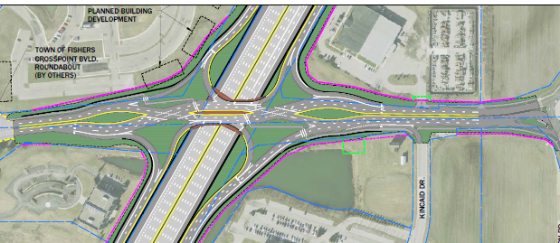
Alternatives Considered
Diverging Diamond Interchange (DDI)

Slide 22
Alternatives Considered
Comparison of Performance
Interchange Alternative | Roundabout (preferred) | TDI | SPUI | DDI
2035 Peak Hour Operations (average delay in seconds per vehicle) | 5.8 (AM) 28.7 (PM) | 42.4 (AM) 45.5 (PM) | 33.3 (AM) 33.0 (PM) | 29.7 (AM east) 19.2 (AM west) 44.3 (PM east) 24.8 (PM west)
2035 “Off-Peak” Operations | Little to no delay | Some traffic signal delay | Some traffic signal delay | Some traffic signal delay
Satisfies Purpose and Need | Yes | Yes | Yes | Yes
Estimated Cost | $34 million | $32 million | $36 million | $35 million

Slide 23
Alternatives Considered
Comparison of Environmental Impacts
Interchange Alternative | Roundabout (preferred) | TDI | SPUI | DDI
New permanent ROW (acres) | 9.5 | 9.0 | 10.7 | 10.1
Wetlands (acres) | 0.63 | 0.52 | 0.69 | 0.73
Floodplain (acres) | 0.0 | 0.0 | 0.0 | 0.0
Streams (lineal feet) | 0.0 | 0.0 | 0.0 | 0.0
Farmland (acres) | 0.0 | 0.0 | 0.0 | 0.0
Relocations (number) | 0 | 0 | 1 | 0

Slide 24
Maintenance of Traffic During Construction
Mainline I-69
  Lanes narrowed to 11 feet
  Speed limit reduced to 55 mph
  No lane closures during the day, lane shifts only
  Nighttime lane closures
  20 minute stoppages for overhead construction
106th Street
  Complete closure for duration of construction
Detour
  Hague Road, 96th Street and Lantern Road

Slide 25
Maintenance of Traffic During Construction

Slide 26

Real Estate Acquisition Process

Slide 27
Real Estate Acquisition Process
"Uniform Act of 1970"
  All federal, state and local governments must comply
  Requires an offer for just compensation
Acquisition Process
  Appraisals
  Review Appraisals
  Negotiations
INDOT Real Estate Team to work with impacted property owners

Slide 28
New Interchange
Right-of-way
    Permanent R/W: 9.5 acres
      Commercial
      Agricultural
      Forest
    Temporary R/W: 1.7 acres
      Commercial

Slide 29
Project Schedule
Public Hearing: September 2015
Public comments requested by COB 9/25/15
INDOT review and consideration of comments; finalize environmental document and design – Fall 2015
Real estate acquisition phase – 2015/2016
Construction: 2016 through 2017

Slide 30
Feedback
INDOT would like to hear from you
  Talk with INDOT project team members
  Comment sheet in information packet
  E-mail or mail comments to INDOT
  Sign-in list to be added to project mailing list
  Visit INDOT Greenfield District page at http://www.in.gov/indot/2704.htm
  All comments are very much appreciated and will be given full consideration by project team

Slide 31
Submit Public Comments
Submit public comments using the options described in first page of information packet:
  Public Comment Form
  Via e-mail
  Participating during public comment session via microphone
  Verbal comments recorded and transcribed for inclusion into public hearings transcript
INDOT respectfully requests comments be submitted by Friday, September 25, 2015.
All comments submitted will become part of public record, entered into transcript, reviewed, evaluated and given full consideration during decision making process.

Slide 32
Next Steps
Public and project stakeholder input
  Submit comments via options described on page 1 of information packet
INDOT review and evaluation
  All comments are given full consideration during decision-making process
  Address comments, finalize/approve environmental document, complete project design
Communicate a decision
  INDOT will notify persons on mailing list of decision
  Work through local media outlets and paid legal notice
  Make project documents accessible via repositories
Questions? Contact Public Involvement Team

Slide 33
Public Involvement Team
Rickie Clark
INDOT Office of Public Involvement
(317) 232-6601
rclark@indot.in.gov
Nathan Riggs , Communications Director
INDOT Greenfield District Office
(855) 463-6848
eastcentralin@indot.in.gov

Slide 34
Thank You
Please visit with INDOT project officials following the public comment session
Project Open House
  Project maps, displays, real estate acquisition table, INDOT project team and informal Q & A
  View environmental document on INDOT Greenfield District page http://www.in.gov/indot/2704.htm
  Visit Project Page at: http://www.in.gov/indot/3399.htm

Slide 35

Public Comment Session

