Slide 1
US 24 at C.R. 600 East and Logansport Road J-Turn Intersection Improvement
Tuesday, June 27, 2017

Slide 2
Welcome
Purpose/explanation of public information meeting
Public information meeting format
Visit our sign-in table
Informational handouts
Submitting written public comments
Project display area

Slide 3
Welcome
Introduction of INDOT Project Team
Project Management
Public Involvement
LaPorte District – INDOT Regional Office
Environmental Services
Design
Recognition of elected and local public officials
Sign-in at attendance table to be added to project mailing list
Announcement of this public information meeting was posted to INDOT website
Media release issued
Local and elected officials notified
A copy of presentation and project documentation is available on-line via INDOT website

Slide 4
Project Stakeholders
Indiana Department of Transportation
Indiana Division Federal Highway Administration
Cass County & City of Logansport
Elected & Local officials
Residents and citizens
Commuters
Businesses
Emergency services
Schools
Churches
Community Organizations

Slide 5
Project Development
Project Selection
Early Coordination
Environmental phase begins
Purpose & Need
Develop alternatives
Preliminary design phase
Release environmental document for public review and comment
Additional work to finalize environmental document and project design
Real Estate Acquisition
Construction
Public Information Meeting
Offer opportunity to request a public hearing
Communicate project decision
Public Involvement:

Slide 6
Environmental Document
National Environmental Policy Act (NEPA)
Requires INDOT to analyze and evaluate the impacts of a proposed project to the natural and socio-economic environments
NEPA is a decision-making process
Purpose and Need
Alternatives Screening
Preferred Alternative
Impacts are analyzed, evaluated and described in an environmental document
What are the impacts this project might have on the community?
How can impacts be avoided?
Can impacts be minimized?
Mitigation for impacts?
Draft environmental document to be released for public involvement
Will be available for review via public repositories

Slide 7
Project Resource Locations
INDOT LaPorte District Office
315 E. Boyd Boulevard, LaPorte, IN 46350
Toll Free 1-855-464-6368
LaPorteDistrictCommunications@indot.in.gov
http://www.in.gov/indot/2705.htm
Planning, Project Development/Delivery, Construction, Maintenance for Northwest Indiana
Logansport Public Library - 616 East Broadway, Logansport, IN 46947
INDOT Office of Public Involvement
100 North Senate Avenue, Room N642, Indianapolis, IN 46204
Phone (317) 232-6601
rclark@indot.in.gov

Slide 8
US 24 at C.R. 600 East and Logansport Road
Project purpose is to enhance intersection safety
Project Needed due to high crash rates
Significant number of vehicular conflicts (crashes) occurring at each intersection
U.S. 24 at C.R. 600
43 crashes occurring between 2010 - 2016
U.S. 24 at Logansport Road
42 crashes occurring between 2010 - 2016

Slide 9
Crash Data
Crash Data for U.S. 24 at C.R. 600 East (2010-2016)
SEVERITY |  |  |  |  |  | Total
Property damage |  |  |  |  |  | 12
Non-Incapacitating Injury |  |  |  |  |  | 15
Incapacitating Injury |  |  |  |  |  | 13
Fatal |  |  |  |  |  | 3
TOTAL |  |  |  |  |  | 43
Crash Data for U.S. 24 at Logansport Road (2010-2016)
SEVERITY |  |  |  |  |  | Total
Property damage |  |  |  |  |  | 20
Non-Incapacitating Injury |  |  |  |  |  | 18
Incapacitating Injury |  |  |  |  |  | 4
Fatal |  |  |  |  |  | 0
TOTAL |  |  |  |  |  | 42

Slide 10
US 24 at C.R. 600 East
U.S. 24 at C.R. 600 East
43 crashes between 2010 – 2016
Number of fatal and incapacitating injury crashes (16); additional 15 non-capacitating crashes
Traffic from C.R. 600E failing to yield to traffic on U.S. 24
Traffic from C.R. 600E, after crossing the median, involved in crashes with U.S. 24 traffic

Slide 11
U.S. 24 and C.R. 600 East

Slide 12
U.S. 24 at C.R. 600 East

Slide 13
US 24 at Logansport Road
U.S. 24 at Logansport Road
42 crashes between 2010 - 2016
Number of injury crashes (22)
Traffic from Logansport Road failing to yield to U.S. 24 traffic
Traffic from Logansport Road, after crossing the median, involved in crashes with U.S. 24 traffic

Slide 14
U.S. 24 at Logansport Road

Slide 15
U.S. 24 at Logansport Road

Slide 16
J-Turn intersections enhance safety
Crashes most often involve through movements and left turns being struck on the far side of the wide intersection.

Slide 17
Alternatives Considered
No Build
Would not improve safety at intersection
Signalized Intersection
Signals are not warranted. Signal warrants are determined by the amount of traffic traveling in all directions at an intersection. Unwarranted signal may cause crashes, especially on a high speed, four-lane divided highway
Realign the cross-road to intersect at 90 degrees
Both intersections are at a slight skew which contributes to the failure to yield. This would help and result in reduction of crashes, however would also involve significant real estate acquisition impact
Build a bridge
Would reduce the number of crashes by eliminating conflict between U.S. 24, C.R. 600E and Logansport Road traffic. Significant real east acquisition impact, cost and does not allow for mobility between U.S. 24 and local roads
Build an interchange
Would reduce crashes, however the crash reduction would be comparable to the reduction realized by a J-Turn intersection. Significant real estate acquisition impact and cost
J-Turn Intersection (Preferred Alternative)
Meets purpose & need of project
Enhances safety at intersection by eliminating or significantly reducing injury crashes

Slide 18
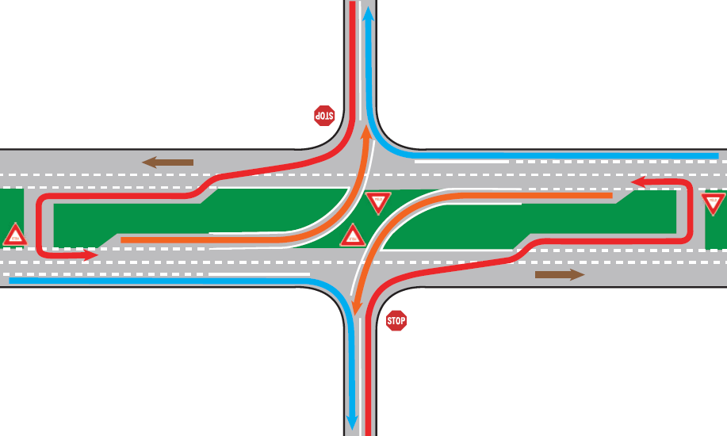
J-Turn – INDOT Preferred Alternative
Left turns and crossing minor roads are made using U-turn movement on major road.
Left turns from major road are made under yield (as current)

Slide 19
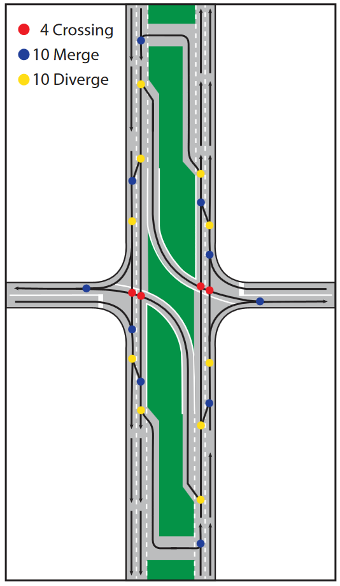
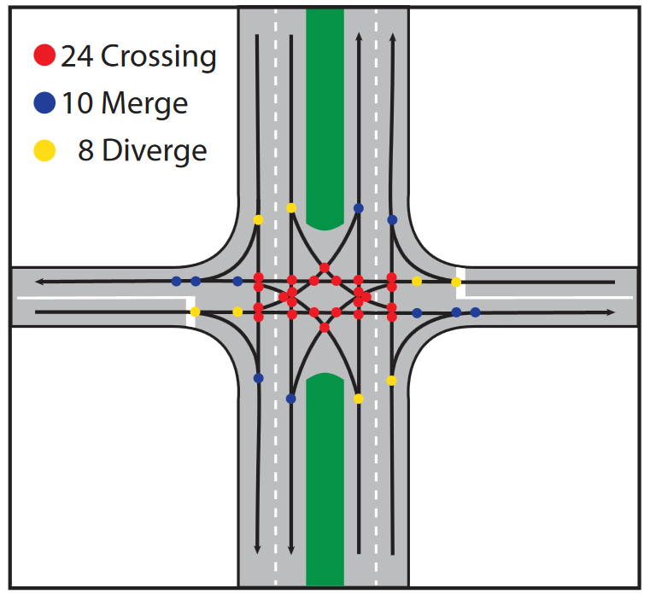
Benefits of J-Turns
Conflict points are dramatically reduced
Conventional
Intersection
J-Turn
Intersection

Slide 20
Benefits of J-Turns
Improved Capacity
Reduced Intersection Delay
Low Cost relative to other improvement alternatives
No additional Right-of-Way necessary
May delay the need for traffic signal or interchange

Slide 21
Traffic Simulation – Example
North

Slide 22
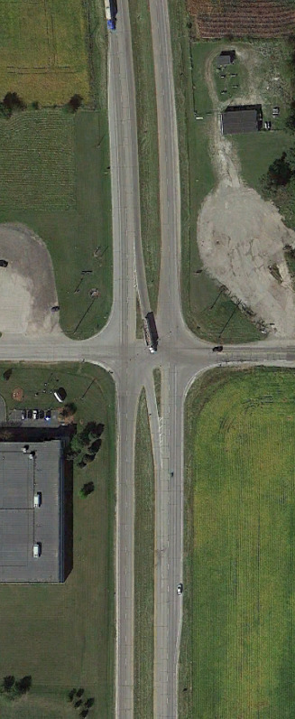
Recent Case Study
US 41 at SR 114, near Morocco, IN
First J-turn intersection in Indiana
Improvement needed to reduce injury accidents
New intersection alignment opened in May, 2015
Zero injury accidents in two years since opening
Before:
After:
US 41
US 41
SR 114
SR 114

Slide 23
Project Schedule
Public Information Meeting: 6/27/17
Public comments requested by 7/17/17
Draft NEPA document complete - Fall 2017
Additional public involvement – offering opportunity to request a public hearing
NEPA Document and Design complete - Fall 2017
Construction: 2018

Slide 24
Submit Public Comments
Submit public comments using the options described in first page of information packet:
Public Comment Form
Via e-mail
INDOT respectfully requests comments be submitted by Monday, July 17, 2017
All comments submitted will be reviewed, evaluated and given full consideration during decision making process.

Slide 25
Next Steps
Public and project stakeholder input
Submit comments via options described on page 1 of information packet
INDOT review and evaluation
All comments are given full consideration during decision-making process
Finalize/approve environmental document, complete project design
Communicate a decision
INDOT will notify project stakeholders of decision
Work through local media, social media outlets; paid legal notice
Make project documents accessible via repositories
Questions? Contact Public Involvement Team

Slide 26
Thank You
Please visit with the design team and INDOT project officials following the presentation and Q&A.
Project Open House
Project maps, displays, real estate acquisition table, INDOT project team and informal Q & A
INDOT LaPorte District page http://www.in.gov/indot/2705.htm
LaPorteDistrictCommunications@indot.in.gov

