Slide 1
U.S. 20 at State Road 2 New Interchange
Indiana Department of Transportation
Wednesday, Aug. 1, 2018
6 p.m.

Slide 2
Welcome
Purpose/explanation of public hearing
Public hearing format
Visit our sign-in table
Informational handouts
Participate during public comment session
Submit written public comments
Project display area

Slide 3
U.S. 20 at SR 2 New Interchange
Introduction of INDOT Project Team
Project Management
Public Involvement
LaPorte District – INDOT Regional Office
Environmental Services
Troyer Group
Engineering, Design & Environmental Analysis Team
Recognition of elected and local public officials
Sign-in at attendance table to be added to project mailing list
Legal notice of public hearing was published in the South Bend Tribune 7/16 & 7/23
A notice of the public hearing was mailed to known property owners within project area
Announcement of this hearing was posted to INDOT website. A media release was also issued
A copy of presentation and project documentation are available for review on-line via INDOT website

Slide 4
Project Stakeholders
Indiana Department of Transportation
Indiana Division Federal Highway Administration
LaPorte County
Elected & local officials
Residents and citizens
Commuters
Businesses
Emergency services
Schools
Churches
Community Organizations

Slide 5
Project Development
Project Selection
Early Coordination
Environmental phase begins
Purpose & Need
Develop alternatives
Preliminary design phase
Release environmental document for public review and comment
HOLD PUBLIC HEARING
Additional work to finalize environmental document and project design
Communicate Project Decision
Real Estate Acquisition
Project Letting
Construction

Slide 6
Environmental Analysis Phase
National Environmental Policy Act (NEPA)
Requires INDOT to analyze and evaluate the impacts of a proposed project to the natural and socio-economic environments
NEPA is a decision-making process
Purpose and Need
Alternatives Screening
Preferred Alternative
Impacts are analyzed, evaluated and described in an environmental document
What are the impacts this project might have on the community?
How can impacts be avoided?
Can impacts be minimized?
Mitigation for impacts?

Slide 7
Environmental Analysis Phase
Notice of Entry for Survey – late 2015
Letters mailed to properties within general area
Describing early project proposal
Project personnel in area, may need to enter properties
Gather data for environmental analysis
Section 106 of National Historic Preservation Act – early 2018
Take into account proposal’s impact to historic & archaeological properties
Consulting Parties Process – early 2018
Groups invited to participate
Public notice issued with 30 day comment period
South Bend Tribune
LaPorte Herald Argus
“No historic properties affected” finding issued by INDOT Cultural Resources Office (CRO) acting on behalf of the Federal Highway Administration (FHWA)
Draft environmental document released for public involvement – July 2018
Available for review via public repositories

Slide 8
Project Resources
INDOT LaPorte District Office
315 E. Boyd Boulevard, LaPorte, IN 46350
LaPorteDistrictCommunications@indot.in.gov
http://www.in.gov/indot/2705.htm
Planning, Project Development/Delivery, Construction, Maintenance for Northwest Indiana
Rolling Prairie Public Library
1 East Michigan Street, Rolling Prairie, IN 46371
Phone: (219) 778-2390
INDOT Office of Public Involvement
100 North Senate Avenue, Room N642, Indianapolis, IN 46204
Phone: (317) 232-6601
rclark@indot.in.gov
Transportation Services Call Center
Provides citizen and business customers with a single point-of-contact to request transportation services, obtain information, or provide feedback through multiple channels of communications.
855-463-6848 • INDOT4U.com • INDOT@indot.in.gov

Slide 9
U.S. 20 at SR 2 – Purpose and Need
Purpose
Increase operational safety at the intersection of U.S. 20 and SR 2
Decrease points of conflict with highest volume of traffic
Deter truck traffic from utilizing U.S. 20 through New Carlisle as a shortcut between the western leg of the intersection and U.S. 31
Maintain and improve operational efficiency
Need
High rate of traffic accidents
The existing intersection struggles to provide an acceptable Level of Service (LOS) and the operational efficiency necessary to adequately meet current and future traffic demand

Slide 10
Crash Data
Crash Data for U.S. 20 at SR 2
YEAR SEVERITY | ‘08 | ‘09 | ‘10 | ‘11 | ‘12 | ‘13 | ‘14 | ‘15 | ‘16 | ‘17 | Total
Crash with no Injury | 14 | 12 | 7 | 7 | 9 | 14 | 10 | 12 | 14 | 17 | 159
Non-Incapacitating Injury | 4 | 4 | 3 | 9 | 10 | 5 | 4 | 3 | 1 | 7 | 67
Incapacitating Injury | 1 | - | 1 | 1 | - | 1 | 1 | 2 | - | 3 | 10
Fatal | - | - | 1 | - | - | - | - | - | 1 | - | 2
Total | 19 | 16 | 12 | 17 | 19 | 20 | 15 | 17 | 16 | 27 | 238

Slide 11
Alternatives Considered
No Build
Baseline for comparison for build alternatives
Does not meet purpose and need, does not enhance safety at intersection
Tight Diamond Interchange
Stop controlled intersections with a bridge carrying the north-south leg over the east-west leg
May require additional right-of-way
Does not decrease the number of conflict points to greatest degree
Does not increase traffic efficiency to the greatest degree
Dog-bone interchange with a 3-sided structure
East-west roadway would pass over the north-south roadway by means of a three-sided structure (i.e. tunnel).
Results in more expensive structure, both up-front and long-term (tunnel vs. bridge)
No right-of-way acquisition necessary

Slide 12
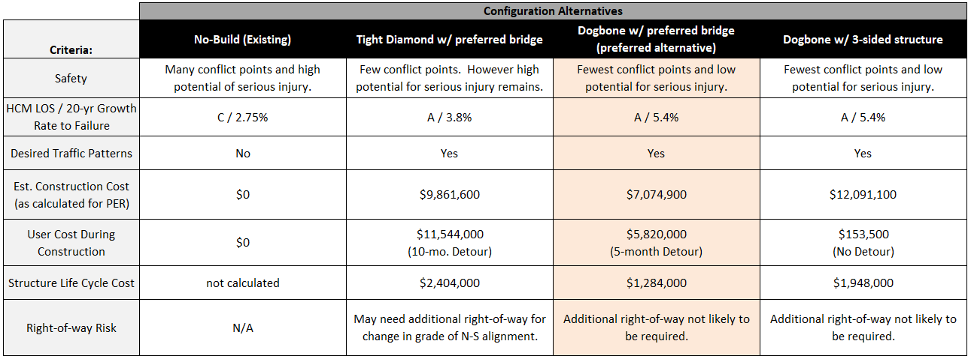
Alternatives Considered

Slide 13
Alternatives Analysis – Traffic Capacity

Slide 14
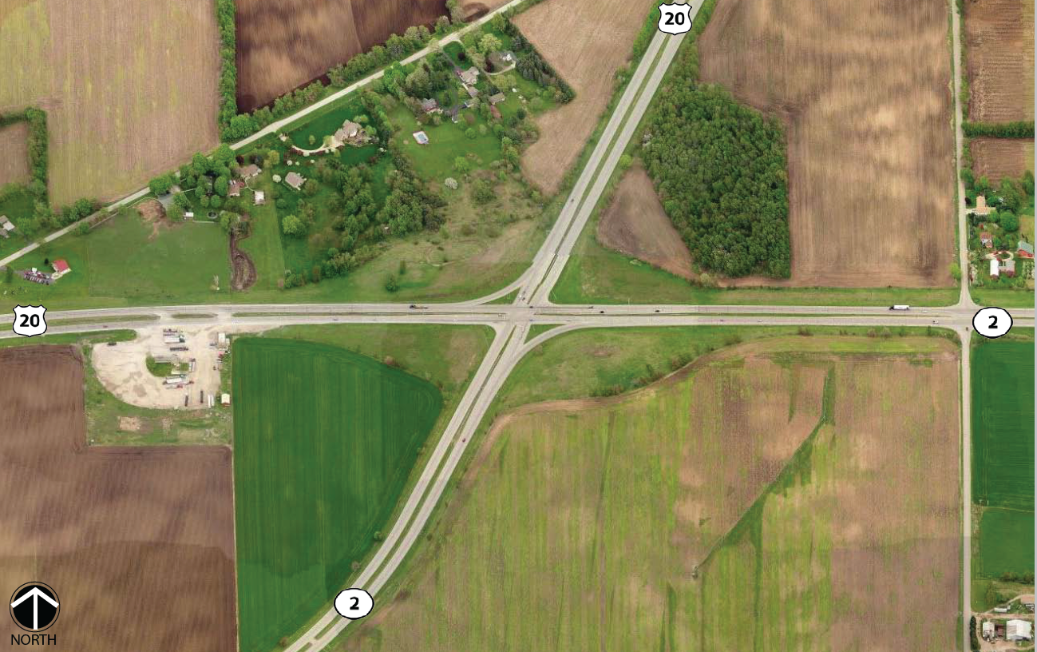
Existing Intersection

Slide 15
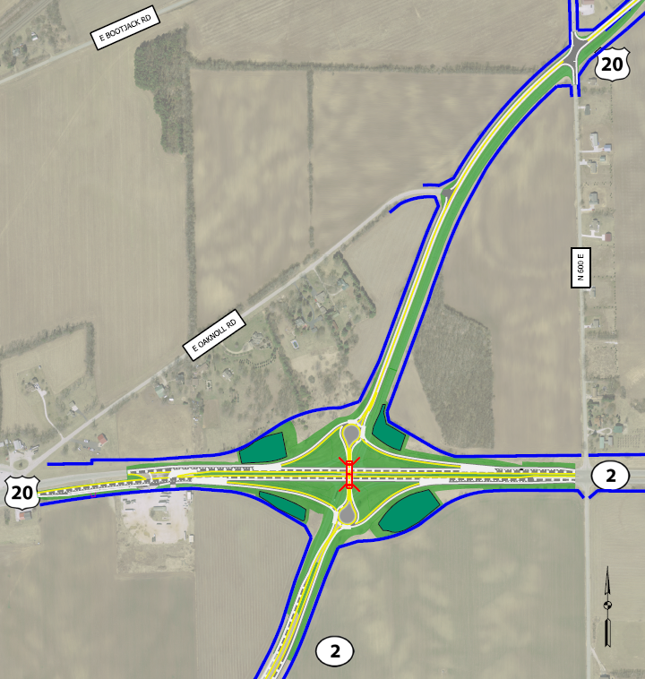
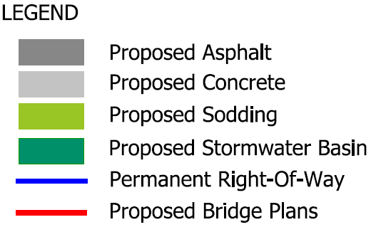
Preferred Alternative – Overall Plan

Slide 16
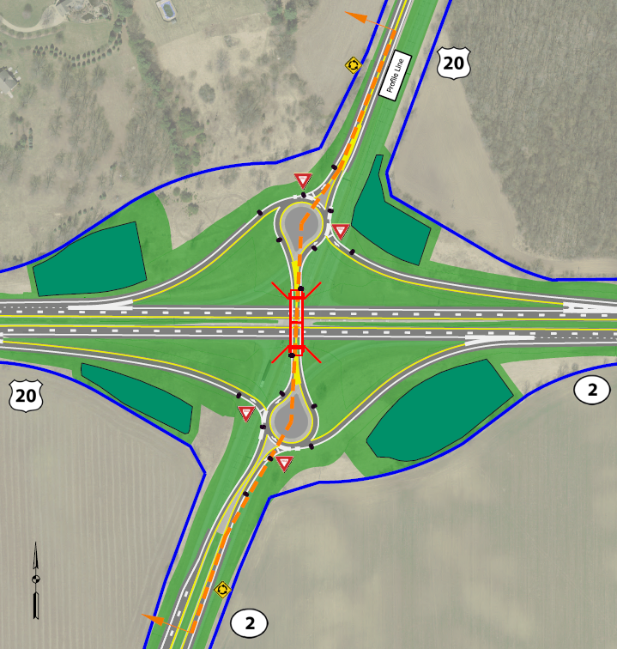
Preferred Alternative – Enlarge Plan and Profile

Slide 17
Truck Turning Movements
WB ‒ 67

Slide 18
Truck Turning Movements
19-axle Heavy Haul

Slide 19
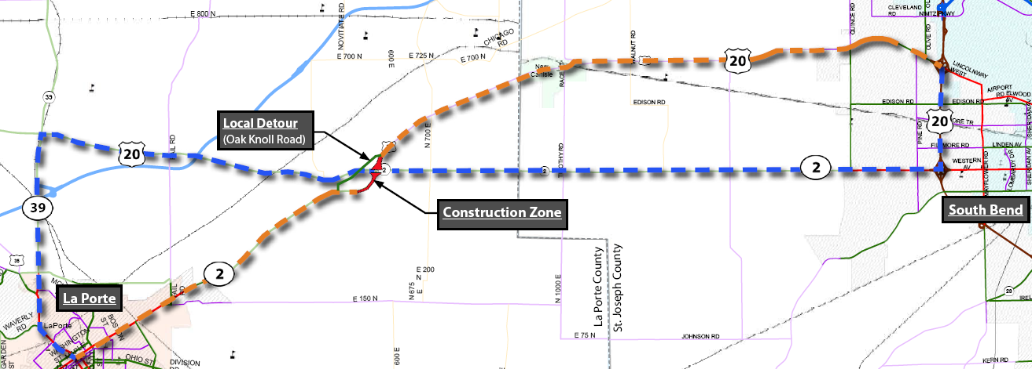
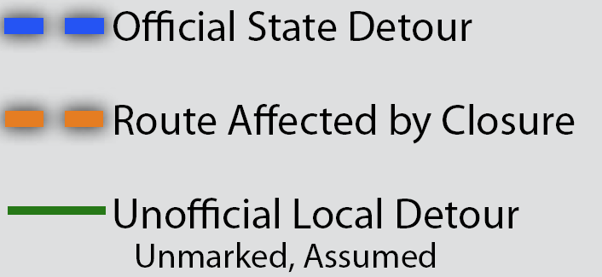
Maintenance of Traffic
State Detour Route

Slide 20
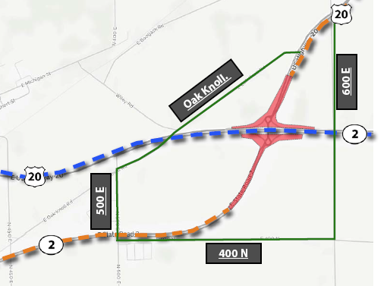
Maintenance of Traffic
Local Detour Routes

Slide 21
Project Schedule
PUBLIC HEARING
Public comment period
Prepare Public Hearing Transcript
AUGUST 2018
Review public comments
Continue work on preliminary design and environmental document
FALL 2018
Finalize environmental document
Communicate Project Decision
FALL 2018
Complete design
LATE 2018
Project Letting
Construction
2019

Slide 22
Submit Public Comments
Submit public comments using the options described in first page of information packet:
Public Comment Form
Via e-mail
Participate during public comment session following formal presentation
INDOT respectfully requests that comments be submitted by Friday, Aug. 17, 2018
All comments submitted will become included in an official public hearings transcript and made part of the public record
Comments will be reviewed, evaluated and given full consideration during decision-making process

Slide 23
Next Steps
Public and project stakeholder input
Submit comments via options described on page 1 of information packet
INDOT review and evaluation
All comments given full consideration during decision-making process
Finalize/approve environmental document, complete project design
Communicate a decision
INDOT will notify project stakeholders of decision
Work through local media, social media outlets, paid legal notice
Make project documents accessible via repositories
Questions? Contact Public Involvement Team

Slide 24
Thank You
Please visit with the design team and INDOT project officials following the presentation and Q & A.
Project Open House
Project maps, displays, INDOT project team and informal Q & A
INDOT LaPorte District page: http://www.in.gov/indot/2705.htm
LaPorteDistrictCommunications@indot.in.gov

Slide 25
Project Resources
INDOT LaPorte District Office
315 E. Boyd Boulevard, LaPorte, IN 46350
LaPorteDistrictCommunications@indot.in.gov
http://www.in.gov/indot/2705.htm
Planning, Project Development/Delivery, Construction, Maintenance for Northwest Indiana
Rolling Prairie Public Library
1 East Michigan Street, Rolling Prairie, IN 46371
Phone: (219) 778-2390
INDOT Office of Public Involvement
100 North Senate Avenue, Room N642, Indianapolis, IN 46204
Phone: (317) 232-6601
rclark@indot.in.gov
Transportation Services Call Center
Provides citizen and business customers with a single point-of-contact to request transportation services, obtain information, or provide feedback through multiple channels of communications.
855-463-6848 • INDOT4U.com • INDOT@indot.in.gov

