Slide 1
ADA Self-Inventory Execercise
In the room we will again break into 8 groups.
Online you would need to download the sample ADA Inventory to Participate
This activity will take place for an hour

Slide 2
Setting the Stage:
Focus on prioritization NOT what technical knowledge you do or don’t have. The information from the ADA presentation may be used to guide you.
You are a new ADA coordinator & team (go you!)
You recognize there is a lot of information you don’t have, but your predecessor had started collecting information about pedestrian facilities along your new transit route. This will be the starting point of your inventory.

Slide 3
First things first:
In your groups review the locations provided in your sample inventory.
Each page has a photo and some information on the back.
Disclaimer: it’s all made up for training purposes!

Slide 4
In the beginning:
There may be barriers! (There may NOT be barriers)
Identify the intersections / facilities in your sample inventory that may have barriers. 10 minutes
The next set of slides may help you find barriers
Use the knowledge you DO have, make observations.

Slide 5
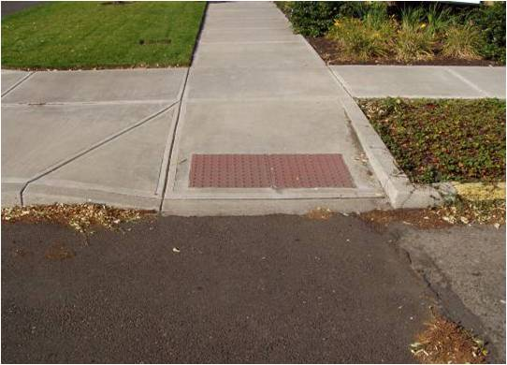
Curb Ramp Design
Perpendicular curb ramp
PROWAG R304.2 and R304.5
Notes:
You will have to have some basic knowledge about ramp types also. This is the most common ramp type.

Slide 6
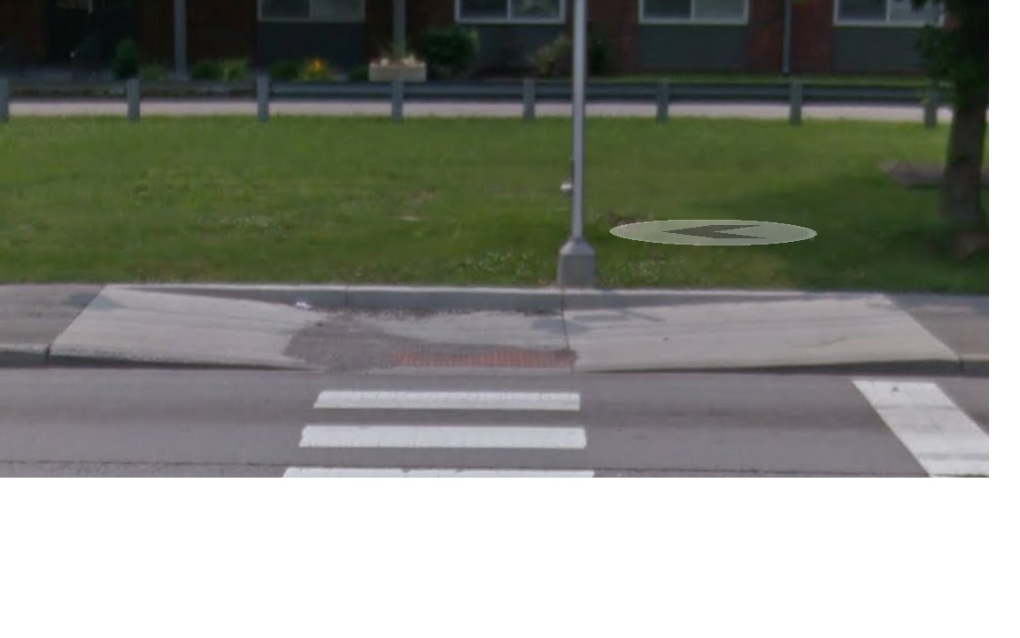
Curb Ramp Design
Parallel curb ramp
PROWAG R304.3 and R304.5
Notes:
A parallel curb ramps is part of the direction of travel along the sidewalk. These do tend to collect water and debris since their turn space is level with the street and runs alongside curb drainage routes. These are not as preferred as parallel ramps.

Slide 7
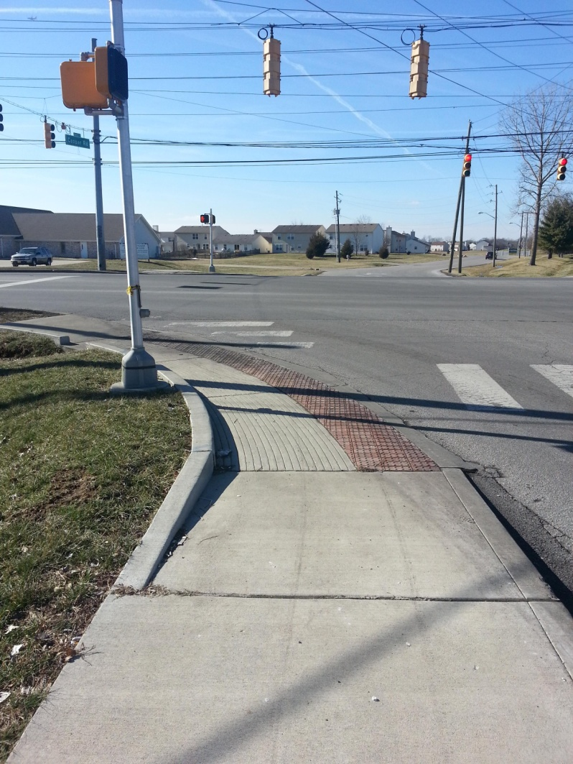
Curb Ramp Design
Blended transition curb ramp
PROWAG R304.4 and R304.5
Notes:
A blended transition may be a ramp spanning the entire curb ramp. It may have sidewalk above ore the entire width of the pedestrian access route (PAR) may be part of the ramp. These ramps cannot have as steep of a slope since someone may have to travel around the corner leaning toward traffic.

Slide 8
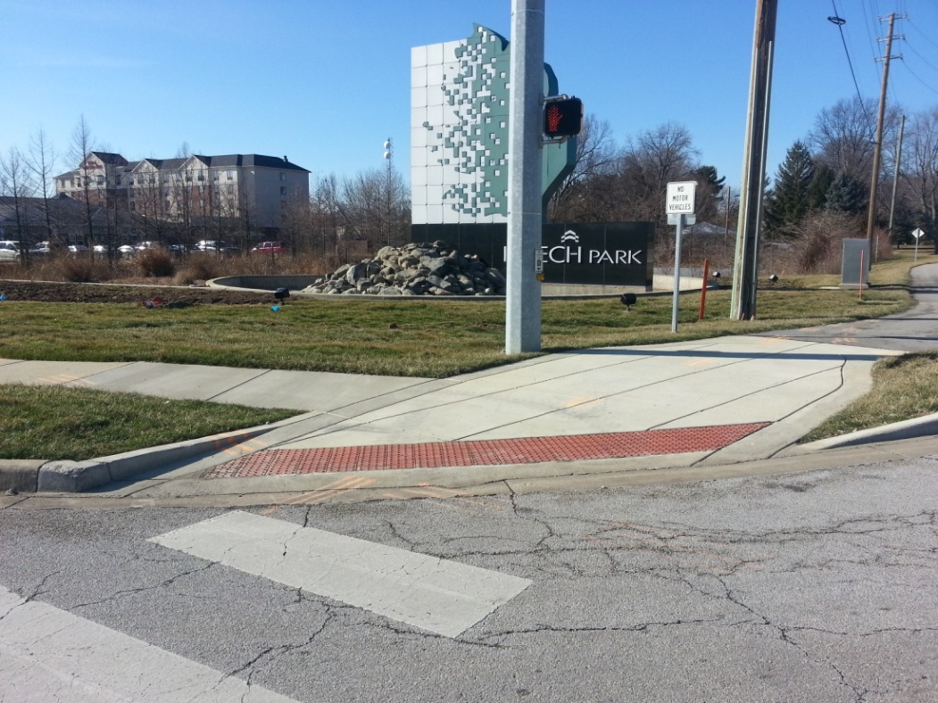
Curb Ramp Design
Depressed corner curb ramp
Same as Parallel Curb Ramp
Notes:
A depressed corner is most often used in a retrofit scenario and is another way one ramp may serve both directions of travel, but it is a little more challenging to maneuver than a blended transition.

Slide 9
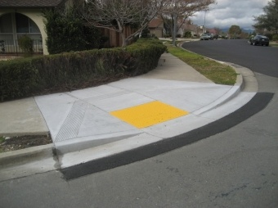
Curb Ramp Design
Diagonal curb ramp
Prohibited in New Construction
Same as Perpendicular Curb Ramp
Notes:
These are the least preferable ramp types because they force a pedestrian to turn and navigate while in the street and exposed to traffic. They are very challenging for people with low vision and are not permitted in new construction.

Slide 10
Curb Ramp Priority
Perpendicular curb ramp – BEST (8.33%)
Parallel curb ramp (8.33%)
Blended transition curb ramp (5% or 2%)
Depressed corner, and (5%)
Diagonal curb ramp (Prohibited for New Construction) (8.33%)
Consider maintenance: will the ramp get driven over? What is the effect on drainage? Safety?
Notes:
Here is the order of priority for ramps to be constructed. These should be considered for pedestrian projects you will complete as part of your barrier removal.

Slide 11
Curb Ramps: “201”
Ramp and Turning
Space Width (4 ft)
Turning Space
Turning Space Length (4ft)
Grade Break
Turning Space
Cross Slope (2%)
Return Curb
Turning Space
Running Slope (2%)
Grade Break
Ramp
Counter Slope
Ramp
Cross Slope (2%)
Flared Side
Ramp
Running Slope (8.33% or 5%)
Clear Space
Clear Space Width (4 ft)
Flare Slope
Detectable Warning Surface
Notes:
Each ramps has many components that need to be measured. All of this data is collected as part of your self-inventory to help you determine how complaint a particular ramp is. This in turn sets the foundation for prioritizing your barrier removal.

Slide 12
Crosswalks
Whether crosswalks are present at any or all crossings
If present, the width, type, if there are islands
Notes:
You will need to include information about crosswalks in your self evaluation.

Slide 13
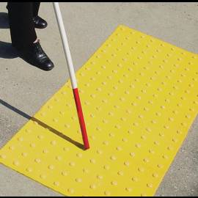
Detectable Warnings
Detectable Warnings are designed to be felt underfoot or with a cane by people who are blind or have low vision, to alert them to hazards – should extend whole width of the ramp and be part of a flush transition.
Notes:
You will also need to collect information aobut detectable warnings, where they exist and whether or not they meet compliance standards.

Slide 14
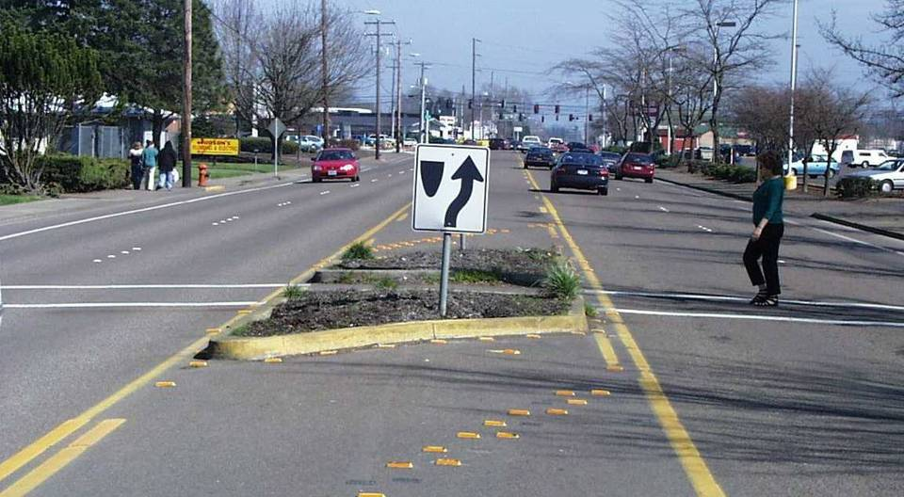
Islands/Medians
Notes:
Islands should be considered where they obstruct or are intergral to a pedestrian route. They may even have their own ramps.

Slide 15
Islands –Are there islands IN the pedestrian path (even if they block it)
Pedestrian Signals
Whether visual and accessible pedestrian signals are present and if they are APS (Accessible Pedestrian Signals)
Notes:
Finally, pedestrian signals should be in compliance and measurements taken to determine whether or not they are accessible. You may also want to consider collecting data about location where pedestrian signals do not currently exist but should be considered for safety or accessibility reasons.

Slide 16
Pushbuttons
Is the tactile arrow in line with the crosswalk direction?
Is the pedestrian push button at least 2 inches in diameter?
Is the push button unobstructed?
42” target (“shall” U.S. access board)
www.Apsguide.org
https://www.access-board.gov/guidelines-and-standards/streets-sidewalks/public-rights-of-way/background/access-advisory-committee-final-report/x02-5-pedestrian-street-crossings
Notes:
The pushbutton is the feature of a pedestrian signal that received the most complaints.

Slide 17
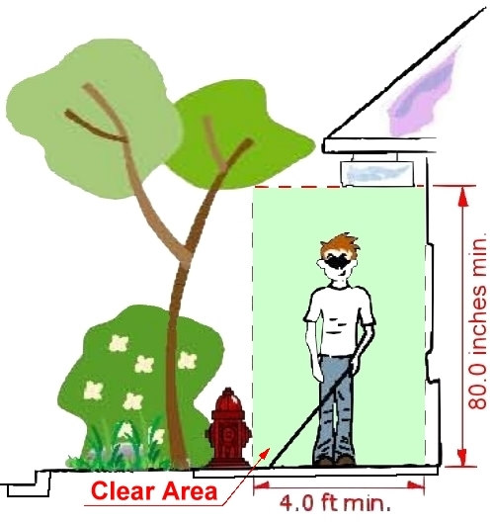
Pedestrian Access Route (PAR)
Pedestrian Access Route (PAR)
Width is measured from the back of the curb or buffer to the outside edge of the sidewalk
Notes:
Everything with the Pedestrian Route, or PAR should be evaluated.
The Pedestrian circulation path (sidewalk) width is measured from
the back of the curb or buffer to the outside edge of the sidewalk.
It Should be free of obstacles and protruding objects

Slide 18
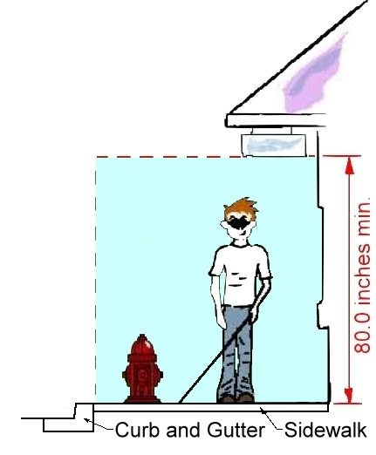
Protruding objects
Protruding Objects
Objects above 27 inches and below 80 inches are not detectable
Notes:
Protruding objects within sidewalks and other pedestrian circulation paths must not reduce the 4 ft clear width required for the PAR
Protrusion limits (4 inch max horizontal protrusion for objects between 27 to 80 inches high)
Single post-mounted objects (4 inch max protrusion allowed beyond the post for objects between 27 and 80 inches above the ground surface)
Double post-mounted objects with a clear distance between the posts greater than 12 inches (the lowest edge of the object shall be between 27 and 80 inches above the ground surface)
Examples (mounted and free-standing)
Signs/guy wires/utility poles
Trees/limbs/bushes
Phone booths/water fountains/utility cabinets
Lighting
Fire hydrants
Mailboxes
Stairs or steps
Permanent and temporary street furnishings (sign boards, seating, planters, etc.)
Parked vehicle overhangs

Slide 19
Where to start inventory / updates?
Recent projects
High pedestrian traffic areas
Areas near facilities frequently used by pedestrians
Notes:
You get to decide where to sart taking your inventory, but you may want to prioritize these locations. Many communities begin ADA work before they have completed their inventory.

Slide 20
Prioritize:
Your town wants to pick one pilot project to start on right away…. Which location would you fix and why? 5 min.
If you knew you could fix three locations per year, how would you build a prioritization schedule for the remaining locations? 20 minutes.
What criteria would you use to prioritize?
How would you engage the public?
What role does location play? Cost? (we will discuss here)
Go ahead and group the inventory using these factors, leave out those assets that don’t have any issues…

Slide 21
Wrap up:
What was challenging?
What did you want to know that you didn’t know?
Was there anything that was easier than you expected?
How was it helpful to have a group? (how can we be a group of peers in our community, across the state, etc.)
Thoughts?
Questions?

