Slide 1
Intersection Improvement Project SR 37 at Strawtown Avenue
Hamilton North Public Library
Tuesday, Aug. 23, 2016

Slide 2
Welcome
Rickie Clark, INDOT Office of Public Involvement
Purpose/explanation of public hearing
Intersection improvement, SR 37 at Strawtown Avenue, 6 miles north of SR 32/SR 38, Hamilton Co
Public hearing format
Visit our sign-in table
Informational handouts
Submitting public comments for hearings transcript
Project display area

Slide 3
Welcome
Introduction of INDOT Project Team
Project Management
Public Involvement
Greenfield District – INDOT Regional Office
Environmental Services
Real Estate
CrossRoad Engineers
Design Team
Recognition of elected & local public officials

Slide 4
Public Hearing
Sign-in at attendance table to be added to project mailing list
A public hearing notice was mailed to known property owners within project area
Announcement of this hearing was posted to INDOT website. A media release was also issued.
A copy of presentation and project documentation is available on-line via INDOT website
Legal notice publishing:
The Times (Noblesville)
Thursday, Aug. 4 & Thursday, Aug. 11

Slide 5
Project Stakeholders
Indiana Department of Transportation
Indiana Division, Federal Highway Administration
Hamilton County
Elected & local officials
Community residents & citizens
Commuters
Businesses
Emergency services
Schools

Slide 6
Project Development Process
Project Selection
Early Coordination
Environmental phase begins
Purpose & Need
Develop alternatives
Preliminary design phase
Release environmental document for public review and comment
Additional work to finalize environmental document and project design
Real Estate Acquisition
Construction
Public Hearing
Notes:
6

Slide 7
Environmental Document
Requirement of the National Environmental Policy Act (NEPA)
Requires INDOT to analyze and evaluate the impacts of a proposed project to the natural and socio-economic environments
Impacts are described in environmental document
Environmental document released for public involvement
June 2016
Is available for review via public repositories

Slide 8
Environmental Document
Environmental Process
Establish Purpose & Need
Develop a number of possible alternatives
The “Do Nothing” alternative is a baseline for comparison
Evaluate and screen alternatives
Identify a preferred alternative
Solicit public comment on environmental document and preliminary design plan
Solicit, address and fully consider public comment as a part of decision-making process
Finalize and approve environmental document

Slide 9
A number of items are evaluated
Environmental Documentation
Right-of-way
Streams, wetlands, and other waters
Floodplains
Endangered species
Farmland
Cultural resources (Historic/archaeological)
Parks and recreational lands (Trails)
Air quality
Noise
Community impacts
Environmental justice
Hazardous materials
Permits
Mitigation
Public involvement
Commercial development

Slide 10
Environmental Documentation
INDOT Greenfield District Office
Planning & Programming Department
32 South Broadway
Greenfield, IN 46140
(855) 463-6848; eastcentralin@indot.in.gov
INDOT Office of Public Involvement, IGCN Room N642
100 North Senate Avenue
Indianapolis, IN 46204
(317) 232-6601; rclark@indot.in.gov
Hamilton East Public Library
1 Library Plaza
Noblesville, Indiana 46060
(317) 773-1384

Slide 11
Project Overview
Safety Project
Intersection Improvement
Purpose and Need:
To improve safety at the intersection by improving sight distance and reducing speed at the intersection
Accident data suggest significant number of right angle collisions due to Strawtown Avenue traffic crossing or turning onto SR 37
Speed limit was lowered from 55 mph to 40 mph in 2014; however high speeds continue at this intersection

Slide 12
Alternatives Considered
No Build
Would not improve safety at intersection
New four-way traffic signal
Is a feasible alternative
Does not improve the sight distance at intersection
Allows for high speeds & possibility of right angle crashes
Impacts traffic flow on SR 37
Roundabout
Meets purpose & need of project
Enhances safety at intersection
Reduces speeds at intersection while contributing towards efficient traffic flow
Reduces severity of vehicular collisions
Addresses sight distance

Slide 13
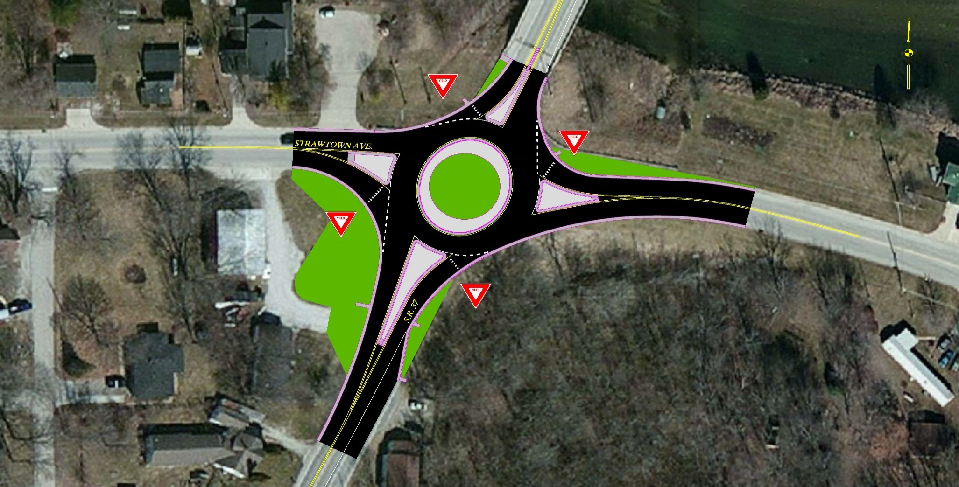
Roundabout Alternative
INDOT Preferred Alternative

Slide 14
What is a Roundabout?
One-way circular intersection
Traffic flows counter-clockwise around a center island
Yield at entrance
No parking
No “activity” in center island

Slide 15
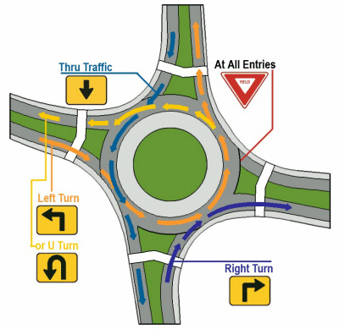
What is a Roundabout?

Slide 16
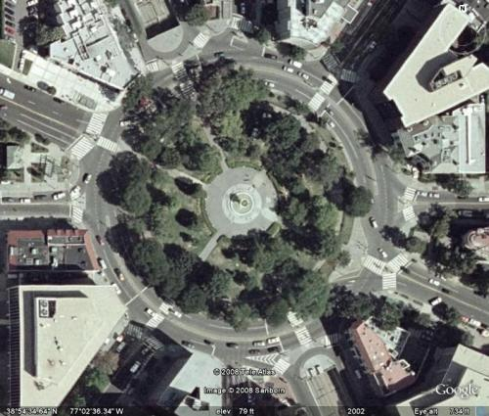
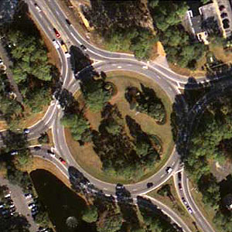
What is NOT a Roundabout?
Traffic circle
Stop control or signalized
D Circle, Washington, D.C.
Monument Circle – Indianapolis
Rotary
Common in New England states
Entering traffic has right-of-way

Slide 17
Roundabouts
U.S. DOT Federal Highway Administration Statistics
Traditional intersections account for:
45% of all crashes – FHWA
33% of all traffic fatalities – FHWA
Compared to traditional intersections roundabouts:
Reduce fatalities and injuries by 82% – FHWA
Reduce total crashes by 44% – FHWA
Require vehicles to travel at lower speeds
For more information: http://safety.fhwa.dot.gov/intersection/innovative/roundabouts/

Slide 18
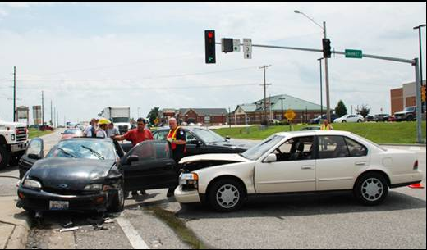
Roundabouts Enhance Safety
Collisions at traditional intersections are severe because:
High speed
Angle of impact

Slide 19
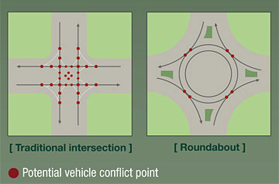
Roundabouts Enhance Safety
Conflict points are dramatically reduced because all vehicles travel in the same direction.

Slide 20
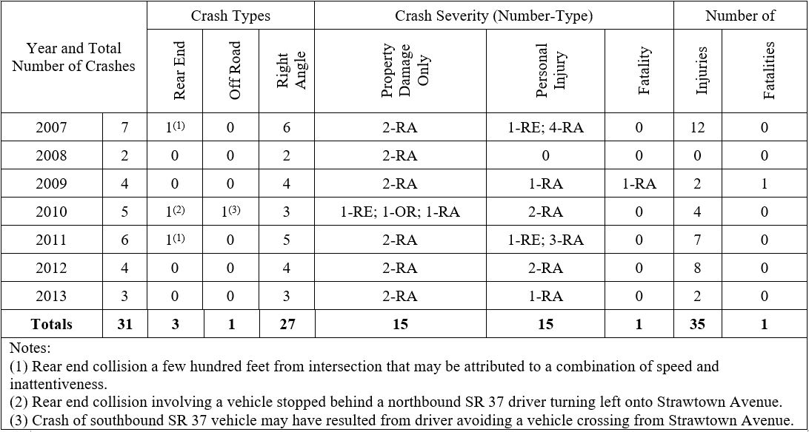
Intersection Accident History

Slide 21
Traffic Patterns – PM Peak

Slide 22
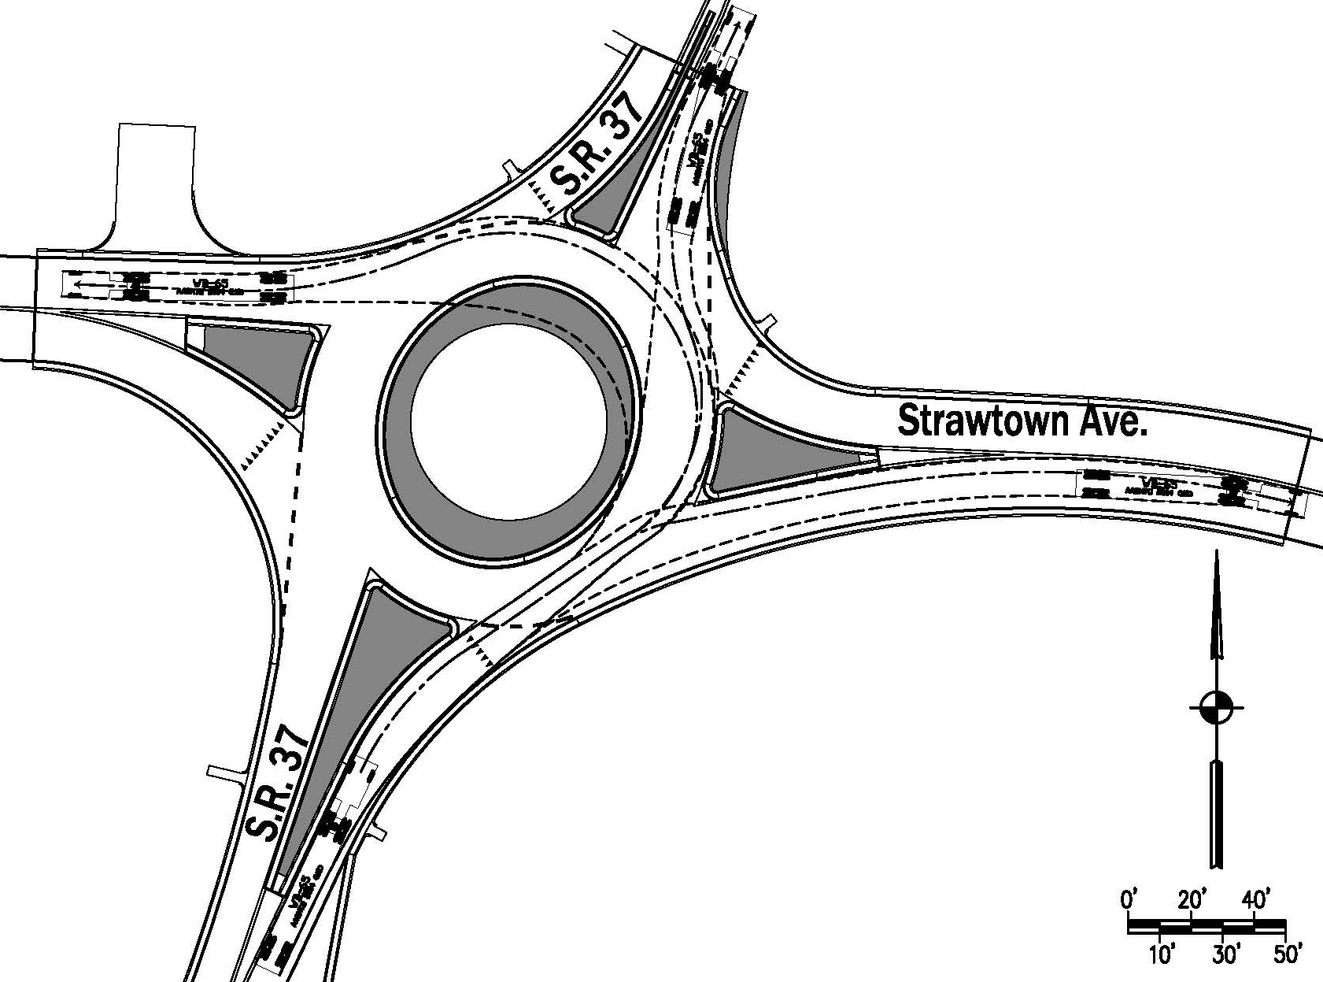
Truck Turning Movements – NB

Slide 23
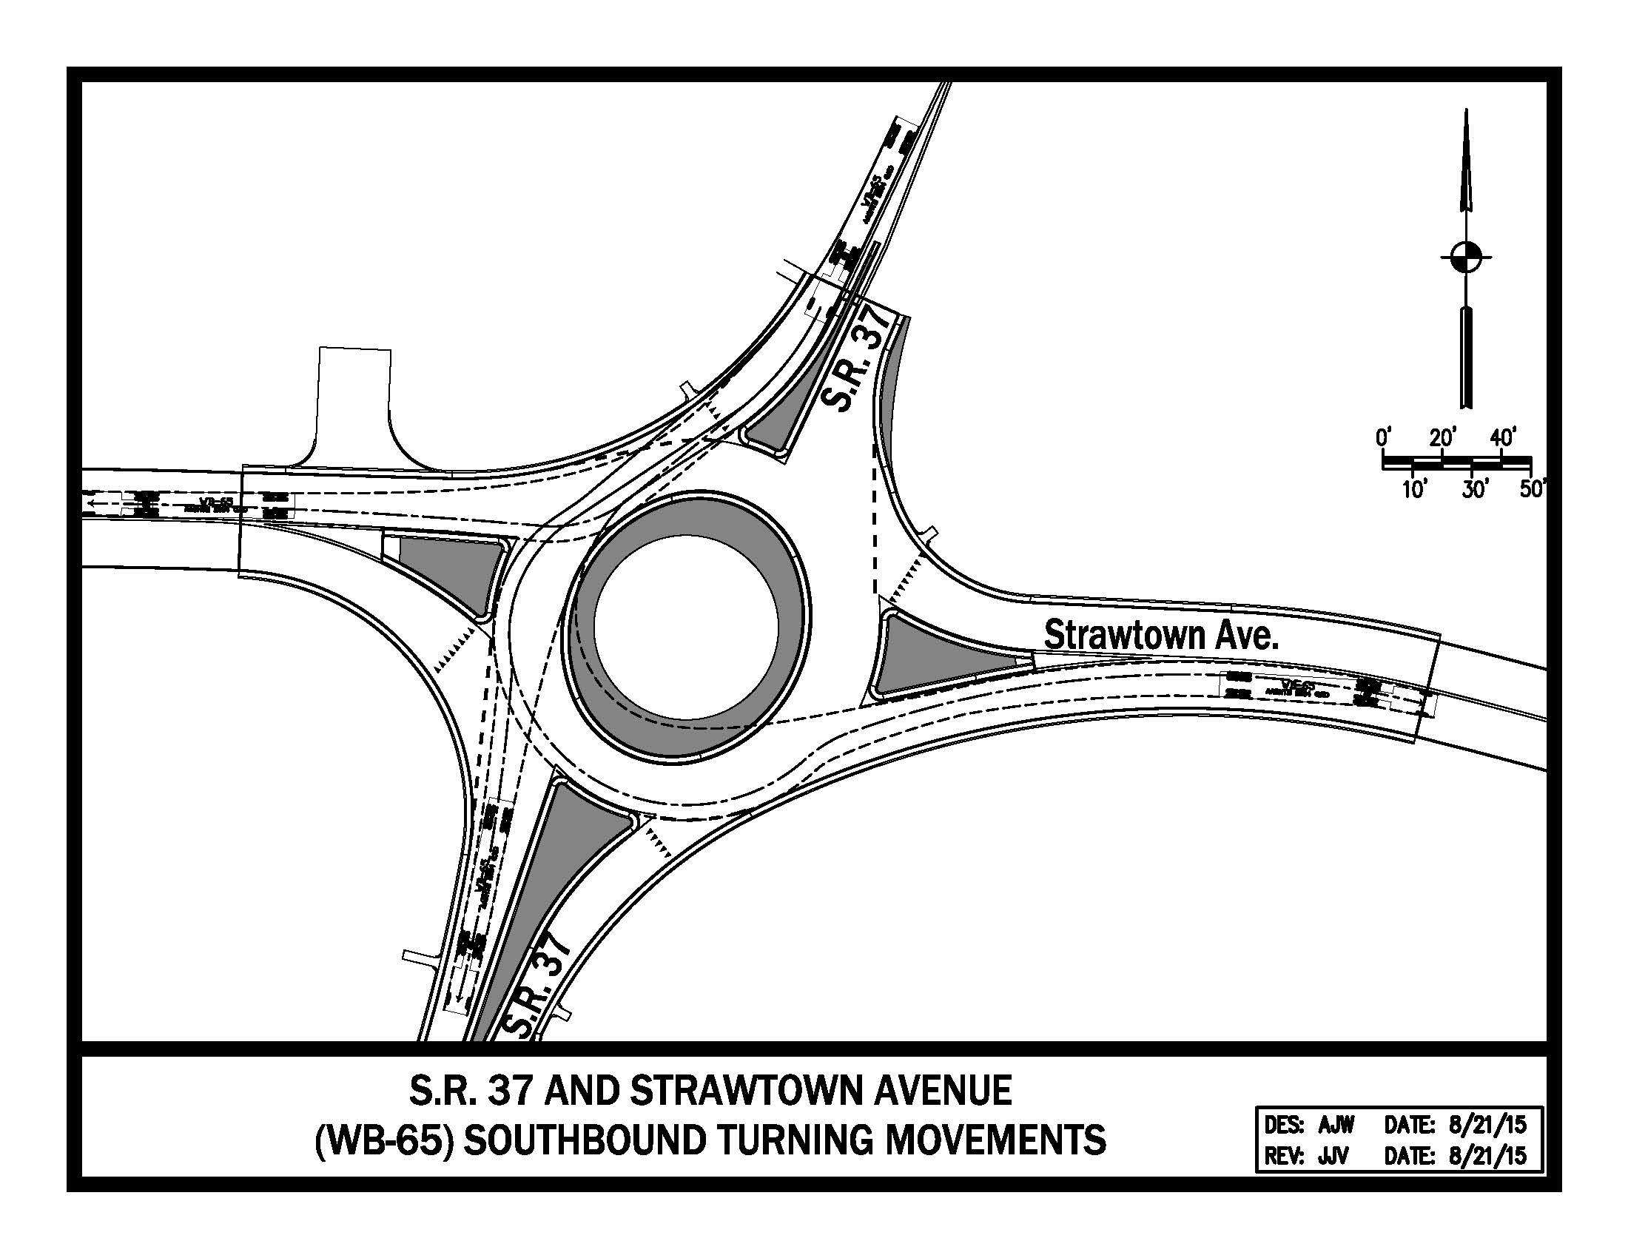
Truck Turning Movements – SB

Slide 24
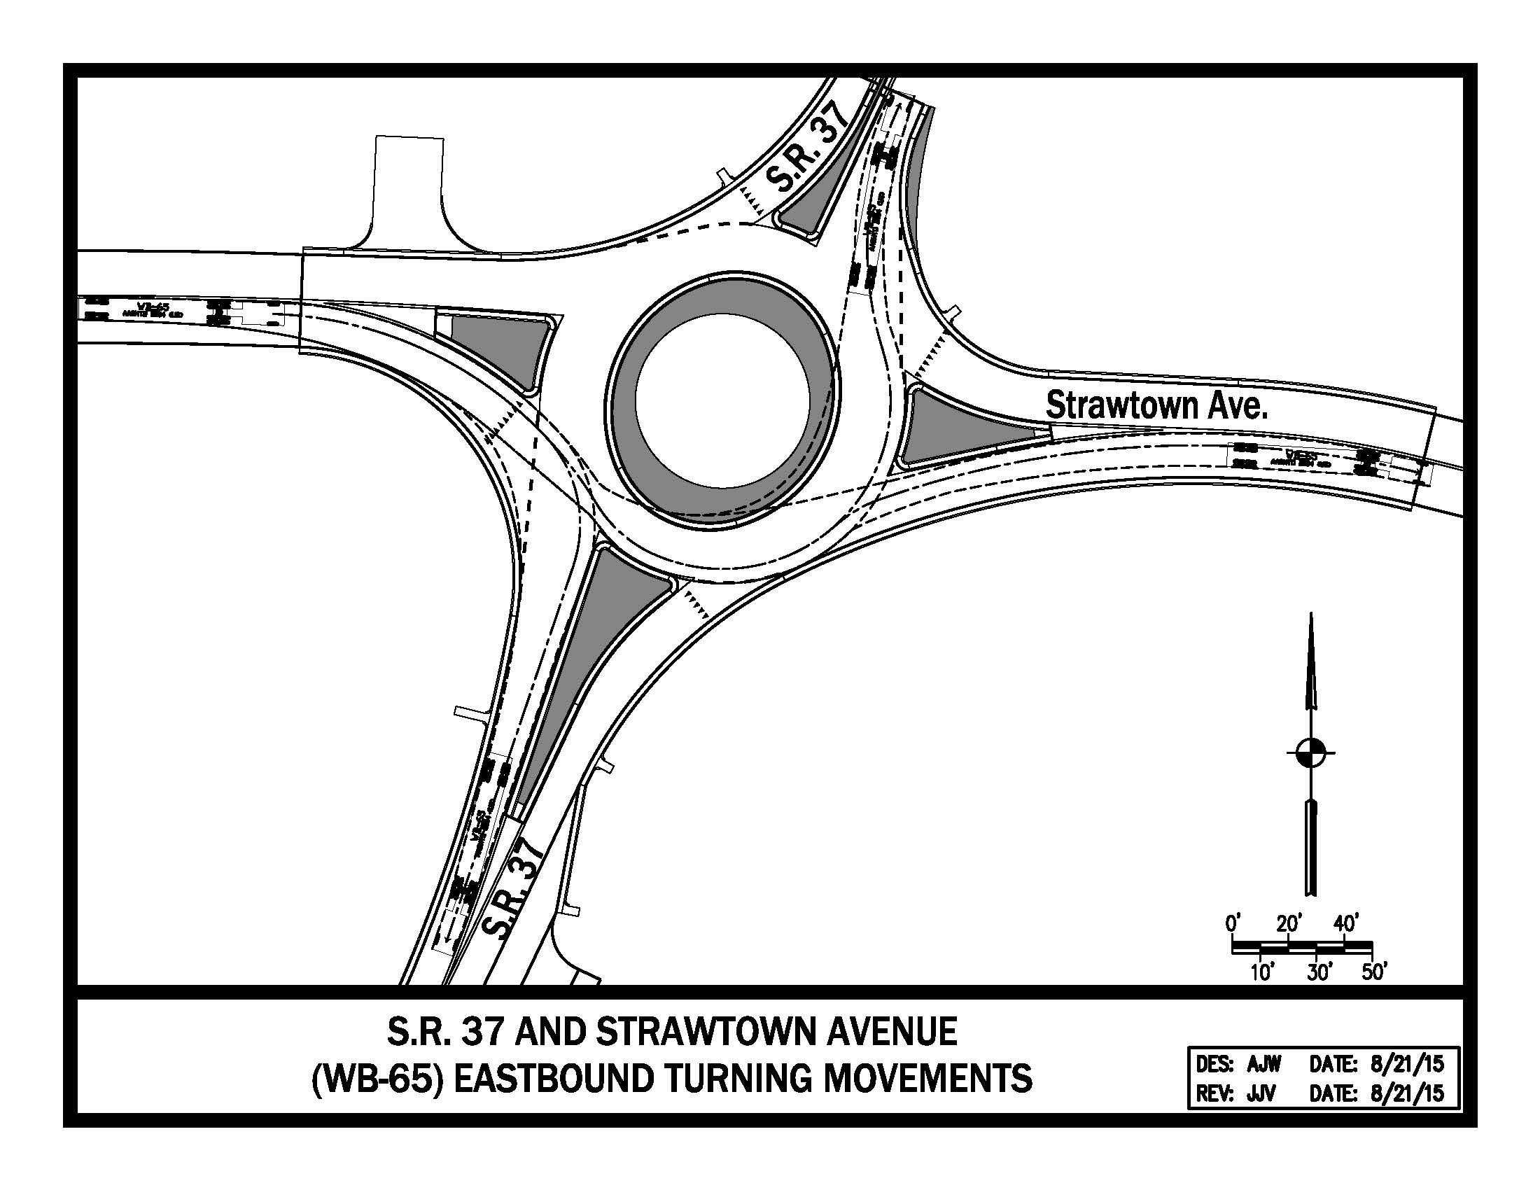
Truck Turning Movements – EB

Slide 25
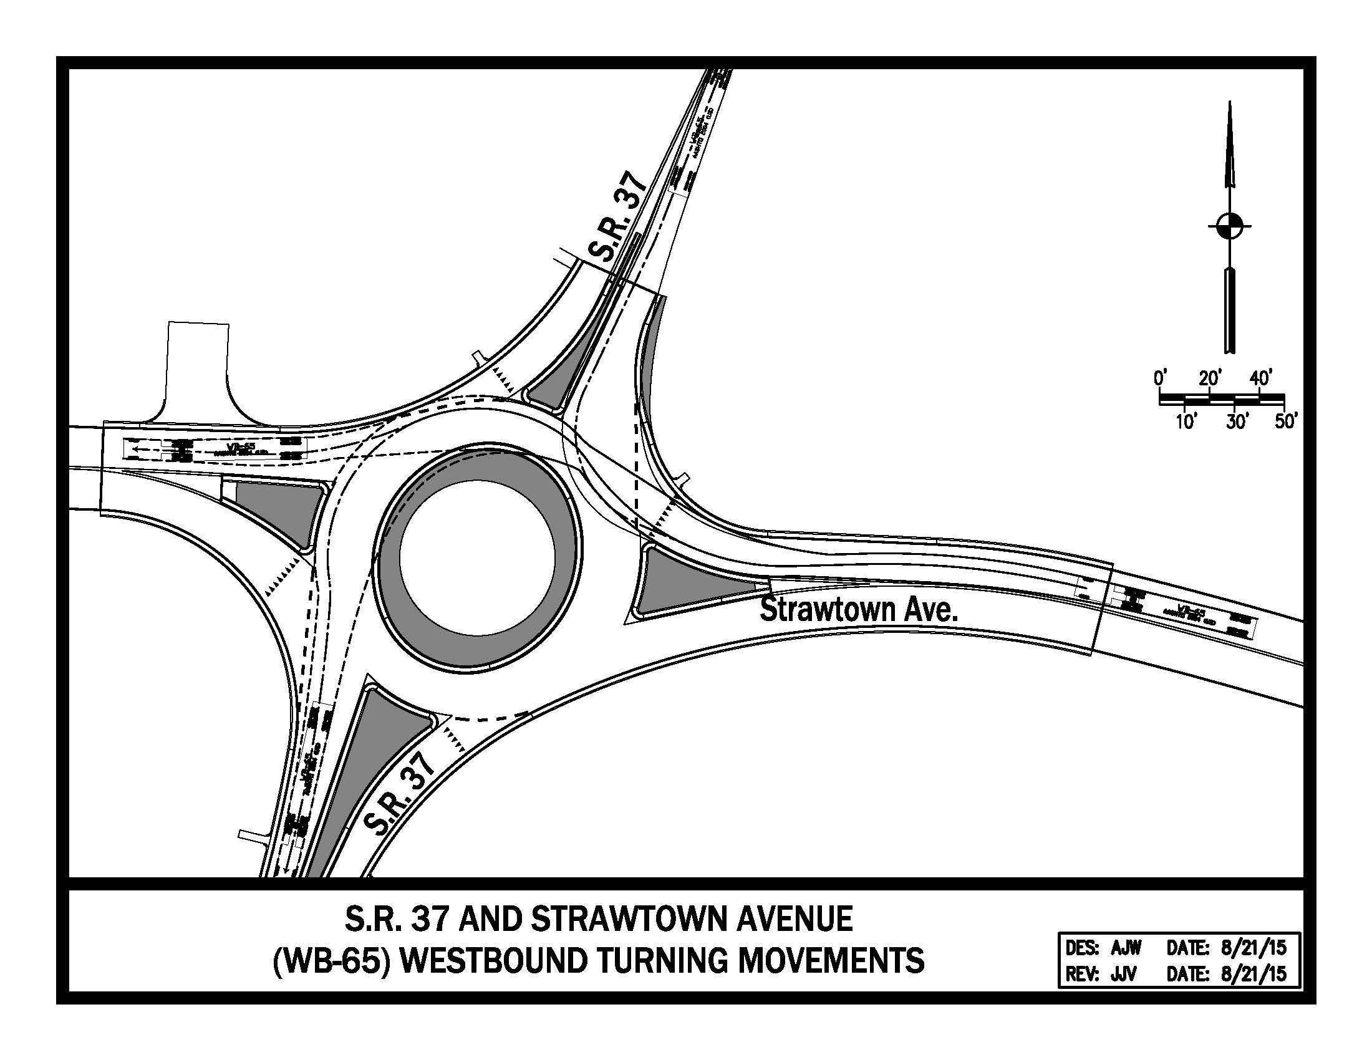
Truck Turning Movements – WB

Slide 26
Construction Phasing – I

Slide 27
Construction Phasing – II

Slide 28
Strawtown Avenue Detour Route

Slide 29
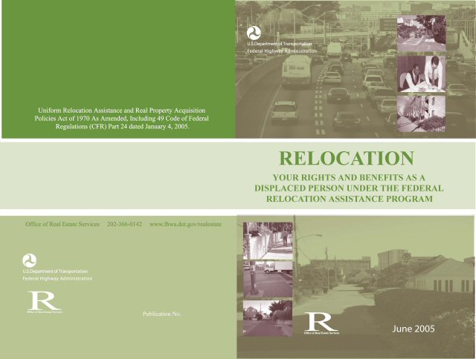
Real Estate Acquisition Process

Slide 30
Real Estate Acquisition Process
"Uniform Act of 1970"
All federal, state and local governments must comply
Requires an offer for just compensation
Acquisition Process
Appraisals
Review appraisals
Negotiations
INDOT Real Estate Team to work with impacted property owners

Slide 31
Real Estate Impact
Right-of-way
Permanent R/W: 0.06 acre
Residential
Temporary R/W: 0.2 acre
Residential
Project proposes removal of building in southwest quadrant of intersection
Proposed residential relocation

Slide 32
Project Schedule
Public Hearing: 8/23/16
Public comments requested by COB 9/9/16
INDOT review and consideration of comments; finalize environmental document and design; reach project decision – Fall 2016
Real estate acquisition phase: 2017
Construction: 2018

Slide 33
Feedback
INDOT would like to hear from you
Talk with INDOT project team members
Comment sheet in information packet
E-mail or mail comments to INDOT
Sign-in list to be added to project mailing list
Visit INDOT Greenfield District page at http://www.in.gov/indot/2704.htm and project webpage at http://www.in.gov/indot/3573.htm
All comments are very much appreciated and will be given full consideration by the project team

Slide 34
Submit Public Comments
Submit public comments using the options described in first page of information packet:
Public Comment Form
Via e-mail
Participating during public comment session via microphone
Verbal comments recorded and transcribed for inclusion into public hearings transcript
INDOT respectfully requests comments be submitted by Friday, Sept. 9, 2016.
All comments submitted will become part of public record, entered into transcript, reviewed, evaluated and given full consideration during decision making process.

Slide 35
Next Steps
Public and project stakeholder input
Submit comments via options described on page 1 of information packet
INDOT review and evaluation
All comments are given full consideration during decision-making process
Address comments, finalize/approve environmental document, complete project design
Communicate a decision
INDOT will notify project stakeholders of decision
Work through local media, social media outlets, paid legal notice
Make project documents accessible via repositories
Questions? Contact Public Involvement Team

Slide 36
Public Involvement Team
Rickie Clark
INDOT Office of Public Involvement
(317) 232-6601
rclark@indot.in.gov
Chris Myers Communications Director
INDOT Greenfield District Office (855) 463-6848
eastcentralin@indot.in.gov

Slide 37
Thank You
Please visit with INDOT project officials following the public comment session
Project Open House
Project maps, displays, real estate acquisition table, INDOT project team, and informal Q & A
INDOT Greenfield District page http://www.in.gov/indot/2704.htm
Project webpage http://www.in.gov/indot/3573.htm

Slide 38
Public Comment Session

