Slide 1
State Road 26 Intersection Project at C.R. 100 West (Park Road) Howard County
Indiana Department of Transportation
Thursday, Feb. 13, 2020
6 p.m.

Slide 2
Welcome
Purpose/explanation of public hearing
Public hearing format
Visit our sign-in table
Informational handouts
Participate during public comment session
Submit written public comments
Project display area

Slide 3
S.R. 26 Intersection Improvement
Introduction of INDOT Project Team
Greenfield District Office
Project Management
Design
Environmental Services
Real Estate
Communications
Lawson Fisher & Associates
Engineering and Design Team
Recognition of elected and local public officials.
Sign-in at attendance table to be added to project mailing list.
A public hearing notice was mailed to known property owners within project area.
Announcement of this hearing was posted to INDOT website. A media release was also issued.
A copy of presentation and project documentation is available on-line via INDOT website.
Legal notice publishing:
Kokomo Tribune
January 29, 2020
February 5, 2020
February 12, 2020

Slide 4
Project Stakeholders
Indiana Department of Transportation
Indiana Division Federal Highway Administration
Howard County
City of Kokomo
Elected & Local officials
Residents and citizens
Commuters
Businesses
Emergency services
Schools
Community Organizations
Churches

Slide 5
Project Development
Project Selection
Early Coordination
Environmental phase begins
Purpose & Need
Develop alternatives
Preliminary design phase
Release environmental document for public review and comment
Additional work to finalize environmental document and project design
PROJECT DECISION
Project Letting
Construction
Public Hearing
Additional public involvement to communicate project decision

Slide 6
Environmental Document
National Environmental Policy Act (NEPA)
Requires INDOT to analyze and evaluate the impacts of a proposed project to the natural and socio-economic environments
NEPA is a decision-making process
Purpose and Need
Alternatives Screening
Preferred Alternative
Impacts are analyzed, evaluated and described in an environmental document
What are the impacts this project might have on the community?
How can impacts be avoided?
Can impacts be minimized?
Mitigation for impacts?
Environmental document released for public involvement
January 2019
Is available for public review

Slide 7
Environmental Document
Environmental Process
Establish Purpose and Need
Develop possible alternatives
The “No Build” alternative is a baseline for comparison
Evaluate and screen alternatives
Identify a preferred alternative
Solicit public comment on environmental document and preliminary design plan
Address and consider public comment as part of decision-making process
Finalize and approve environmental document

Slide 8
Types of Items Evaluated
Right-of-Way
Streams, Wetlands, and Other Waters
Floodplains
Endangered Species
Farmland
Cultural Resources (Historic/Archaeological)
Parks and Recreational Lands (Trails)
Air Quality
Community Impacts
Public Involvement

Slide 9
Public Involvement
Notice of Entry for Survey – 2019
Letters mailed to properties within general area
Gather data for environmental analysis
Public involvement process – February 2020
Opportunity for public to provide input regarding the proposed project
Communicate project decision Spring 2020
INDOT seeking public comment and input regarding proposed project

Slide 10
Project Resource Locations
INDOT Greenfield District Office
32 South Broadway, Greenfield, IN 46140
Planning, Project Development/Delivery, Construction, Maintenance for East Central Indiana
http://www.in.gov/indot/2704.htm
Kokomo-Howard County Public Library
1755 East Center Road, Kokomo, IN 46902
INDOT Office of Public Involvement
100 North Senate Avenue, Room N642, Indianapolis, IN 46204
Phone: (317) 232-6601; rclark@indot.in.gov
Visit Project Web Page https://www.in.gov/indot/4023.htm
Transportation Services Call Center
Provides citizen and business customers with a single point-of-contact to request transportation services, obtain information, or provide feedback through multiple channels of communications.
855-463-6848 • INDOT4U.com • INDOT@indot.in.gov

Slide 11
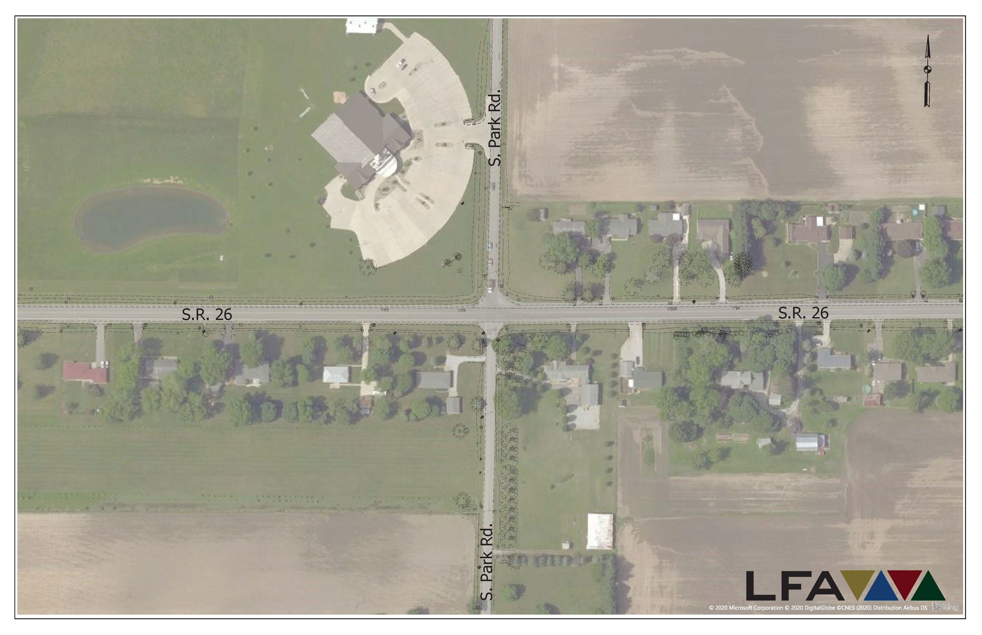
Existing Intersection

Slide 12
S.R. 26 Intersection Improvement
Purpose
To provide a safe intersection for the traveling public by improving traffic control, creating left turn storage, improving vehicle movements, and reducing the number of vehicle crashes
Need
Based on safety concerns due to increased traffic volume, congestion and crash patterns due to frequent turning movements within the intersection
Traffic volume at intersection increased 11% from 2016 to present
Volume is expected to increase

Slide 13
Intersection Safety Analysis
Traffic Signal
Updated traffic count in early 2019
Significant growth in traffic over 3 most recent years
INDOT performed a crash study and re-evaluated a traffic signal warrant analysis after updated traffic counts
Signal determined to be warranted

Slide 14
Alternatives Considered
No Build Alternative
Baseline for comparison of build alternative
Does not meet purpose and need of project
Does not enhance safety at intersection
Vehicular collisions and accidents would be expected to continue at this location as traffic volume increases
Traffic Signal
Including auxiliary lanes

Slide 15
S.R. 26 Intersection Improvement
12 ft Left Turn Lanes on SR 26, 11 ft Left Turn Lanes on Park Road
12 ft Right Turn Lane for Westbound to Northbound Traffic
Drainage Improvements
New Driveway approaches to R/W
New Drive Culverts
Widening to Occur Around Existing Pavement
Mill and Re-Surface of Mainline
Construction in Phases, Traffic to be Maintained
Protected Left Turn Southbound to Eastbound
All Other Left Turns Permissive Green
Span and Catenary Between 4 Strain Poles
SR 26 Typically Green
Detection in Pavement for Signal Change
North and South Park Road Vehicles at Approaches Trigger Signal Change

Slide 16
Aerial View of Proposed Intersection

Slide 17
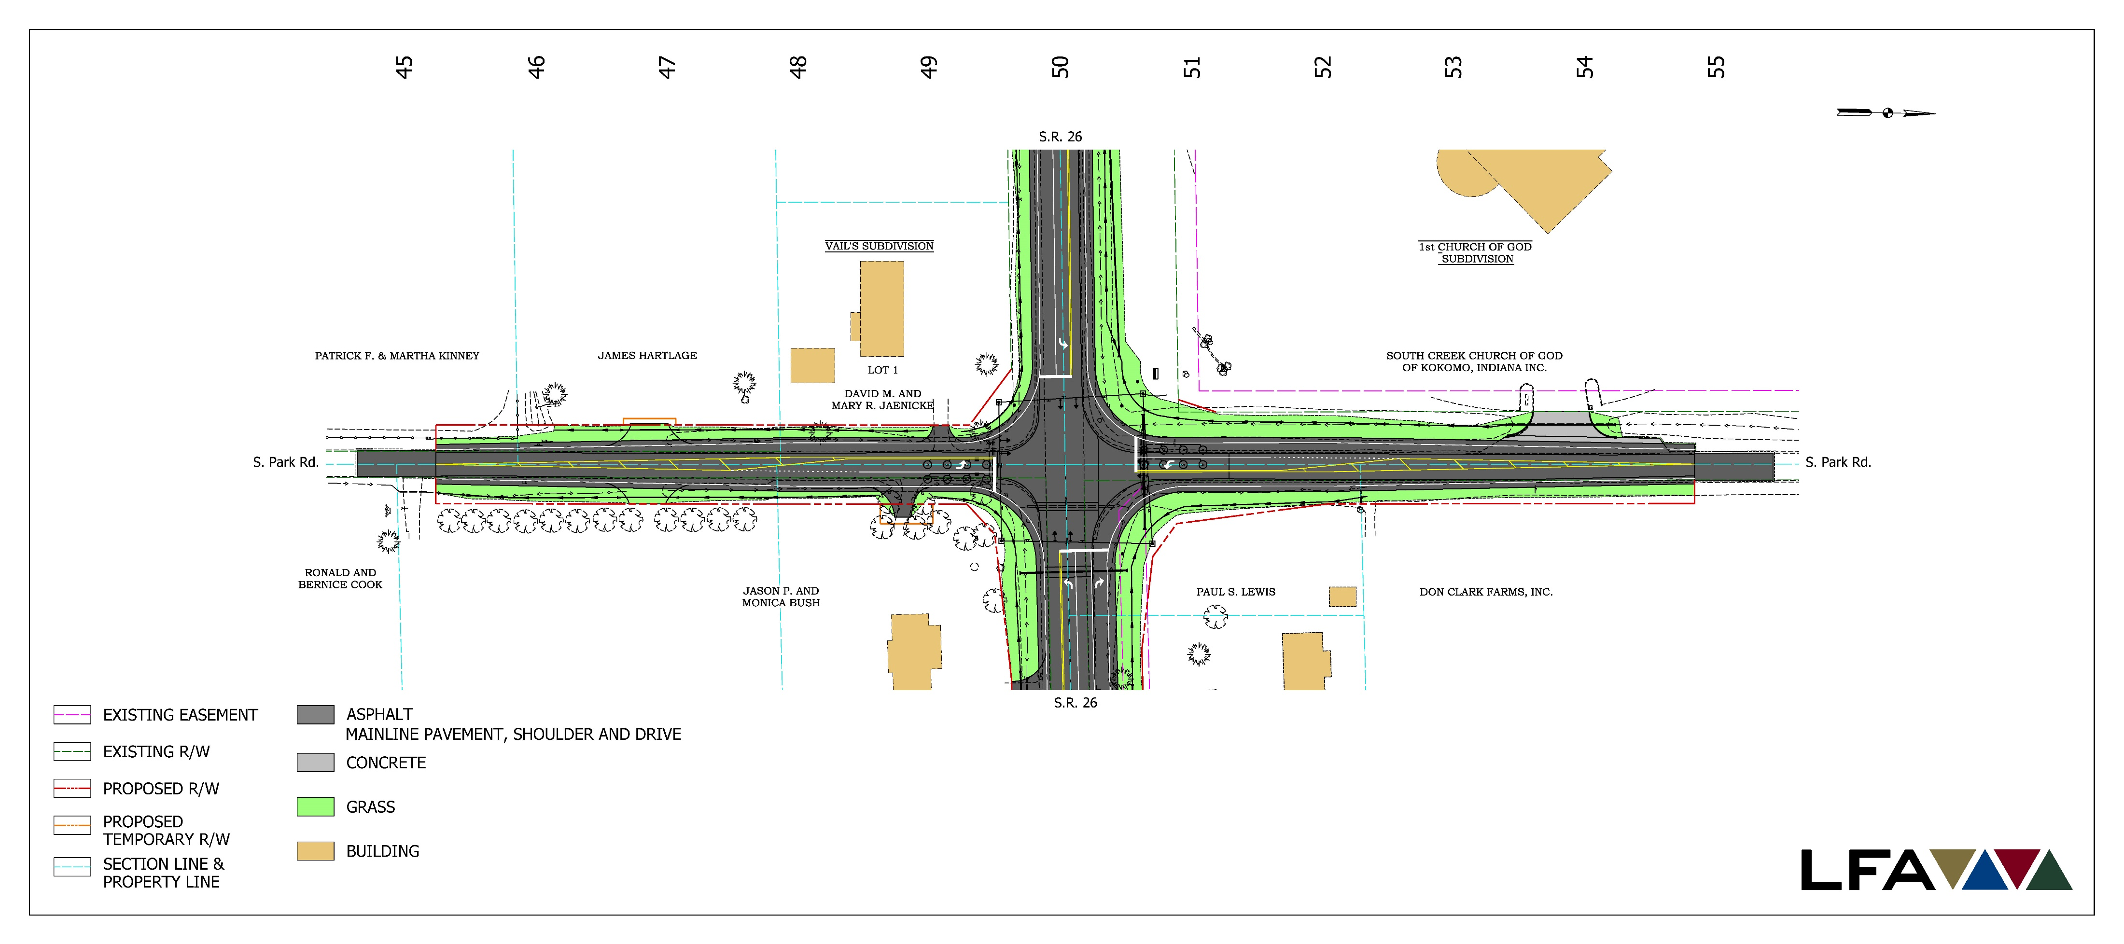
Aerial View of Proposed Intersection

Slide 18
Approaching the Intersection
Images courtesy of Google Maps

Slide 19
Approaching the Intersection
Images courtesy of Google Maps

Slide 20
Real Estate

Slide 21
Real Estate Acquisition Process
"Uniform Act of 1970"
All federal, state and local governments must comply
Requires an offer for just compensation
Acquisition Process
Appraisals
Review Appraisals
Negotiation
Right-of-Way (ROW) needed for project
0.7 acre of permanent new ROW
Less than 0.1 acre temporary ROW
1.4 acre reacquisition ROW
INDOT Real Estate Team to work with impacted property owners
Right-of-Way
Permanent ROW
Land, once purchased by INDOT from legal landowner, becomes ROW owned by INDOT
Existing apparent ROW
Existing apparent ROW — INDOT acquired land by Highway Grant some years ago, transactions in some cases were not properly recorded, requires further action by INDOT
Temporary ROW
Land required during the construction of a project and is used for the purposes of construction-related activity
INDOT pays legal landowner a fee for land use during construction and/or as part of construction-related activities

Slide 22
Submit Public Comments
Submit public comments using the options described in first page of information packet:
Public Comment Form
Via e-mail
Participating during public comment session via microphone
Verbal comments recorded and transcribed for inclusion into public hearings transcript
INDOT respectfully requests comments be submitted by Monday, March 2, 2020
All comments submitted will become part of the public record, entered into the transcript, reviewed, evaluated and given full consideration during the decision-making process.

Slide 23
Project Schedule
Public Hearing: February 13, 2020
Public comments requested by Monday, March 2, 2020
INDOT review and consideration of public comments – Winter/Spring 2020
Finalize environmental document
Complete preliminary design
Reach project decision
Inform community and project stakeholders of project decision
Proposed construction: 2021
Completed within one construction season

Slide 24
Next Steps
Public and project stakeholder input
Submit comments via options described in project handout
INDOT review and evaluation
All comments are given full consideration during the decision-making process
Address comments, finalize/approve environmental document, complete project design
Communicate a decision
INDOT will notify project stakeholders of decision
Work through local media, social media outlets; paid legal notice
Make project documents accessible via repositories
Questions? Contact Public Involvement Team

Slide 25
Project Resource Locations
INDOT Greenfield District Office
32 South Broadway, Greenfield, IN 46140
Planning, Project Development/Delivery, Construction, Maintenance for East Central Indiana
http://www.in.gov/indot/2704.htm
Kokomo-Howard County Public Library
1755 East Center Road, Kokomo, IN 46902
INDOT Office of Public Involvement
100 North Senate Avenue, Room N642, Indianapolis, IN 46204
Phone: (317) 232-6601; rclark@indot.in.gov
Visit Project Web Page https://www.in.gov/indot/4023.htm
Transportation Services Call Center
Provides citizen and business customers with a single point-of-contact to request transportation services, obtain information, or provide feedback through multiple channels of communications.
855-463-6848 • INDOT4U.com • INDOT@indot.in.gov

Slide 26
Public Comment Session
Please visit with INDOT project officials following the public comment session
Project Open House
Project maps, displays, INDOT project team and informal Q & A
INDOT Greenfield District webpage: http://www.in.gov/indot/2704.htm

