Slide 1
Public Information Meeting
SR 63 intersection improvements
Public hearing
Des. No. 1700098
January 25, 2023
Notes:
Megan - Good evening and welcome

Slide 2
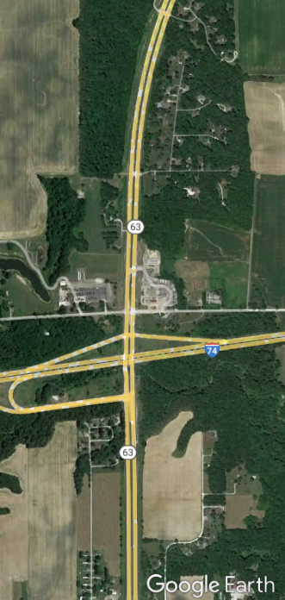
Public HEARING
Project Location
SR 63 Intersection Improvements (Reduced Conflict Intersection and Improved Auxiliary Lanes)
from CR 1650N to approx. 1000-ft north of CR 1650N
in Vermillion County
Wednesday, January 25th, 2023
Notes:
Megan

Slide 3
Agenda
SR 63 Intersection Improvements
Project Team
Welcome / Opening Remarks
Public Hearing Process
Environmental Process
Project Overview
Project Schedule
Public Comment
Notes:
Megan

Slide 4
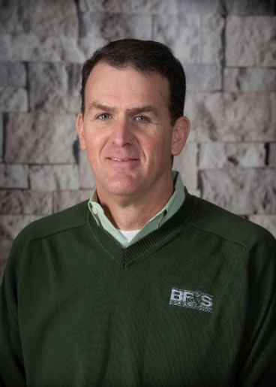
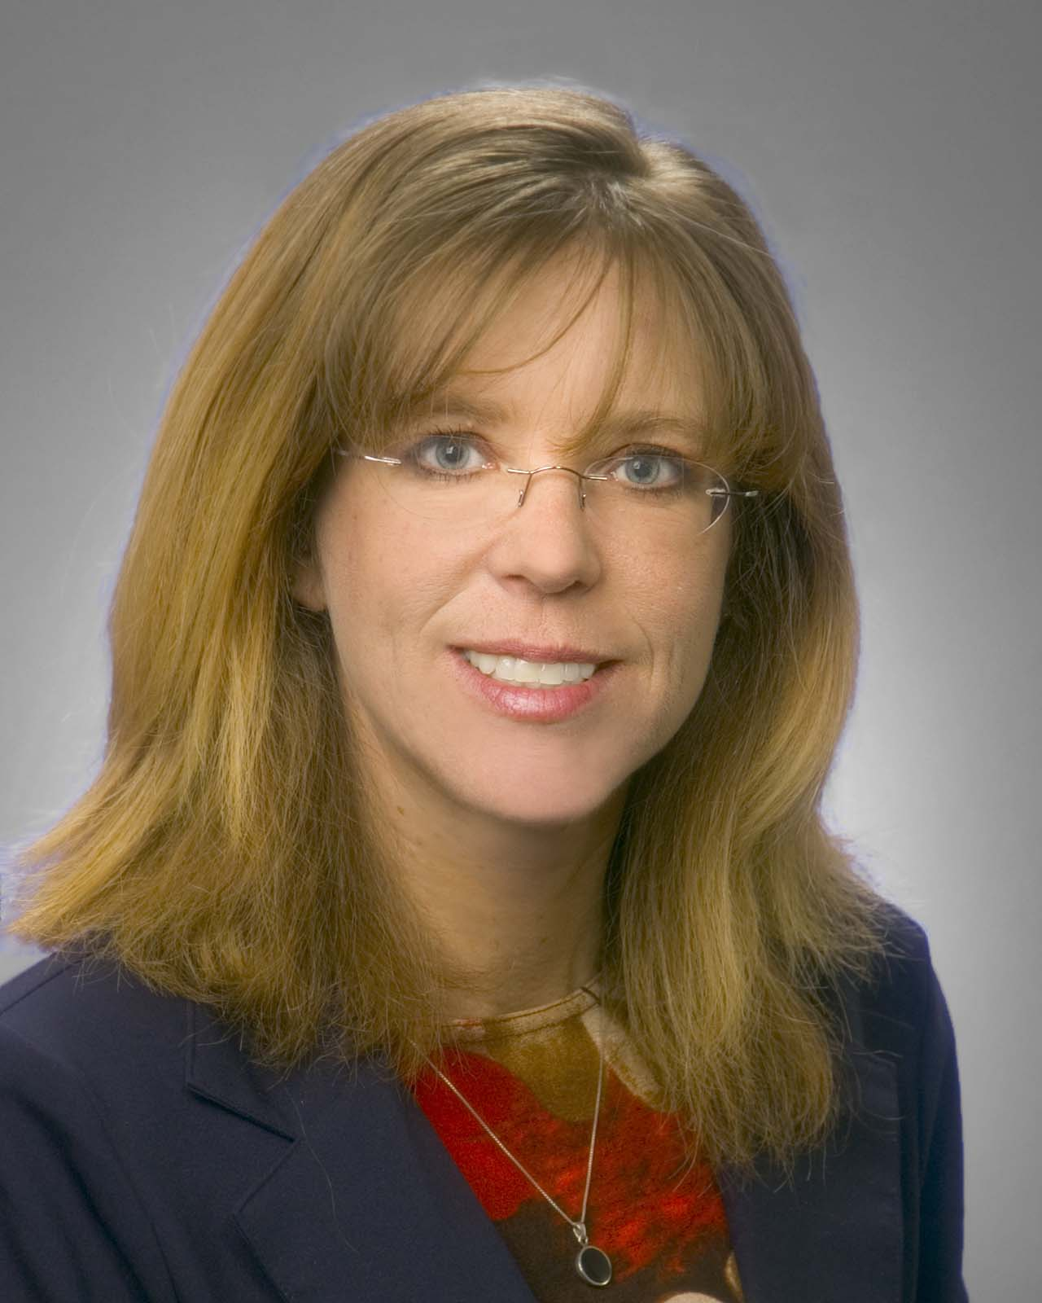
Team Overview
SR 63 Intersection Improvements
Arshad Ahmed
INDOT Senior Project Manager, Crawfordsville District
arahmed@indot.in.gov
765-326-5258
Megan DeLucenay
INDOT Public Relations Director, Crawfordsville District
mdelucenay@indot.in.gov
765-365-4347
Debbie Calder
INDOT Communications Director, West Central District
dcalder@indot.in.gov
765-366-9520
Chris Wheatley, PE
BF&S Lafayette Road Design Department Manager
Susan Castle
METRIC ENVIRONMENTAL Senior Project Manager
Notes:
Megan

Slide 5
Purpose of Meeting
SR 63 Intersection Improvements
Discuss purpose and need for the project
Share project information with the community
Opportunity for public comment
Notes:
Megan

Slide 6
Feedback
SR 63 Intersection Improvements
Fill out a comment form
Email team member
Call 1-855-INDOT-4-U
Visit INDOT website:
https://www.in.gov/indot/about-indot/central- office/welcome-to-the-crawfordsville-district/sr-63-and-cr-1650-reduced-conflict-intersection/
Ways to provide feedback:
Please Submit comments by January 25, 2023
Notes:
Megan
The plans for projects and presentation will be available at the INDOT website link

Slide 7
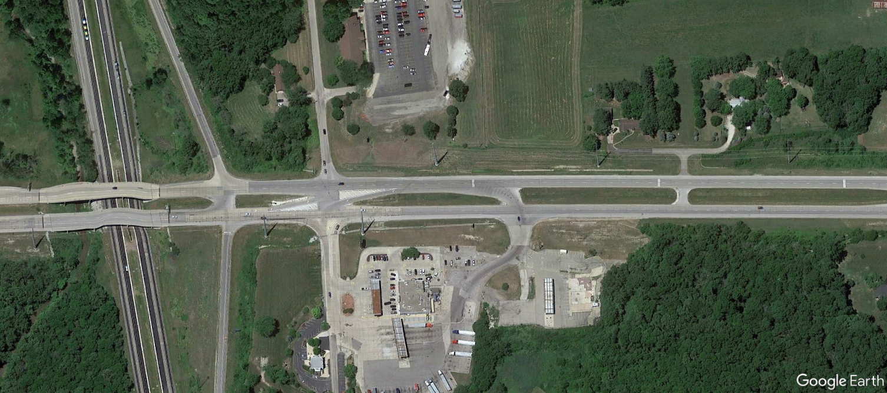
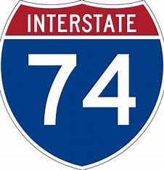
SR 63 OVERVIEW
SR 63 Intersection Improvements
N
CR 1650N
INDIANA
63
Notes:
Megan will give a short transition to Susan

Slide 8
Environmental
SR 63 Intersection Improvements
NEPA - National Environmental Policy Act of 1970
Required for all federally funded highway improvements to consider impacts on the natural and human environment
Level of study and review based on potential impacts and scope
Levels:
Categorical Exclusion*< Environmental Assessment < Environmental Impact Statement
*This project will be processed as a Categorical Exclusion (CE)
Notes:
Susan

Slide 9
Environmental
SR 63 Intersection Improvements
GENERAL PROCESS
Validate Purpose and Need (P&N) of Project
Evaluate Alternatives to meet P&N
(including “No Build”)
Assess resources
Social, economic, cultural and natural resources
Notes:
Susan

Slide 10
Environmental
SR 63 Intersection Improvements
GENERAL PROCESS (cont.)
Select preliminary preferred alternative
Investigate resources
Schedule public information meetings & get feedback
Design to avoid/minimize/mitigate project impacts
Notes:
Susan

Slide 11
Environmental
SR 63 Intersection Improvements
GENERAL PROCESS (cont.)
Release of Draft CE document by INDOT
Offer opportunity to request a Public Hearing
Finalize plans based on public hearing input
Submit Final CE document after Hearing Certification
Notes:
Susan

Slide 12
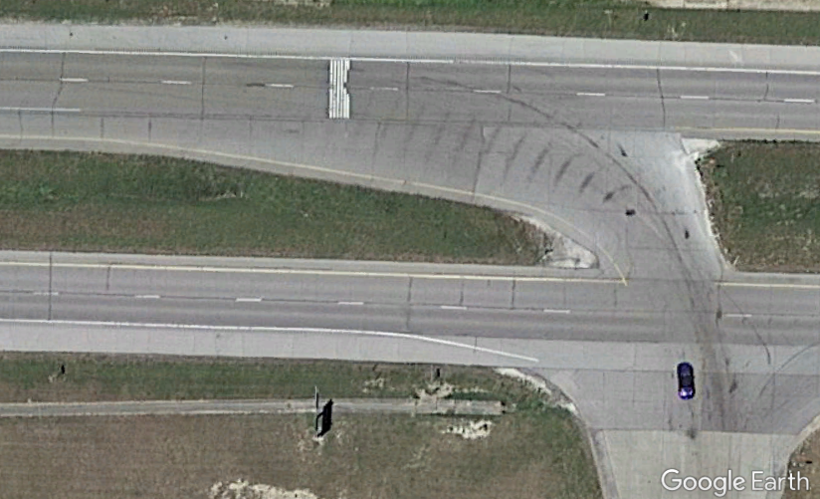
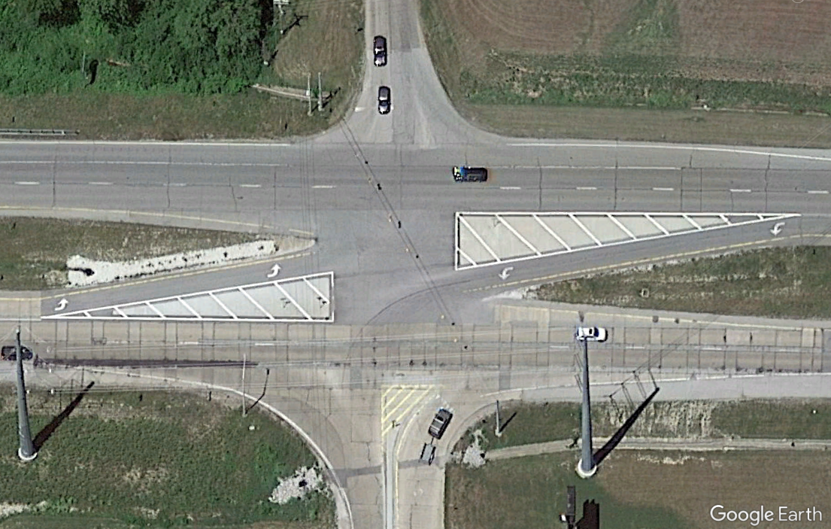
Project OVERVIEW
SR 63 Intersection Improvements
N
CR 1650N
INDIANA
63
Notes:
Chris

Slide 13
Existing Conditions
SR 63 Intersection Improvements
CR 1650N Westbound Motorists Right Turn only
No U-Turn Accommodations
2-inch mountable SR 63 splitter islands
N
Image Source: Google Earth
Notes:
Chris

Slide 14
Project Need
SR 63 Intersection Improvements
3 year crash data included 18 crashes, 1 fatality
Right-angle and failure to yield
Left-turn sight distance restrictions
Low compliance with speed and operations
PROJECT PURPOSE: Improve project safety conditions for vehicle traffic on SR 63, by providing a northbound u-turn and increasing driver compliance at CR 1650N.
Notes:
Chris

Slide 15
Safety Benefits
Extend medians at CR 1650N, to increase compliance
Reduced Conflict Intersection
Remove existing cross over
Add deceleration lane
Add median u-turn accommodations
Add lighting for u-turn
SR 63 Intersection Improvements
CR 1650N
INDIANA
63
N
Notes:
Chris

Slide 16
HOW TO DRIVE An RCI
SR 63 Intersection Improvements
*** A finished exhibit will be inserted for this sketch ***
N
Notes:
Chris

Slide 17
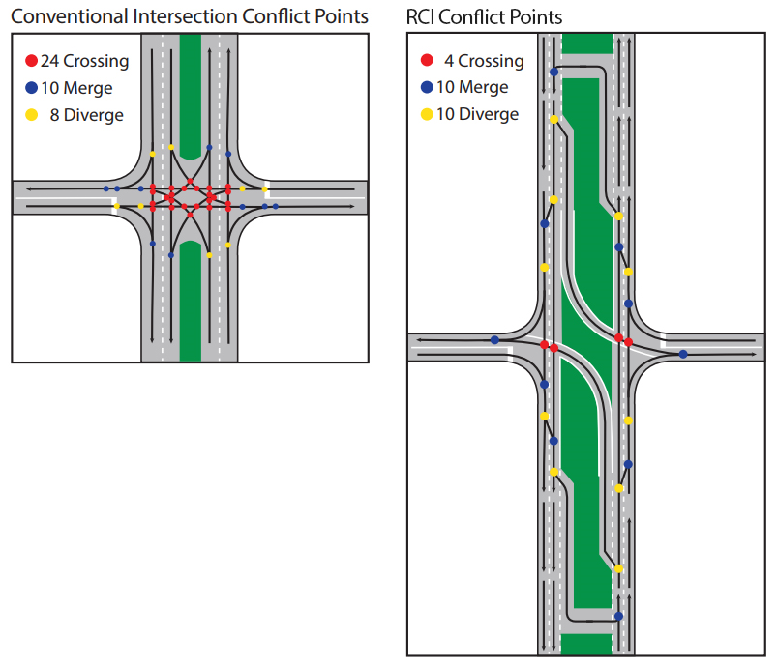
Safety Benefits
SR 63 Intersection Improvements
N
Notes:
Chris

Slide 18
Safety Benefits
SR 63 Intersection Improvements
Nationwide statistics show:
Fatal crashes decline as much as 85%
More than 50% decline in crashes
INDOT statistics show:
Fatal and injury crashes reduced by an average of 81%
Property-damage crashes reduced by an average of 58%
Crashes of any severity reduced by an average of 68%
N
Notes:
Chris

Slide 19
Maintenance of Traffic
SR 63 Intersection Improvements
One lane of traffic in each direction will be maintained
Image Source: Groundforcecrew.com
Notes:
Chris

Slide 20
PROPOSED Project
Schedule
SR 63 Intersection Improvements
Begin
Construction
Construction
Completion
Spring 2024
Summer 2024
Note: The above timeline is subject to change, depending on adjacent project.
Notes:
Chris

Slide 21
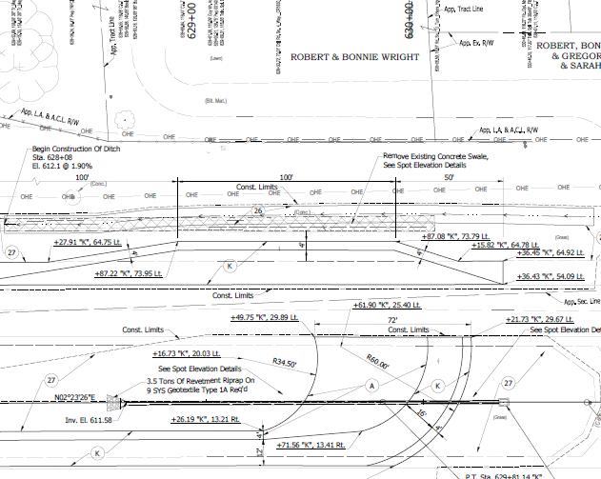
Proposed Condition
SR 63 Intersection Improvements
Exhibits Around the Room
Proposed Improvements
Construction Limits
Notes:
Chris

Slide 22
Feedback
SR 63 Intersection Improvements
Public Comment Period
Notes:
Megan
Please take note that the public comment period is for this portion of SR 63 work. If you have questions or comments on other nearby projects, please wait to discuss after the public comment period has concluded.

Slide 23
Feedback
SR 63 Intersection Improvements
Fill out a comment form
Email team member
Call 1-855-INDOT-4-U
Visit INDOT website:
https://www.in.gov/indot/about-indot/central- office/welcome-to-the-crawfordsville-district/sr-63-and-cr-1650-reduced-conflict-intersection/
Ways to provide feedback:
Please Submit comments by February 9, 2023
Notes:
Megan
The plans for projects and presentation will be available at the INDOT website link

Slide 24
THANK YOU!
SR 63 Intersection Improvements
Contact Information
INDOT
Design/Environmental
Arshad Ahmed
INDOT Senior Project Manager, Crawfordsville District
arahmed@indot.in.gov
765-326-5258
Susan Castle
METRIC ENVIRONMENTAL Senior Project Manager
susanc@metricenv.com
317-608-2730
Megan DeLucenay
Media Inquiries - INDOT Public Relations Director, Crawfordsville District
mdelucenay@indot.in.gov
765-365-4347
Notes:
Megan

