Slide 1
U.S. 6 at C.R. 29 New Bridge Placement
Wednesday, August 28, 2013
6:00 p.m. Presentation
Wawasee High School Auditorium
Syracuse, Indiana

Slide 2
Welcome
Rickie Clark, INDOT Office of Public Involvement
Purpose/Explanation of Public Hearing
Public Hearing Format
Visit our sign-in table
Informational Handouts
Participate during public comment session
Project display area

Slide 3
Welcome
Introduction of INDOT Project Officials
Project Management – Doug Burgess
Design
Real Estate
Public Involvement
Local Communities
Elkhart County
Recognition of Elected Public Officials

Slide 4
INDOT
INDOT Mission:
INDOT will plan, build, maintain and operate a superior transportation system enhancing safety, mobility and economic growth
INDOT Values:
Respect
Teamwork
Accountability
Excellence
Notes:
INDOT utilizes innovative management, construction and financing methods to achieve our mission.
Our Values drive our approach to business to deliver quality results for our customers, partners and employees.

Slide 5
INDOT Profile
Six district offices
3,578 employees
1,534 Highway Technicians
780 Managers/Supervisors
437 Engineers
$401 million/annual operating budget
$1 billion/annual capital expenditures
28,400 total roadway lane miles
5,300 INDOT-owned bridges
INDOT also:
Assists 42 railroads in planning & development of more than 3,880 miles of active rail lines
Supports 69 Indiana State Aviation System Plan airports
Notes:
5,100 lane miles of interstate
16,500 lane miles of two-lane roads
+ $300 million/year since ITR lease
Pavement Ride Quality:
According to the most recent national statistics for interstate and other National Highway System (NHS) roads, 94 percent of INDOT roads are classified as Excellent, Good, Satisfactory or Fair condition relative to pavement ride quality. The average in the United States is 90 percent.
Bridge Condition:
Today, 86 percent of INDOT bridges are rated as Excellent, Good or Satisfactory.
National bridge element condition rankings are unavailable.
However, only 3.3 percent of INDOT bridges are rated as “Poor” condition according to FHWA national standards. Nationally, an overall average of 7 percent of bridges are rated as “Poor.”
The Indiana rail network is comprised of about 3,884 route miles of active rail lines. Of these, Class I carriers operate over 2,315 route miles, regional carriers operate over 269 route miles, local carriers operate over 1,107 route miles, and switching & terminal carriers operate over 194 miles of track.
Indiana’s official State Aviation System Plan includes 69 airports that serve the air transportation needs of more than 6.5 million Hoosiers and, in doing so, directly support more than 69,000 Hoosier jobs.

Slide 6
Public Hearing
Sign-in at attendance table to be added to project mailing list
A public hearing notice was mailed to known property owners within project area
Announcement of this hearing was posted to INDOT website. A media release was also issued
Legal notice of public hearing published in the Goshen News on 8/14 & 8/19 and The Mail-Journal “the Paper” in Milford on 8/14 & 8/21

Slide 7
Project Development Process
Engineering Assessment
Project purpose & need
develop project alternatives
Screen project alternatives
Additional work on project alternatives & preliminary design
Release environmental document & preliminary design
Public Hearing to solicit public comment
Right-of-Way
Construction
We Are Here
Notes:
7

Slide 8
Environmental Document
Requirement of the National Environmental Policy Act (NEPA)
Requires INDOT to analyze and evaluate the impacts of a proposed project to the natural and socio-economic environments
Impacts are described in environmental document
Environmental document was released for public involvement July 2013

Slide 9
Environmental Document
Development of document begins once purpose and need for the project has been clearly identified
Develop a number of possible alternatives including a “Do Nothing” alternative as a baseline for comparison
Screen alternatives to identify a preferred alternative
Solicit public comment on environmental document and preliminary design plan
Solicit, address, and fully consider public comments as part of decision making process

Slide 10
Elements of the Environmental Documentation
Real Estate Community Impacts
Air Quality Wetlands and Waterways
Noise Floodplains
Farmland Endangered Species
Hazardous Materials
Historic/Archaeological
Cultural Resources

Slide 11
Environmental Document
INDOT Fort Wayne District Office, Planning & Programming Department, 5333 Hatfield Road in Fort Wayne (866) 227-3555
INDOT Office of Public Involvement, Indiana Government Center North, Room N642, 100 North Senate Avenue, Indianapolis (317) 232-6601
Syracuse Public Library, 115 East Main Street, Syracuse, Indiana (574) 457-3022

Slide 12
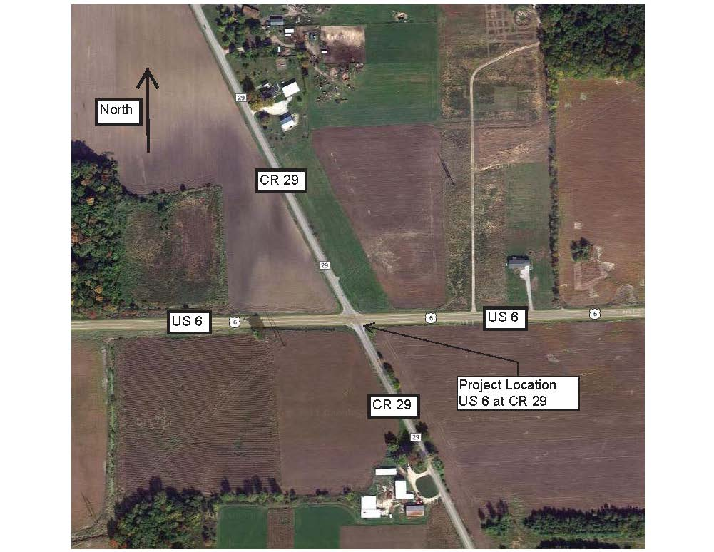
Project Description
U.S. 6 at C.R. 29 New Bridge Placement

Slide 13
Alternatives Considered
Do Nothing
Re-alignment of C.R. 29 to provide an improved intersection angle
Re-alignment of C.R. 29 to provide 2-offset “T” intersections
Roundabout
Grade Separation Bridge with no access between U.S. 6 and C.R. 29

Slide 14
Do Nothing Alternative
This would not meet the purpose of the project to reduce crash frequency and severity
In the last two years there have been 17 crashes recorded, 6 crashes with injuries (9 people with recorded injuries)

Slide 15
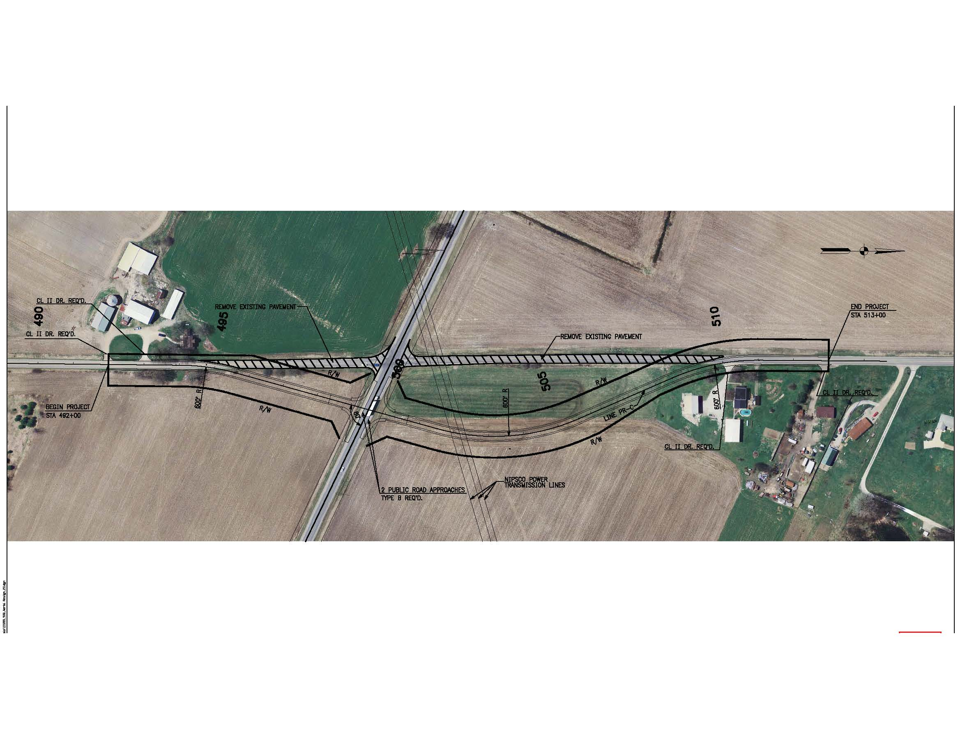
Alternatives Considered
Re-alignment of C.R. 29 to provide an improved intersection angle
Re-aligning the roadway in this manner does not enhance the safety of the intersection

Slide 16
Alternatives Considered
Re-alignment of C.R. 29 to provide 2-Offset “T” intersections
The north and south approaches of C.R. 29 would be offset, forming – “T” intersection
The through C.R. 29 traffic may have difficulties reaching adequate speeds along U.S. 6 as they accelerate from one intersection to the next
This alternative was eliminated due to operational concerns

Slide 17
Alternatives Considered
Roundabout intersection was considered
Placement of roundabouts occur when traffic volumes are approximately equal for intersecting roadways
Due to the traffic volumes along U.S. 6 being much higher than C.R. 29 and driver expectancies, the roundabout alternative was eliminated

Slide 18
Alternatives Considered
Add a signal at the intersection
The traffic counts and movements along C.R. 29 do not warrant a signal

Slide 19
Preferred Alternative
Grade separation bridge with no access between U.S. 6 and C.R. 29
This alternative eliminates 100% of At-Grade Intersection Crashes
The intersections east and west of C.R. 29, S.R. 13/C.R. 33 and C.R. 127 will operate within INDOT standards
Both right angle intersections
Both intersections east and west of C.R. 29 will continue to operate within INDOT standards after construction of the C.R. 29 bridge

Slide 20
Preferred Alternative
Grade separation bridge with no access between U.S. 6 and C.R. 29
Recorded crashes in the last two years
C.R. 29 – 17 recorded crashes, 6 crashes involved injuries (9 people injured)
S.R. 13 / C.R. 33 – 11 crashes, 2 crashes involved injuries (2 people injured)
C.R. 127 – 1 recorded crash, no injuries recorded

Slide 21
Preferred Alternative
C.R. 29 will travel over U.S. 6, with a single span bridge
No access between C.R. 29 and U.S. 6
The difference in grade between C.R. 29 and U.S. 6 will be approximately 20ft
Allow for a 16.5 ft clearance for U.S. 6 traffic to pass under the C.R. 29 bridge
C.R. 29 will have two travel lanes, one each southbound and northbound, both 11ft wide with 6ft usable shoulders (4ft paved and 2ft aggregate

Slide 22
Preferred Alternative
A 10ft paved mailbox approach will be provided for the mailboxes that fall within the project area
Guardrail will be placed per INDOT standards
Sheet flow drainage is proposed for the northwest quadrant
Ditches proposed for the remaining 3 quadrants
Designed to match existing drainage pattern
Replacement of two existing cross pipes under the north approach of C.R. 29
Pipes will be large enough to prevent flooding during a 100 year rain event

Slide 23
Preferred Alternative
Two existing field entrances along C.R. 29 near the intersection of U.S. 6
One located in southwest quadrant, the other in the northeast quadrant
With raised grade and guardrail locations, INDOT is proposing to close both field entrances
No road work is currently proposed for U.S. 6 at this location
Ditches along U.S. 6 will be improved within project limits

Slide 24
Construction
U.S. 6 will remain open with shoulder restrictions anticipated at times during construction
Short-term closures will be required during construction
Placement of the bridge beams
Closures will be outside of peak traffic movement hours
INDOT will issue media release prior to any closure on U.S. 6

Slide 25
Construction
C.R. 29 will be closed and traffic will be detoured to S.R. 13 / C.R. 33 and C.R. 46
The closure of C.R. 29 is expected to be 6 months

Slide 26
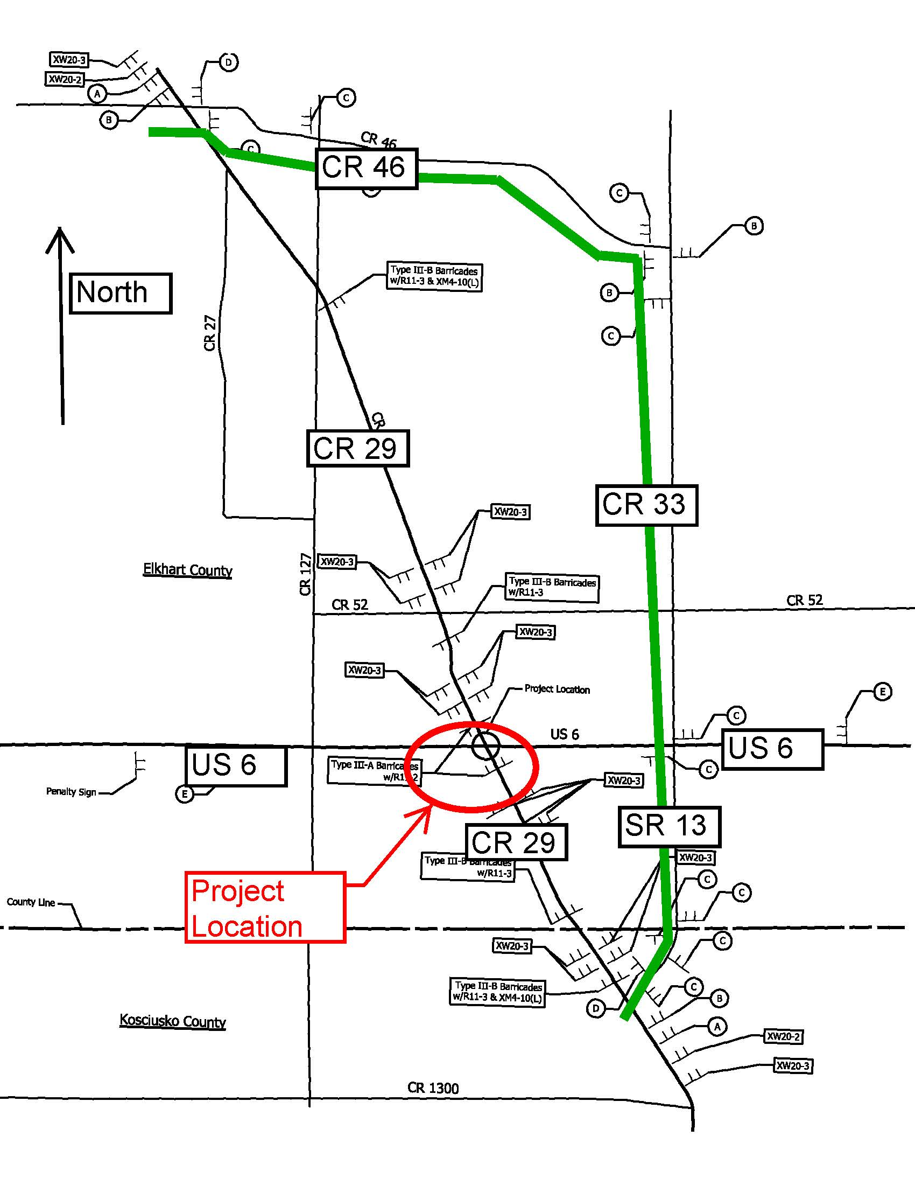
Proposed Detour

Slide 27
Real Estate Acquisition Process

Slide 28
Real Estate Acquisition
Approximately 11 acres of permanent r/w to be acquired
Agricultural – 10 acres
Residential – 1 acre
R/W estimates based on information available at this time

Slide 29
Real Estate Acquisition Process
"Uniform Act of 1970"
All federal, state, and local governments must comply
Requires an offer for just compensation
Acquisition Process
Appraisals
Review Appraisals
Negotiations

Slide 30
Project Schedule
Public Hearing – August 2013
Preliminary Design Plan refinement - Fall 2013
Finalize Environment Document – Fall 2013
Real Estate Acquisition Activities - 2014
Appraising
Negotiations / Buying
Utilities coordination / relocation
Construction - 2016
1 construction season anticipated

Slide 31
INDOT would like to hear from you
Talk with INDOT project team members
Comment sheet in information packet
E-mail or Mail comments to INDOT
Sign-in sheet to be added to project mailing list
Visit INDOT website at www.in.gov/indot/2366.htm “Public Involvement” page
Visit INDOT Fort Wayne District page at www.in.gov/indot/2307.htm
All comments are very much appreciated and will be given full consideration by project team

Slide 32
Public Involvement Team
Rickie Clark, INDOT Office of Public Involvement (317) 232-6601 rclark@indot.in.gov
Toni Mayo, Fort Wayne District Customer Service Center Director (866) 227-3555 Neinformation@indot.in.gov
Mary Foster, INDOT Fort Wayne District Media Relations Director (866) 227-3555 Neinformation@indot.in.gov

Slide 33
Submit Public Comments
Submit public comments using the options described in 1st page of information packet
Public Comment Form
Via e-mail
Participating during public comment session via microphone
INDOT respectfully requests comments be submitted by Friday, September 20, 2013
All comments submitted will be reviewed, evaluated and given full consideration during decision making process
INDOT will take appropriate measure to communicate information to community stakeholders once a decision is made

Slide 34
THANK YOU
Please visit with INDOT project officials following the public comment session
Project Open House
Project maps, displays, real estate acquisition table, INDOT project officials, informal Q & A
Thank you for your attendance this evening

