Slide 1
IHCDA Lead based paint technical assistance webinar February 28, 2018 March 2, 2018 presented by: Dave Pugh

Slide 2
Presentation today
New Lead focused programs
State Licensing requirements
EPA Certifications
Federal and State Regulations
Risk Assessments
Policy
Notes:
Please mute your phones

Slide 3
Lead hazard control programs
Lead Hazard Reduction Demonstration Grant
Balance of State
CHIP
Notes:
Please mute your phones

Slide 4
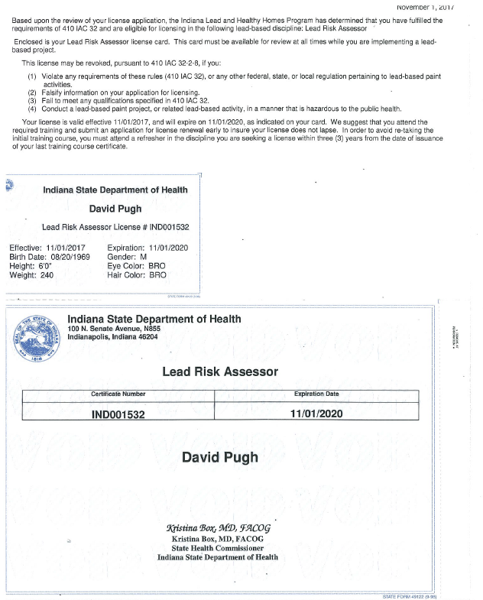
Licensing requirements
The Indiana State Department of Health requires the following to be licensed:
Risk Assessors
Lead Inspectors
Project Supervisor license (Abatement)
Contractors (Abatement)
Project Designer (Abatement)
Worker License (Abatement)
Clearance Examiner
Indiana State Department of Health (ISDH) Lead Professional Licensing Overview https://www.in.gov/isdh/19153.htm
Indiana Professional Licensing Agency
https://mylicense.in.gov/everification/Search.aspx

Slide 5
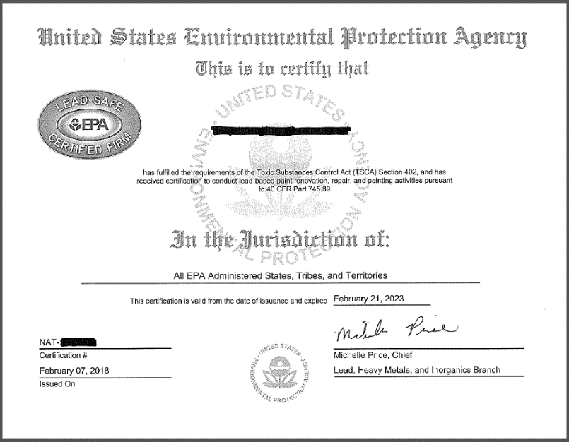
Renovation, repair, & Painting Program (RRP)- contractors
In general, anyone who is paid to perform work that disturbs paint in housing and child-occupied facilities built before 1978 must be EPA certified. This includes all firms, even sole proprietorships.
Examples of the types of firms covered:
Residential rental property owners/managers
General contractors
Special trade contractors, including
Painters
Plumbers
Carpenters
Electricians
https://www.epa.gov/lead/renovation-repair-and-painting-program

Slide 6
LSHR and interim controls
A person performing interim controls must be supervised by an individual licensed as a lead-based paint abatement supervisor or have successfully completed one of the following lead-safe work practices courses:
A lead-based paint abatement supervisor course accredited in accordance with 40 CFR 745.225
A lead-based paint abatement worker course accredited in accordance with 40 CFR 745.225; or
A renovator course accredited in accordance with 40 CFR 745.225.

Slide 7
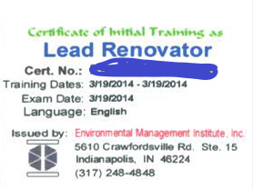
RRP- Renovators
Federal law requires that a “certified renovator” be assigned to each job, and that all involved individuals are trained in the use of lead-safe work practices.
https://cfpub.epa.gov/flpp/pub/index.cfm?do=main.trainingSearch

Slide 8
EPA Rule Part 745- lead based paint poisoning prevention in certain residential structures
This subpart contains regulations developed under sections 402 and 406 of the Toxic Substances Control Act (15 U.S.C. 2682 and 2686) and applies to all renovations performed for compensation in target housing and child-occupied facilities. The purpose of this subpart is to ensure the following:
(a) Owners and occupants of target housing and child-occupied facilities receive information on lead-based paint hazards before these renovations begin; and
(b) Individuals performing renovations regulated in accordance with §745.82 are properly trained; renovators and firms performing these renovations are certified; and the work practices in §745.85 are followed during these renovations.
https://www.ecfr.gov/cgi-bin/retrieveECFR?gp=&SID=b1c2b29dd0c663462ae20cc2c875412a&mc=true&n=pt40.34.745&r=PART&ty=HTML

Slide 9
HUD’s Lead Safe Housing Rule (LSHR)
24 CFR Part 35
Covers all Federally-assisted or owned target housing
Effective September 15, 2000
Requirements depend on type and amount of federal housing assistance
https://www.hud.gov/program_offices/healthy_homes/enforcement/lshr
HUD Guidelines for the Evaluation & Control of Lead-Based Paint Hazards in Housing
https://www.hud.gov/program_offices/healthy_homes/lbp/hudguidelines
Interpretive Guidance on HUD’s Lead Safe Housing Rule
https://www.hud.gov/sites/documents/DOC_25476.PDF

Slide 10
Exemptions to the LSHR
Any rehabilitation that does not disturb a painted surface
Residential property for which construction was completed on or after Jan 1, 1978
Zero-bedroom units, including single room occupancy (SRO) units
Housing exclusively for elderly or disabled (see HUD definition) in §35.110
Property evaluated as free of lead-based paint (LBP) or where LBP was removed
Property or part of property that is not used for human residential habitation
* Historic Preservation exemption- listed as eligible, or contributes to a
historic district

Slide 11
Risk assessments
In residential dwellings, dust samples (either composite or single-surface samples) from a window (sill) and floor shall be collected in all living areas where one (1) or more children, six (6) years of age or younger, are likely to come into contact with dust. 410 IAC 32-4-4
Chapter 5 of HUD’s Guidelines for the Evaluation & Control of Lead-based Paint Hazard in Housing recommend that risk assessors select a minimum of four rooms for dust sampling (except, of course, when the dwelling unit has less than four rooms).
The rooms generally recommended for sampling, in approximate order of importance, are:
the principal play area of young children,
the kitchen,
the bedroom of the youngest child,
the bedroom of the next oldest child,
the bathroom used by the youngest child, and
the living room.
* If no children under age six are in residence, one can presume that the smaller bedrooms are those that would be used by young children and that the living room or family room would be the principal play area
Bare soil areas to be sampled for lead contamination are
Each play area with bare soil, including sandboxes
Non-play areas in drip line/foundation areas
Non-play areas in the rest of the yard, including, but not limited to vegetable gardens, pet sleeping areas, and bare soil
4. Vegetable gardens

Slide 12
Risk assessment 410 IAC 32-4-4
The licensed risk assessor shall prepare a risk assessment report that shall include the following information:
(A) The date of the assessment including visual inspections.
(B) The address of each building.
(C) The date of construction.
(D) The apartment number, if applicable.
(E) The name, address, and telephone number of each owner or owners of each residential dwelling or child-occupied facility.
(F) The name, signature, and license number of the licensed risk assessor conducting the assessment.
(G) The name, address, and telephone number of the firm employing each licensed risk assessor.
(H) The name, address, and telephone number of each recognized laboratory conducting analysis of the collected samples.
(I) Each testing method, device, or sampling procedure employed for paint analysis, including quality control data and, if used, the serial number of any x-ray fluorescence device.
(J) Specific locations of each painted component tested for the presence of lead-based paint.
(K) All results of laboratory analysis on collected paint, soil, and dust samples.

Slide 13
Risk assessment 410 IAC 32-4-4
(L) Any background information collected.
(M) To the extent that they are used as part of the lead-based paint hazard determination, the results of any previous inspections or analyses for the presence of lead-based paint or other assessments of lead-based paint-related hazards.
(N) A description of the location, type, and severity of lead-based paint hazards and other potential lead hazards.
(O) A description of interim controls and abatement options for each identified lead-based paint hazard and a suggested prioritization for addressing each hazard. If the use of an encapsulant or enclosure is recommended, the report shall recommend a maintenance and monitoring schedule for the encapsulant or enclosure.
(P) Results of visual inspections.
The licensed risk assessor shall submit documentation of the inspection in the format prescribed by the department within five (5) business days after completing the risk assessment report.
http://www.in.gov/legislative/iac/T04100/A00320.PDF
I-Lead- managed by the ISDH- https://gatewayp.isdh.in.gov/Gateway/SignIn.aspx

Slide 14
Example of a Basic Interior Dust Sampling Plan
Dust samples should be collected from each of the following locations:
✦ One from the floor of the youngest child’s principal play area, usually the living room
✦ One from the interior window sill of the most frequently opened window in the living
room.
✦ One from the floor of the kitchen.
✦ One from an interior window sill in the kitchen.
✦ One from the floor of the bedroom of the youngest child (older than 6 months).
✦ One from the interior window sill of the bedroom of the youngest child (older than 6months)
✦ One from the floor of the bedroom of the next oldest child, if any.
✦ One from the interior window sill of the bedroom of the next oldest child.
✦ One from the floor and window sill of every other room selected by the risk assessor.
✦ One from the floor inside the most frequently used door that provides direct access
to the outdoors.
* One field blank per property
If no playroom can be identified, the living room should be sampled. If the youngest
child’s bedroom cannot be identified, the smallest bedroom should be sampled.

Slide 15
De Minimis Levels
Work which disturbs less than
20 square feet on exterior surfaces
2 square feet in any one interior room or space
10 percent of total surface area of interior or exterior component type with a small area (sills, baseboards, etc.)
Exemption to Safe Work Practices and Clearance only

Slide 16
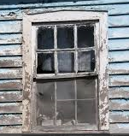
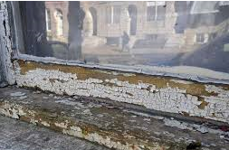
Abatement
Intent is to permanently eliminate LBP or LBP hazard(s)
Licensed lead abatement contractor
Methods include-
Encapsulation, enclosure, component replacement or removal of paint
Paving or removal for soil
Clearance by inspector or risk assessor
https://portalapps.hud.gov/CORVID/HUDLBPAdvisor/info/documents/HUD-EPAabateguidance.pdf

Slide 17
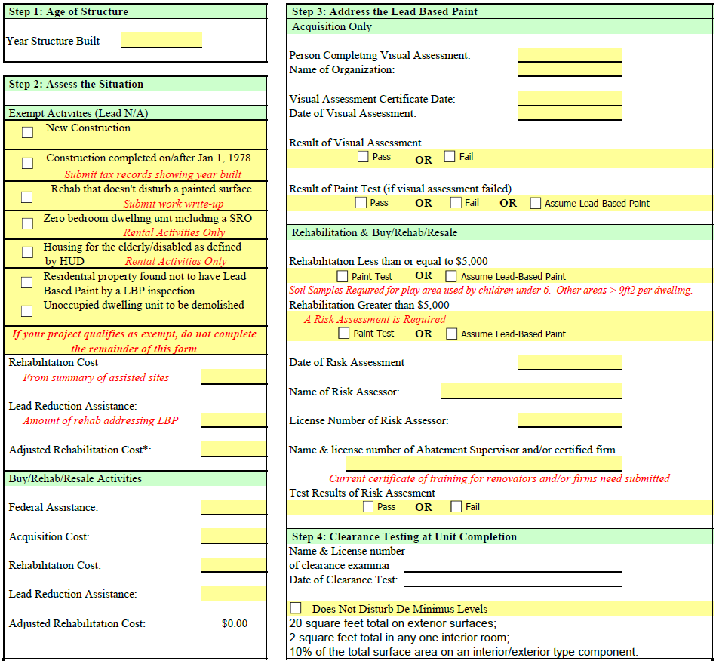

Slide 18
Lead form step 2

Slide 19
Led form step 3

Slide 20
Set-up and Inspections
Set-up
Lead Inspector/Risk Assessor name and license
Certified RRP Firm certificate
Lead Abatement Supervisor/Contractor/worker license (if applicable)
Certified renovator certificates
Owner-occupied rehab and Rental Rehab
Detailed scope of work
Signed Inspection Certification form (inspector, contractor, owner)
Lead form
New Construction
Signed Inspection Certification form
Development Design commitments
Planned work

Slide 21
web links
EPA Lead Rules- https://www.ecfr.gov/cgi-bin/retrieveECFR?gp=&SID=b1c2b29dd0c663462ae20cc2c875412a&mc=true&n=pt40.34.745&r=PART&ty=HTML
RRP Rules- https://www.epa.gov/lead/renovation-repair-and-painting-program
RRP Certified Firm Verification- https://cfpub.epa.gov/flpp/pub/index.cfm?do=main.firmSearch
RRP Renovator Training- https://cfpub.epa.gov/flpp/pub/index.cfm?do=main.trainingSearch
HUD LSHR- https://www.hud.gov/program_offices/healthy_homes/enforcement/lshr
Interpretive Guidance on HUD’s Lead Safe Housing Rule- https://www.hud.gov/sites/documents/DOC_25476.PDF
HUD Guidelines for the Evaluation & Control of Lead-Based Paint Hazards in Housing- https://www.hud.gov/program_offices/healthy_homes/lbp/hudguidelines
HUD Abatement Guidance- https://portalapps.hud.gov/CORVID/HUDLBPAdvisor/info/documents/HUD-EPAabateguidance.pdf
ISDH Lead Rules- http://www.in.gov/legislative/iac/T04100/A00320.PDF
Indiana State Department of Health (ISDH) Lead Professional Licensing Overview- https://www.in.gov/isdh/19153.htm
I-Lead- managed by the ISDH- https://gatewayp.isdh.in.gov/Gateway/SignIn.aspx
Indiana Professional Licensing Agency (IPLA)- https://mylicense.in.gov/everification/Search.aspx
IHCDA Program Manual- http://www.in.gov/myihcda/files/CDBG,%20HOME,%20HTF%20Program%20%20Manual%204thEdition.pdf

Slide 22
For Further Information
Sign up for our email list for newsletters and notices
If you want an IHCDA contact name for a specific program, let us know
Contact Info:
Dave Pugh
Lead Grant Manager
317-234-6289
dpugh@ihcda.in.gov
IHCDA Contact Info:
317-232-7777
askihcda@ihcda.in.gov

Slide 24
Questions?
Thank you

