Slide 1
Clinic and Home Based Contingency Management with Adolescent Substance Users
Catherine Stanger, Ph.D.
Catherine.stanger@Dartmouth.edu
July 24, 2015

Slide 2
Objectives
Overview of Contingency Management
Results from our adolescent CM trials
Review clinical application, primarily focused on home-based procedures

Slide 3
What is Contingency Management?
CM programs arrange the therapeutic environment such that
  target behaviors such as drug abstinence, counseling attendance, and medication compliance are carefully monitored
  reinforcing or punishing events (eg, tangible rewards or incentives, suspension of employment or school, loss of privileges) occur when the target behavior is or is not achieved

Slide 4
Determining Characteristics of CM
“I used CM” is more like “I used medication” than “I used CBT” or “I used MI”
CM interventions vary in their:
  Target(s)
  Monitoring
  Schedule of Reinforcement
  Magnitude of Reinforcement
  Type of Consequence

Slide 5
CM Targets
Abstinence is the recommended primary target
  Currently, a reduction in use target (quantitative urine drug testing) is not practical/feasible for drug abuse due to the frequency of testing required
Attendance or other therapeutic tasks can be targets but may not result in drug abstinence
Select achievable target (short period of abstinence, especially early in treatment).

Slide 6
Monitoring
Target must be verified using biochemical or other objective measure
Monitoring schedule must match schedule of reinforcement
  You can’t reinforce more frequently than you are monitoring (e.g., if you monitor monthly, can’t reward weekly)

Slide 7
Schedule of Reinforcement
Minimize delay between target behavior and reinforcement
Use frequent reinforcement especially early in treatment (weekly or even more often)
Creative use of different schedules guided by behavioral principles of reinforcement
  e.g., prize bowl vs. vouchers

Slide 8
Magnitude of Reinforcement
Higher magnitude incentives are more potent than lesser magnitude
Some intermittent schedules (e.g., fishbowl) are effective, but magnitude still has a large influence on outcomes

Slide 9
Type of Consequence
Use a variety of reinforcers
Allow client choice when possible
Can include nonmonetary reinforcers (privileges, praise).

Slide 10
CM is moving beyond substance use to a variety of health behaviors
  Weight loss
  Medication adherence
  Immunization
  Medical regimen adherence

Slide 11
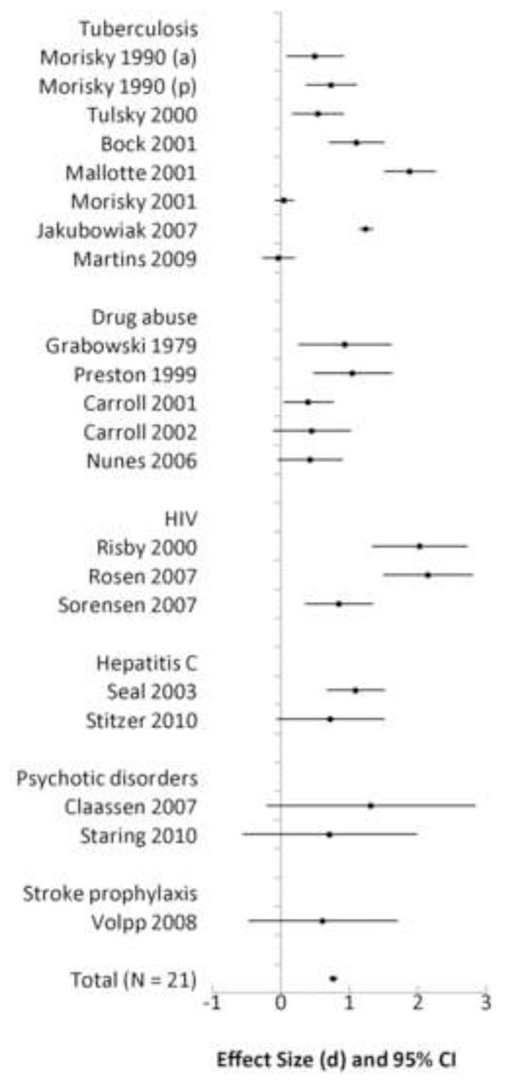
CM for medication adherence
(Petry et al., 2012)

Slide 12
Largest CM effect sizes
Interventions that were
  longer in duration
  provided average reinforcement of ≥$50/week
  reinforced patients at least weekly

Slide 13


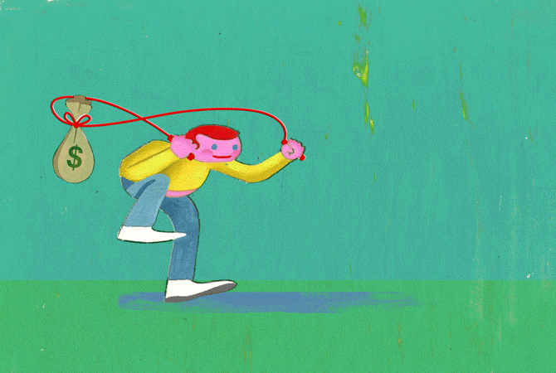
EDITED BY DAVID LEONHARDT FOLLOW US:
GET THE UPSHOT IN YOUR INBOX
THE NEW HEALTH CARE
Paying People to Be Healthy Usually Works, if the Public Can Stomach It
JULY 6, 2015
Few people seem comfortable with the idea of paying patients to do what we want them to do.
Aaron E. Carroll
That’s unfortunate, because there’s a significant amount of research that says this works.
Email
I’m not talking about things like wellness programs, which offer reductions in insurance premiums if you do what your employer wants.
Those are really a means of cost- sharing in which expenses are shifted onto people who are less healthy. I’m talking about paying incentives directly to people in exchange for changes to their behavior or health.
Share
Pete Ryan
Tweet
Save
More

Slide 14
Our Clinic Based Adolescent CM program
Target
  Abstinence from MJ, alcohol, and other drugs
Monitoring
  1x or 2x weekly monitoring: urine testing, self report, parent report
Schedule of Reinforcement
  Earn incentive for each documented period of abstinence; Incentives increase with consecutive periods of abstinence; Reset for use
Magnitude of Reinforcement
  $590 over 14 weeks in the clinic
Type of Consequence
  Clinic uses using reloadable credit cards [ctpayer] to provide incentives

Slide 15
Home Based Adolescent CM
  Parent contracts with teen for rewards and consequences based on substance use status
  Contract is implemented once or twice weekly, on same schedule as urine drug testing and clinic CM program
    Same target, monitoring, and schedule as clinic CM
    Individualized magnitude and type of reward/consequence
Notes:
The second part of contingency management includes parent training.
We are using the program designed by Thomas Dishion called Adolescent Transitions.
The intervention includes 12 sessions which focus on working collaboratively with parents to help them encourage positive behavior, engage in contingency contracting, limit setting, and the use of consequences, and improve communication and family problem solving skills. We also work with parents to help them contract with their adolescent for rewards and consequences based on substance use status.
Again, we felt this program was ideal because it was designed for conduct disordered youth and many of the youth we see in treatment are engaging in a number of delinquent behaviors.

Slide 16
Initial Trial (Vermont)
Stanger et al., 2009
All teens received:
  Individual Motivational Enhancement Therapy/ Cognitive Behavior Therapy
    Manualized, tested in the CYT trial (Dennis et al., 2004)
  Twice weekly urine drug testing (parents informed)
Randomized to receive:
  Contingency Management + Parent Training (Dishion + Kavanaugh, 2003)
  or
  Participation incentives + Parent Drug Education

Slide 17
N=69
Randomly Assigned
N=33
14 weeks MET/CBT
2x/week UA
N=36
14 weeks MET/CBT
2x/week UA
Participation
Incentives
Abstinence Based
Incentives
Parent Substance
Monitoring Contract
Parent Drug Education
Parent Training
Post RX 12 weekly UAs
Post RX 12 weekly UAs

Slide 18
VT Study: Mean Weeks of
Continuous Abstinence
CBT+CM>CBT+PDE, p<.05

Slide 19
Arkansas Trial Design
Stanger et al. (2015)
3 Condition, Randomized Trial
  N=153 adolescents
Designed to isolate the efficacy of CM vs. CM+Parent Training

Slide 20
N=153
Randomly Assigned
N=51
14 weeks MET/CBT
2x/week UA
N=51
14 weeks MET/CBT
2x/week UA
N=51
14 weeks MET/CBT
2x/week UA
Participation
Incentives
Abstinence Based
Incentives
Abstinence Based
Incentives
Parent Substance
Monitoring Contract
Parent Substance
Monitoring Contract
Parent Training
Post RX 12 weekly UAs
Participation Incentives
Post RX 12 weekly UAs
Abstinence Based CM
6 Parent Booster Sessions
Post RX 12 weekly UAs
Abstinence Based CM
6 Parent Booster Sessions

Slide 21
Inclusion/Exclusion Criteria
DSM-IV Marijuana abuse or dependence
MJ use in past 30 days OR THC positive urine drug test
Age 12-18
Not dependent on any other substance (except tobacco)

Slide 22
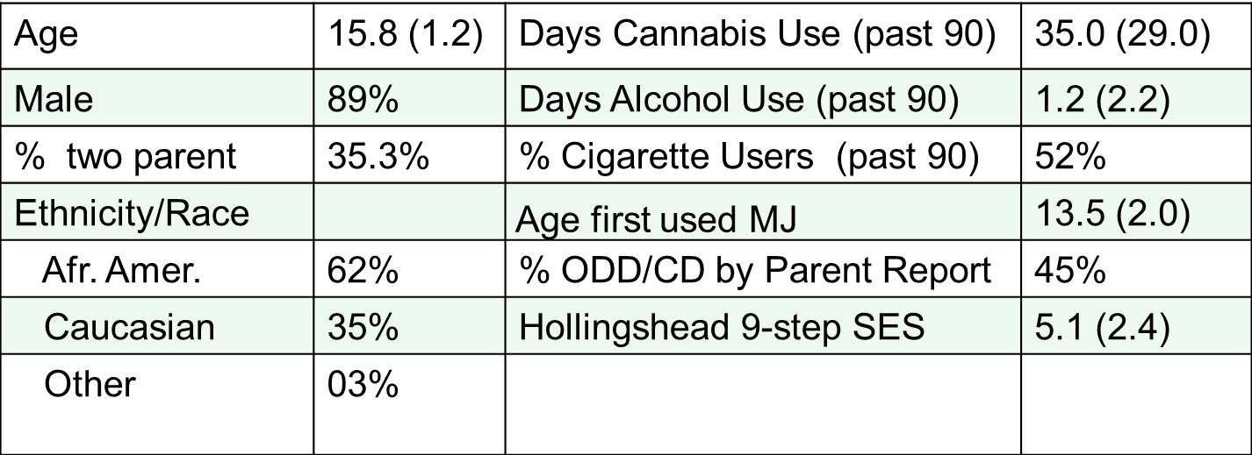
Teens (N=153); Parents (N=208)

Slide 23
During and End of Treatment Marijuana Abstinence
* Chi Square Analyses: Both CM groups > MET/CBT (p<.05)

Slide 24
Post Treatment Abstinence
GEE analysis with paired contrasts
Significant relapse in MET/CBT (p<.05): no differences between conditions

Slide 25
Marijuana Use Frequency
0=0% days used, 1=greater than 0 and less than 15% of days used, 2=15% or more and less than 50% of days used, and 3=50% or more days used; during treatment improvement sustained post treatment

Slide 26
Summary
Replicated positive CM effects on abstinence during treatment in a more diverse, lower SES, sample.
Parent training did not enhance effects on abstinence during or post treatment.
Maintenance of abstinence was poor across all treatments; reductions in use frequency were sustained

Slide 27
AR Alcohol Study
Similar to MJ trial except:
  Alcohol abuse/dependence or binge episodes was inclusion criteria
  Used Fishbowl (same magnitude as voucher program)
  Used EtG (ethyl glucuronide) to measure alcohol use in urine samples

Slide 28
N=75
Randomly Assigned
N=38
14 weeks MET/CBT
1x/week UA
N=37
14 weeks MET/CBT
1x/week UA
Participation
Incentives
Abstinence Based
Incentives
Parent Substance
Monitoring Contract
Parent Training
Post RX 12 weekly UAs
Post RX 12 weekly UAs

Slide 29
Demographics
 | MET/CBT+CM+PT (n = 37) | MET/CBT (n = 38)
Male | 27 (73.0%) | 29 (76.3%)
Minority | 8 (21.6%) | 6 (15.8%)
Mean SES^{c} | 6.2 (2.2) | 7.2 (1.6)
Mean Age | 16.1 (1.2) | 16.2 (1.2)
Tobacco user | 30 (81.1%) | 30 (79.0%)
Intake % days used alcohol | 12% (16%) | 12% (14%)
Mean drinks per drinking day | 5.7 (4.9) | 6.4 (4.5)
Intake cannabis positive urine | 13 (35.1%) | 13 (34.2%)
Intake % days used cannabis | 28% (35%) | 27% (34%)
Alcohol Dependence | 7 (18.9%) | 7 (19.4%)
Alcohol Abuse | 12 (32.4%) | 14 (36.8%)
MJ Dependence | 10 (27.0%) | 19 (50.0%)
MJ Abuse | 18 (48.6%) | 7 (18.4%)

Slide 30
Alcohol vs. Marijuana Samples
Youth using alcohol +/- marijuana
  Were higher SES
  Less likely to be minority
  More likely to be female
  Similar days of cannabis use on average
  More likely to use tobacco

Slide 31
Positive via Self vs. Parent vs. UA results
Alcohol less likely to be positive via UA in the absence of self or parent report than cannabis

Slide 32
Abstinence Effects
There were no differences across treatment conditions in the % of youth having ANY vs. NO substance use during or post treatment
About ½ of the youth in both conditions were abstinent during and post treatment
Traditional statistical approaches (assuming normal distribution) not appropriate

Slide 33
During Treatment Abstinence from Alcohol and Cannabis: Number of Positive UAs
ZIP analysis: MET/CBT+CM+PT had fewer positive cannabis samples among those with at least 1 positive sample; no difference in number of positive alcohol samples

Slide 34
During Treatment Alcohol and Cannabis Use Days: Percent Days Used if Used Any Days
ZIP analysis: MET/CBT+CM+PT had fewer alcohol days used if any alcohol was used. Cannabis result is significant when controlling for SES and Cannabis Dependence

Slide 35
During Treatment Summary
Many youth showed complete abstinence based on UAs in both conditions (about 50%)
  CM did not increase the odds of complete abstinence
Among those not completely abstinent, those receiving CM achieved more weeks of marijuana (but not alcohol) abstinence
  However, rates of alcohol use were generally low across conditions
  And, alcohol use may not be a substance use target appropriate for CM if testing only weekly (need more frequent testing to detect than for marijuana)
Among those reporting some alcohol use during treatment, those receiving CM reported fewer days of use
  A similar effect was seen for cannabis when controlling for SES and marijuana dependence

Slide 36
Post Treatment Summary
Close to half of all youth also showed complete abstinence based on self report in the 9 month post treatment period
  CM again did not increase the odds of complete abstinence
Among those not completely abstinent, those receiving CM reported fewer percent days of alcohol and marijuana use in the 9 months after treatment

Slide 37
Post Treatment Alcohol and Cannabis Use Days: Percent Days Used if Used Any Days
ZIP analysis: MET/CBT+CM+PT had fewer alcohol and marijuana use days used if any was used; this difference was no longer significant for MJ after controlling SES and MJ Dependendence

Slide 38
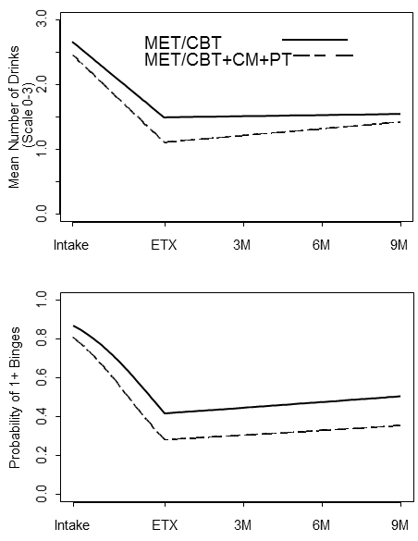
Mean Drinks and Binges
Both show sustained improvements over time, across treatment conditions
There were similar sustained improvements in both conditions in externalizing symptoms, positive parenting, parental monitoring, and negative discipline.

Slide 39
Alcohol Study Summary
Despite differences in the sample characteristics, we see similar during treatment benefits of CM
  Post treatment effects are somewhat stronger in this higher SES, less minority sample
We replicated our finding of improvement across treatment conditions in parenting and conduct problems.

Slide 40
Cannabis Use Cluster Analysis across all 3 CM trials
75% of participants show sustained improvements in use frequency

Slide 41
Predictors, Moderators, Mediators
Timing of Abstinence
Parent Monitoring
Disruptive Behavior Disorders

Slide 42
Timing of Abstinence:
Early or Not at All?
Hazard function: Onset of first week of abstinence; Brown et al., 2012

Slide 43
Abstinence in Week 6 as Predictor of Outcome

Slide 44
Abstinence in Week 6 Predicts Post Treatment Outcome
Chi Square at each time point: If Week 6 UA is negative for THC, each follow up UA is significantly more likely to be negative for THC

Slide 45
CM improves the trajectory
51% of CM and 35% of non CM youth were abstinent in Week 6
  Across conditions if abstinence does not occur by week 6, it is unlikely to occur
Week 6 abstinence is a strong predictor of during and post treatment abstinence
  We are beginning a trial that will re-randomize teens who are not abstinent in week 4 to a higher level of care (higher magnitude CM for teens)

Slide 46
Improvement in Parent Monitoring Predicts Lower Post Treatment Marijuana Use
.43
Intake Poor Monitoring
.66
End of Tx Poor Monitoring
.15
.36
-.26
Post Tx
MJ Use
CBT+CM
X2(22)=33.9, p=.05, TLI=.95, RMSEA=.059; n=153, AR sample; Replication of Stanger et al., 2009

Slide 47
Parent Monitoring
Improvements in parental monitoring are a consistent predictor of treatment outcome
  Over and above assigned treatment condition
  Our hypothesis is that sharing weekly urine drug test results with parents may prompt improved monitoring
Because CM does not predict monitoring improvements, it is important to continue to develop new interventions that target this important parenting behavior
  Our new trial targets time outside adult supervision among those not abstinent in Week 6

Slide 48
ODD/CD Moderates Treatment Response
Significant DBD x CM interaction; independent replication of VT finding (Ryan et al., 2012) (similar results for both CM conditions)

Slide 49
Conduct Problems: Future Tailoring Variable?
Teens without ODD +/or CD showed similar response across interventions
  Suggesting individual MET/CBT + Urine drug testing and participation incentives might be the appropriate first line treatment for this group.
Teens with ODD +/or CD had outcomes similar to youth without ODD/CD if they received CM
  These youth seem to benefit greatly from CM and parent contracting

Slide 50
Summary
CM consistently resulted in better during treatment outcomes.
Post treatment effects are weaker and less consistent
Our CM includes both clinic and home based components. The independent effects of each are not known (but some recent negative findings for clinic based ONLY)
Guided by these findings on moderators of response, we are attempting to boost outcomes in our current trial

Slide 51
Parent CM

Slide 52
Parent CM
Goal is to help parents increase and sustain teen motivation to abstain from substance use
Teaches parents how to respond to substance use and to abstinence
Reverses typical pattern of
  Lack of positive attention to abstinence
  Lack of consistent consequences for substance use
    Consequences are typically inconsistent (threaten, don’t enforce, lecture, harsh)
Impossible for parents to systematically/directly influence substance use without urine drug testing

Slide 53
Why start CM in week 3?
So that teen has the opportunity to abstain and earn incentives when the contract starts
  Takes into consideration the timing of negative urine drug tests after marijuana abstinence
Family has time to plan and consider incentives and consequences

Slide 54
Substance Monitoring Contract
[Handout]
If ________________’s urine drug screen is negative [no drugs detected or reported] and there were no positive or refused alcohol breath tests since the last drug screen, I will:
  Praise their progress!
  Ask how I can help them keep up the good work.
  Celebrate their abstinence by:
    Allowing them him use of the car
    Taking her out to dinner
    Contributing $5 toward Ipod purchase

Slide 55
Substance Monitoring Contract
If ____________’s urine drug screen is positive [drugs detected or reported] and/or there were positive or refused alcohol breath tests since the last drug screen, I will:
  Remain calm! Not give a lecture.
  Ask how I can help
  Express confidence that they can do better next time
  Use the following consequence:
    Chores
    Grounded till next test
    Loss of privileges (car, computer, cell phone)

Slide 56
How to select rewards?
Select meaningful rewards
  Get youth input
Use rewards that parents are willing and able to provide
Using a variety of rewards sustains the reward value

Slide 57
Helping teens identify rewards
[Developing a good reward list handout]
What you like to see happen if you test negative?
What kinds of things do your parents do for you?
  Rides? Car? Spending money? Privileges?
What do you like to do for fun?
What do you like to do with your family?

Slide 58
What if teens won’t cooperate?
Therapists can make suggestions
Teen refusal to identify rewards doesn’t stop the contract
Give multiple opportunities for teen to suggest rewards
  Before, during, after contract is established

Slide 59
Parents and rewards:
Using Rewards that Work
Does parent control access to the reward?
  If teen does not earn reward, can parent stop teen from obtaining the reward?
Can the reward be provided immediately?
  Proximal rewards most effective
Will the parent agree that earned rewards cannot be taken away?
  Need to use other reward/consequence for other behaviors
What if teen wants something parent won’t allow?
  Modify reward to be consistent with goal of abstinence/reduction in risky behavior
  Remember that in order to be able to receive the reward, teen must be abstinent

Slide 60
Using consequences that Work
Behavior changes slowly
  Teens will test new limits
  Need to give the contract a few weeks
Consequences must be consistently enforced
  Every time
Refrain from lectures
  Parents have excellent intentions, but lectures are not effective

Slide 61
Using consequences
Calmer is better
  Consequences should not be implemented when the parent is angry – use a cooling off period if necessary
  Discussing consequences in session after UA results with therapist can help
Consequences do not have to be severe to be effective
  Briefer is better
    If UA is once a week, consequence does not last longer than 1 week
Warmth is important
  Consequences work best in the context of a positive parent-teen relationship
  Work to build positive communication

Slide 62
Tips for consequences
Are they meaningful to the youth?
Can parents monitor consistently and enforce immediately?
Will they help teen become abstinent?
  Reduce access to substance using peers
  Increase adult supervision

Slide 63
You need a backup!
What if teen ignores/does not follow the consequence?
  a youth who is grounded sneaks out of the house in the middle of the night after his/her parents are asleep
  a youth who has been given an early curfew of 8:00 pm arrives home at midnight regardless of the parents’ instructions.
Back-up consequences are negative consequences which can be used to gain compliance with the original consequence given.
  For sneaking out at midnight, a back-up consequence to that behavior might be to refuse to allow friends over or removal of phone privileges.
  For breaking curfew, if the youth arrives home at midnight one night after being told to be home at 8:00 pm, the back-up consequence might be that s/he cannot go out at all the following night.

Slide 64
You need a backup!
If the youth escalates his/her behavior, parents respond by administering a negative consequence under the parents’ control
IF parents have to implement a back-up consequence, the back-up consequence should last no longer than the original consequence.
Generally, the back-up consequence should be more aversive than the original consequence.
  If the back-up consequence is more aversive than the original consequence, the likelihood is greater that the teen will comply with the original, less aversive consequence in an effort to avoid the more aversive, back-up consequence.

Slide 65
Reviewing the contract
Focus on opportunity to earn rewards
  Hopefully rewards the teen is interested in/excited about
Discuss consequences and timing
  If parent is unaware of use, consequence will be based on positive urine drug test
  If parent is aware of use, consequence will be administered immediately between sessions
    Positive/refused breathalyzer
    Other evidence of drug use
Remind teen they are in control of whether or not they receive a reward or consequence
  Normalize teen anger about this whole idea
Signing contract indicates understanding of the plan

Slide 66
Contract as living document
Rewards and consequences usually change
Reasons for change include
  Boredom
  Change in family routine/activities
  Enforcement difficulties
    Shaping limit setting – start small
  Substance use is ongoing
    Rewards not motivating?
    Consequences too small?

Slide 67
Contracting sessions
Session 1: we are going to have a contract!
Session 2: identify potential rewards and consequences
Session 3: decide on the contract – write it down and sign it
  Implement it immediately based on session 3 substance use status
Session 4 and later: review contract every week
  Should it be changed?
    Implementation problems [not giving rewards, not enforcing consequences]
    Lack of effectiveness

Slide 68
Importance of Urine Drug Testing: With or Without CM

Slide 69
Effectiveness of Treatment for Adolescent Substance Use:
Is Biological Drug Testing Sufﬁcient?
MEGAN S. SCHULER, PH.D.,BETH ANN GRIFFIN, PH.D.,RAJEEV RAMCHAND, PH.D.,DANIEL ALMIRALL, PH.D.,
AND DANIEL F. MCCAFFREY, PH.D.
J. Stud. Alcohol Drugs, 75, 358–370, 2014)

Slide 70
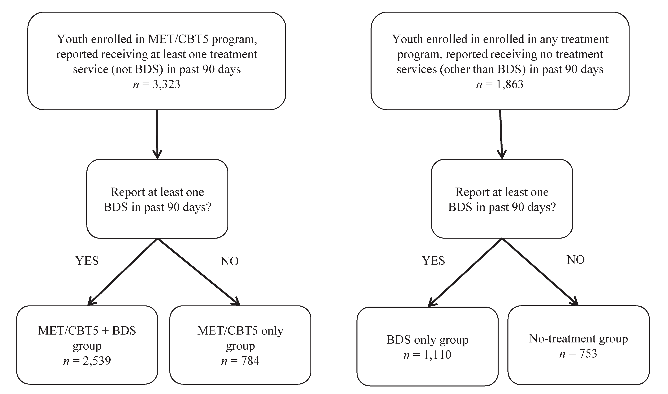
BDS=urine drug testing

Slide 71
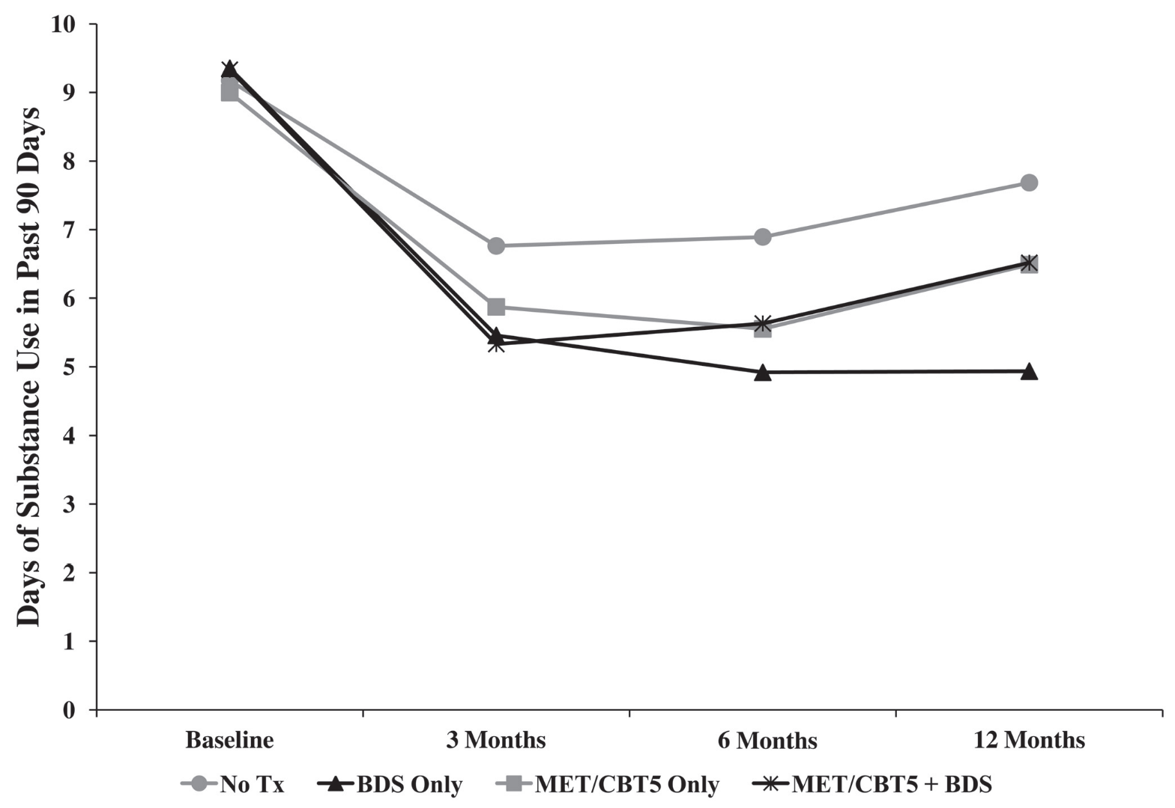
Urine Drug Testing Only was most efficacious treatment

Slide 72
Drug Testing is an Essential Component of Effective Substance Abuse Treatment
Helps decrease drug use
Keeps the focus of treatment on the primary problem (drug use)
Provides a chance to catch teen not using drugs, which...
Creates opportunities to provide incentives, praise, or other kinds of positive support for drug abstinence or consequences for using

Slide 73
Drug Testing (2)
Reduces tendency to hide drug use because of embarrassment, pride, or not wanting to get into trouble (external contingencies)
Detection facilitates work on relapse triggers
Help regain credibility with friends, relatives, parents, schools, employers, etc.
Provides reassurance of abstinence

Slide 74
Drug Testing (3)
Frequent schedule to initiate abstinence
  - detect use
  - provide opportunity for + or - consequences
Collection procedure
- obtain valid urine specimen
- observed, temperature checks
- dilution checked

Slide 75
Urine testing procedure
Administer TLFB
  Interview the youth and the parents separately
    Also ask parents about use of breathalyzers
  Ask about all the days since the end of last TLFB
Administer breathalyzer to teen
Collect urine sample from teen
  temperature test sample
  test sample for adulterants and substances

Slide 76
Recommended Reading
Urine Collection procedures [SAMHSA] (handout)
Drug Court Practitioner Fact Sheets
  Urine Drug Concentrations
    Why you should not worry about “levels”
    www.ndci.org/sites/default/files/ndci/Urine_Drug_Concentrations.pdf
  Marijuana Detection Window
    How long does it take to test clean?
      Not as long as you think!
    www.ndci.org/sites/default/files/ndci/THC_Detection_Window_0.pdf

Slide 77
Excused vs. Unexcused Absences
Excused absence
  Therapist/clinic cancels appointment
    Therapist vacation, holiday, weather, etc.
  Family cancels appointment/can’t reschedule within the week
    Vacation, doctors appointment, family emergency
Unexcused absence
  Teen refuses to provide sample
  Teen refuses to attend session

Slide 78
Absences and the Contract
Excused absence
  Continue prior reward/consequence
Unexcused absence
  Treat the same as substance use
  Abstinence not documented

Slide 79
Invalid Samples
Temperature too low
Creatinine too low [sample too dilute]
  Drinking to much water, flushing, taking diuretic
Adulterant present
If a urine sample is considered invalid, the youth is encouraged to provide another sample later that same day (>4 hours if creatinine low or adulterant present) or early the next day.
If the youth fails to do so, the invalid sample is treated as a positive test result for substance use.

Slide 80
Drug Testing Summary
It’s important and it’s (very) complicated!
I recommend testing in the clinic
  Temperature check, adulterants, rapid test
Need a plan for excused and unexcused absences
Need a form to document UA results

Slide 81
Conclusion
Contingency management increases the impact of evidence based substance use treatment for adolescents
Parents are important in implementing contingency management at home
Urine drug testing is a key part of contingency management and may be effective on its own

Slide 82
Thank you!
And thanks to my great teams from VT, AR, and now in NH
My husband and collaborator Alan Budney
NIDA and NIAAA for funding this work
All the families who have participated in this work over the past 20 years

